Slide 1

Strand 3
Chapter 13
Leading And Managing An Organisation
Back In Business

Slide 2
Learning Outcomes
13.1 Distinguish between leadership and management in organisations.
13.2 Analyse the significance of organisational culture and innovation in successful organisations.
13.3 Outline how leadership styles foster organisational culture and organisational innovation.
13.4 Appreciate the range of reasons for conflict in the workplace and demonstrate an understanding of how conflict may impact on the workplace.
13.5 Analyse how both employees and employers may deal with conflict internally.
13.6 Outline different external approaches to conflict resolution.
Back In Business

Slide 3

Back In Business
Priming activity
1. Do you think there is a difference between leading and managing people?
2. Many workers seek more responsibility and power - can you think of jobs where some workers wouldn’t?
3. If you owned a business, how would you encourage staff to come up with and suggest new ideas?

Slide 4



Back In Business
Starter Activity
Worksheet
Teacher
YouTube Link

Slide 5
Learning Outcome 13.1
13.1 Distinguish between leadership and management in organisations.
Back In Business

Slide 6
Back In Business
Distinguish Between Leadership & Management In Organisations
Leadership
Leadership is the ability to inspire, influence, and guide people towards achieving a common vision or goal. It involves taking risks, building relationships, and encouraging innovation.
Management
Management is the process of planning, organising, and controlling resources (people, time, money) to achieve specific business objectives efficiently and effectively.

Slide 7
Back In Business
Distinguish Between Leadership & Management In Organisations
Role | Leader | Manager
Role in the Business | Provides a vision for the business — inspires staff, sets long-term direction, and drives innovation. | Organises resources so the business can meet day-to-day objectives efficiently. Focuses on systems, structure, and control.
Innovation | Promotes creative thinking and encourages staff to share ideas and try new approaches. Sees change as opportunity. | Focuses on implementing plans and tracking progress to meet objectives. Ensures stability and consistency in operations.
Risk-Taking | Accepts risk and willing to experiment and understands failure is part of innovation. | Controls risk — aims to minimise uncertainty and prevent problems from occurring.
People Management | Influences and motivates employees by building relationships and trust; develops a positive culture. | Coordinates and supervises staff in defined roles; ensures tasks are completed correctly and on time.

Slide 8
Suggested Activities for LO 13.1
Sample Papers
HL2 Q4 (d) (ii): Examine three differences between leadership and management in organisations.
Activity Book Qs
HL Q1, BW Q1
OL Q1, BW Q1

Slide 9
Learning Outcome 13.2
13.2 Analyse the significance of organisational culture and innovation in successful organisations.
Back In Business

Slide 10
Back In Business
Organisational Culture
LINK

Slide 11

Back In Business
Organisational Culture
Organisational culture is a set of shared values, beliefs and behaviours that shape how a business operates. The culture in place will provide employees with a clear expectation of how they are supposed to behave and what the business values the most.

Slide 12

Back In Business
The Significance Of A Strong Organisational Culture In Organisations
Creates Shared Values And Purpose
A clear culture unites staff around common goals and values. When employees understand what the business stands for, decision-making becomes consistent and focused.
Patagonia’s commitment to sustainability shapes
every business choice, from product design to marketing.
Improves Employee Wellbeing & Work-Life Balance
Supportive cultures value people as much as performance. Flexible work, respect, and inclusion reduce stress and absenteeism while boosting morale and productivity.
Companies adopting a four-day week or hybrid work options often see higher satisfaction and lower turnover.

Slide 13

Back In Business
The Significance Of A Strong Organisational Culture In Organisations
Fosters Collaboration And Innovation
Open, trust-based cultures allow staff to share ideas without fear of criticism. This psychological safety drives creativity and better problem-solving across teams.
Google’s innovation labs and “20 per cent time” approach emerged from a culture that rewards experimentation.
Increases Employee Loyalty And Retention
When employees feel recognised and supported, they are more likely to stay, reducing recruitment costs and preserving organisational knowledge.
Irish firms recognised by Great Place to Work awards invest in continuous development and transparent communication to keep staff committed.

Slide 14
Back In Business
Reflect & Research Pg 232
LINK

Slide 15
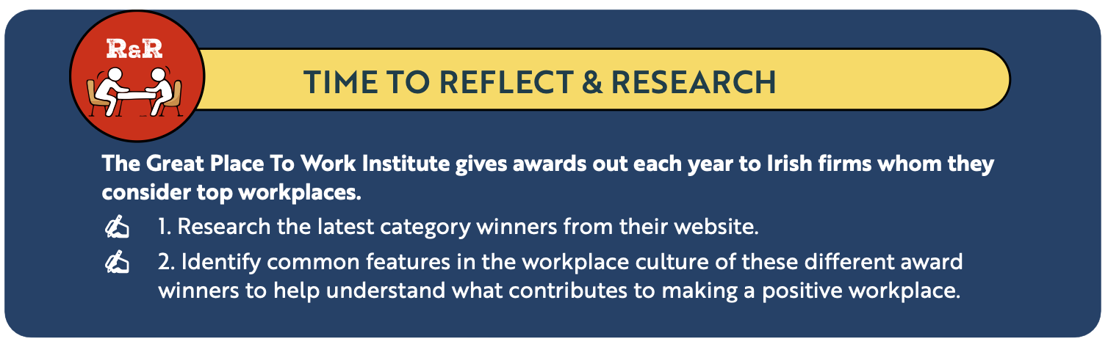

Back In Business
Reflect & Research Pg 232
LINK

Slide 16
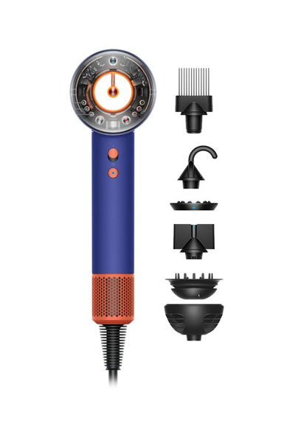
Back In Business
The Importance Of Innovation For Organisations
Helps A Business Stand Out From Competitors
Innovation allows a business to offer something unique or improved whether through design, technology, or customer experience helping it attract attention and win market share.
Dyson moved beyond traditional vacuums by applying
engineering design to entirely new product lines like hair styling tools.
Enables A Business To Adapt To Change
Businesses that innovate can respond quickly to shifts in technology, consumer behaviour, or regulation, staying relevant in fast-changing markets.
Zoom expanded rapidly by improving features and accessibility to meet the growing demand for online interaction during Covid.

Slide 17
Back In Business
The Importance Of Innovation For Organisations
Drives Efficiency And Profitability
Innovation improves internal systems and processes, helping businesses operate faster and more sustainably. This can reduce waste, cut costs, and increase productivity.
Amazon’s investment in logistics technology and automation has streamlined global operations and improved customer delivery times.
Opens Up New Markets Or Customer Segments
Innovative thinking allows companies to diversify and reach new customer segments, spreading risk and growing revenue potential.
Revolut’s expansion from money transfers into investing and crypto trading transformed it from a start-up into a global fintech brand.

Slide 18
Back In Business
The Importance Of Innovation For Organisations
LINK

Slide 19
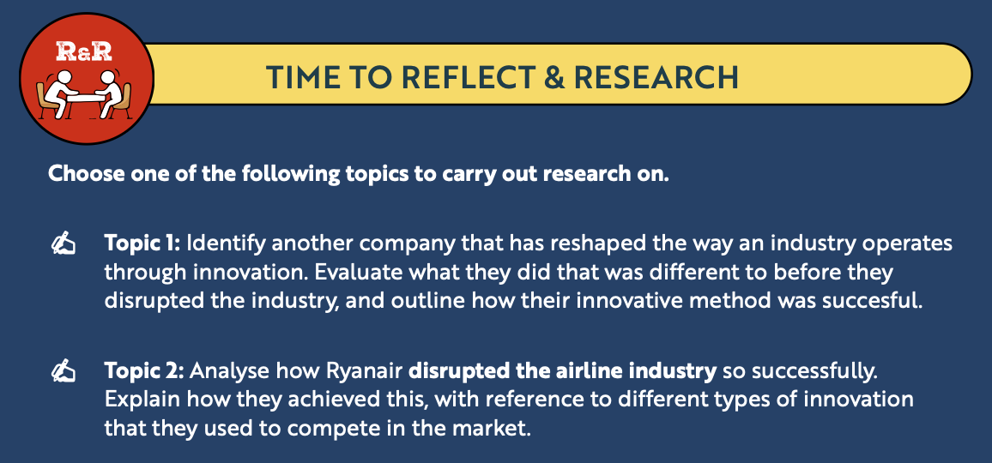
Back In Business
Reflect & Research Pg 234

Slide 20
Suggested Activities for LO 13.2
Sample Papers
HL1 Q1 (C): Analyse three ways ProjectOne’s organisational culture has contributed to the success of the business.
Activity Book Qs
HL Q2, BW Q2
OL Q2, BW Q2

Slide 21
Learning Outcome 13.3
13.3 Outline how leadership styles foster organisational culture and organisational innovation.
Back In Business

Slide 22
Back In Business
Autocratic Leadership And Its Impact On Culture & Innovation
An autocratic leader makes decisions themselves and gives instructions to subordinates without consulting anyone. They retain control over how the business is run and expect staff to be compliant.
Where Is It Appropriate?
This style might be effective in situations that demand speed and clarity, such as during a crisis, when safety is critical, or where procedures must be followed exactly - for instance, in manufacturing, fast food, or logistics operations.

Slide 23

Back In Business
Autocratic Leadership And Its Impact On Culture & Innovation
What kind of organisational culture does an autocratic leadership style foster?
1. Highly Controlled Environment
Clear direction and strict supervision ensure consistency but reduce employee input and flexibility.
2. Low Engagement Over Time
Staff often feel undervalued, which can affect morale and trust in management.
What is the impact of an autocratic leadership style on innovation?
1. Limited Creativity
Decision-making rests solely with leaders, leaving little space for staff ideas or experimentation.
2. Risk-Averse Culture
Employees avoid taking initiative, leading to stability but slower adaptation to change.

Slide 24
Back In Business
Democratic Leadership And Its Impact On Culture & Innovation
A democratic leader involves staff in decision-making, trusts their employees, and maintains open communication. They delegate responsibility and empower staff to take ownership of their work.
Where Is It Appropriate?
Useful in businesses that value creativity, teamwork, and employee input. It will work best in a workplace of skilled employees that are happy to take ownership of tasks and be involved in decision-making.

Slide 25
Back In Business
Democratic Leadership And Its Impact On Culture & Innovation
What kind of organisational culture does a democratic leadership style foster?
Open Communication
Employees feel heard and respected, creating a culture of trust and mutual problem-solving.
High Morale and Inclusion
Shared decision-making builds ownership and engagement, making it easier to introduce change.
What is the impact of a democratic leadership style on innovation?
Encourages Intrapreneurship
Employees are empowered to generate and test new ideas that improve the organisation.
Adaptive Mindset
Collaboration and feedback create a culture that welcomes change and continuous improvement.

Slide 26
Back In Business
Laissez-Faire Leadership And Its Impact On Culture & Innovation
Where leaders adopt a hands-off approach, with minimal employee supervision. They allow employees to make their own decisions without consulting them first.
Where Is It Appropriate?
Effective when leading experienced, self-motivated professionals who thrive on autonomy such as researchers, consultants, or teams in innovative start-ups.

Slide 27
Back In Business
Laissez-Faire Leadership And Its Impact On Culture & Innovation
What kind of organisational culture does a democratic leadership style foster?
Independent Work Environment
Encourages trust and self-direction, allowing staff to manage their own workload.
Potential Lack of Structure
Without clear goals or feedback, some employees may feel uncertain or disconnected.
What is the impact of a democratic leadership style on innovation?
High Creativity Potential
Freedom and autonomy often lead to original ideas and innovative problem-solving.
Inconsistent Output
Without strong guidance, innovation may lack focus, leading to uneven results across teams.

Slide 28
Suggested Activities for LO 13.3
Sample Papers
HL2 Q4 (5) (i): Outline how a leadership style you have studied fosters organisational innovation.
Activity Book Qs
HL Q3
OL Q3

Slide 29
Learning Outcome 13.4
13.4 Appreciate the range of reasons for conflict in the workplace and demonstrate an understanding of how conflict may impact on the workplace.
Back In Business

Slide 30
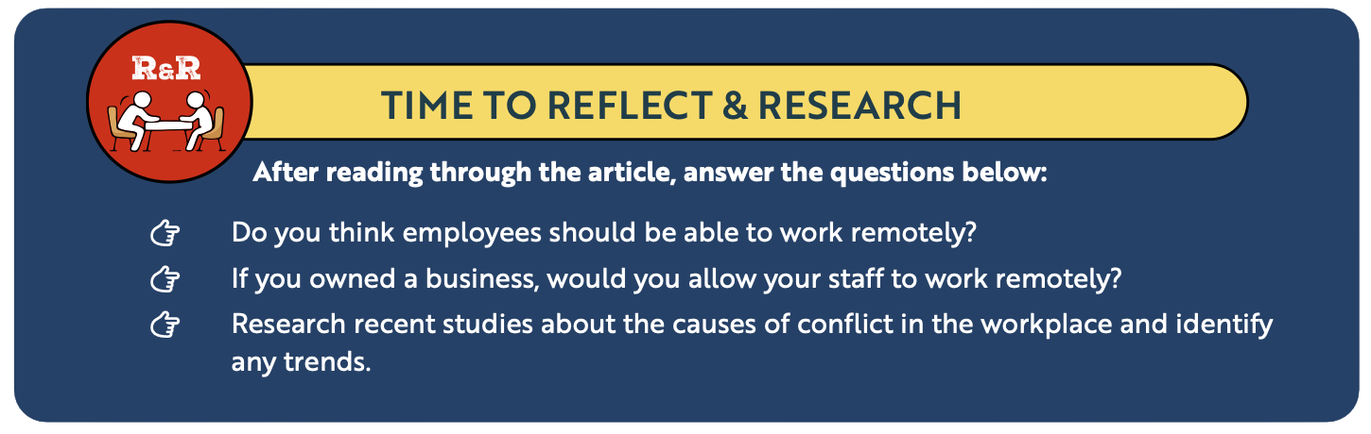
Back In Business
Reflect & Research Pg 237

Slide 31
Back In Business
Reasons For Conflict In The Workplace
Disagreement over pay rises, bonuses, or pension entitlements is a common cause of dispute, especially during times of inflation or financial pressure. Employees may seek cost-of-living increases that employers resist.
Disputes Over Pay
Conflict can arise when management introduces new technology, duties, or work patterns without proper consultation or training. Return-to-office policies have also created tension where staff expect hybrid options.
Working Conditions
Disputes often occur around how redundancies are decided or the level of compensation offered. When employees feel decisions are unfair or target certain groups, trust and morale decline.
Redundancies
Perceived bias in promotion, workload, or dismissal decisions or discrimination on the basis of gender, age, or background can cause serious breakdowns in workplace relationships.
Discrimination

Slide 32
Back In Business
Reasons For Conflict In The Workplace
Unclear instructions or inconsistent messaging between managers and staff can create misunderstanding and frustration, leading to mistakes, blame, and resentment.
Poor Communication
Differences in personalities, working styles, or expectations within teams can escalate if not managed early. Competitive or high-pressure environments make these conflicts more likely.
Staff clashes
Disputes often occur around how redundancies are decided or the level of compensation offered. When employees feel decisions are unfair or target certain groups, trust and morale decline.
Redundancies
Conflict can develop where management refuses to recognise a trade union or ignores collective demands, leading to mistrust and poor employee relations.
Union recognition

Slide 33
Back In Business
How Conflict Impacts On The Workplace
Damage To Productivity Levels And Collaboration
Conflict damages teamwork and slows decision-making. When trust breaks down, employees may avoid communication or cooperation, leading to delays, errors, and missed targets.
Lower Morale and Higher Staff Turnover
Ongoing disputes make the work environment stressful and demotivating. Employees may take more sick leave or leave the organisation entirely, increasing recruitment and training costs.

Slide 34
Back In Business
How Conflict Impacts On The Workplace
Damage to Reputation and Customer Service
A tense workplace can affect how staff interact with customers or clients. Poor service, negative reviews, or media attention can harm the organisation’s public image.
Potential for Positive Change
When managed well, conflict can highlight underlying issues such as unrealistic workloads or poor communication systems. Addressing these problems can strengthen relationships and improve long-term performance.

Slide 35
Suggested Activities for LO 13.4
Sample Papers
OL1 Q2 (b): i) Outline two reasons for conflict in a workplace.
(ii) Explain one impact conflict may have on a workplace.
Activity Book Qs
HL Q4, BW Q3
OL Q4, Q5, BW Q3

Slide 36
Learning Outcome 13.5
13.5 Analyse how both employees and employers may deal with conflict internally.
Back In Business

Slide 37
Back In Business
Ways To Prevent Conflict
Encourage Open Communication
Employers should create an environment where employees feel comfortable raising concerns and sharing opinions.
Regular meetings or check-ins help identify issues early, and staff are more likely to engage when they feel genuinely listened to and respected.
Provide or Attend Training on Conflict Resolution
Both managers and employees can take part in training to develop effective communication, empathy, and problem-solving skills.
These skills help to resolve disagreements quickly and prevent small issues from growing into larger disputes.

Slide 38
Back In Business
Ways To Prevent Conflict
Establish Clear Grievance Procedures
A well-defined grievance process allows employees to formally raise concerns in a structured and confidential way.
Consistent procedures ensure fairness, transparency, and confidence that problems will be handled appropriately.

Slide 39
Back In Business
Ways To Deal With Conflict Internally
Meet & Talk
The employee and employer should meet to discuss the issue directly and clarify any misunderstandings. Open communication often helps to resolve problems before they escalate.
Employees may also ask their shop steward (the workplace trade union representative) to attend the meeting to support them or represent a group of workers.
Negotiation or Bargaining
Both sides work together to find a compromise that is acceptable to everyone involved. This process usually involves each party giving up something to reach a fair agreement.
For example, if employees request a 10% pay increase and the employer offers 2%, they may negotiate and settle on a 5% increase as a balanced outcome.

Slide 40
Suggested Activities for LO 13.5
Sample Papers
OL1 Q2 (c): Explain two internal methods that managers at Amazon could use to resolve employee conflict.
Activity Book Qs
HL Q4, BW Q4
OL Q5

Slide 41
Learning Outcome 13.6
13.6 Outline different external approaches to conflict resolution.
Back In Business

Slide 42
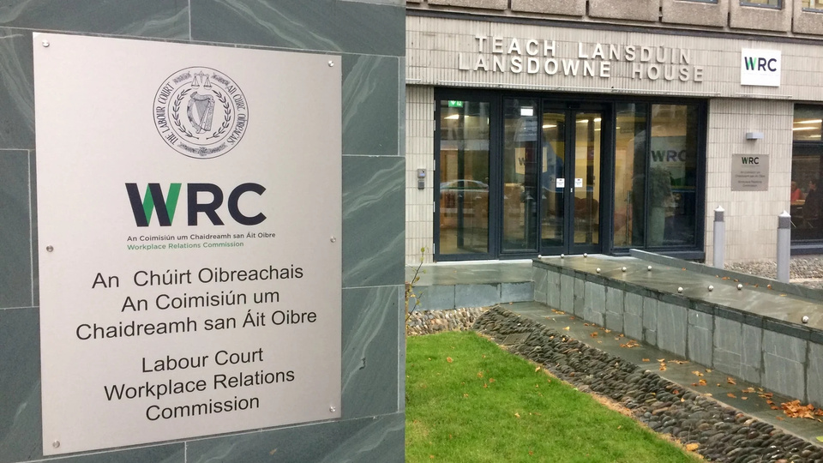
Back In Business
Ways To Deal With Conflict Externally
NOTE
  These are external, non-legislative methods of conflict resolution.
  Legislative options such as the Workplace Relations Commission (WRC) and Labour Court are explored in Chapter 19.

Slide 43
Back In Business
Ways To Deal With Conflict Externally
Mediation
  A neutral third party helps both sides communicate and express their views.
  The mediator does not make recommendations or impose solutions.
  Focuses on creating open, respectful discussion so both sides feel heard.
  Helps parties reach their own agreement through dialogue.

Slide 44
Back In Business
Ways To Deal With Conflict Externally
Conciliation
  A trusted third party encourages both sides to talk and listen to one another.
  The conciliator may suggest possible solutions to help resolve the issue.
  The final decision is made by the employer and employee — not by the conciliator.
  Useful when communication has broken down but both sides want to find common ground.

Slide 45
Back In Business
Ways To Deal With Conflict Externally
Arbitration
  An independent third party listens to both sides of the dispute.
  The arbitrator makes a recommendation or decision to resolve the issue.
  Can be binding (the decision must be accepted) or non-binding (each side can choose).
  Used when earlier attempts at resolution have failed or a clear outcome is required.

Slide 46
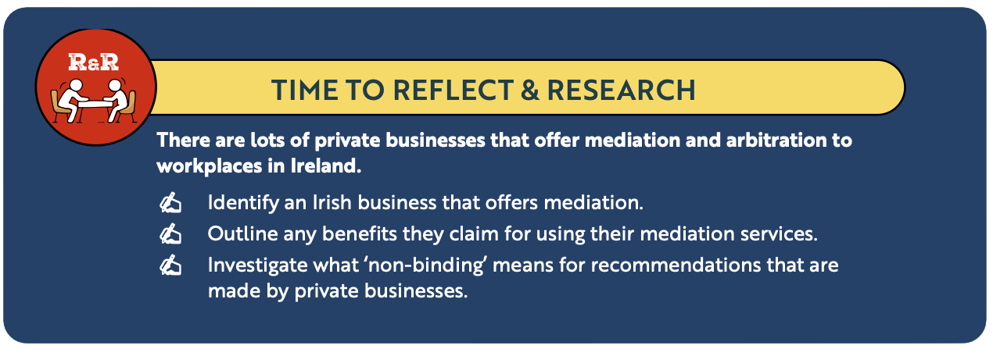
Back In Business
Reflect & Research Pg 240

Slide 47
Suggested Activities for LO 13.6
Sample Papers
-
-
Activity Book Qs
HL Q5
OL Q6

