Slide 1

Unifying Strand - U2/3/5
LC Project 2027
Back In Business

Slide 2
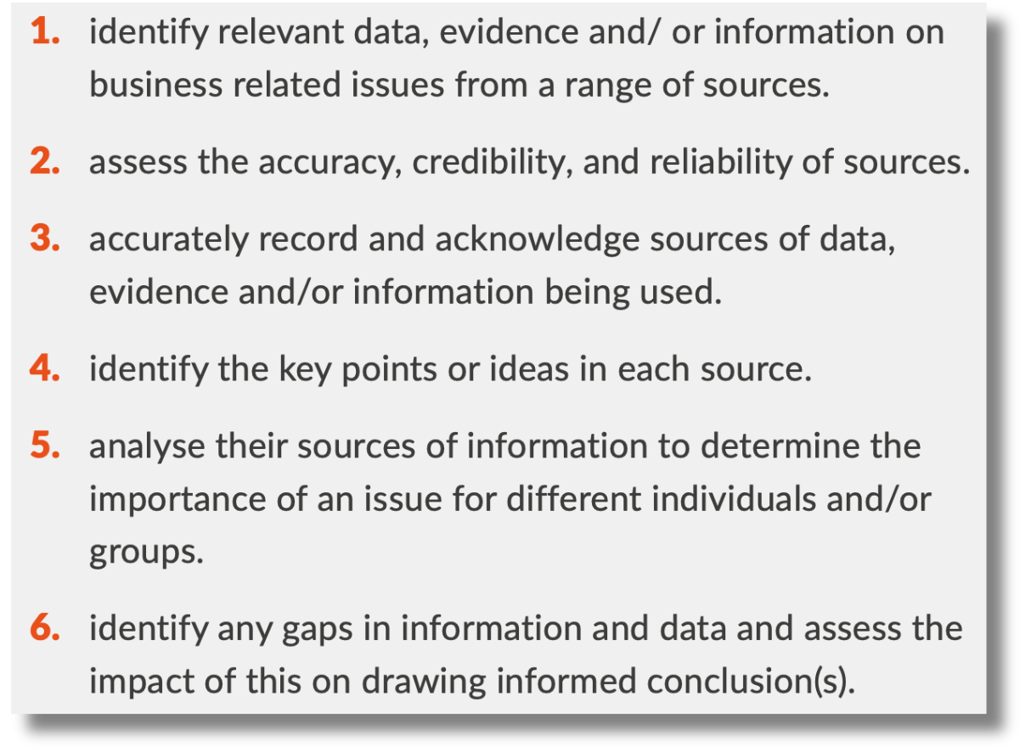
Learning Outcome U2.1-2.6
Back In Business

Slide 3

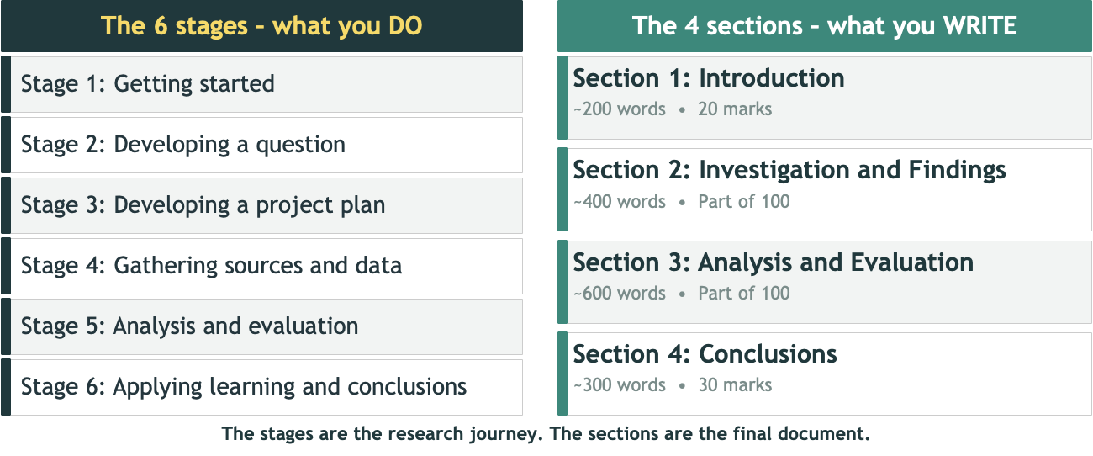
Stages vs Sections
Back In Business

Slide 4
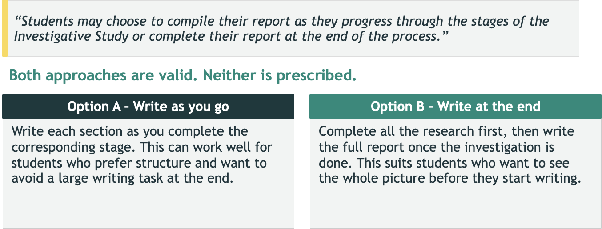
Stages vs Sections
Back In Business

Slide 5
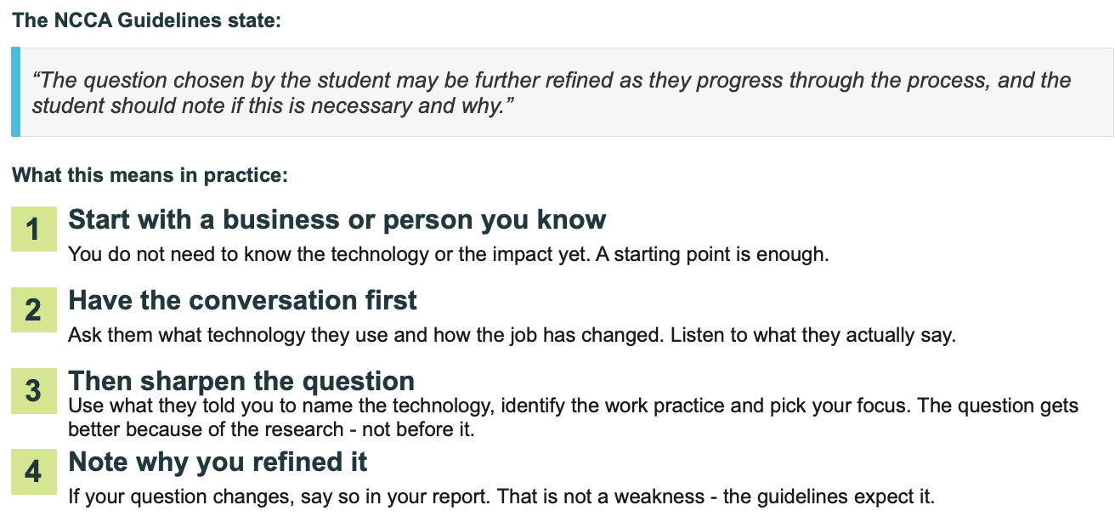
Your first question does not need to be perfect
Back In Business

Slide 6

Stage 1: Getting Started
What do we need to think about?
Back In Business
1 - Work practice
→ What people actually do as part of their job
2 - Digital Technology
→ Named type of software, platform, system, tool
3 - A measurable impact on Employer / Employee
→ Workload, expectations, monitoring, decisions, wellbeing, efficiency
#TheGates

Slide 7
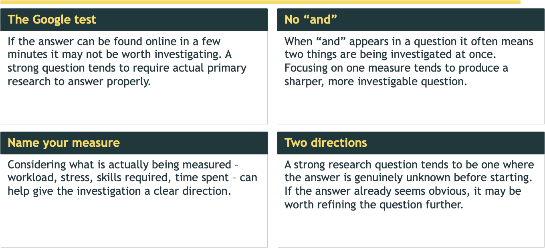
What else is worth considering?
Back In Business

Slide 8
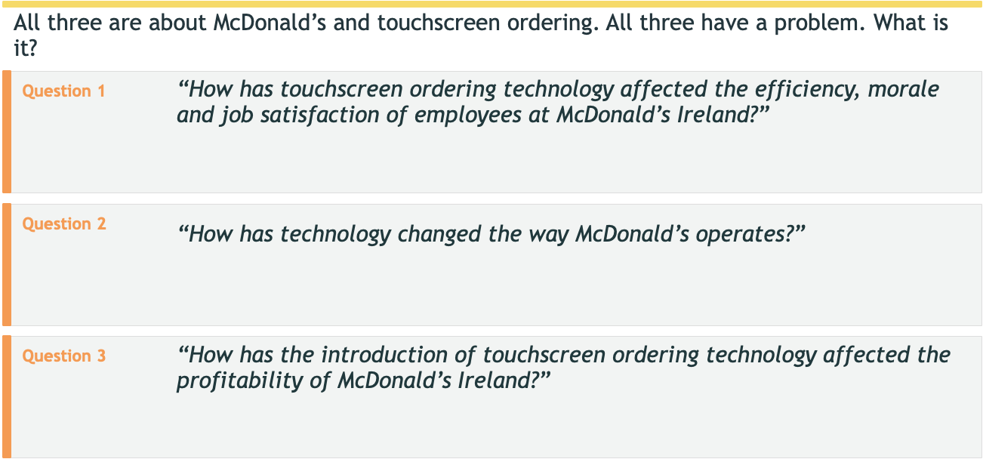
What is wrong with these questions
Back In Business

Slide 9
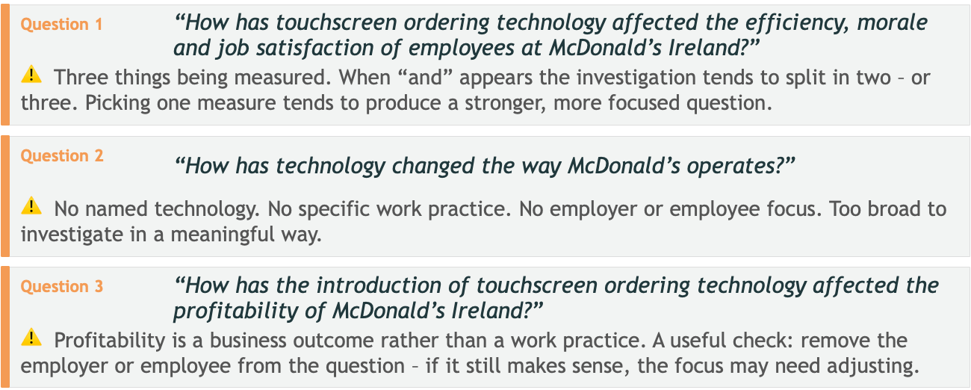
What is wrong with these questions
Back In Business

Slide 10

Sample scenarios using a quote from a worker from our initial interview
Back In Business
1. Creche
Digital child monitoring and reporting apps
“We use an app to log everything – nappy changes, meals, naps, any incidents. Parents can see it in real time. It’s great for them but we’re updating it constantly throughout the day. Sometimes I feel like I’m spending as much time on the phone as I am with the children.”
Spot the three things:
What is the digital technology?
What is the work practice that changed?
What is the impact on the employee?

Slide 11
Sample scenarios using a quote from a worker from our initial interview
Back In Business
1. Creche – which question is stronger?
Version A
Version B
How has technology changed working in a creche?
How has digital child monitoring software changed the daily reporting work practice of childcare employees in creches?

Slide 12
Sample scenarios using a quote from a worker from our initial interview
Back In Business
2. Estate agent
“We do virtual tours now for most properties before anyone comes to view in person. I record them, edit them, upload them. It cuts down on wasted viewings but it’s added a whole other job on top of what I was already doing.”
Spot the three things:
What is the digital technology?
What is the work practice that changed?
What is the impact on the employee?

Slide 13
Sample scenarios using a quote from a worker from our initial interview
Back In Business
2. Estate agent – which question is stronger?
Version A
Version B
How has technology changed the work of estate agents?
How has virtual viewing software changed the property presentation work practice of employees in estate agencies?

Slide 14
Sample scenarios using a quote from a worker from our initial interview
Back In Business
3. Aldi – shop floor
Self-service till technology
“The self-service tills need someone watching them the whole time. Customers get stuck, things don’t scan right, you get the odd person trying to chance it. It’s actually more interaction with customers than the regular till was, just a different kind.”
Spot the three things:
What is the digital technology?
What is the work practice that changed?
What is the impact on the employee?

Slide 15
Sample scenarios using a quote from a worker from our initial interview
Back In Business
3. Aldi – shop floor – which question is stronger?
Version A
Version B
How have self-service tills changed working in a supermarket?
How has self-service till technology changed the customer assistance work practice of employees on the shop floor at Aldi?

Slide 16
Sample scenarios using a quote from a worker from our initial interview
Back In Business
4. McDonald’s
Touchscreen ordering technology
“Before the screens came in, you took the order at the till, handled the payment, dealt with the customer. Now the orders just appear on the kitchen screen from every direction at once. You can’t pace yourself the way you used to.”
Spot the three things:
What is the digital technology?
What is the work practice that changed?
What is the impact on the employee?

Slide 17
Sample scenarios using a quote from a worker from our initial interview
Back In Business
4. McDonald’s – which question is stronger?
Version A
Version B
How has technology affected working in McDonald’s?
How has the introduction of touchscreen ordering technology changed the workload of order processing employees at McDonald’s Ireland?

Slide 18
Start with who you know - ask questions
Back In Business
Think of two or three people you know who work somewhere. A sibling, a parent, someone in a local business, your own workplace. Write them down.
Try asking them one question:
“What technology do you use at work now that you didn’t use before – and how has it changed what you actually do day to day?”
Things worth listening for:
A specific piece of technology they name
A part of their job that is done differently now
Whether the change made things better, harder, or just different

Slide 19
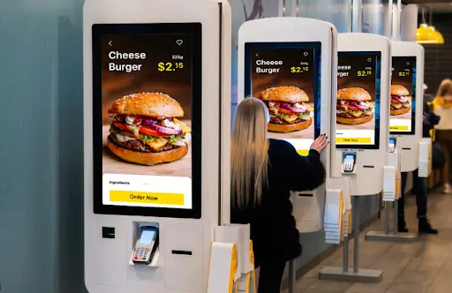
A worked example
Back In Business
McDonalds
A worked example

Slide 20
The confirmed research question
“How has the introduction of touchscreen ordering technology changed the workload of order processing employees at McDonald’s Ireland?”
✓ Named technology
✓ Named measure
Touchscreen ordering technology
Workload
✓ Specific work practice
✓ Two directions / no obvious answer - investigate
Order processing
Workload could increase, decrease or change
✓ Employee focus
Employees at McDonald’s Ireland

Slide 21
Planning what, where or who to research...
What the brief asks for:
Five sources • four perspectives
• Explain the purpose and relevance of each source
Staff interview
Manager interview
Employee voice
First-hand lived experience
Employer view
Business decisions and training
• Consider a variety of perspectives
Observation
McDonald’s website
What might be rewarded:
Independent external view
Unfiltered – what actually happens
Corporate stated position
For comparison with primary research
A range of sources that bring genuinely different perspectives. Each source evaluated for what it specifically offers – not just listed.
CNN Business
Independent media
International pattern context
A useful question for each source:
Why this source – and not something else? What can I find out from this source that I can’t get in another source?

Slide 22
‘Looking for a research quesiton’ worksheet

