Slide 1

Unifying Strand - U4
Analysing and evaluating
information
Back In Business

Slide 2
Learning Outcome U4
  Analyse and interpret information and data.
  Evaluate the range of perspectives within the findings.
  Synthesise findings to create new or enhanced understanding.
  Appraise the value of this information.
  Evaluate findings to make informed decision(s), reach informed conclusion(s) or make recommendation(s).

Slide 3
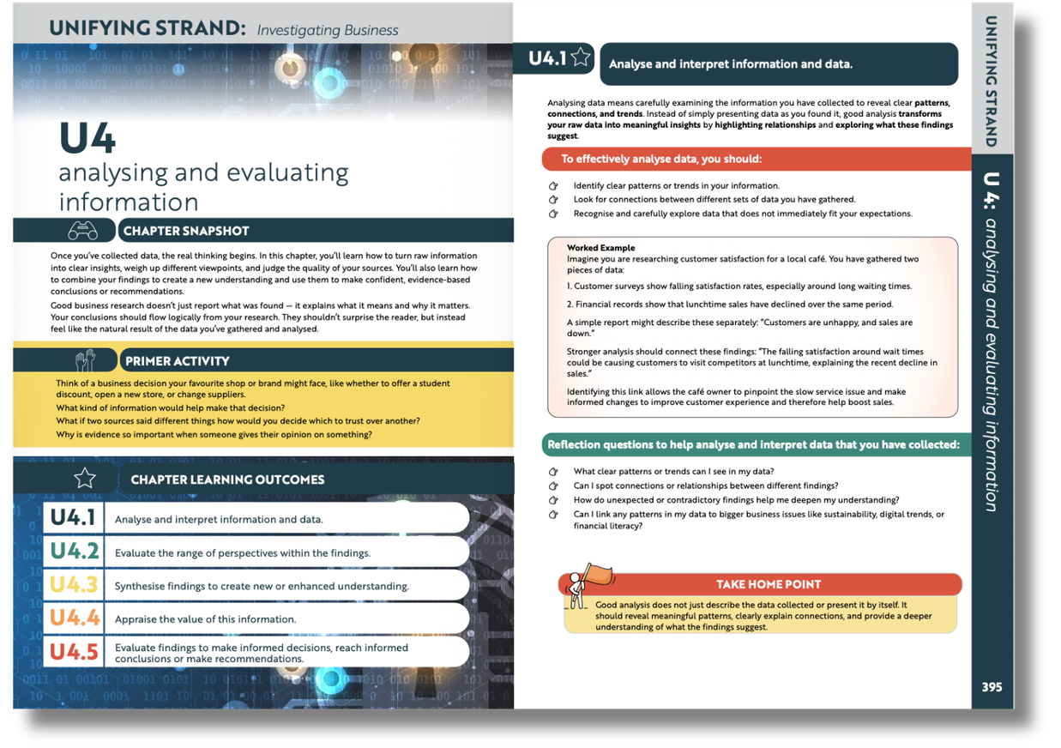

Textbook content pages 414-419

Slide 4
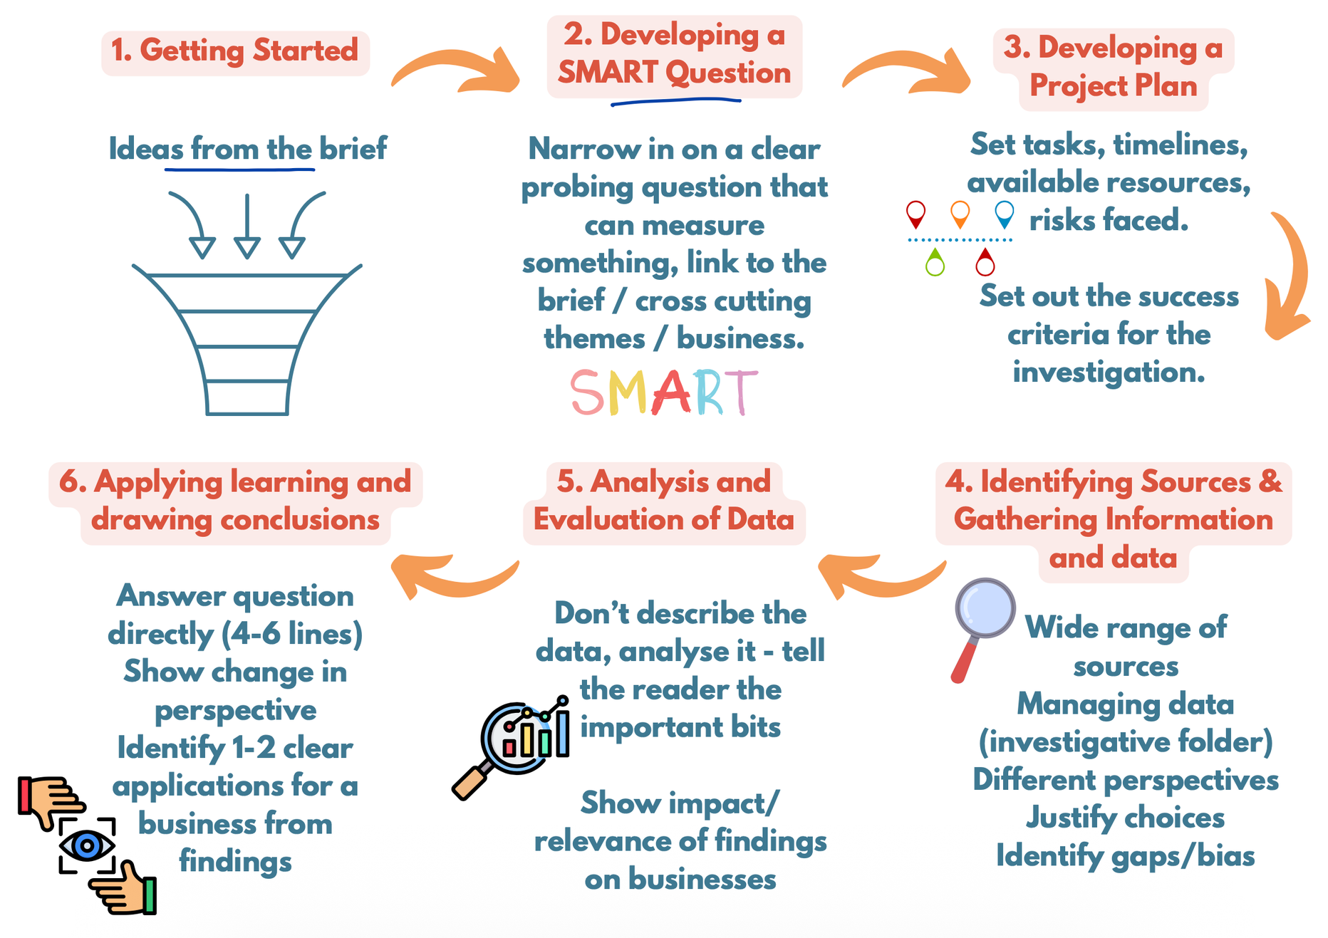

Slide 5
How does using [Digital Tool/Tech] to do [Specific Work Task] impact the [Something to measure] of an [Employee or Employer] in an [industry/business]?

Slide 6
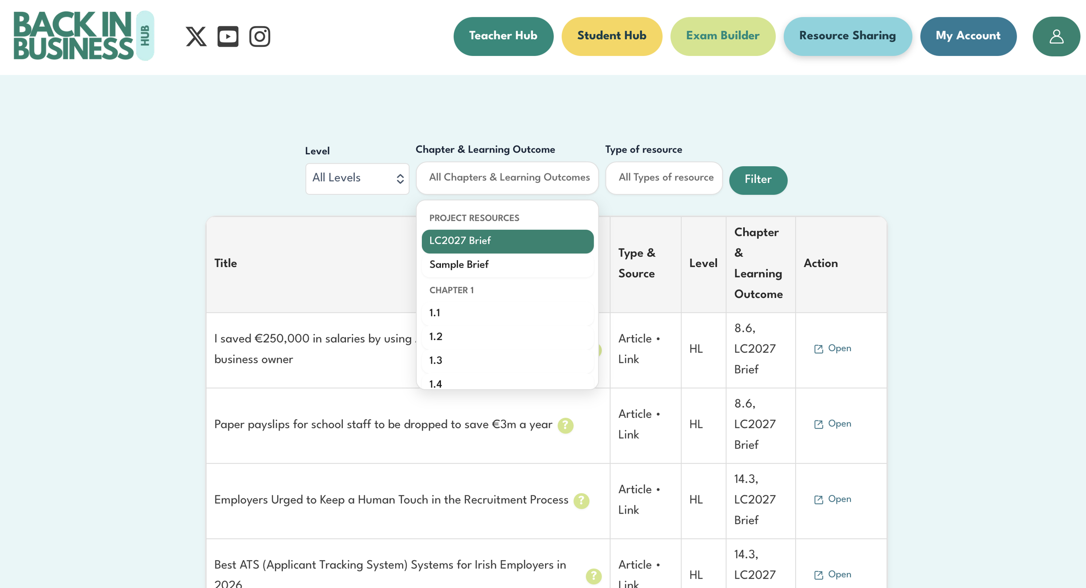

Resource Sharer
Project 2027

Slide 7
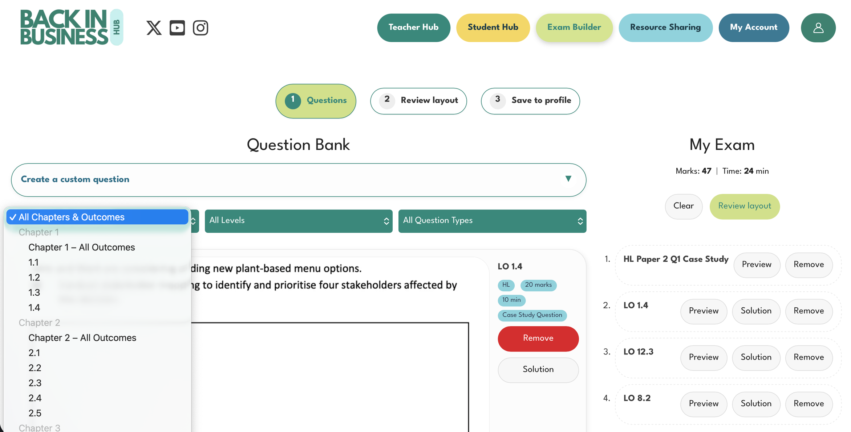
EXAM BUILDER

Slide 8
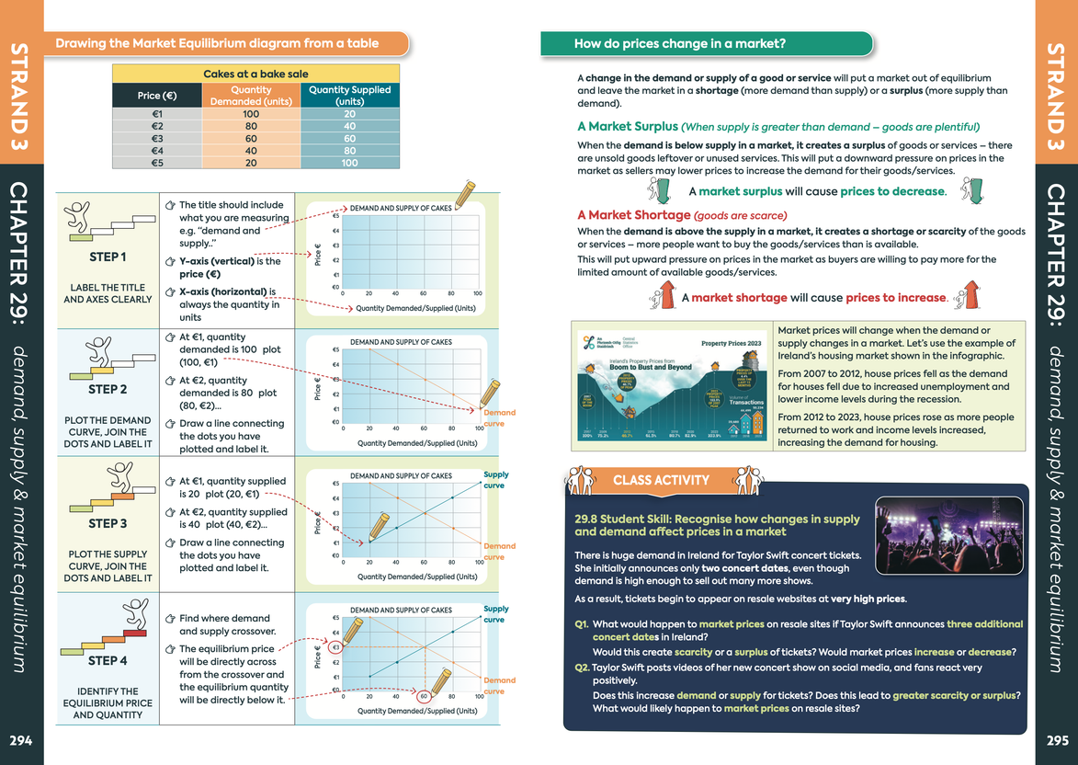

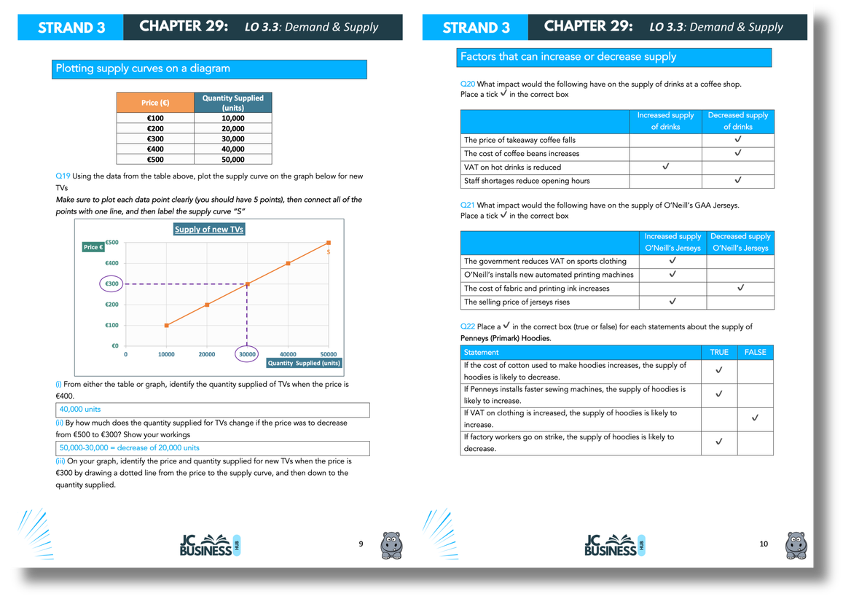
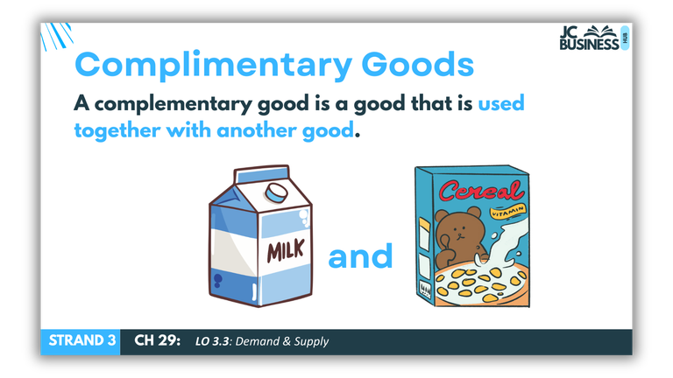
BUSINESS
JC
Trial content to help revise
with your 3rd years
HUB

Slide 9


Making a judgement
Back In Business
Don’t think of a judgement or opinion as right or wrong.
What makes a judgment weak is if it is not supported by evidence.
Think of it like a court case: cases that lack evidence never make it to trial - evidence is crucial.

Slide 10

Analysing evidence
Back In Business
Analysis reveals patterns and connections.
Analysing data means identifying patterns, trends, and links between findings.
Strong analysis does not just describe information; it explains what it suggests.

Slide 11

Balancing Conflicting Viewpoints
Back In Business
Strong research does not ignore disagreement.
Strong projects should present conflicting viewpoints from varied sources, and evaluate where they differ, why they differ, and what each contributes to their conclusion.

Slide 12

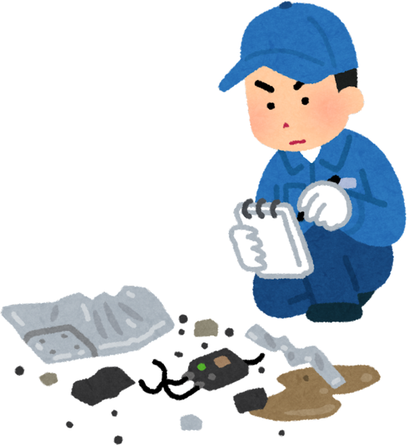

Not all evidence is equal
Back In Business
Students should judge how reliable, accurate, and relevant their data sources are.
A source can be valid but still have limitations (eg a small sample size).

Slide 13

Connecting the dots
Back In Business
Synthesising means bringing together different pieces of information to build a clearer, deeper understanding of a topic.
A weaker project will just summarise different data separately.
A stronger project will connect the dots to develop new insights.

Slide 14

Making an Evidence-Based Recommendation
Strong recommendations are practical and supported.
A strong recommendation:
  Links directly to findings
  Acknowledges risks or limitations
  Makes sense in a real-world business context

Slide 15


Activity to teach it
Print evidence and get them to pin it on to the board one by one, with the board split down the middle as pro’s and con’s

Slide 16



Activity
Back In Business
Q: Should a local takeaway start selling food through delivery apps?
Make a decision on this ->
YES / NO?

Slide 17


Activity
Back In Business
Evidence to help reach a decision will be presented to you.
For each piece of evidence, you need to decide two things:
Decide how relevant it is to the decision and how reliable it is (accuracy /sample size)
5 stars means very relevant and very reliable
Identify a weakness or limitation of the evidence

Slide 18
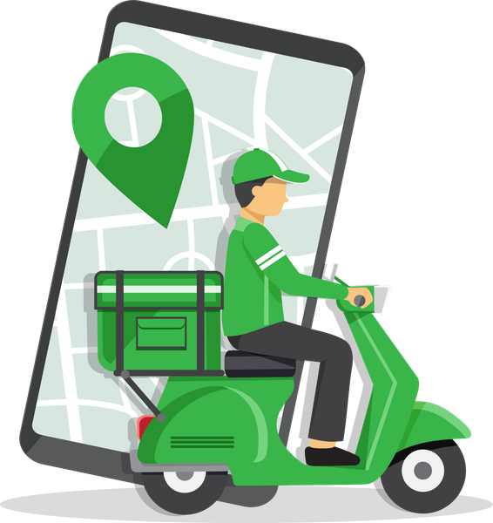

Evidence #1
Back In Business
Online Research found that 9 out of 10 local takeaways in the area already use Just Eat or Deliveroo
Judge its relevance and reliability ->
Identify any weakness/limitation with the evidence

Slide 19

Q: Should a local takeaway start selling food through delivery apps?

Slide 20

Evidence #2
Back In Business
An online article in an Irish newspaper reports: “Small restaurants that have started using food delivery apps like Deliveroo have reported average increases of 25% in the number of daily orders within 3 months.”
25%
Judge its relevance and reliability ->
Identify any weakness/limitation with the evidence

Slide 21

Evidence #3
Back In Business
Research in to the cost of using delviery apps reveals that delivery platforms charge commission fees of up to 35% per order.
(The delivery app can keep up to
35cent of every €1 for each order)
Judge its relevance and reliability ->
Identify any weakness/limitation with the evidence

Slide 22
Evidence #4
Back In Business
To gauge the impact on consumers, research was done on the Google Reviews for local takeaways that have introduced similar apps.
Ratings for 6 out of the 9 restaurants show a fall in their average rating since using a food delivery app, with one review commenting “Food is gone to the dogs since they started selling on Just Eat - they are too busy now”
Judge its relevance and reliability ->
Identify any weakness/limitation with the evidence

Slide 23
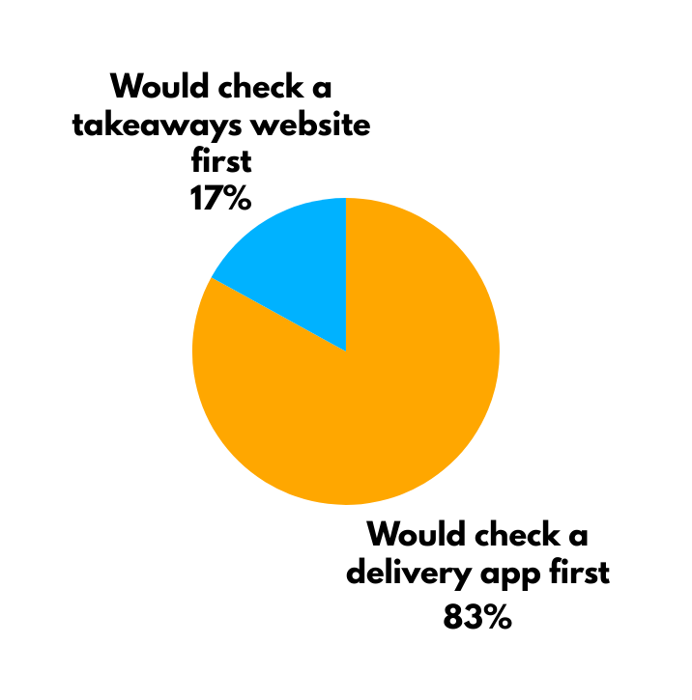
Evidence #5
Back In Business
A survey of 58 local customers found that 83% said a food delivery app would be the first thing they would check when ordering takeaway in the evening. 17% said they would check individual takeaway’s websites first.
Judge its relevance and reliability ->
Identify any weakness/limitation with the evidence

Slide 24
Evidence #6
Back In Business
A 2023 hospitality industry report found that small independent restaurants using delivery platforms reported
  Increased staffing costs in 42% of cases
  68% of staff reported feeling significantly busier at peak times
  54% reported longer waiting times for in-store customers
Judge its relevance and reliability ->
Identify any weakness/limitation with the evidence

Slide 25
Evidence #7
Back In Business
A small Irish restaurant owner interviewed by an SME newsletter said:
“Once we joined Deliveroo, we no longer controlled the customer relationship. If there’s a delay, it’s blamed on us, but we can’t track the rider or speak to the customer directly.”
Judge its relevance and reliability ->
Identify any weakness/limitation with the evidence

Slide 26
Weighing the evidence
Back In Business
  Which piece of evidence is the strongest? Why?
  Which piece of evidence is the weakest? Why?
  Does your evidence cover info about profits, workload, reputation, control, customer satisfaction, employees...?
  Which evidence would matter most to the owner? Why?
  What other evidence that is missing, do you think would help you in reaching a more informed conclusion?

Slide 27
Decision time
Back In Business
Q: Should a local takeaway start selling food through delivery apps?

Slide 28
Option 1 – Full Adoption (Growth-Focused Strategy)
Back In Business
Judgement: The takeaway should begin using Deliveroo on a full-time basis.
Justification:
  83% of surveyed local customers prefer ordering through apps.
  Industry data shows average order increases of 25%.
  9/10 local competitors use delivery platforms, suggesting strong market pressure.
Suggests strong demand for the service and a potential loss of market share if the business does not adapt.
Limitations / Acknowledgements:
  Commission fees of up to 35% may significantly reduce profit margins.
  Increased staffing costs - 42% of restaurants reported increased staffing costs.
  An Irish restaurant owner reported losing control over customer relationships.

Slide 29
Option 2 – Trial Approach (Balanced Strategy)
Back In Business
Judgement: The takeaway should trial Deliveroo on a limited basis.
Justification:
  Customer demand for app ordering is high (83% of survey)
  Evidence suggests potential sales growth (increases of 25%)
  A trial limits financial and operational risk (control higher staffing costs 42%)
A controlled rollout (e.g. two evenings per week on quieter nights so regular customers aren’t impacted) allows the business to test demand without overcommitting.
Limitations / Acknowledgements:
  Commission costs still apply.
  Trialling on quiet nights may not give a fair reflection on potential impact on sales

Slide 30
Option 3 – Reject for Now (Protection Strategy)
Back In Business
Judgement: The takeaway should not join Deliveroo at present.
Justification:
  Commission rates of up to 35% significantly reduce profit margins.
  42% of restaurants reported increased staffing costs.
  An owner reported losing control over customer relationships.
  6 out of 9 local restaurants experienced falling Google ratings after joining delivery apps.
These risks may outweigh the reported 25% increase in order volume.
Limitations / Acknowledgements:
  83% of customers prefer ordering through apps, meaning demand may shift away.
  Competitors (9 out of 10) are already using platforms.
  Avoiding delivery could result in lost market share.

Slide 31

Other Options?
Back In Business
Use a delivery app like Deliveroo but with an adjusted marketing mix - certain meal bundles, different pricing, limited or exclusive menu
Hire a delivery driver and serve customers directly, maintaining control
Strengthen In-Store Experience Instead

Slide 32
Reflection
Back In Business
  Did your view change during the process? At what point did it change?
  Which specific piece of evidence influenced you most?
  Are there any limitations with the conclusion you reached? Would any other evidence help?
  Could someone else reach a different conclusion from you using the same evidence? Why?

Slide 33
Take Home Point
Back In Business
A strong judgement is not about being “right.”
It is about being able to justify your conclusion using evidence, while recognising limitations and alternative viewpoints.

Slide 34
Final Take Home Point
Back In Business
Use evidence gathered to justify your conclusions
Students that may not score well are likely to:
  Act like it is a data collection competition
  Give opinions without any evidence to support
  Summarise findings separately

