Slide 1

Unifying Strand - U1
Developing Questions To Research
LC Project 2027
Back In Business

Slide 2
Learning Outcome U 1.1
Develop a range of questions to research
Back In Business

Slide 3

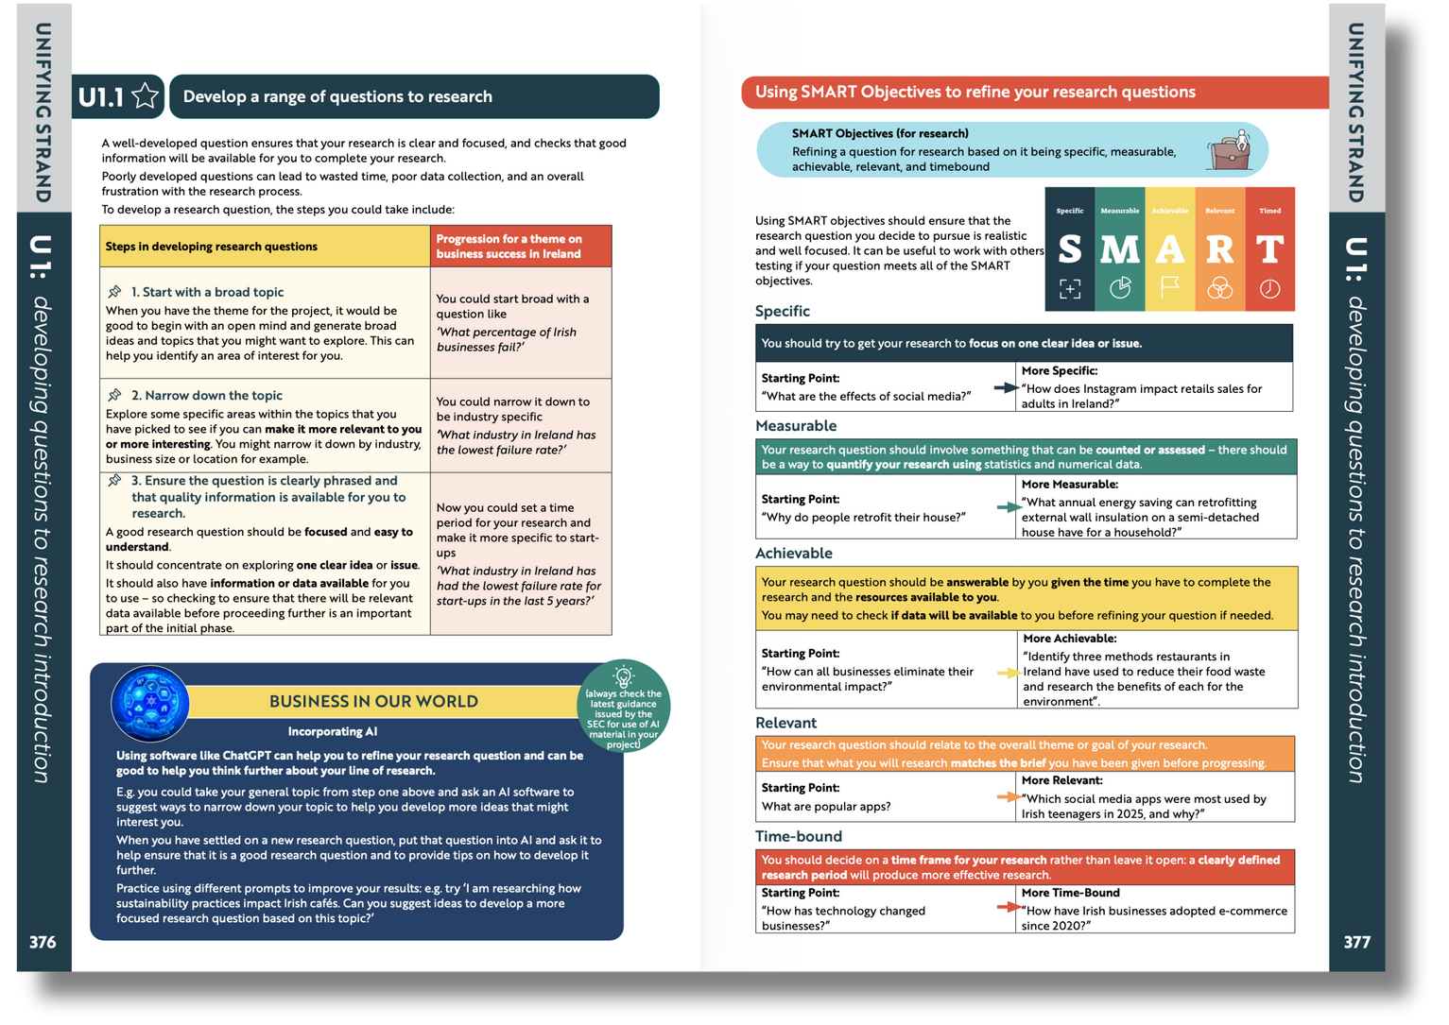

Introduction
Back In Business
Textbook content pages 375-379

Slide 4
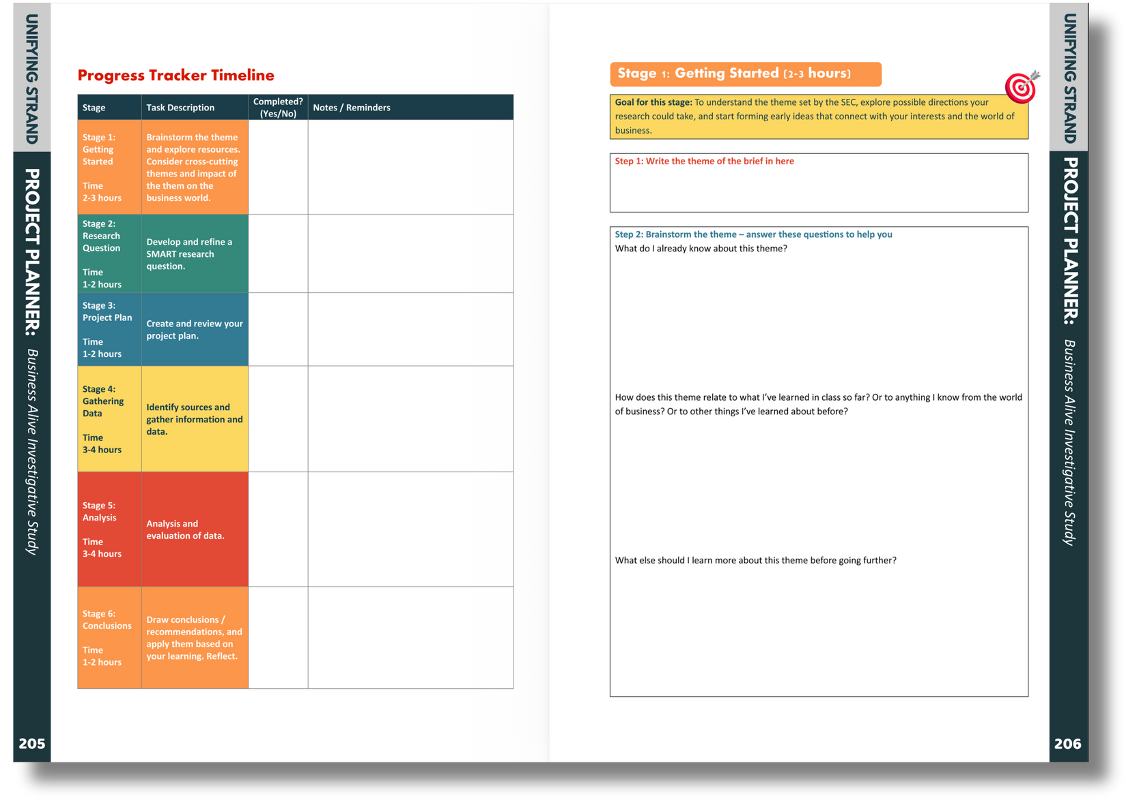
Introduction
Back In Business
Activity book content pages 206-209

Slide 5
Stage 1: Getting Started
What is the purpose of it?
Back In Business
“complete initial background research to inform their (student) understanding and thinking around the theme.”
Guidance
Doc
The purpose of this stage is to build background understanding of the brief, explore how digital technology is used in work practices, and identify possible areas worth investigating further.

Slide 6
Stage 1: Getting Started
Back In Business
The role of the teacher
  To inform planning for the coming year by identifying learning outcomes that relate to the brief
  To highlight relevant news items/media
  To hear students initial ideas and try to identify gaps in student knowledge/understanding to help

Slide 7
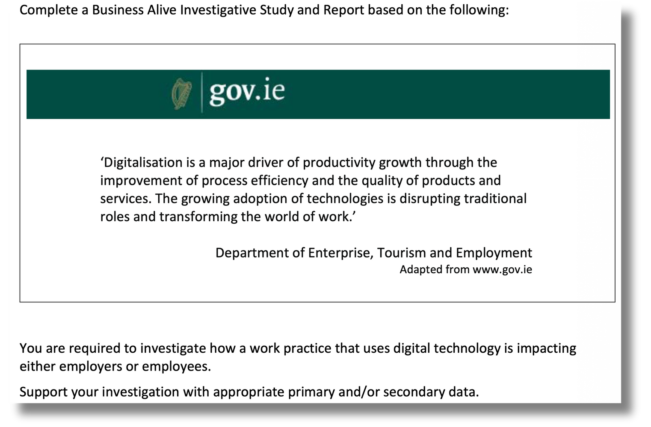
Stage 1: Getting Started
LC 2027 Brief - The Focus
Back In Business
1 - Work practice
2 - Digital Technology
3 - Impact on Employer / Employee

Slide 8

Stage 1: Getting Started
What do we need to think about?
Back In Business
1 - Work practice
→ What people actually do as part of their job
2 - Digital Technology
→ Software, platforms, systems, tools
3 - Impact on Employer / Employee
→ Workload, expectations, monitoring, decisions, wellbeing, efficiency

Slide 9
Stage 1: Getting Started
Potential Approachs to it
Back In Business
Work practice → Digital Technology → Impact on Employer / Employee
Digital Technology → Work practice → Impact on Employer / Employee
Digital Technology → Impact on Employer / Employee → Work practice

Slide 10
Stage 1: Getting Started
What do we need to think about?
Back In Business
What is a ‘work practice’?
Work practices are the actions someone does repeatedly at work; the routines people do in their jobs.
How something is done rather than what gets done.

Slide 11
Stage 1: Getting Started
What do we need to think about?
Back In Business
What are some work practices?
  Different routines like attending meetings, working in office/from home, responding to messages, entering orders, using software to schedule shifts...
  The focus should be less about improving customer service or increasing sales without linking them to the actual work people do and the impact of technology.

Slide 12

Stage 1: Getting Started
Starting to connect the dots
Back In Business
  Work Practice
Monitoring a salesperson’s performance

Slide 13

Stage 1: Getting Started
Starting to connect the dots
Back In Business
  2. Digital
Technology
Salesforce is a CRM (Customer Relationship Management) system
CRM systems are used to manage customer relationships. They will also allow employers to track/monitor and measure sales reps’ activities and performance in real time.

Slide 14


Stage 1: Getting Started
Starting to connect the dots
Back In Business
  3. Impact on Employee
Increased pressure/stress?, Feeling constantly supervised? Happy progress is tracked?
Better rewarded due to data?

Slide 15
Stage 1: Getting Started
Starting to connect the dots
Back In Business
Salesforce is a CRM (Customer Relationship Management) system
CRM systems allow employers to track and measure sales reps’ activities and performance in real time.
Work practice | Digital Technology | Impact on Employee
Monitoring a sales reps’ performance | Technology can now track and measure every interaction/ sale/ thing a sales rep does through a CRM | Increased pressure, fear of being tracked / data used against them / risk of burnout

Slide 16

Stage 1: Getting Started
An eye on stage 2
Back In Business
Access to data will be important - let’s imagine a student’s sibling works as a sales rep where they use Salesforce.
They might use that to come up with an investigation like...
How has the use of Salesforce to help monitor sales performance changed the pressure sales representatives feel to meet their targets since its introduction in ABC Ltd?
Tech
work practice
Impact

Slide 17



Stage 1: Getting Started
An eye on stage 2
Back In Business
The roads you can take
Seek out alternative answers and viewpoints to what you think is the likely answer.
Decide what answer you want to find, and then find data to help you do that

Slide 18
Stage 1: Getting Started
An eye on stage 2
Back In Business
CRMs
What are the other viewpoints I can try to consider?

Slide 19


Stage 1: Getting Started
More ideas
Back In Business
Work Practice
Monitoring and responding to customer comments on social media in real time.
Tech
Employee Impacts?
Out of work hours availability, blurred work-life boundaries, screentime...

Slide 20

Stage 1: Getting Started
More ideas
Back In Business
work practice
Communicating and collaborating with colleagues remotely on work tasks
Workplace messaging and collaboration tool that enables remote working
Tech
How are social needs impacted by remote work?
+ less commuting, more time for friends … - social isolation from lack of face to face work interactions
Employee Impacts?

Slide 21
Stage 1: Getting Started
What do we need from an idea?
Back In Business
Before refining an idea in to a research question, this checklist can help see if you are on the right path:
☐ I am focused on one work practice
☐ I have narrowed in on one digital technology
☐ I am focusing on the point of view of employers or employees
☐ There is going to be something that I could measure or compare on this topic (e.g. workload, time saved, expectations...)
☐ I could realistically access data or people (interview / survey)
☐ This can be done within the time available

Slide 22
Stage 1: Getting Started
Back In Business
Strong project ideas will likely need to have:
☐ A very clear focus
☐ Realistic access to data
☐ A measurable impact
☐ Varied viewpoints - can the impact be seen from different angles? (stakeholders, positive v negative impacts)
Begin with the end in mind

