Slide 1
Strand 4
Chapter 18
Making Informed Financial Decisions
Back In Business

Slide 2
Learning Outcomes
18.1 Examine the factors to be considered with saving, investing, and borrowing.
18.2 Explain risk tolerance from a consumer perspective and investigate the range of risks facing consumers of financial products and how consumers can identify reliable sources of financial information.
18.3 Outline the importance of considering switching between financial product providers.
18.4 Explain how technology impacts the provision of financial products and outline the benefits and challenges of fintech.
18.5 Outline how a person’s credit rating is established, the factors that can impact on credit rating, and the consequences of a poor credit rating.
Back In Business

Slide 3
Learning Outcomes
18.6 Investigate how the financial services industry is regulated and discuss the potential consequences of under-regulation.
18.7 Outline a range of financial fraud activities and discuss how consumers can protect themselves.
18.8 Describe Central Bank Digital Currency and examine the potential impact of digital currency on consumers and businesses.
18.9 Appreciate the importance of making informed financial decisions and use this understanding to discuss finance-re!ated stories in the news and media.
Back In Business

Slide 4
Back In Business
Priming activity
  What is the difference between saving and investing?
  What factors should someone think about before borrowing?
  What do you think affects someone’s credit rating, and why does it matter?
  What are the best and worst things about using technology to manage money?
  Do you trust digital currencies like Bitcoin?
  What are the benefits or dangers of using them?

Slide 5

Back In Business
Starter Activity
Starter Activity Sheet here

Slide 6
Learning Outcome 18.1
18.1 Examine the factors to be considered with saving, investing, and borrowing.
Back In Business

Slide 7
Back In Business
What Is The Difference Between AER And APR?
AER and APR are both ways of showing the true cost or benefit of money over a year, but they are used in different situations:
AER - Annual Equivalent Rate -> This is the rate used for savings and investments. The AER shows what the true yearly interest rate would be if you left your money untouched over a period of time, including the effects of compounding (interest on top of interest).
APR - Annual Percentage Rate -> This is the rate used for loans and credit based products. APR shows the true yearly cost of borrowing money, including the interest charged and any extra fees or costs included with credit.

Slide 8
Back In Business
Factors To Be Considered When Deciding Where To Save Money
Inflation
  Inflation reduces the purchasing power of money over time.
  If the interest rate on savings is lower than inflation, savings lose purchasing power over time e.g. inflation @3% interest rates @ 2%
  Savers should aim for returns that keep pace with inflation.
Risk
  Savings in regulated Irish banks and credit unions are protected (up to €100,000 per person).
  This makes saving generally low-risk.
  Unregulated providers do not offer this protection.

Slide 9
Back In Business
Factors To Be Considered When Deciding Where To Save Money
Interest Rates
  AER shows the total interest earned in one year, including compounding.
  Higher AER means higher returns.
  Some high-rate accounts may have restrictions.
Taxes and Charges
  Interest is subject to DIRT, which reduces final returns.
  Any fees or charges on the account may further reduce savings.

Slide 10
Back In Business
Factors To Be Considered When Deciding Where To Save Money
Terms and Conditions (Access)
  The savings goal determines the best account type.
  Higher returns usually mean less access to funds.
  Flexibility to access funds may mean someone is happy to accept a lower reward/interest rate.

Slide 11
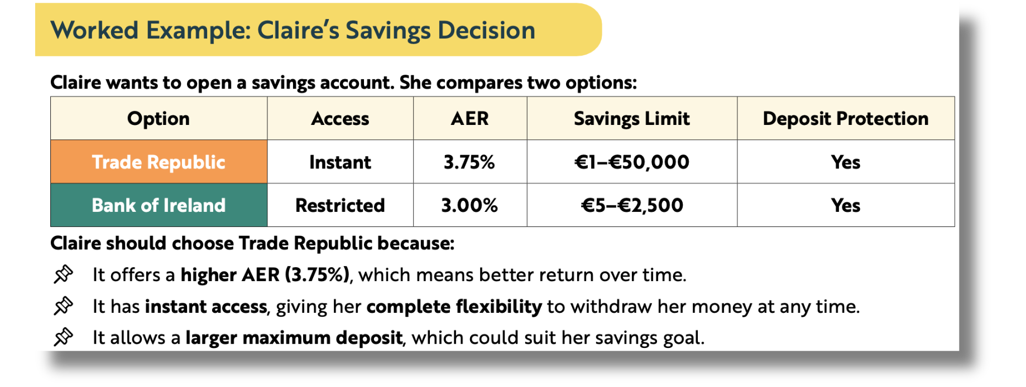
Back In Business
Comparing savings options

Slide 12
Back In Business
Investing
Saving means putting money aside in a secure, low-risk account, usually for short- or medium-term goals.
Investing means using your money to try to grow your wealth over time, but it comes with risk.
Compared to savings, the aim is usually to achieve a higher return, but the value of your investment can go up or down, unlike with savings.

Slide 13
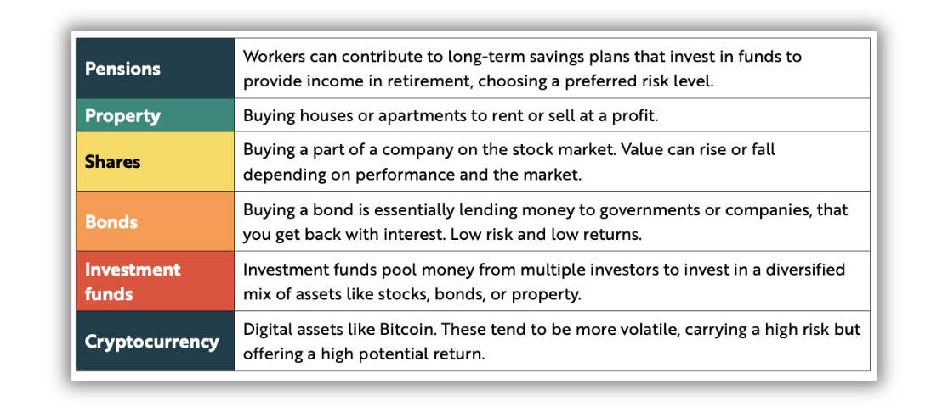
Back In Business
Common Types Of Investment In Ireland

Slide 14
Back In Business
Factors To Be Considered When Deciding Where To Save Invest
Return on Investment (ROI)
  ROI measures the profit earned from an investment as a percentage.
  Higher potential returns usually involve higher risk.
  Established shares may offer steadier returns than volatile assets like cryptocurrency.
Inflation
  If inflation exceeds returns, money loses real value.
  Investors may choose higher-growth assets to beat inflation.
  Higher-growth investments usually carry greater risk.

Slide 15
Back In Business
Factors To Be Considered When Deciding Where To Save Invest
Risk
  All investments carry some level of risk.
  Cryptocurrency is higher-risk than shares but may offer higher returns.
  Diversifying investments (investing in a varied number of shares and assets) spreads and reduces overall risk.
Taxes and Charges
  Profits may be subject to Capital Gains Tax (33% in Ireland).
  Some investments include management or transaction fees.
  Pensions are tax-efficient while saving but taxed when withdrawn.

Slide 16

Back In Business
Factors To Be Considered When Deciding Where To Save Invest
Time Horizon
  Short-term investors may take higher risks for quicker returns.
  Long-term investors often prefer stable, lower-risk investments.
  Longer time frames allow investments to grow gradually.
A smart investor should invest based on their risk tolerance level, their financial goals, the time frame they want to invest for, and expected return after tax and fees.

Slide 17
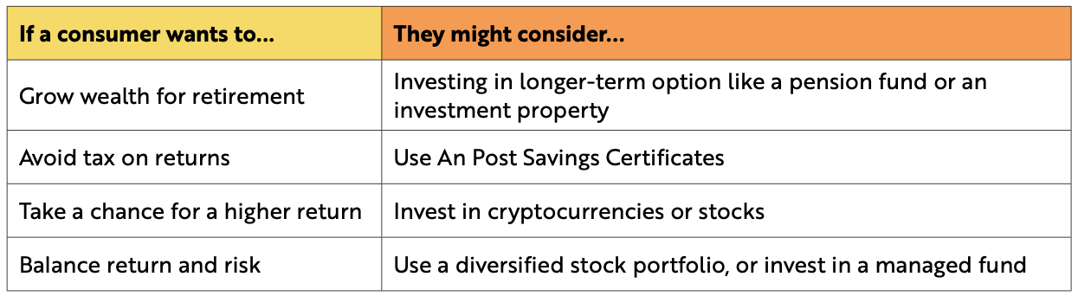
Back In Business
Making An Informed Decision

Slide 18
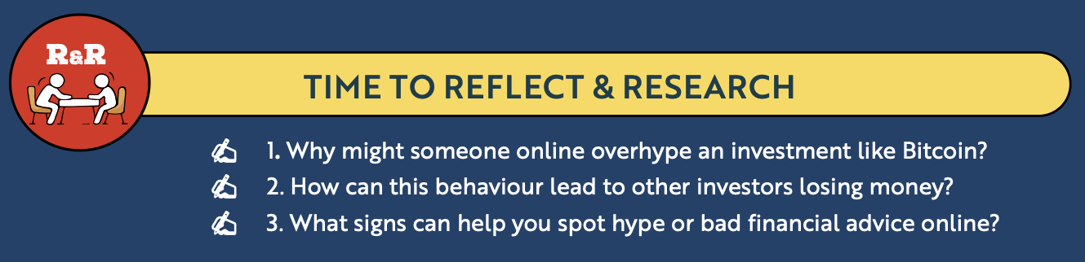
Back In Business
Reflect & Research Pg 331

Slide 19
Back In Business
Borrowing
Borrowing allows a consumer to afford a larger expense without having to pay the full cost upfront.
It usually means taking money from a bank, credit union, or lender and agreeing to pay it back at a later date with added interest and fees.

Slide 20
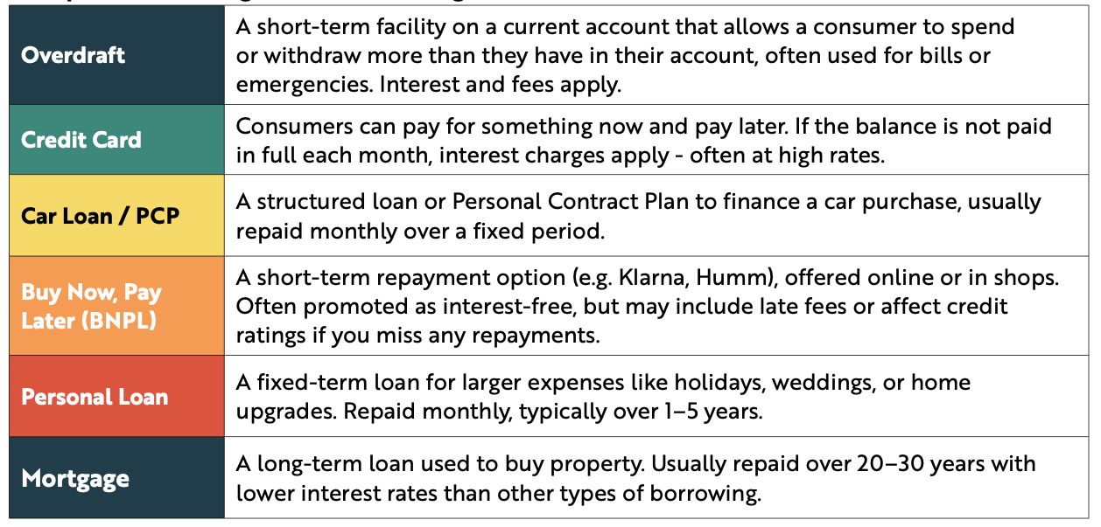
Back In Business
Examples Of Borrowing

Slide 21
Back In Business
Factors To Be Considered When Deciding Where To Borrow
Risk
  Borrowing creates a legal obligation to repay the loan.
  Failure to repay can damage a credit rating or lead to repossession (e.g. mortgage).
  Borrowing for non-essential items increases financial pressure.
Taxes and Charges
  Interest is the cost charged by lenders on top of the amount borrowed.
  Small differences in interest rates can greatly affect the total cost.
  Fixed rates offer certainty, while variable rates can rise or fall over time.

Slide 22
Back In Business
Factors To Be Considered When Deciding Where To Borrow
Taxes and Charges
  Some loans include setup fees or maintenance charges.
  Early repayment penalties may apply.
  Extra costs increase the real cost of borrowing.

Slide 23
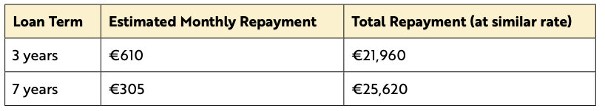
Back In Business
Factors To Be Considered When Deciding Where To Borrow
Short, Medium and Long-Term Loan Considerations
  A longer loan term reduces monthly repayments, improving short-term cash flow.
  However, a longer term increases the total interest paid over time.
  Borrowers must balance affordability now and overall cost of the loan.
📌 A longer loan offers lower monthly payments (€305 vs €610), helping cash flow for a household.
📌 However, the total interest paid is much higher over time (€3,660 higher).
📌 Borrowers must balance between the affordability of repayments now with the total cost over time.

Slide 24
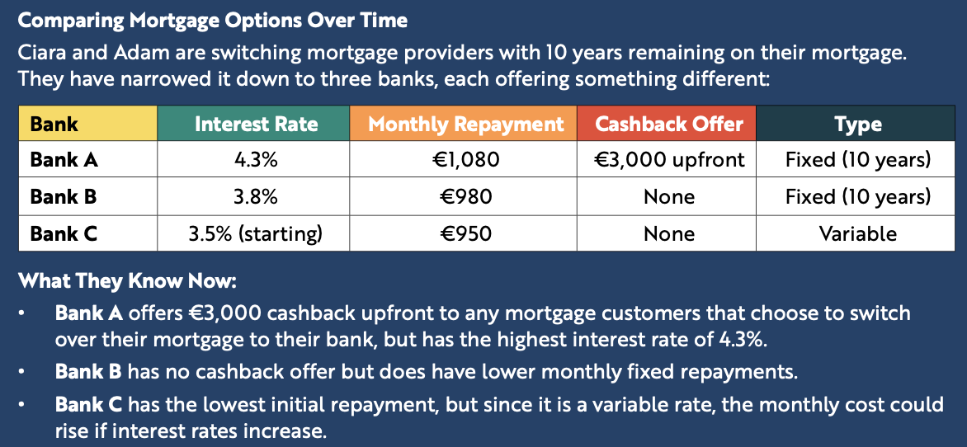
Back In Business
Reflect & Research Pg 333

Slide 25
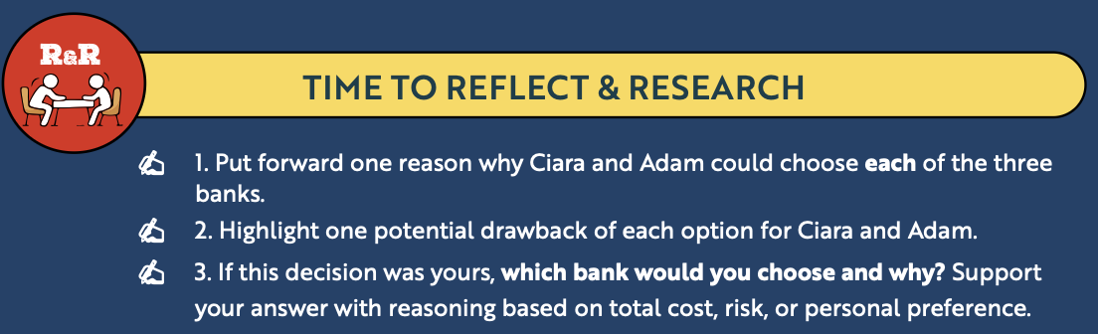
Back In Business
Reflect & Research Pg 333

Slide 26
Suggested Activities for LO 18.1
Sample Papers
HL2 Q2 (c): Explain three factors a consumer should consider before borrowing money.
OL1 Q4 (a) & (b): (a) (i) & (ii) Claire is planning to set up a savings account. Choose between two options and give reason. (iii) what does AER stand for.
(b) Outline two factors, apart from interest rates, that a person should consider when deciding where to save their money.
Activity Book Qs
HL Q1, Q2. BW Q1
OL Q1

Slide 27
Learning Outcome 18.2
18.2 Explain risk tolerance from a consumer perspective and investigate the range of risks facing consumers with financial products and how consumers can identify reliable sources of financial information
Back In Business

Slide 28
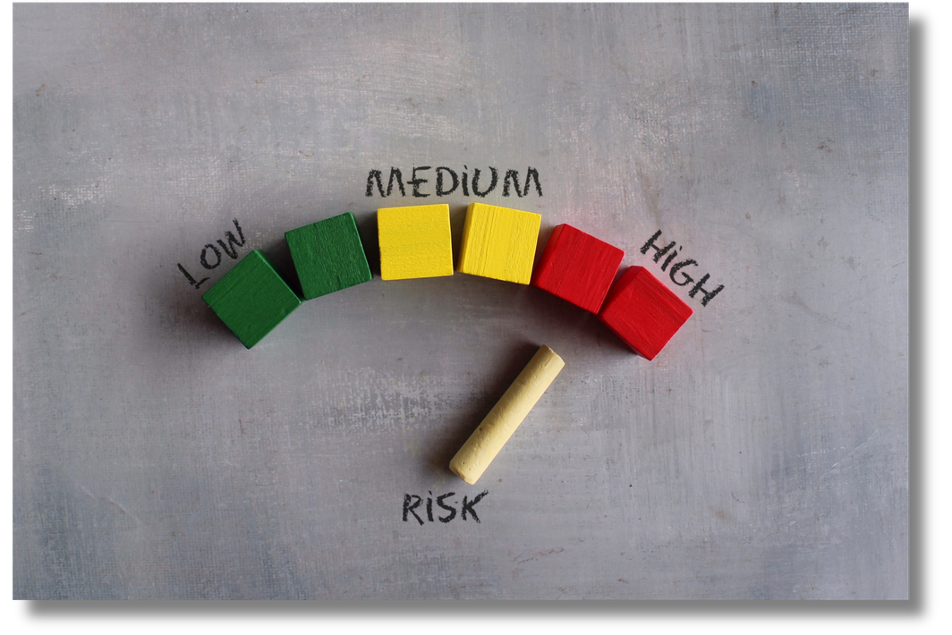
Back In Business
Risk Tollerance From A Consumer Perspective
Risk tolerance is a consumer’s willingness to accept possible financial loss in return for potential reward.
It depends on personality, age, life stage, income and financial stability.
Younger consumers may accept higher risk, while those nearing retirement often prefer lower risk and greater certainty.

Slide 29
Back In Business
Factors To Be Considered When Deciding To Borrow Money
Financial Loss / Performance Risk
  The value of investments or pensions can fall.
  Interest rate increases can raise loan repayments.
  Savings may not keep up with inflation, reducing real value.
Lack Of Information
  Financial products can be complex and difficult to understand.
  Consumers may choose unsuitable products if they ignore terms and conditions.
  Improving financial literacy reduces this risk.

Slide 30
Back In Business
Factors To Be Considered When Deciding To Borrow Money
Risk Of Fraud
  Consumers may fall victim to scams or fake financial offers.
  Fraud can involve phishing texts or fake investment schemes.
  Offers that seem too good to be true should be treated with caution.
Suitability Risk
  This is the risk that a financial product does not match a consumer’s goals, life stage, or financial situation.
  Taking on large repayments with an unstable income increases financial pressure

Slide 31
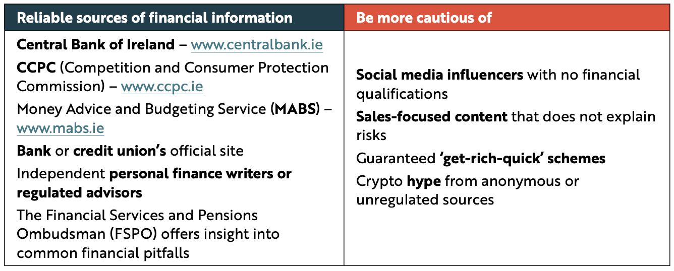
Back In Business
How Consumers Can Identify Reliable Sources Of Financial Information
To check if a financial source is reliable, a consumer should ask: Who is providing the information? Are they qualified or regulated? Is the content balanced, or just trying to sell something? Reliable sources explain the risks, are clear about who they are, and never promise guaranteed results. In Ireland, government-funded and regu!ated websites are the most reliable sources for financial information.

Slide 32
Suggested Activities for LO 18.2
Sample Papers
-
-
Activity Book Qs
HL Q3 BW Q2
OL Q2, Q3

Slide 33
Learning Outcome 18.3
18.3 Outline the importance of considering switching between financial product providers
Back In Business

Slide 34

Back In Business
An Informed Consumer Should Consider The Following When Considering Switching Any Financial Product

Slide 35
Back In Business
An Informed Consumer Should Consider The Following When Considering Switching Any Financial Product
Rates
Incentives
  Interest rates determine how much you earn on savings or pay on borrowing.
  Small differences in rates can significantly impact total returns or costs over time.
  Example: Moving savings from 1% to 3% AER increases long-term returns significantly.
  Providers may offer cashback, introductory rates or fee reductions to attract customers.
  Incentives can provide valuable short-term financial benefits.
  Example: Switching a €400,000 mortgage with 3% cashback could result in €12,000 received.

Slide 36
Back In Business
An Informed Consumer Should Consider The Following When Considering Switching Any Financial Product
Terms
Convenience
  Terms include repayment flexibility, exit penalties and fees.
  A product may appear cheaper but include restrictive conditions.
  Example: Switching to a mortgage that allows penalty-free overpayments can reduce total interest paid.
  Modern financial products offer mobile apps, online access and 24/7 support.
  Greater convenience improves money management and financial control.
  Example: Moving to a digital bank with instant notifications and budgeting tools simplifies daily banking.

Slide 37
Suggested Activities for LO 18.3
Sample Papers
-
-
Activity Book Qs
HL Q4. BWQ 1
OL Q5

Slide 38
Learning Outcome 18.4
18.4 Explain how technology impacts the provision of financial products and outline the benefits and challenges of fintech
Back In Business

Slide 39
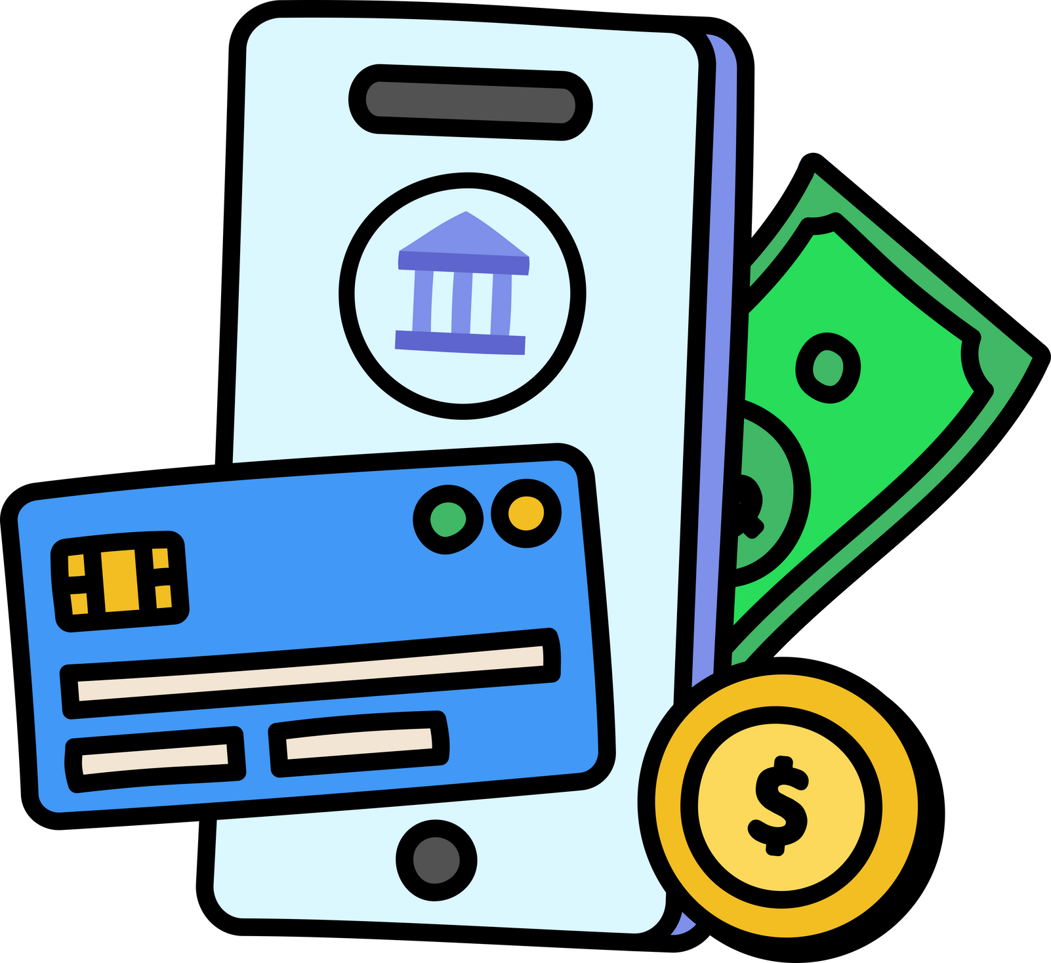
Back In Business
Fintech
The use of technology to deliver financial services and products to consumers. This includes everything from mobile banking apps and digital wallets to automated investing and cryptocurrencies.

Slide 40
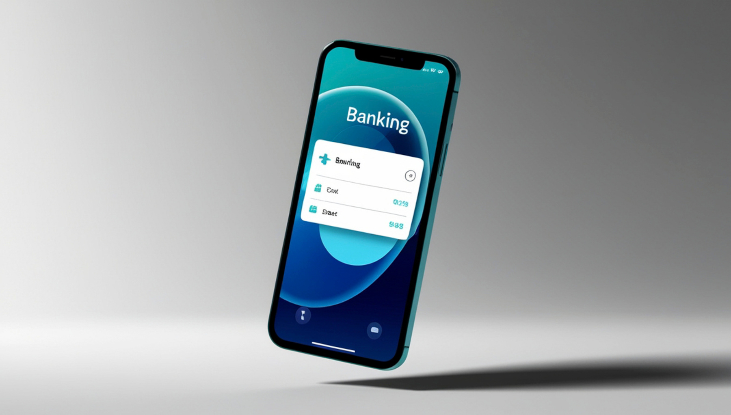
Back In Business
How Technology Has Impacted Financial Products
  Consumers can now access and manage bank accounts fully online without visiting a branch.
  Mobile apps and digital wallets allow instant payments, easier analysis and budgeting and money transfers.
  Fintech platforms use technology to provide faster loan approvals, investing options and 24/7 customer support.

Slide 41
Back In Business
Benefits Of Fintech For Consumers
  Speed & Convenience – Fintech services are available 24/7, allowing consumers to open accounts, transfer money, or apply for credit quickly through apps or websites.
  Greater Choice – Consumers can access a wide range of financial products online rather than being limited to their local bank.
  Lower Costs – Fintech companies often operate without physical branches, enabling them to offer lower fees and better rates.
  Improved Financial Insights – Many fintech tools analyse spending data to provide personalised budgeting support and tailored financial products.

Slide 42
Back In Business
Challenges Of Fintech For Consumers
  Impulsive Decisions – Quick online approvals and user-friendly apps may encourage consumers to agree to products without fully understanding the terms.
  Cybersecurity Risks – Data breaches, hacking and phishing scams can expose personal and financial information.
  Digital Exclusion – Limited access to reliable internet, devices or digital skills can prevent some groups from using fintech services.
  Unclear Regulation – Some fintech products may not be fully regulated in Ireland, which can reduce consumer protection.

Slide 43
Suggested Activities for LO 18.4
Sample Papers
OL1 Q4 (c): Explain two advantages for consumers of setting up an account with a digital bank such as Trade Republic.
OL2 Q2 (b): Outline one benefit and one challenge of fintech for consumers.
Activity Book Qs
HL Q5
OL Q4

Slide 44
Learning Outcome 18.5
18.5 Outline how a person’s credit rating is established, the factors that can impact on credit rating, and the consequences of a poor credit rating
Back In Business

Slide 45
Back In Business
How A Credit Rating Is Established

Slide 46
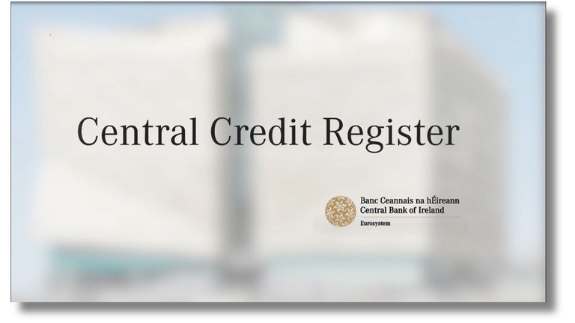
Back In Business
How A Credit Rating Is Established
  The Central Credit Register (CCR) stores information on loans over €500 but does not assign a credit score.
  Lenders use a borrower’s credit history from the CCR to assess creditworthiness.
  Credit reports include loans taken out, repayments made or missed, and new credit applications.
  Making repayments on time improves creditworthiness, while missed payments damage it.
Click for infograph

Slide 47
Back In Business
Factors That Impact Credit Rating
  Payment History
  Paying bills and loan repayments on time improves your credit rating, while missed payments damage it.
  Level of Debt
  High levels of debt compared to income or credit limits can negatively affect your rating.
  Level of Borrowing
  Using only a small portion of available credit shows good financial control.
  Credit Applications
  Making multiple loan or credit card applications in a short period can lower your credit rating.

Slide 48
Back In Business
Consequences Of A Poor Credit Rating
  Limited Access to Credit
  Lenders may refuse loans or credit cards if they view the borrower as high-risk.
  Higher Interest Rates
  Borrowers may face higher interest charges, increasing the total cost of borrowing.
  Difficulty Renting or Buying Property
  Landlords and mortgage lenders may reject applications or require larger deposits.
  Long-Term Impact
  Missed repayments remain on credit history for years and can affect future loan applications.

Slide 49
Suggested Activities for LO 18.5
Sample Papers
HL1 Q3 (c): Outline three factors that can aﬀect a person's credit rating.
Activity Book Qs
HL Q6. BW Q3
-

Slide 50
Learning Outcome 18.6
18.6 Investigate how the financial services industry is regulated and discuss the potential consequences of under-regulation
Back In Business

Slide 51
Back In Business
Regulation Of Financial Services
The purpose of regulation
  The financial services industry in Ireland is regulated to protect consumers and ensure fair treatment.
  Regulation helps maintain trust and stability in the financial system.
  Without regulation, consumers could face scams, unfair practices, and potential financial system collapse.

Slide 52

Back In Business
Role of the Central Bank of Ireland
The Central Bank of Ireland regulates and supervises financial institutions to protect consumers and maintain financial stability.
It enforces rules on fairness and transparency and works to prevent fraud, insider trading and money laundering.

Slide 53
Back In Business
Regulation Of Financial Services In The EU
The European Central Bank (ECB) and European Banking Authority (EBA) set rules and supervise financial institutions across the EU.
National regulators, such as the Central Bank of Ireland, enforce these rules locally.
Key EU regulations include GDPR, which protects personal data, and the Consumer Credit Directive, which ensures transparency and consumer rights in lending.

Slide 54
Back In Business
Consequences Of Under-Regulation
High Consumer Risk | Consumers may be sold unsuitable products, charged hidden fees, or lose money to scams.
No Guarantee or Safety | Unregulated firms may not offer access to compensation or complaint procedures.
System Instability | Risky lending and poor oversight can trigger financial crises (e.g. 2008 crisis).
Collapse of the Banking System | Loss of public confidence can lead to mass withdrawals and economic damage.

Slide 55
Suggested Activities for LO 18.6
Sample Papers
-
-
Activity Book Qs
-
OL Q6

Slide 56
Learning Outcome 18.7
18.7 Outline a range of financial fraud activities and discuss how consumers can protect themselves
Back In Business

Slide 57
Back In Business
Financial Fraud
Financial fraud is when someone uses deception or dishonesty to trick another person into giving away their money, personal details, or access to their financial accounts. The goal is usually the same: to steal money or financial information without the victim’s knowledge or
full consent, and consumers should take steps to protect themselves from it.

Slide 58
Back In Business
Financial Fraud
Phishing, Smishing & Vishing
What consumer can do?
Fraudsters send fake emails, texts or phone calls pretending to be trusted organisations to steal personal details.
  Phishing = Email
  Smishing = SMS/Text
  Vishing = Voice/Phone Call
Never share passwords or PINs. Verify requests directly with your provider using official contact details.
What consumer can do?
Card Skimming or Cloning
Always cover your PIN. Avoid
machines that look damaged or
tampered with. Check statements regularly for any unusual transactions.
Devices attached to ATMs or card machines copy card details, sometimes using hidden cameras.

Slide 59
Back In Business
Financial Fraud
Investment & Crypto Scams
What consumer can do?
Fake investment offers promise high or guaranteed returns and pressure victims to act quickly.
Avoid “too good to be true” offers. Check the Central Bank register before investing.
Fake Online Shops/Payment Requests
What consumer can do?
Fake retail websites or payment requests trick consumers into paying for goods that never arrive.
Use secure websites (https & padlock icon) and avoid direct transfers to unknown sellers.

Slide 60
Back In Business
Protection For Consumers
1. Be informed –> Do not rush decisions. Take time to check if an offer, call, or message is genuine.
2. Be alert –> Question cold calls or unexpected contact and check bank statements regularly.
3. Be secure –> Never give out full PINs, passwords or codes, change passwords regularly and set up 2FA (Two Factor Authentication) to protect their online accounts and cards.

Slide 61
Back In Business
Managing risk with different financial products
Pensions | Investment values can fall, reducing retirement income. Reduce risk: Review rebalance regularly and only use regulated providers.
Mortgages | Interest rate or income changes can make repayments unaffordable. Reduce risk: Consider fixed rates, avoid borrowing the maximum, and switch for better terms if possible.
Credit Products | High interest and missed repayments can cause debt damaging credit rating. Reduce risk: Set spending limits and pay the full balance each month.
Crypto-Finance | Highly volatile and less regulated, leading to possible large losses. Reduce risk: Only invest what you can afford to lose and research carefully.

Slide 62
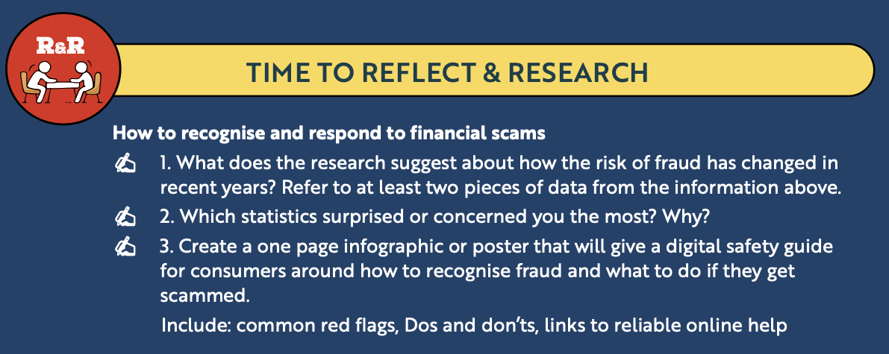
Back In Business
Reflect & Research Pg 343

Slide 63
Suggested Activities for LO 18.7
Sample Papers
OL1 Q2 (e) (i): Explain three ways consumers can protect themselves against fraud.
Activity Book Qs
HL Q7
OL Q7

Slide 64
Learning Outcome 18.8
18.8 Describe Central Bank Digital Currency and examine the potential impact of digital currency on consumers and businesses
Back In Business

Slide 65
Back In Business
Central Bank Digital Currency (CBDC)

Slide 66

Back In Business
Central Bank Digital Currency (CBDC)
CBDC is a digital form of central bank money that acts as electronic cash.
It is issued and backed by a central bank (e.g. the ECB for a digital euro).
It is centralised, regulated and designed to complement physical cash.

Slide 67
Back In Business
Features Of Central Bank Digital Currency
Issued by a central bank – e.g. the ECB would issue a digital euro.
Backed by a currency – e.g. the digital euro would be backed by the euro.
Centralised – The central bank manages and controls the supply of the digital currency, ensuring its stability, security, and compliance with national and EU regulations.

Slide 68
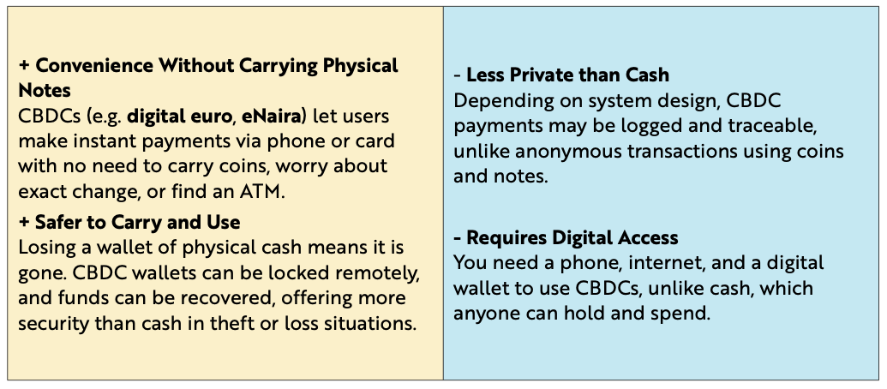
Back In Business
The Advantages And Disadvantages Of Central Bank Digital Currency
(CBDC) As An Electronic Equivalent To Cash

Slide 69
Back In Business
Crypto Assets
Crypto is any digital asset that uses cryptography and blockchain technology. This covers cryptocurrencies like Bitcoin, Ethereum, NFTs (non-fungible tokens) and stablecoins.
What is a Blockchain? Blockchains are essential for the functioning of digital currencies – they provide a secure public record book that tracks all crypto transactions to make it trustworthy, transparent and secure.

Slide 70
Back In Business
Cryptocurrency vs Stablecoin
Cryptocurrency | Stablecoin
A decentralised digital currency not controlled by any government or bank. | A digital currency usually pegged to a stable asset (e.g. US dollar or gold).
Highly volatile – value can rise or fall quickly. | Designed to maintain stable value.
Not backed by a central authority. | Managed by a private company holding reserves.
Example: Bitcoin, Ethereum | Example: Tether
Cryptocurrencies are volatile and decentralised, while stablecoins aim to reduce volatility by linking their value to an existing asset.

Slide 71
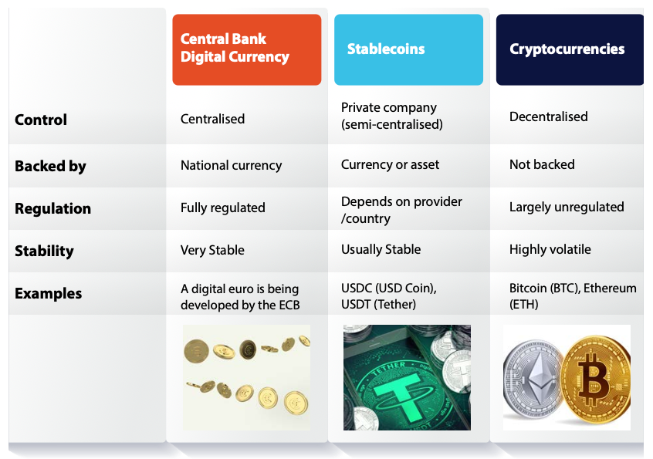
Back In Business
How CBDCs Differ From Stablecoins And Crypto Assets

Slide 72
Back In Business
Advantages And Disadvantages Of Digital Currency For Consumers And Businesses
Advantages
  Lower transaction costs and faster payments
  Transparent records that reduce fraud
  24/7 access and improved financial inclusion
Disadvantages
  Privacy concerns due to traceable transactions
  Requires digital access and technology
  Legal and regulatory uncertainty (especially for crypto)

Slide 73
Suggested Activities for LO 18.8
Sample Papers
HL2 Q3 (c): (i) Describe two differences between Central Bank Digital Currency (CBDC) and crypto assets. (ii) Explain one potential impact of digital currency on consumers and businesses.
Activity Book Qs
HL Q8. BW Q2
OL Q8

Slide 74
Learning Outcome 18.9
18.9 Appreciate the importance of making informed financial decisions and use this understanding to discuss finance-related stories in the news and media.
Back In Business

Slide 75
Back In Business
Making Informed Financial Decisions
Compare Before Choosing
Research different providers and products instead of accepting the first offer you see.
Understand the Terms
Read interest rates, fees and conditions carefully to avoid hidden costs.
Match Decisions to Your Situation
Choose financial products that suit your goals, income and risk tolerance.

Slide 76
Back In Business
Making Informed Financial Decisions
Use Trusted & Regulated Sources
Seek information from reliable bodies (e.g. Central Bank) and avoid relying on social media advice.
Stay Alert & Review Regularly
Watch for scams, review long-term products and adjust decisions as your circumstances change.

Slide 77
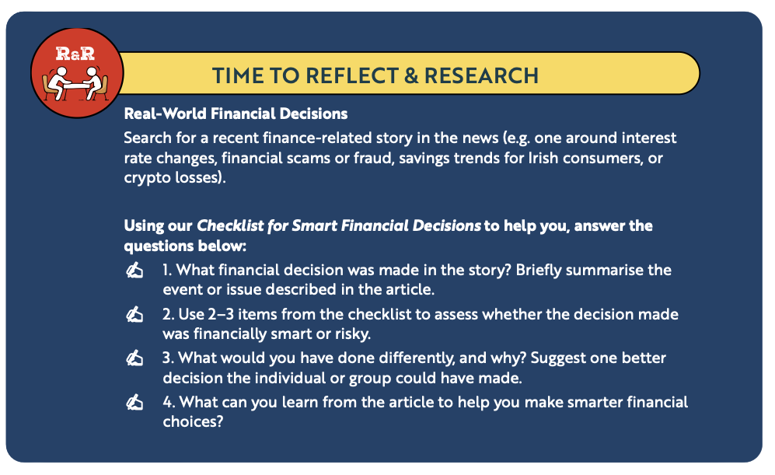
Back In Business
Reflect & Research Pg 348

Slide 78
Suggested Activities for LO 18.9
Sample Papers
-
-
Activity Book Qs
HL BW Q1

