Slide 1

Strand 4
Chapter 19
Being An Informed Employee
Back In Business

Slide 2
Learning Outcomes
19.1 Examine how employees are protected, both legislatively and non-
legislatively, in the workp!ace.
19.2 Investigate how the rights and responsibilities of both employees and
employers are set out in current relevant employment legislation.
19.3 Describe the role of trade unions in the workplace.
19.4 Discuss the role of the gig-based economy and identify the
associated opportunities and challenges for workers.
19.5 Investigate how the annual government budget impacts on workers.
19.6 Appreciate the importance of making informed decisions as an
employee and use this understanding to discuss workplace-related
stories in the news and media.
Back In Business

Slide 3


Back In Business
Priming activity
Can a manager fire a worker if they are not doing a good job without notice? Why?
What do you think a trade union does?
If you owned a business, would you like your workers to be in a union?
Do you know of any budget announcements that impact workers?

Slide 4
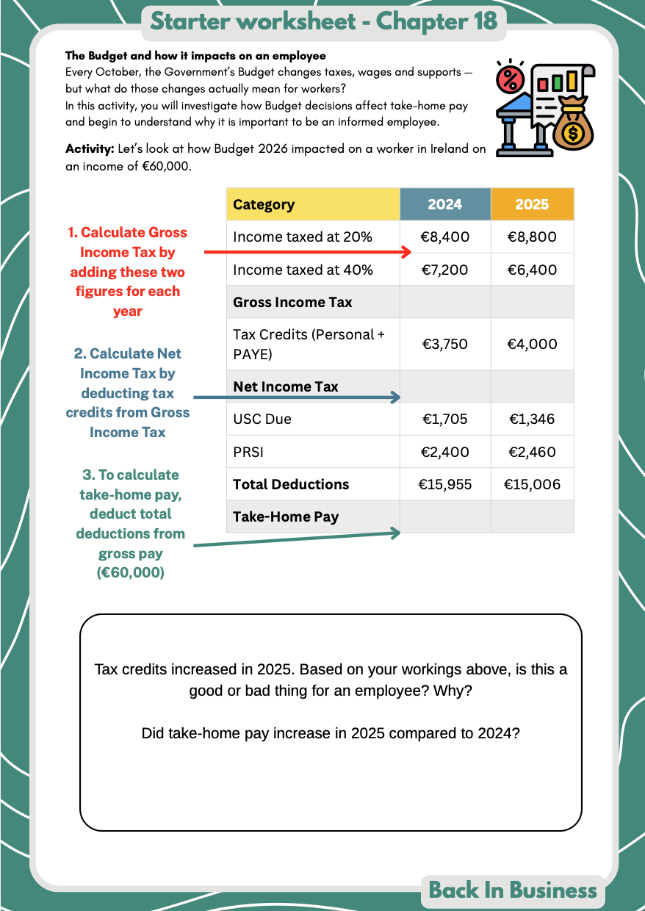
Back In Business
Starter Activity

Slide 5
Learning Outcome 19.1
19.1 Examine how employees are protected, both legislatively and non-legislatively, in the workplace.
Back In Business

Slide 6
Back In Business
Types of Employee Protection in Ireland
Non-Legislative Protection
Protection that resolves workplace issues internally or through voluntary systems, without going to a legal body or court.
Legislative Protection
Legislative protections give employees enforceable legal rights and access to state bodies, such as the Workplace Relations Commission (WRC) and the Labour Court, to resolve disputes.

Slide 7
Back In Business
Non-Legislative Protection For Employees
Meet & Talk
An informal discussion between the employee and employer to resolve an issue at an early stage.
This protects employees by allowing concerns to be raised quickly and privately before they escalate into formal disputes.
Grievance Procedure
A formal internal process used for all employees to help deal with complaints about issues such as unfair treatment or working conditions.
It protects employees by ensuring their complaint is investigated in a structured and transparent way.

Slide 8

Back In Business
Non-Legislative Protection For Employees
Shop Steward / Trade Union Support
A workplace representative who supports and speaks on behalf of the employee in discussions with management.
This protects employees by providing experience, representation and reducing any imbalance of power.

Slide 9

Back In Business
Legislative Protection For Employees

Slide 10

Back In Business
Legislative Protection For Employees
The Workplace Relations Commission is the state body responsible for overseeing employment rights and resolving workplace disputes in Ireland. It ensures that employment law is applied correctly and fairly.

Slide 11
Back In Business
Role Of The Workplace Relations Commission
Advisory Service
A support service provided by the WRC to help develop and improve workplace procedures eg grievance handling, discipline, consultation and communication.
It protects employees by encouraging fair systems and clear communication before problems arise.
Mediation
A voluntary process provided by the WRC where a neutral mediator helps both parties reach agreement without a formal hearing.
It protects employees by offering a confidential and less adversarial way to resolve disputes at an early stage.

Slide 12
Back In Business
Role Of The Workplace Relations Commission
Conciliation
A process mainly used in industrial relations disputes where a WRC Conciliation Officer assists both sides in reaching agreement.
It protects employees by helping resolve disputes through discussion rather than formal legal proceedings.
Adjudication
A formal hearing conducted by an Adjudication Officer when a complaint is made under employment law.
It protects employees by providing a legally binding decision where their rights have been breached.

Slide 13

Back In Business
Role Of The Workplace Relations Commission
Inspection and Compliance Service
A monitoring service carried out by WRC Inspectors to ensure employers comply with employment legislation.
It protects employees by identifying breaches of the law even where no complaint has been made.

Slide 14

Back In Business
The Labour Court
The role of the Labour Court in dispute resolution is to act as a court of last resort.
The Labour Court deals with:
📌 Appeals of WRC adjudication decisions
📌 Unresolved industrial disputes that have not been settled through conciliation
📌 Setting and reviewing Employment Regulation Orders (EROs) for specific sectors through Joint Labour Committees (JLCs)

Slide 15
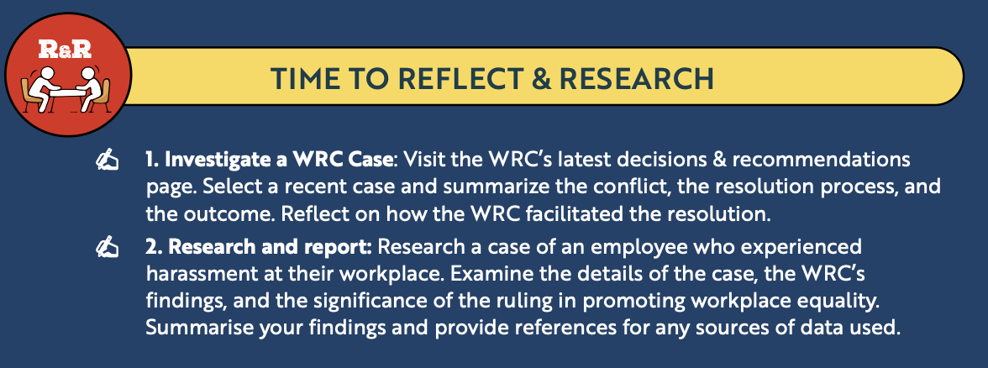
Back In Business
Reflect & Research Pg 355

Slide 16
Suggested Activities for LO 19.1
Sample Papers
-
-
Activity Book Qs
HL Q1. BW Q3
OL Q1

Slide 17
Learning Outcome 19.2
19.2 Investigate how the rights and responsibilities of both employees and employers are set out in current relevant employment legislation.
Back In Business

Slide 18
Back In Business
Rights & Responsibilities of Employees around Pay
Right to a Payslip
Employees are entitled to a written payslip showing gross pay, deductions and net pay under the Payment of Wages Act 1991 (as amended). This allows employees to check that they are paid correctly.
Right to the National Minimum Wage
Employees must receive at least the statutory hourly rate under the National Minimum Wage Act 2000 (as amended). This protects workers from underpayment.
Right to Written Terms of Employment
Employees must receive core written terms, including pay and hours, within five days under the Employment (Miscellaneous Provisions) Act 2018. This ensures clarity from the start of employment.

Slide 19
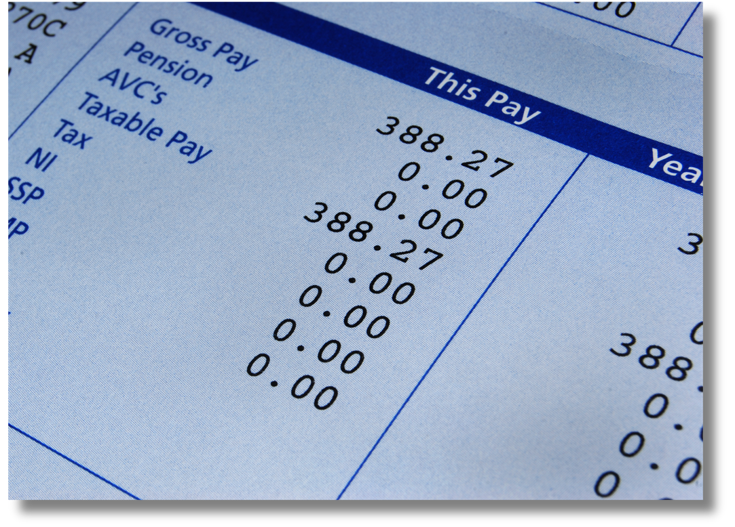
Back In Business
Rights & Responsibilities of Employers around Pay
Provide Payslips
Employers must issue a written payslip each payday under the Payment of Wages Act 1991 (as amended).
Pay the Minimum Wage
Employers must comply with statutory minimum rates under the National Minimum Wage Act 2000 (as amended).
Provide Written Terms
Employers must give core employment terms in writing under the Employment (Miscellaneous Provisions) Act 2018.

Slide 20

Back In Business
Rights & Responsibilities of Employees around Working Conditions
Right to Limited Working Hours
Employees cannot work more than an average of 48 hours per week under the Organisation of Working Time Act 1997.
Right to Rest Breaks
Employees are entitled to statutory breaks and daily rest under the same Act.
Right to Paid Leave
Employees are entitled to paid annual leave and public holiday benefits under the Organisation of Working Time Act 1997.

Slide 21
Back In Business
Rights & Responsibilities of Employers around Working Conditions
Limit Working Hours
Employers must ensure employees do not exceed legal working time limits under the Organisation of Working Time Act 1997.
Provide Breaks and Rest
Employers must allow statutory breaks and daily rest periods.
Provide Leave Entitlements
Employers must grant annual leave and public holiday entitlements in line with the Act.

Slide 22
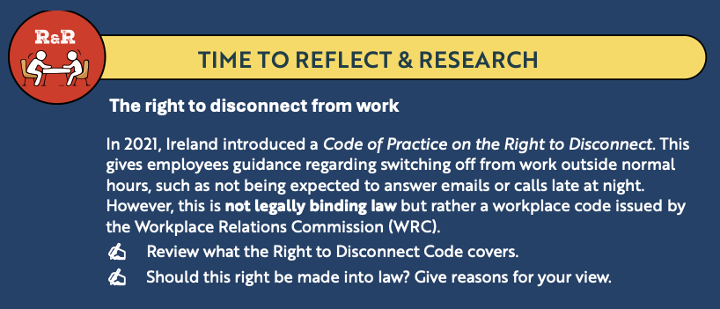
Back In Business
Reflect & Research Pg 357

Slide 23

Back In Business
Rights & Responsibilities of Employees around H&S
Right to a Safe Workplace
Employees have the right to work in an environment that does not expose them to unnecessary risk under the Safety, Health and Welfare at Work Act 2005.
Right to Safety Training
Employees must receive appropriate training to carry out their work safely under the same Act.
Right to Raise Safety Concerns
Employees may report unsafe practices without fear of penalisation under the Act.

Slide 24
Back In Business
Rights & Responsibilities of Employers around H&S
Provide a Safe Working Environment
Employers must ensure the workplace is safe and carry out risk assessments under the Safety, Health and Welfare at Work Act 2005.
Prepare a Safety Statement
Employers must identify hazards and outline control measures in a written Safety Statement.
Provide Training and Protective Equipment
Employers must supply necessary training and protective equipment where required.

Slide 25
Back In Business
Rights & Responsibilities of Employees around Discrimination
Right to Equal Treatment
Employees must not be discriminated against on any of the nine protected grounds under the Employment Equality Acts 1998–2015.
This applies to recruitment, pay, promotion and dismissal.
Right to Reasonable Accommodation
Employees with disabilities are entitled to reasonable accommodation under the same Acts.
Right to a Respectful Workplace
Employees are protected from harassment, bullying and victimisation in employment.
9 grounds discrimination is illegal:
  Gender
  Civil Status
  Family Status
  Age
  Disability
  Sexual Orientation
  Race
  Religion
  Membership of the Traveller Community

Slide 26
Back In Business
Rights & Responsibilities of Employers around Discrimination
Prevent Discrimination
Employers must ensure no employee or applicant is treated unfairly on any protected ground.
Provide a Respectful Working Environment
Employers must address complaints of discrimination or harassment appropriately.
Provide Reasonable Accommodation
Employers must take reasonable steps to support employees with disabilities unless it causes disproportionate hardship.

Slide 27

Back In Business
Rights & Responsibilities of Employees around Security of Employment
Right to Fair Redundancy Procedures
Employees must be consulted and selected using fair and objective criteria under the Protection of Employment Act 1977.
Selection cannot be based on personal bias againast an employee or discriminatory.
Right to Statutory Redundancy Payment
Employees with sufficient service are entitled to redundancy payment under the Redundancy Payments Acts 1967–2014.
This is calculated as two weeks’ pay per year of service, plus one additional bonus week.

Slide 28
Back In Business
Rights & Responsibilities of Employers around Security of Employment
Use Fair Selection Criteria
Employers must apply objective and non-discriminatory criteria when selecting employees for redundancy under the Protection of Employment Act 1977.
Provide Advance Consultation and Notice
Employers must consult employees in advance and provide statutory notice under the Minimum Notice and Terms of Employment Acts 1973–2005.
Pay Statutory Redundancy Entitlements
Employers must pay eligible employees their statutory redundancy under the Redundancy Payments Acts 1967–2014.

Slide 29
Back In Business
Rights & Responsibilities of Employees around Security of Employment
Right Not to Be Unfairly Dismissed
Employees are protected under the Unfair Dismissals Acts 1977–2015. An employer must have a valid reason and follow fair procedures (eg issued verbal and written warnings) when dismissing an employee.
Right to Appeal a Dismissal
• No Proper Procedure Was Followed – where the employer failed to provide warnings or an opportunity to improve.
• No Evidence provided – where there is no evidence of misconduct, poor performance or genuine redundancy to prove dismissal was fair.
• Discrimination – where dismissal was linked to gender, religion, age...
• Constructive Dismissal – where the employee resigns because the employer made the position intolerable. In such cases, the burden of proof rests with the employee.

Slide 30
Back In Business
Rights & Responsibilities of Employees around Security of Employment
Right to Redress
If a dismissal is found to be unfair, employees have the right to seek compensation, reinstatement or re-engagement under the Unfair Dismissals Acts 1977–2015.
• Compensation – up to two years’ pay for financial loss. Compensation is not awarded for emotional distress.
• Reinstatement – returning to the exact same job with full back pay and benefits, usually where the employee did not contribute to the dismissal.
• Re-engagement – being re-employed in a similar role without back pay, often where the employee partly contributed to the situation.

Slide 31
Back In Business
Rights & Responsibilities of Employers around Security of Employment
Dismiss workers on fair grounds only
• Incapability – when an employee is unable to perform their duties due to issues such as repeated lateness, unauthorised absences or persistent ill health affecting performance.
• Incompetence – where an employee fails to meet reasonable and clearly communicated performance standards despite being given support and time to improve.
• Lack of Qualifications – where an employee does not have, or loses, a qualification that is essential for the role.

Slide 32
Back In Business
Rights & Responsibilities of Employers around Security of Employment
Dismiss workers on fair grounds only
• Misconduct – includes serious breaches of company rules such as theft, bullying or harassment. In cases of gross misconduct, dismissal may occur without prior warnings, but fair procedures must still be followed.
• Redundancy – where the role itself is no longer required due to closure, restructuring or reduced business need.
• Contravention of the Law – where continued employment would breach the law, such as losing a required work permit.

Slide 33
Back In Business
Rights & Responsibilities of Employers around Security of Employment
Follow the correct procedures to dismiss a worker
  Provide counselling and clear guidance on required improvements.
  Issue a formal verbal warning and add it to the employee’s record.
  Issue a written warning, which may include appropriate sanctions such as suspension.
  Issue a final written warning making clear that dismissal may result.
  If dismissal occurs, provide written reasons within 14 days.
They should then offer a fair appeals process for the employee to challenge the dismissal

Slide 34
Suggested Activities for LO 19.2
Sample Papers
HL2 Q4 (a): List three grounds, apart from gender, on which discrimination is illegal
OL1 Q3 (d): Based on current legislation, explain two rights of employees that are related to pay.
OL2 Q2 (f): Based on current employment legislation, list four grounds under which discrimination is illegal.
Activity Book Qs
HL Q2. BW Q1, Q2
OL Q2, Q3, Q4

Slide 35
Learning Outcome 19.3
19.3 Describe the role of trade unions in the workplace.
Back In Business

Slide 36

Back In Business
Trade Unions
A trade union is an organisation formed by workers to promote and protect their rights and interests in the workplace.
Unions aim to improve conditions such as pay, hours, safety, job security, and overall treatment of workers through lobbying, public protests and calling for industrial action.
Examples of Trade Unions in Ireland
• SIPTU (Services, Industrial, Professional and Technical Union)
• Fórsa
• INMO (Irish Nurses and Midwives Organisation)
• Mandate

Slide 37
Back In Business
The Role Of Trade Unions In The Workplace
Representation In Talks
Trade unions represent members in disputes with management.
A shop steward or union official may attend meetings to ensure the employee’s interests are protected.
Collective Bargaining
Trade unions negotiate with employers to improve wages, working conditions and benefits for groups of employees.
These negotiations can result in collective agreements that improve work conditions/pay and apply to all workers covered.

Slide 38
Back In Business
The Role Of Trade Unions In The Workplace
Legal Support
Trade unions provide advice and legal assistance, including support in bringing cases to the Workplace Relations Commission or Labour Court.
This ensures employees understand and can enforce their rights.
Campaigning
Trade unions lobby and campaign for improvements in employment law and worker protections at national level.
Their efforts have contributed to changes such as minimum wage increases and enhanced leave entitlements.

Slide 39
Back In Business
The Role Of Trade Unions In The Workplace
Protecting Job Security
Trade unions support workers during redundancies, restructuring or outsourcing.
They ensure fair procedures are followed and may negotiate improved redundancy terms or redeployment options.

Slide 40
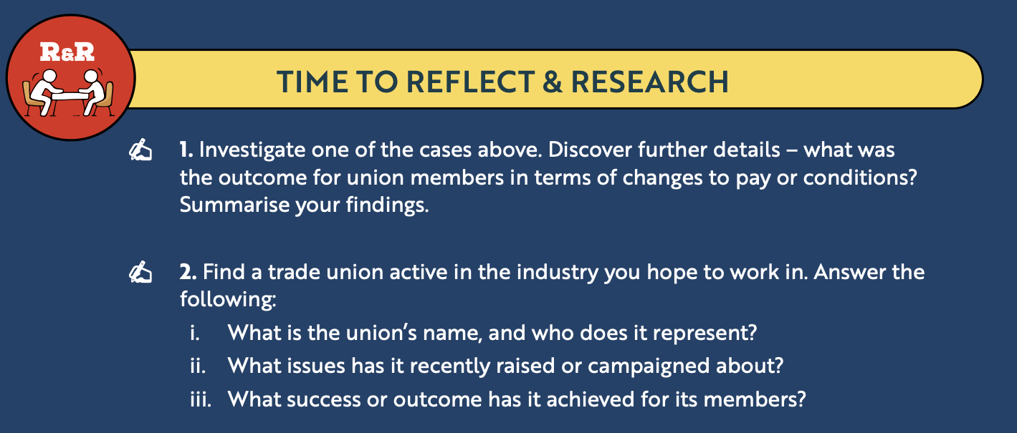
Back In Business
Reflect & Research Pg 363

Slide 41
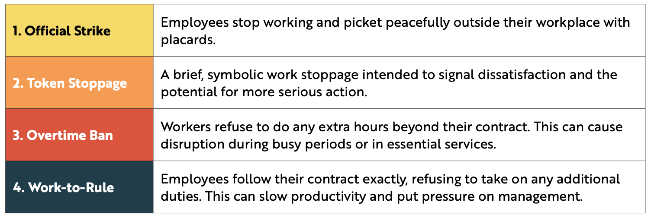
Back In Business
Types Of Industrial Action

Slide 42
Suggested Activities for LO 19.3
Sample Papers
OL2 Q3 (c): (i) Do employees in Ireland have the right to join a trade union?
ii) Outline two ways that trade unions support employees in the workplace.
Activity Book Qs
HL Q3. BW Q3
OL Q5

Slide 43
Learning Outcome 19.4
19.4 Discuss the role of the gig-based economy and identify the associated opportunities and challenges for workers.
Back In Business

Slide 44
Back In Business
Gig Economy

Slide 45


Back In Business
Gig Economy
The gig economy refers to a part of the labour market which relies on
temporary positions, part-time workers, or freelancers.
Workers are usually self-employed and paid per task, per project or per hour, often through digital platforms.
In Ireland, gig work is common in delivery, transport, hospitality and creative industries.

Slide 46
Back In Business
Opportunities For Workers In The Gig Economy
Opportunities | Explanation
Greater Flexibility | Workers can choose when and how much they work, making it suitable for students or those with other commitments.
Multiple Income Streams | Freelancers can work for several clients at once, increasing independence and earning potential.
Quick Access to Work | Gig work often requires fewer formal qualifications and allows faster entry into the labour market.
Work from Anywhere | Online gig work can be done remotely, allowing workers to access national and international clients.

Slide 47
Back In Business
Challenges For Workers In The Gig Economy
Challenges | Explanation
Lack of Employment Rights | Many gig workers are classified as self-employed and do not receive statutory sick pay, holiday pay or pension contributions.
Unpredictable Income | Earnings depend on demand, making income inconsistent and difficult to budget.
No Job Security | There are usually no guaranteed hours and workers may lose access to platforms with little notice.
Isolation and Pressure | Gig workers often work alone and may feel pressure to constantly seek new work.

Slide 48
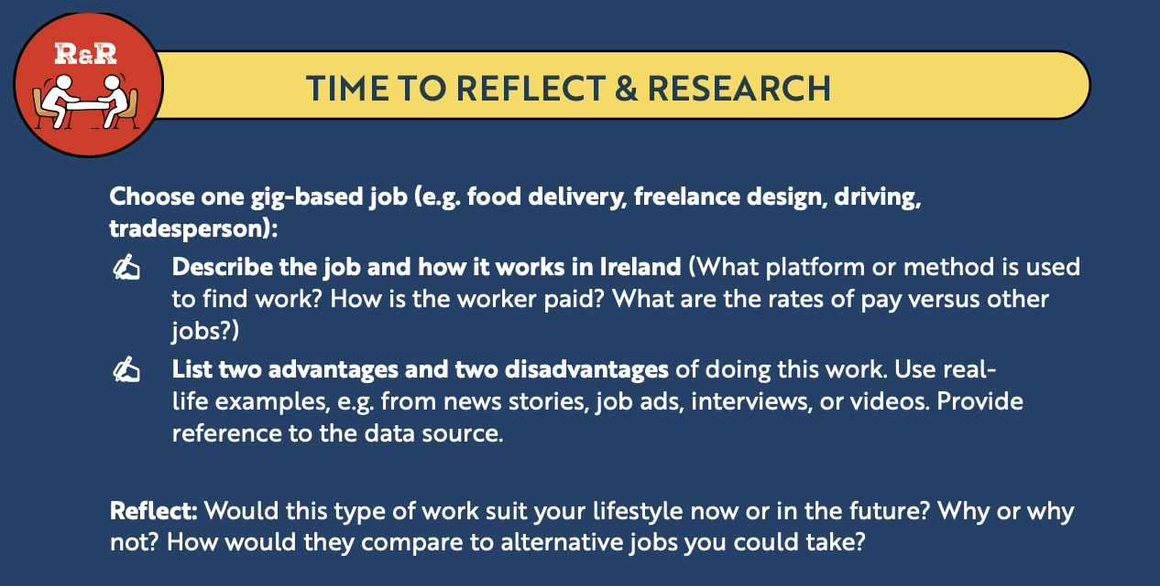
Back In Business
Reflect & Research Pg 366

Slide 49
Suggested Activities for LO 19.4
Sample Papers
HL1 Q5 (a): (i) Explain the term gig economy. (ii) Identify three challenges faced by workers in the gig economy.
OL1 Q1 (e): Identify two advantages and two disadvantages for a worker engaging in freelance work.
Activity Book Qs
HL Q4
OL Q6

Slide 50
Learning Outcome 19.5
19.5 Investigate how the annual government budget impacts on workers.
Back In Business

Slide 51
Back In Business
Government Budget
The Budget is the Irish Government’s financial plan for the year ahead. It is usually announced every October by the Minister for Finance and outlines:
📌 How the government plans to collect money (through taxes like income tax, VAT, and excise duties)
📌 How it plans to spend that money (on areas like health, education, social welfare, housing, and public services)
The Budget directly affects workers by changing tax rates, income supports, minimum wage, and investment in jobs and skills.

Slide 52
Back In Business
1. Take-Home Pay: Changes to Tax, PRSI and USC
Change in Budget | What It Means | Impact on Take-Home Pay
Change to Income Tax Rates | Income tax (PAYE) in Ireland is charged at 20% (standard rate) and 40% (higher rate) in 2026. | An increase in income tax rates reduces take-home pay.
Change to Tax Bands | The standard rate band is the amount of income taxed at a lower rate ie 20%. In 2026 this increased from €42,000 to €44,000. | €2,000 more income gets taxed at 20% instead of 40%, increasing tax bands increases take-home pay.
Change to Tax Credits | Tax credits reduce the amount of tax owed, not taxable income. In Budget 2025, Personal and PAYE credits increased by €125 each. | Higher tax credits reduce total tax payable, increasing take-home pay.

Slide 53
Back In Business
1. Take-Home Pay: Changes to Tax, PRSI and USC
Change in Budget | What It Means | Impact on Take-Home Pay
Change to USC | USC (Universal Social Charge) is a separate tax on income, applied at progressive rates as income increases. | Lower USC or widened bands increase take-home pay.
Change to PRSI | PRSI funds social welfare benefits and is deducted from wages. | An increase in PRSI reduces take-home pay.

Slide 54
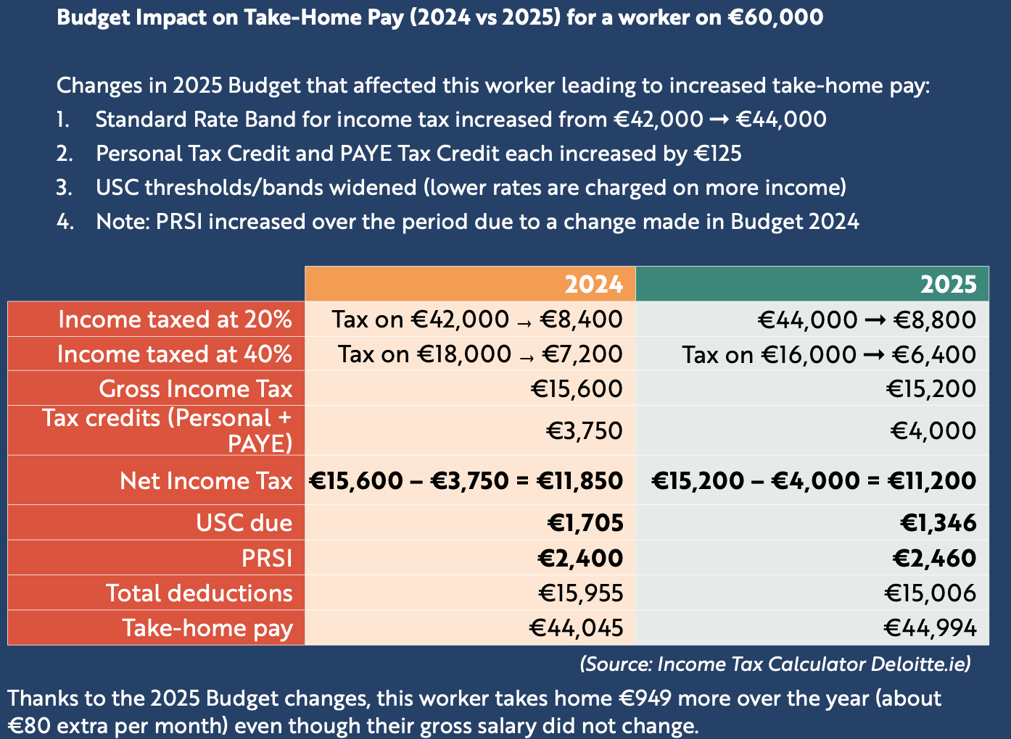
Reflect & Research Pg 366
Back In Business

Slide 55
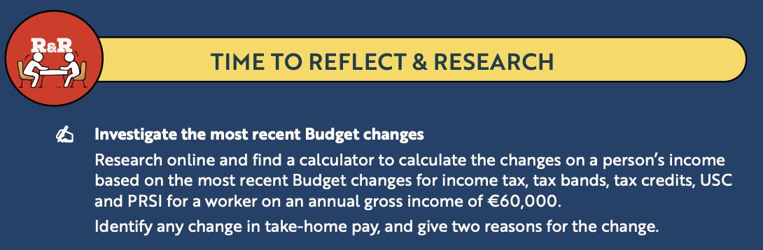
Back In Business
Reflect & Research Pg 366

Slide 56
Back In Business
How The Annual Government Budget Impacts Workers
  Changes To The Minimum Wage
The minimum wage is the lowest hourly rate an employer can legally pay a worker. In 2025, it was €13.50 per hour. The government plans to transition to a national living wage set at 60% of median earnings.
An increase in the minimum or living wage increases take-home pay for low-paid workers
  Changes In Working Entitlements
The Budget may introduce or fund improvements such as additional public holidays, extended paid sick leave, increased parental leave...
These changes enhance working conditions and improve work–life balance for employees.

Slide 57
Back In Business
How The Annual Government Budget Impacts Workers
4. Changes to VAT Rates
VAT is a tax added to goods and services. If the government lowers VAT in sectors such as hospitality or tourism, prices may fall and demand may increase.
Lower VAT can stimulate business activity and potentially create additional job opportunities.
5. Changes to Business Supports
The Budget may increase funding for grants through agencies such as the Local Enterprise Office or Enterprise Ireland, encouraging firms to expand and hire staff.

Slide 58

Back In Business
How The Annual Government Budget Impacts Workers
6. Changes to Training and Upskilling
The government may allocate funding to apprenticeships, adult education and programmes such as Skillnet Ireland to improve workforce skills.
Investment in training improves employability, career progression and long-term job security.

Slide 59
Suggested Activities for LO 19.5
Sample Papers
HL2 Q1 (a): Explain one potential impact of the minimum wage increase on The Local Table.
OL2 Q4 (b): Advise the staff member on how the following changes may impact their net pay. Give a reason for your answer: Increase in personal tax credits; Increase in USC rate
Activity Book Qs
HL Q5
OL Q7

Slide 60
Learning Outcome 19.6
19.6 Appreciate the importance of making informed decisions as an employee and use this understanding to discuss workplace-related stories in the news and media.
Back In Business

Slide 61
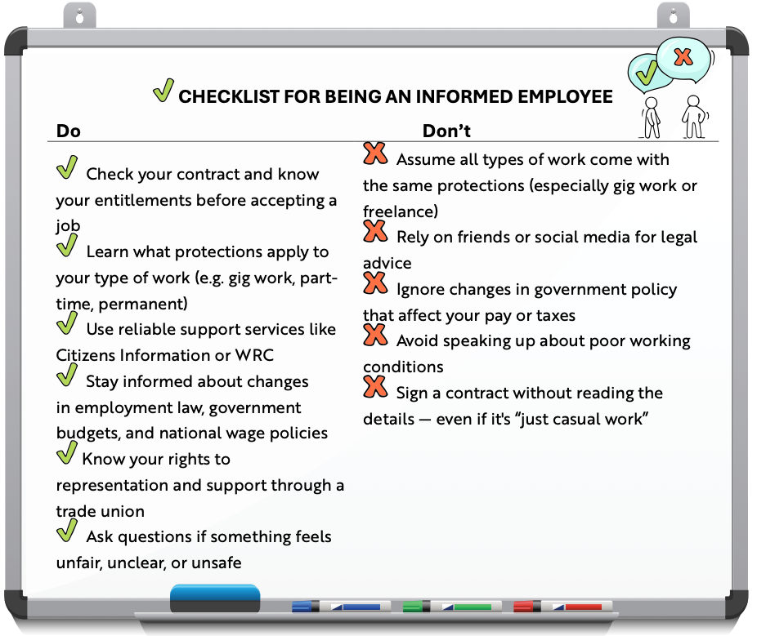
Back In Business

Slide 62
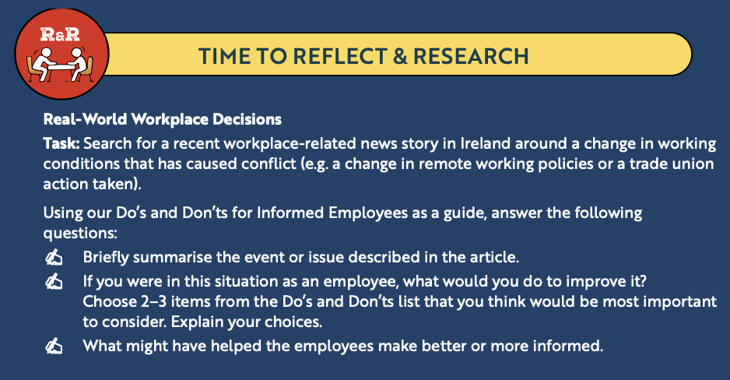
Back In Business
Reflect & Research Pg 370

Slide 63
Suggested Activities for LO 19.6
Sample Papers
-
-
Activity Book Qs
-
-

