Slide 1

Strand 4
Chapter 17
Making Informed Decisions As A Consumer
Back In Business

Slide 2
Learning Outcomes
17.1 Investigate the rights and responsibilities of consumers using current
relevant consumer legislation.
17.2 Demonstrate how consumer behaviour might be informed by ethical
and sustainability concerns.
17.3 Investigate how digital technology impacts on consumer behaviour.
17.4 Investigate how personal data is protected by European regulation.
17.5 Appreciate the importance of making informed consumer decisions
and use this understanding to discuss consumer-related stories in the
news and media.
Back In Business

Slide 3

Back In Business
Priming activity
What do you know about the CCPC?
Do you have any rights if you buy a second hand car from a garage?
What is the circular economy?
Can businesses keep emailing you if you have unsubscribed from their newsletter?
What are the rights that you know you have if you buy a faulty good?

Slide 4

Back In Business
Starter Activity
Starter
worksheet

Slide 5
Learning Outcome 17.1
17.1 Investigate the rights and responsibilities of consumers using current relevant consumer legislation.
Back In Business

Slide 6

Back In Business
Rights and responsibilities of consumers using current relevant consumer legislation.
The information around rights we will look at in this chapter are:
  CCPC - Competition and Consumer Protection Commission
  The Consumer Rights Act 2022 (Rights when purchasing a product, service, or digital service or content
  The Consumer Protection Act 2007
  The Small Claims Procedure/Court
  The Ombudsman
  Rights when purchasing in the EU versus outside the EU

Slide 7
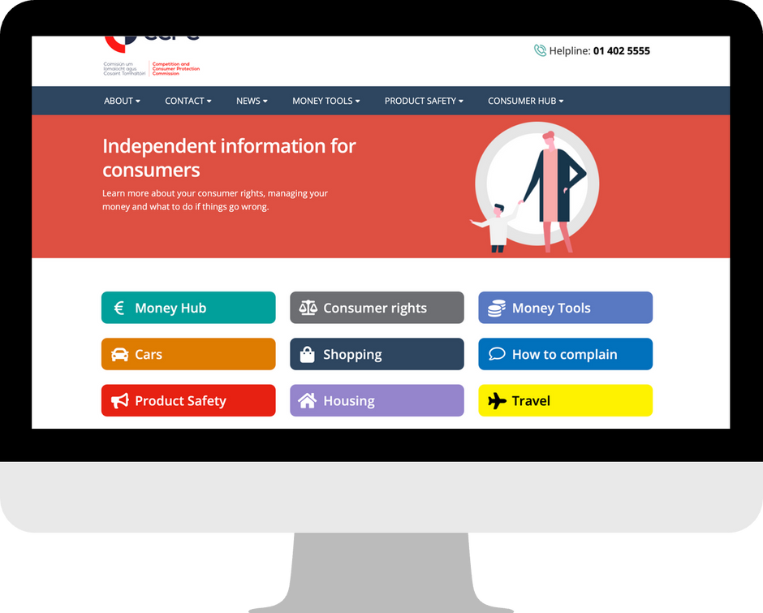
Back In Business
The Competition and Consumer Protection Commission (CCPC)
The CCPC is an independent statutory body that plays a key role in promoting consumer rights and ensuring fair competition in Ireland. It protects consumers by enforcing relevant laws and by helping people make informed decisions in the marketplace.

Slide 8

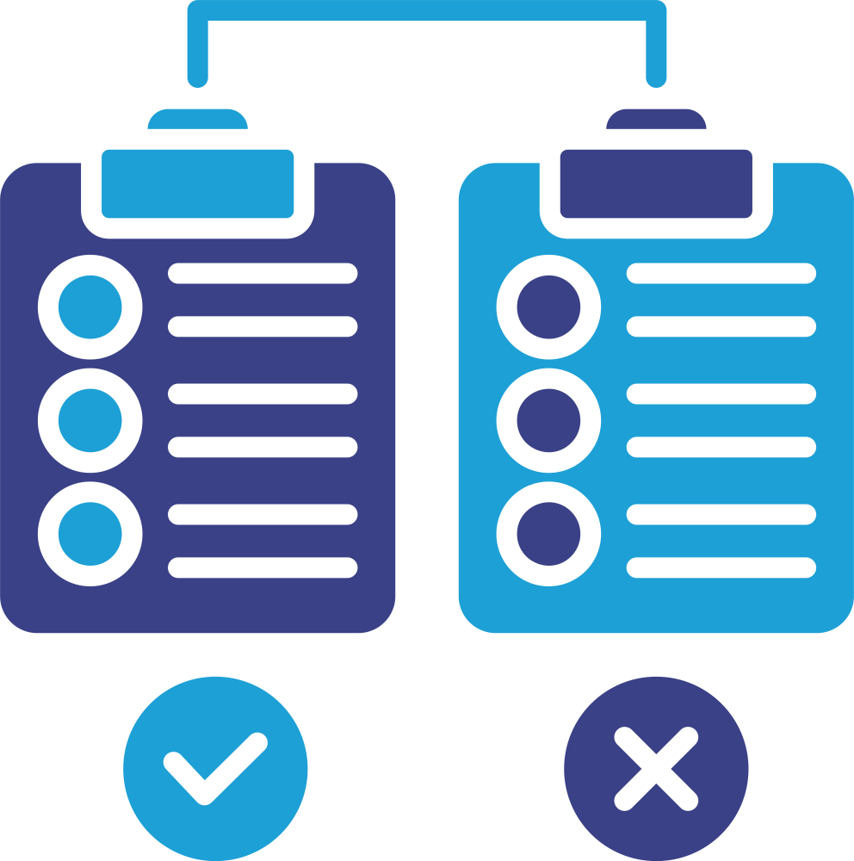
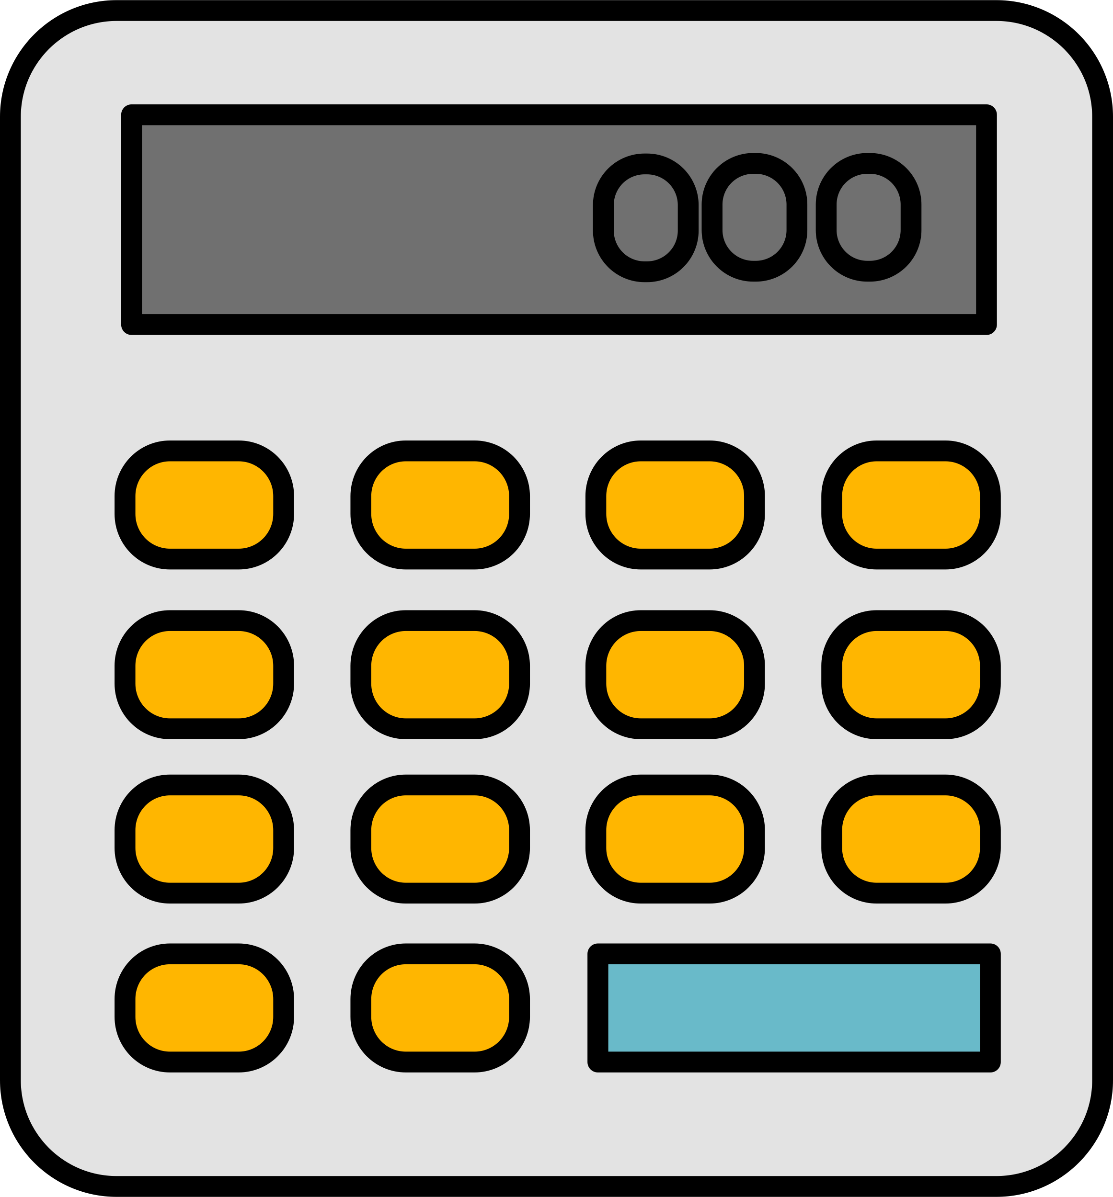

Back In Business
Main Functions Of The CCPC
Advise and Inform Consumers
Provides clear information on ccpc.ie and through their social media to help consumers understand their rights, including simplified explanations of laws such as the Consumer Rights Act 2022.
Educate the Consumer
Offers tools such as financial calculators, mortgage and service comparison tools to help consumers make better financial and purchasing decisions.
Advise the Government
Identifies issues affecting consumers and advises the Government on policy and law changes needed to protect consumers and promote fair competition.

Slide 9


Back In Business
Main Functions Of The CCPC
Enforce Consumer Law
Has legal powers to investigate breaches of consumer legislation, enter premises, and issue on-the-spot fines where laws are broken.
Publish the Consumer Protection List
Publishes a list of businesses that have breached consumer law or have been convicted of criminal offences, helping consumers make informed choices.
Promote Fair Competition
Works to prevent monopolies and anti-competitive behaviour that could lead to higher prices, reduced choice, or lower quality for consumers.

Slide 10
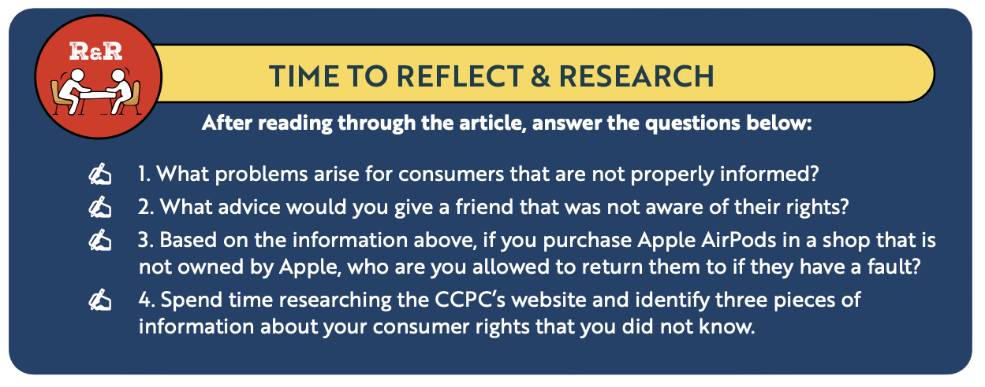
Back In Business
Reflect & Research Pg 307

Slide 11


Back In Business
The Consumer Rights Act 2022
The Consumer Rights Act 2022 modernises and consolidates consumer protection laws in Ireland, strengthening consumer rights and aligning them with European Union rules. It sets out the following rights for consumers...
listen now

Slide 12
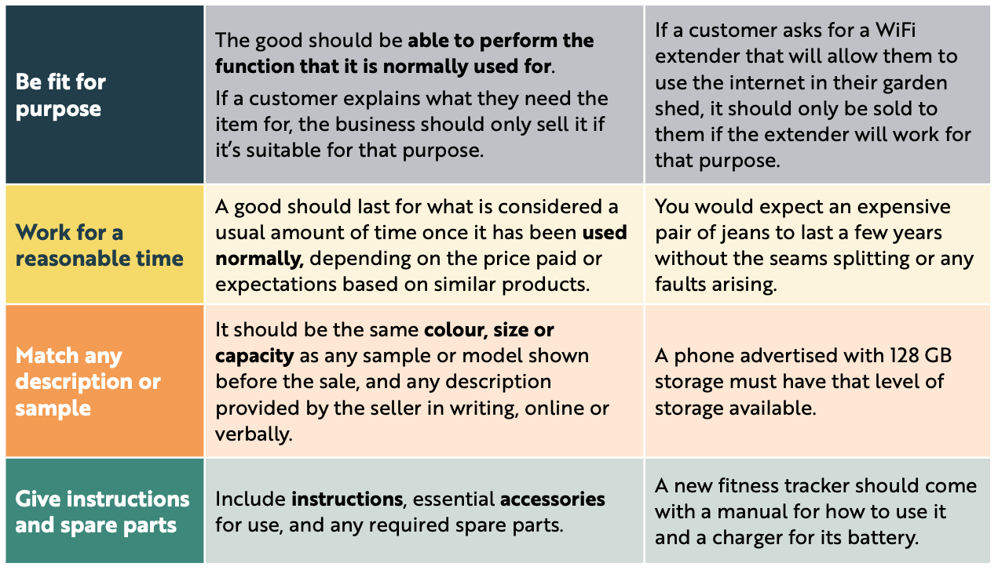
The Consumer Rights Act 2022
Rights For Consumers When Buying Products
These obligations do not apply if the product is not working due to normal wear and tear or accidental damage, or if the consumer did not install a required update needed for the product to continue to work.
A consumer has the same rights when they buy at full price, reduced price (for example, in a sale) or buy a second-hand good (if it is bought from a business).
Back In Business

Slide 13
Back In Business
The Consumer Rights Act 2022
Redress For Faulty Products
If a product is faulty within 30 days of purchase, you are entitled to a refund. The seller must issue the refund within 14 days of receiving the returned item.
If a fault appears after 30 days, you are normally entitled to a free repair or replacement within a reasonable time and without major inconvenience. If the fault is serious, the repair or replacement did not work, isn’t offered, or is too costly, you can request a full or partial refund.
If a fault appears within the first 12 months, it’s assumed the product was faulty at the time of purchase unless the seller can prove otherwise (burden of proof for fault is on the retailer).

Slide 14
Back In Business
The Consumer Rights Act 2022
Right To Cancel A Distance Contract
When purchasing an item online, over the phone, by mail order or on your doorstep (all known as distance contracts), you have the right to cancel your order within 14 days of receiving the good. You do not need a reason to ask for a refund. This is because you would not have the opportunity to inspect
the product before it was purchased.

Slide 15
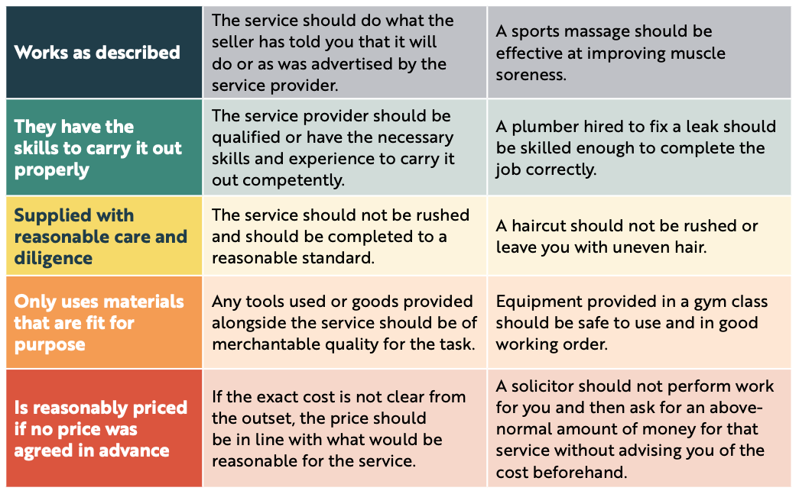
Back In Business
The Consumer Rights Act 2022
Rights For Consumers When Buying Services
Under this law, a seller must provide their name, address and phone number, as well as all the details of what is included in the service if it is not clear.
They should also show the total price, including VAT, or how the price will be calculated and if any additional charges will apply.

Slide 16
Back In Business
The Consumer Rights Act 2022
Redress For Problems With Services
No supply of service
If a service is not provided at all, or not delivered on the agreed date, the consumer can cancel the contract and receive a refund.
Problem with a service
If a service is not carried out properly, the consumer may be entitled to a refund or a price reduction.
Additional damage caused
If a service causes financial loss or damage, the consumer may claim compensation (e.g. a plumber causing flooding). Refunds should be issued within 14 days once agreed.
Cooling-off period
Consumers can cancel many services within 14 days of agreeing the contract and receive a refund without giving a reason.

Slide 17
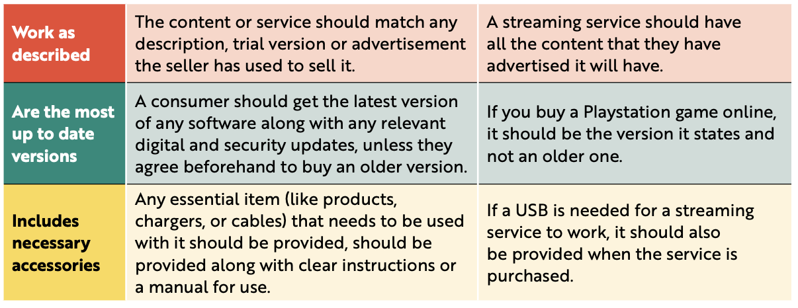


Back In Business
The Consumer Rights Act 2022
Rights Of Consumers Buying Digital Content & Services
Digital Services
Digital services are online services that allow users to create, store, share, or access data.
E.g. Netflix, Spotify, TikTok
Digital Content
Digital content includes downloaded or streamed items, such as digital games, music or video files, e-books, and computer applications.

Slide 18
Back In Business
The Consumer Rights Act 2022
Redress For Problems With Digital Content & Services
Refund: You can get a refund and cancel the contract if the seller did not supply the digital content or
service as agreed.
Price reduction: You can ask for a price reduction or refund for a serious issue or if the service did not
meet the description or trial version fully.

Slide 19




Back In Business
Other Points To Note Around Consumer Rights
Guarantees and warranties → cannot reduce or replace your legal rights, only add to them statutory consumer rights always apply first.
Change of mind (in-store purchases) → There is no automatic legal right to a refund or exchange if the item is not faulty.
Gift vouchers → Consumers do not have to spend the full amount at once, can combine vouchers, and vouchers must have a minimum expiry of 5 years.
Sale items → The same consumer rights apply to sale items as to full-price goods.
Right to Protection Against Unfair Contract Terms → e.g. a business cannot exclude their liability for
causing harm to a consumer due to their negligence.

Slide 20
Back In Business
The Consumer Protection Act 2007
Protects consumers from misleading, false, or aggressive business practices and ensures consumers can make informed purchasing decisions.
It applies to businesses and anyone acting on their behalf, including social media influencers.
Businesses must be transparent, honest, and fair in their dealings with consumers.
It is a criminal offence to make false, misleading, or deceptive claims about goods, services, or prices.

Slide 21
Back In Business
The Consumer Protection Act 2007
Price Display Regulations
Clear and accurate pricing
Prices must be displayed inclusive of charges, fees, and taxes where required.
Standardised price display
The Minister for Enterprise, Trade and Employment can require certain products to show prices in a set format (e.g. food priced per kg or per litre to allow comparison).
Emergency price controls
The Government may control prices in emergency situations.

Slide 22
Back In Business
The Consumer Protection Act 2007
Misleading, false, or aggressive practices
Misleading information
Businesses must not provide false, misleading, or deceptive information about a product, service, price, or availability.
Sales pricing rules
When advertising a sale, businesses must show the prior price → the lowest price charged in the 30 days before the sale.
Aggressive selling practices
Harassment, coercion, undue influence, or pressure selling are prohibited, especially where consumers are vulnerable.

Slide 23
Back In Business
The Consumer Protection Act 2007
Misleading, false, or aggressive practices
Influencer marketing
Paid promotions and gifted items must be clearly labelled. Failure to do so may be misleading by omission.
Hidden or confusing information
Businesses must not hide costs, use unclear terms, or present information in a way that distorts consumer decision-making.

Slide 24
Back In Business
The Consumer Protection Act 2007
Enforcement of the Act (via the CCPC)
Compliance notices
The CCPC can issue a written notice requiring a trader to stop or fix a breach of consumer law.
On-the-spot fines
The CCPC can issue fixed payment notices of €300, payable within 28 days.
Consumer Protection List
The CCPC publishes a list of traders who:
  received compliance notices
  were fined
  were convicted of criminal offences
This helps consumers make informed choices.

Slide 25
Back In Business
How To Enforce Your Consumer Rights
Direct Resolution
The consumer contacts the retailer or service provider directly to resolve the issue. This is usually the quickest and cheapest option. They can refer to their legal rights and provide evidence where needed to support their case (receipts, photos of fault).
Alternative Dispute Resolution
If direct resolution fails, an independent third party helps the consumer and business resolve the dispute without going to court. It is usually quicker, cheaper, and less stressful than legal action.

Slide 26
Back In Business
How To Enforce Your Consumer Rights
Small Claims Procedure
1. The types of consumer claims dealt with include: Claims about faulty goods or poor workmanship, Goods bought for private use from a business, Claims made about minor damage to your property, Claims from a business against another business for goods or services purchased.
2. Affordable for the consumer: A fee for a hearing in the Small Claims Court is just €25.
3. No need for a solicitor: The consumer does not have to hire a solicitor. This limits the legal costs and is convenient.
4. Limited level of compensation available: The Court can award up to the value of €2,000.
5. Convenience and speed of hearing: The seller is given two weeks to respond to a c!aim, otherwise a court date is set in the District Court.

Slide 27
Back In Business
How To Enforce Your Consumer Rights
Ombudsman
Ombudsmen exist to ensure fairness, accountability, and transparency in public services.
They act as independent watchdogs, investigating complaints from individuals who feel they have been treated unfairly by government bodies or other publicly funded organisations.

Slide 28
Back In Business
How To Enforce Your Consumer Rights
Ombudsman
📌 Being a Last Resort: Only intervenes if all other complaint procedures have been exhausted.
📌 Preliminary Investigation: Gathers relevant information from the public service body and may
conduct informal interviews.
📌 Formal Investigation: In a formal investigation, the Ombudsman will draft a statement of
complaint in consultation with the claimant. The Ombudsman may demand any information,
files or documents to help them carry out the investigation. The Ombudsman provides a final
decision at the end and must inform the claimant.
📌 Recommendations: The Ombudsman can only make recommendations. Their decisions are not legally binding.

Slide 29
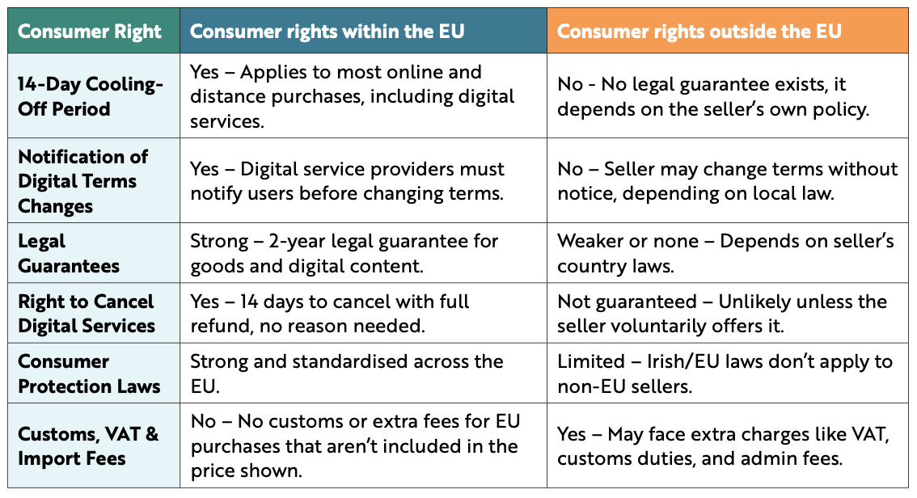
Back In Business
Shopping In The EU Versus Non-EU Countries

Slide 30
Back In Business
Shopping In The EU Versus Non-EU Countries
European Small Claims Procedure
A legal process that helps consumers in Ireland resolve cross-border disputes in EU member states with claims up to the value of €5,000, without needing to attend court in another EU country. It is a simple, low-cost process (€25 fee) that gives Irish consumers access to enforceable legal remedies across borders within the EU when they haven’t been able to resolve their dispute.

Slide 31
Back In Business
Responsibilities Of Consumers
Be informed
Consumers should research before buying and understand their rights and the terms that apply.
Eg Check the CCPC website before returning a faulty item.
Keep records
Consumers should keep receipts, contracts, and warranties in case they need proof of purchase.
E.g. Storing receipts in one place at home or digitally.

Slide 32

Back In Business
Responsibilities Of Consumers
Use products correctly
Products must be used as intended and according to instructions when making a complaint.
E.g. not overloading a washing machine causing it to break, and then seeking a refund for a faulty good
Choose ethical and sustainable options
Consumers should try to reduce waste and support ethical and sustainable brands.
E.g. Buying Fairtrade products or choosing brands such as Tony’s Chocolonely.

Slide 33
Suggested Activities for LO 17.1
Sample Papers
OL1 Q2 (e) (ii): When accessing digital services, consumers have a number of rights. (T/F): EU digital service providers must notify consumers before changing their terms of service; EU consumers have a 14-day cooling-off period, to cancel a service without reason, Consumers have more legal protections when purchasing from a non-EU retailer compared to buying from within the EU.
OL2 Q5 (b): (i) Based on current consumer legislation, explain two forms of redress to remedy this situation. (ii) Do you have the same consumer rights when you purchase items from outside the EU?
Activity Book Qs
HL Q1, BW Q1
OL Q1, Q2

Slide 34
Learning Outcome 17.2
17.2 Demonstrate how consumer behaviour might be informed by ethical and sustainability concerns.
Back In Business

Slide 35
Back In Business
Ethics & Sustainability
Consumers today are more aware of how their choices affect people, the planet, and future generations. Ethical and sustainable consumer concerns are based around making decisions that are fair, responsible, and environmentally friendly. This can influence what people buy, where they buy it, and how they dispose of it afterwards.

Slide 36


Back In Business
Ethical Concerns That Inform Consumer Behaviour
Fair treatment of workers
Consumers may consider how workers are treated when buying clothing, food, or tech products, especially from fast fashion or online retailers.
Example: Choosing Fairtrade or ethically sourced products and checking if brands publish information on working conditions.
Animal welfare
Ethical concerns arise when buying cosmetics, food, or clothing made from animal products.
Example: Choosing cruelty-free or vegan products, such as those with the Leaping Bunny logo.

Slide 37


Back In Business
Ethical Concerns That Inform Consumer Behaviour
Data protection and online privacy
Consumers may be concerned about how their personal data is collected and used when shopping online.
Example: Reading privacy policies, limiting personal data shared, and using trusted platforms.
Supporting local businesses
Consumers may consider the impact of buying imported goods on local jobs and communities.
Example: Choosing Irish businesses, even if prices are slightly higher, to support local employment and reduce environmental impact.

Slide 38
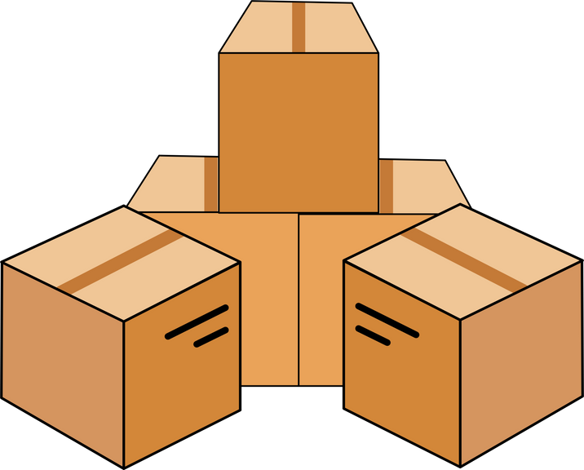

Back In Business
Sustainability Concerns That Inform Consumer Behaviour
Packaging waste
Consumers may consider the amount and type of packaging used when buying products.
Example: Choosing products with recyclable or minimal packaging.
Carbon footprint and transport
Sustainability concerns arise from long-distance transport and high emissions.
Example: Buying locally produced goods to reduce transport emissions.

Slide 39
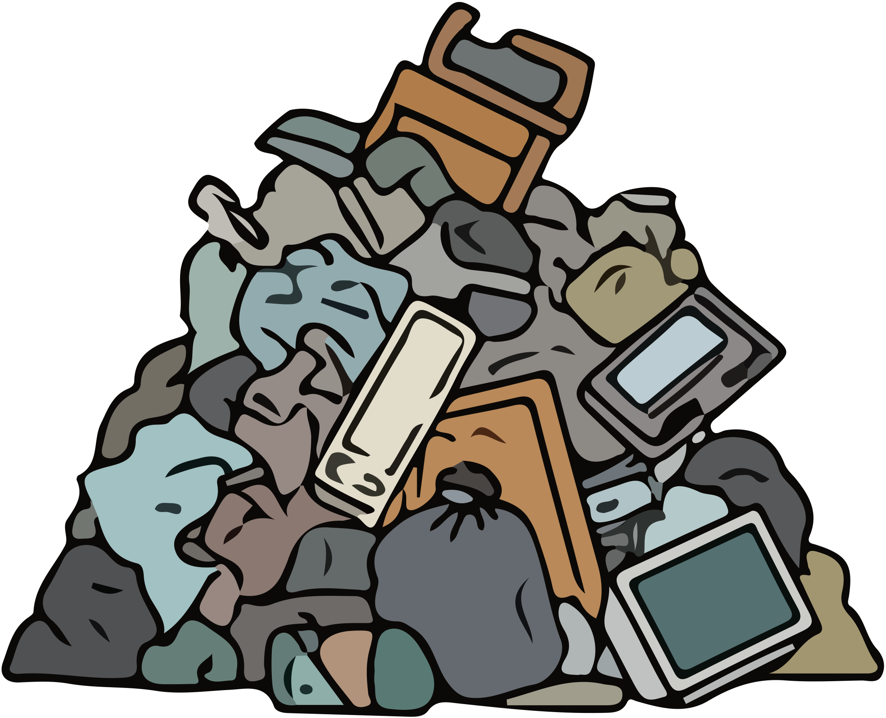

Back In Business
Sustainability Concerns That Inform Consumer Behaviour
Overproduction and waste
Consumers may be concerned about goods being produced in excess and quickly discarded.
Example: Avoiding fast fashion and buying durable, long-lasting products.
Energy efficiency and resource use
Sustainability concerns exist when products use excessive energy or resources.
Example: Choosing energy-efficient appliances or LED lighting.

Slide 40
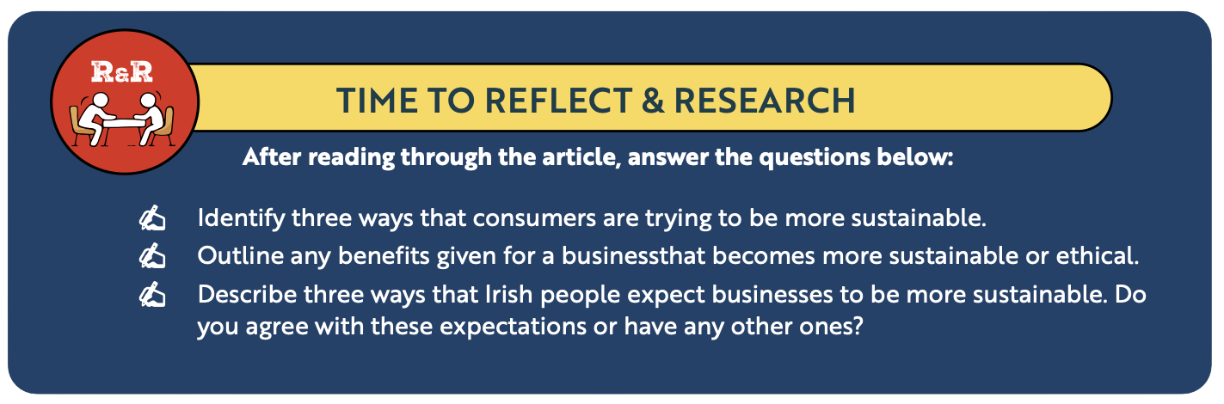
Back In Business
Reflect & Research Pg 316

Slide 41
Back In Business
The Consequences Of Participation In The Shadow Economy For The Consumer, The Business, And The Economy
The shadow economy includes all transactions that take place outside the formal economy and go unrecorded by Revenue. These activities are not declared for tax or regulatory purposes, meaning the state has no record of them. The shadow economy is unregu!ated and may involve illegal or semi-legal behaviour, such as: tax evasion, undeclared wages, or the sale of counterfeit or illegal goods (e.g. dodgy boxes).

Slide 42
Back In Business
The Impact Of Shadow Economy Participation On Different Stakeholders
Stakeholder | Impact of Shadow Economy Participation
Consumers | Goods may be cheaper, but are often unregulated, unsafe, or low quality. Consumers have no legal protection or right to a refund if something goes wrong.
Businesses | Legitimate businesses are undercut by illegal traders, making it harder to compete fairly. Ethical firms may lose sales despite following the law.
Government | Loss of tax revenue from VAT, income tax, and corporation tax due to illegal trading. Higher government spending on inspections, enforcement, and policing of illegal activity.

Slide 43
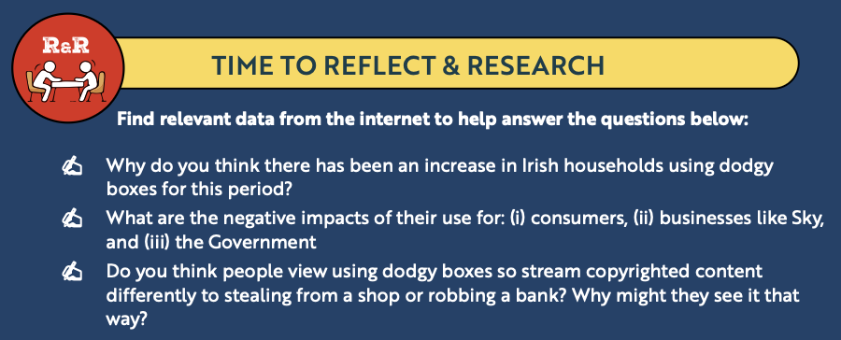
Back In Business
Reflect & Research Pg 317

Slide 44
Back In Business
How Consumers Contribute To The Circular Economy

Slide 45
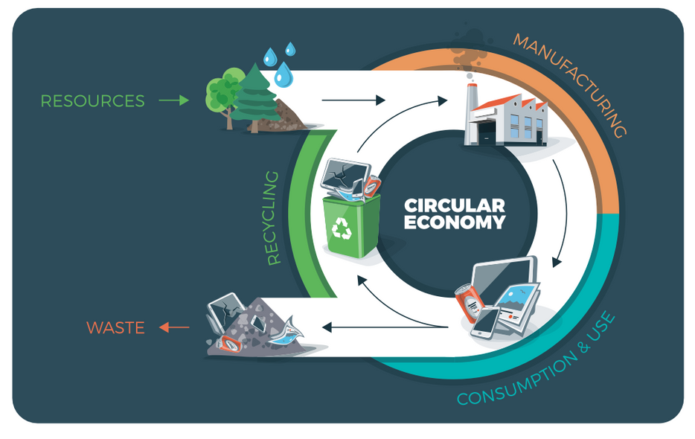
Back In Business
How Consumers Contribute To The Circular Economy
The Circular Economy is a model of production and consumption which extends the life cycle of products, reduces waste, and creates further value. A circular economy model focuses on encouraging re-using, recycling and re-
purposing items, or reducing the waste associated with production and consumption. The aim is to move away from single use items and the idea of buying items, using them once and then throwing them away.

Slide 46
Back In Business
Consumers Can Play A Key Role In The Circular Economy
  Buying second-hand → extends the life of products and reduces waste sent to landfill.
  Recycling products → allows materials to be repurposed or reused, reducing the need for new raw materials.
  Improving consumption habits → reduces unnecessary waste, packaging, and single-use items.
  Choosing sustainable brands → encourages ethical production, fair pay, and environmentally friendly practices.

Slide 47
Back In Business
Consumers Can Play A Key Role In The Circular Economy
Action | Electronics | Clothing
Buying second-hand | Purchasing a refurbished phone or laptop instead of buying new | Buying clothes from Depop, Vinted, charity shops, or thrift stores
Recycling products | Returning old phones, batteries, or chargers to WEEE recycling points | Recycling textiles or donating unwanted clothes
Improving habits | Using devices for longer before upgrading | Repairing clothes or avoiding fast fashion, reducing consumption
Choosing sustainable brands | Buying energy-efficient appliances with longer lifespans | Choosing Fairtrade, organic, or ethically produced clothing

Slide 48
Suggested Activities for LO 17.2
Sample Papers
HL2 Q5 (c) (ii): Describe four ways a consumer purchasing food products can actively contribute to the circular economy.
OL1 Q4 (d): (i) Explain the term circular economy. (ii) Describe two ethical concerns of Irish consumers when purchasing from online retailers.
OL2 Q1 (g): Indicate whether each of the following examples would help contribute to the circular economy, by putting a tick in the correct box. Provide a service for customers where they can leave used or end-of-life electrical items at his premises for recycling; Sell energy efficient bulbs, even though they tend to be more expensive; Change his packaging from recyclable cardboard to single- use plastic cartons in order to save money.
OL2 Q2 (a): Fill in the blanks.
Activity Book Qs
HL Q2, Q3. BW Q2
OL Q3, Q4, Q5

Slide 49
Learning Outcome 17.3
17.3 Investigate how digital technology impacts on consumer behaviour.
Back In Business

Slide 50
Back In Business
Positive Impacts On The Consumer From The Development Of Technology
Increased Convenience
Consumers may consider the amount and type of packaging used when buying products.
Example: Choosing products with recyclable or minimal packaging.
Better access to product information
Consumers can compare prices, features, and reviews before making a purchase, leading to more informed decisions.
Example: Comparison tools on websites such as Bonkers.ie or CCPC.ie for broadband, mortgages, and credit cards.
Consumers should make an effort to shop locally and reduce waste, as well as support brands that are ethical in order to ensure suppliers and employees are treated fairly. E.g. Consumers should look for Fairtrade labels on items and where possible choose brands that are proven to be more sustainable and produced ethically like Tony Chocolonely bars.

Slide 51
Back In Business
Positive Impacts On The Consumer From The Development Of Technology
Increased choice of products
Online shopping gives consumers access to a wider range of products from Irish and international sellers.
Example: Retailers offering large product ranges with fast delivery, allowing consumers to find better value.
Others....
Greater price transparency, Access to customer reviews and ratings (Trust Pilot), Improved accessibility (mobility issues or those living in rural areas.)
Consumers should make an effort to shop locally and reduce waste, as well as support brands that are ethical in order to ensure suppliers and employees are treated fairly. E.g. Consumers should look for Fairtrade labels on items and where possible choose brands that are proven to be more sustainable and produced ethically like Tony Chocolonely bars.

Slide 52
Back In Business
Negative Impacts On The Consumer From The Development Of Technology
Impulse Buying and overconsumption
Constant access to shopping apps, targeted advertising, and influencer marketing can lead to unplanned purchases.
Example: Social media platforms allowing direct purchases through influencer posts.
Reduced Social Interactions
As more consumers shop online, physical stores may close, reducing face-to-face interaction in communities.
Example: Shopping centres facing reduced footfall as consumers buy clothing and electronics online.
Consumers should make an effort to shop locally and reduce waste, as well as support brands that are ethical in order to ensure suppliers and employees are treated fairly. E.g. Consumers should look for Fairtrade labels on items and where possible choose brands that are proven to be more sustainable and produced ethically like Tony Chocolonely bars.

Slide 53
Back In Business
Negative Impacts On The Consumer From The Development Of Technology
Increased screen time and digital addiction
24/7 access to digital platforms encourages excessive screen use, which can influence unnecessary spending.
Example: Extended time spent on apps like TikTok or Instagram promoting trends and products.
Others...
Information overload (paradox of choice), greater exposure to scams/fraud, reduced consumer privacy (tracking, cookies..)
Consumers should make an effort to shop locally and reduce waste, as well as support brands that are ethical in order to ensure suppliers and employees are treated fairly. E.g. Consumers should look for Fairtrade labels on items and where possible choose brands that are proven to be more sustainable and produced ethically like Tony Chocolonely bars.

Slide 54
Suggested Activities for LO 17.3
Sample Papers
HL1 Q3 (d): Analyse three ways digital technology can influence consumer behaviour.
HL2 Q3 (e): Evaluate the impact of digital technology on consumer behaviour.
Activity Book Qs
HL Q4. BW Q3
OL Q6

Slide 55
Learning Outcome 17.4
17.4 Investigate how personal data is protected by European regulation.
Back In Business

Slide 56
Back In Business
General Data Protection Regulation (GDPR)
GDPR is an EU regulation that applies across all member states, including Ireland.
It sets out:
  Rights of data subjects (individuals whose data is collected)
  Responsibilities of data controllers (businesses that control personal data)
  The role of the Data Protection Commissioner (DPC) in enforcement

Slide 57
Back In Business
Rights Of Data Subjects
Data Subject
A data subject is the individual to whom the collected personal data belongs.
Personal data refers to anything that can be used to identify an individual, including name, passport number, financial records, address or employment details.
Consumers should make an effort to shop locally and reduce waste, as well as support brands that are ethical in order to ensure suppliers and employees are treated fairly. E.g. Consumers should look for Fairtrade labels on items and where possible choose brands that are proven to be more sustainable and produced ethically like Tony Chocolonely bars.

Slide 58
Back In Business
Rights Of Data Subjects
Right not to be subject to automated decision-making
Important decisions (e.g. creditworthiness or performance ratings) cannot be made solely by automated systems without consent. Individuals have the right to human involvement.
Right to complain
Consumers can complain to the Data Protection Commissioner if a business breaches data protection law.
Right of access, correction, and erasure
Individuals can request a copy of their data, have inaccurate data corrected, or have data erased (right to be forgotten). E.g. A TikTok user can request account and data deletion.
Consumers should make an effort to shop locally and reduce waste, as well as support brands that are ethical in order to ensure suppliers and employees are treated fairly. E.g. Consumers should look for Fairtrade labels on items and where possible choose brands that are proven to be more sustainable and produced ethically like Tony Chocolonely bars.

Slide 59
Back In Business
Responsibilities Of Data Controllers
Report data breaches
Businesses must notify the DPC of a personal data breach within 72 hours.
Example: A bank must inform the DPC and affected customers if customer data is hacked.
Keep data safe and secure
Businesses must protect personal data using appropriate security measures.
Example: Encryption and restricted access for patient records in healthcare organisations.
Consumers should make an effort to shop locally and reduce waste, as well as support brands that are ethical in order to ensure suppliers and employees are treated fairly. E.g. Consumers should look for Fairtrade labels on items and where possible choose brands that are proven to be more sustainable and produced ethically like Tony Chocolonely bars.
Consumers should make an effort to shop locally and reduce waste, as well as support brands that are ethical in order to ensure suppliers and employees are treated fairly. E.g. Consumers should look for Fairtrade labels on items and where possible choose brands that are proven to be more sustainable and produced ethically like Tony Chocolonely bars.

Slide 60
Back In Business
Functions Of The Data Protection Commissioner (DPC)
Investigates complaints → Examines complaints from individuals and can issue enforcement notices where breaches occur.
Informs people of their rights → Promotes awareness of data protection rights through guidance and public information.
Conducts investigations → Can investigate organisations even without a complaint.
Has investigated companies such as Meta, Google, Apple, WhatsApp, and LinkedIn.
Promotes compliance → Publishes guidelines and works with organisations to ensure GDPR compliance.
Identifies risks → Advises organisations on identifying risks to personal data and best practice to reduce them.
Consumers should make an effort to shop locally and reduce waste, as well as support brands that are ethical in order to ensure suppliers and employees are treated fairly. E.g. Consumers should look for Fairtrade labels on items and where possible choose brands that are proven to be more sustainable and produced ethically like Tony Chocolonely bars.

Slide 61
Back In Business
Evaluation Of The Data Protection Commissioner (DPC)
Strong penalties for non-compliance
Businesses can face fines of up to €20 million or 4% of global annual turnover, whichever is higher.
Real enforcement impact
In 2023, the Irish DPC fined Meta €1.2 billion for unlawful transfers of EU user data to the US.
This should incentivise businesses to control data correctly and ensure data subjects are able to have their rights.
Consumers should make an effort to shop locally and reduce waste, as well as support brands that are ethical in order to ensure suppliers and employees are treated fairly. E.g. Consumers should look for Fairtrade labels on items and where possible choose brands that are proven to be more sustainable and produced ethically like Tony Chocolonely bars.

Slide 62
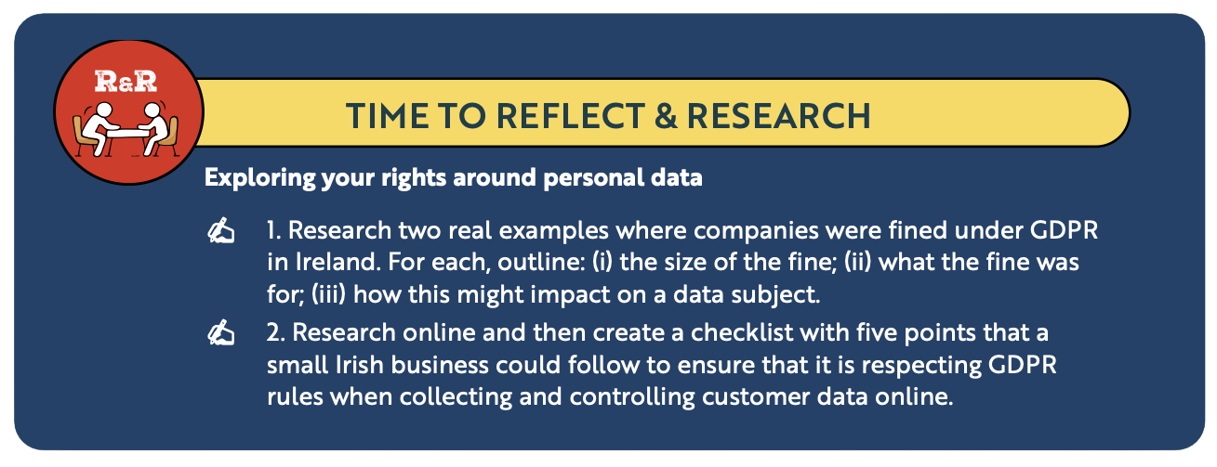
Back In Business
Reflect & Research Pg 321

Slide 63
Suggested Activities for LO 17.4
Sample Papers
OL1 Q1 (5) (f): Based on current EU law, outline two rights consumers have in relation to protection of their personal data.
Activity Book Qs
HL Q5. BW Q4
OL Q7

Slide 64
Learning Outcome 17.5
17.5 Appreciate the importance of making informed consumer decisions and use this understanding to discuss consumer-related stories in the news and media.
Back In Business

Slide 65

Back In Business
Informed Consumer Decisions
Being an informed consumer means that you have the knowledge and understanding of the impact of your decisions. An informed consumer will develop the skills to make choices in their best interest around factors like price, value, quality and ethical considerations.
Consumers should make an effort to shop locally and reduce waste, as well as support brands that are ethical in order to ensure suppliers and employees are treated fairly. E.g. Consumers should look for Fairtrade labels on items and where possible choose brands that are proven to be more sustainable and produced ethically like Tony Chocolonely bars.

Slide 66
Back In Business
The Importance Of Making Informed Decisions
Improves financial wellbeing
Comparing prices, quality, and long-term costs helps consumers avoid unnecessary spending.
Example: Comparing total mortgage repayments before choosing a lender.
Improves safety
Buying from legitimate and certified providers reduces the risk of unsafe or faulty products.
Example: Using a qualified professional to service a gas boiler.
Consumers should make an effort to shop locally and reduce waste, as well as support brands that are ethical in order to ensure suppliers and employees are treated fairly. E.g. Consumers should look for Fairtrade labels on items and where possible choose brands that are proven to be more sustainable and produced ethically like Tony Chocolonely bars.

Slide 67
Back In Business
The Importance Of Making Informed Decisions
Improves legal protection
Knowing consumer rights increases the chance of receiving a refund, repair, or replacement.
Example: Buying from registered businesses rather than the shadow economy.
Positive social and environmental impact
Informed consumers can support ethical brands and reduce environmental harm.
Example: Choosing Fairtrade or locally produced goods to lower carbon impact.
Consumers should make an effort to shop locally and reduce waste, as well as support brands that are ethical in order to ensure suppliers and employees are treated fairly. E.g. Consumers should look for Fairtrade labels on items and where possible choose brands that are proven to be more sustainable and produced ethically like Tony Chocolonely bars.

Slide 68
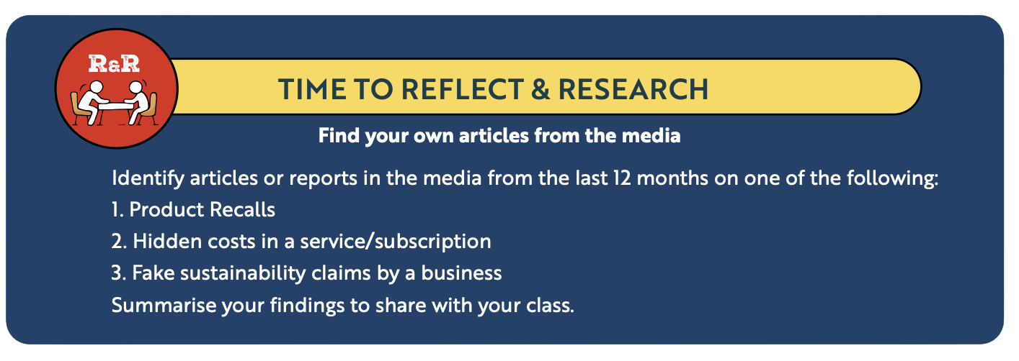
Back In Business
Reflect & Research Pg 322

Slide 69
Suggested Activities for LO 17.5
Sample Papers
-
-
Activity Book Qs
-
-

