Slide 1

Strand 3
Chapter 16
The Rationale For Planning
Back In Business

Slide 2
Learning Outcomes (a)
16.1 Outline the internal and external changes that organisations encounter through their lifetime.
16.2 Analyse the reasons for resistance to change in an organisation.
16.3 Identify the practices that promote innovation and entrepreneurial / intrapreneurial thinking.
16.4 Outline a range of approaches which may help to overcome resistance to change.
16.5 Outline what is meant by strategic p!anning and appreciate the importance of strategic p!anning as an ongoing process.
Back In Business

Slide 3
Learning Outcomes (b)
16.6 Describe the benefit of strategic planning for an organisation.
16.7 Explain the importance of planning for change and discuss how a force-field analysis could support strategically planning for change in an organisation.
16.8 Explain what is meant by contingency planning in terms of crisis management in an organisation.
16.9 Discuss the factors that should be considered when developing a contingency plan.
Back In Business

Slide 4

Back In Business
Priming activity
  Can you think of examples where businesses have adjusted their business strategy?
  What factors do you think forced these changes?
  Why might employees be resistant to proposed changes?
  What are unexpected events businesses had to respond to? How did they adjust?

Slide 5

Back In Business
Starter Activity
Worksheet

Slide 6
Learning Outcome 16.1
16.1 Outline the internal and external changes that organisations encounter through their lifetime.
Back In Business

Slide 7
Back In Business
Internal Changes That Impact An Organisation
Leadership Changes
A new leader can bring a different vision, management style, and set of goals. This can lead to changes in workplace culture, strategy, and how the business operates.
Adoption of technology
Introducing new systems or software helps businesses stay competitive and efficient but often requires staff training or process changes.
Restructuring or downsizing
Economic pressure or market changes can force businesses to merge teams, reduce costs, or lay off staff to remain sustainable. These changes can create uncertainty but may be necessary for long-term success.

Slide 8
Back In Business
Internal Changes That Impact An Organisation
Change in the business model or strategy
Businesses sometimes redesign how they operate to stay relevant or take advantage of new opportunities. This could mean launching new products, entering new markets, or changing their approach to customers.
Cultural or organisational development
Changes in workplace culture can support innovation, flexibility, and employee satisfaction. Many businesses now focus on autonomy and remote working to attract and retain talent.

Slide 9
Back In Business
External Changes That Impact An Organisation
Market trends and consumer expectations
Customer habits and social values change constantly. Many consumers now prefer ethical products or digital-first services instead of traditional in-person options.
Economic trends
Fluctuations in inflation, interest rates, and employment influence spending and business costs. Government decisions such as increasing the minimum wage can also impact profitability.
Legal and regulatory changes
Customer habits and social values change constantly. Many consumers now prefer ethical products or digital-first services instead of traditional in-person options. E.g. GDPR

Slide 10
Back In Business
External Changes That Impact An Organisation
Digital disruption and transformation
Technological advances can change how goods are produced, services are delivered, or customers interact with brands. Businesses often need to invest in new systems or skills to remain competitive.
Competitors’ innovations
When new entrants bring lower prices, better technology, or stronger branding, existing businesses must innovate to stay relevant.

Slide 11
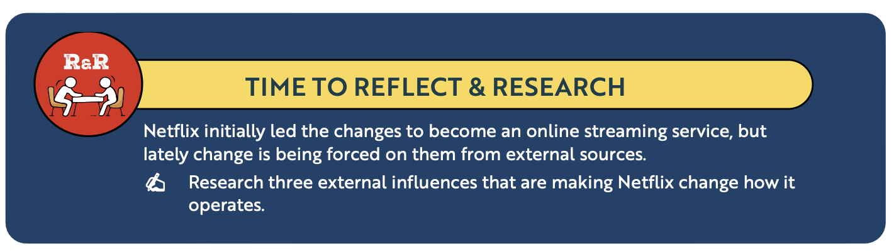
Back In Business
Reflect & Research Pg 288

Slide 12
Suggested Activities for LO 16.1
Sample Papers
-
-
Activity Book Qs
HL Q1
OL Q1

Slide 13
Learning Outcome 16.2
16.2 Analyse the reasons for resistance to change in an organisation.
Back In Business

Slide 14


Back In Business
Reasons For Resistance To Change In An Organisation
Fear Of Job Losses
Fear of failure
When new technology or outsourcing is introduced, employees may worry their roles will be reduced or replaced.
This fear often grows if management does not communicate openly about how the change supports business growth rather than job cuts.
Employees sometimes doubt their ability to adapt to new systems or responsibilities.
Without proper training and reassurance, they may resist change to avoid making mistakes or being judged.

Slide 15


Back In Business
Reasons For Resistance To Change In An Organisation
No clear benefit communicated
Inertia
People are more likely to support change when they understand how it helps them or the organisation.
If management does not explain the benefits clearly, staff may see the change as unnecessary or risky.
Some employees prefer familiar routines and may resist moving away from “the way things have always been done.”
Leaders can overcome inertia by creating a clear vision of why the change matters and how it will improve the workplace.

Slide 16
Suggested Activities for LO 16.2
Sample Papers
HL1 Q5 (d): Analyse four reasons for resistance to change in an organisation.
Activity Book Qs
HL Q2
OL Q2

Slide 17
Learning Outcome 16.3
16.3 Identify the practices that promote innovation and entrepreneurial/intrapreneurial thinking.
Back In Business

Slide 18




Back In Business
Creating An Environment Where New Ideas Are Supported
1. Leadership Culture that Encourages Risk-Taking
Leaders should promote an environment where employees feel safe to take smart risks and learn from mistakes. This builds confidence and helps creative ideas emerge.
2. Provide Training and Resources to Staff
Businesses should invest in time, funding, and skills development so employees can explore new ideas and approaches. Proper support gives staff the tools to be more innovative.
3. Use of Teamwork and Collaboration
Working across departments allows people with different skills and perspectives to share ideas. Collaboration helps spark creativity and strengthens problem-solving.
4. Recognition and Rewards for Innovation
Recognising and rewarding staff for their creative contributions motivates them to keep being innovative.
E.g. give praise, bonuses, or opportunities

Slide 19
Suggested Activities for LO 16.3
Sample Papers
-
-
Activity Book Qs
-
OL Q3

Slide 20
Learning Outcome 16.4
16.4 Outline a range of approaches which may help to overcome resistance to change.
Back In Business

Slide 21
Back In Business
Overcoming Resistance To Change
Lead by Example
Open Communication and Consultation
Leaders should model the behaviour and changes they expect from others. When staff see leadership fully committed, they are more likely to follow.
Explaining why change is happening and involving staff in decisions helps reduce fear. Clear communication makes employees feel informed and valued.

Slide 22
Back In Business
Overcoming Resistance To Change
Training and Resource Support
Employee Empowerment
Providing the right tools, training, and guidance helps employees feel prepared. Support reduces anxiety about new responsibilities or systems.
Giving staff ownership over their role in the change process increases engagement. People are less resistant when they feel they have influence and responsibility.

Slide 23
Back In Business
Overcoming Resistance To Change
Rewarding Staff
Use of Teamwork and Collaboration
Recognising and rewarding employees who embrace change encourages others to participate. Incentives can help build motivation and reinforce positive behaviour.
Team-based approaches help staff support one another during change. Working together reduces isolation and allows people to learn from peers.

Slide 24
Suggested Activities for LO 16.4
Sample Papers
HL2 Q3 (b): Outline two ways companies like JPMorgan Chase & Co can overcome resistance to change.
Activity Book Qs
HL Q2
OL Q4

Slide 25
Learning Outcome 16.5
16.5 Outline what is meant by strategic planning and appreciate the importance of strategic planning as an ongoing process.
Back In Business

Slide 26
LINK
Enterprise Ireland’s current strategic plan is to “Accelerate Sustainable Irish Business” over the next five years

Slide 27
Back In Business
Strategic Planning: What It Means
Strategic Planning
Strategic planning is the ongoing process of setting long-term goals and deciding how the business will achieve them.
It acts as a roadmap that guides the organisation’s direction and helps it prepare for change.
It sets a clear vision and aligns people and resources around shared goals.

Slide 28
Back In Business
Steps Involved In Strategic Planning
1. Define the Vision through the Mission Statement
A mission statement outlines the business’s values, purpose, and long-term ambition.
2. Analyse the Internal and External Environment
Before setting long-term goals, a business needs a clear picture of its strengths, weaknesses, opportunities, and threats.
Tools such as SWOT and STEEPLE help the business understand what is happening inside the organisation and in the wider market.

Slide 29
Back In Business
Steps Involved In Strategic Planning
3. Set the Long-Term Plan
Senior management create the strategic plan by setting long-term goals based on the mission statement.
These goals usually cover a five to ten year period and give direction to the whole organisation.
Strategic objectives should follow the SMART approach so that progress can be tracked and measured.

Slide 30
Back In Business
Steps Involved In Strategic Planning
4. Break Long-Term Plans Into Smaller Chunks - Tactical Plans (1-2 Years)
Tactical plans break the long-term strategic plan into smaller, achievable steps.
They guide departments on what needs to be done in the next one to two years to support the overall strategy.
5. Operational Plans
The strategic plan is then implemented in the day to day running of the business through its operational model or planning.

Slide 31
Back In Business
The Importance Of Strategic Planning As An Ongoing Process
Strategic planning is not a one-off task
It must be reviewed and updated regularly as new information and challenges appear.
This helps the organisation stay flexible and responsive in a changing environment.
Why Strategic Planning Must Be Ongoing
• Regular reviews help track progress and adjust goals when needed.
• Changing customer needs and market conditions require updated plans.
• Reviewing plans improves decision-making and supports continuous improvement.
• Ongoing planning identifies new risks early so the business can adapt.

Slide 32
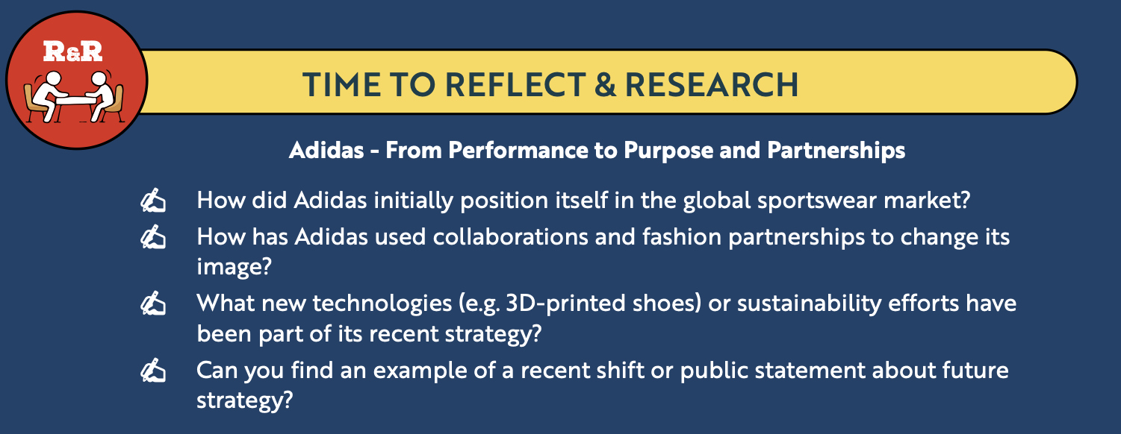
Back In Business
Reflect & Research Pg 294

Slide 33
Suggested Activities for LO 16.5
Sample Papers
-
-
Activity Book Qs
HL Q3
OL Q5

Slide 34
Learning Outcome 16.6
16.6 Describe the benefit of strategic planning for an organisation.
Back In Business

Slide 35

Back In Business
Benefits of Strategic Planning
1. Increased Clarity and Direction
• Gives the business a clear long-term goal.
• Helps leaders and departments make consistent decisions and avoid short-term distractions.
2. Increased Ability to Manage Change
• Allows the organisation to respond to unexpected challenges without losing focus.
• Plans can be reviewed and adjusted when the environment changes.
3. Increased Resource Efficiency
• Helps the business allocate staff, money and time to its most important priorities.
• Reduces wasted effort by aligning resources with long-term goals.
4. Increased Competitive Advantage
• Regular review of strengths, weaknesses, opportunities and threats helps the business stay ahead.
• Supports innovation, differentiation and early identification of opportunities.

Slide 36
Suggested Activities for LO 16.6
Sample Papers
-
-
Activity Book Qs
HL Q3
OL Q5

Slide 37
Learning Outcome 16.7
16.7 Explain the importance of planning for change and discuss how a force-field analysis could support strategically planning for change in an organisation.
Back In Business

Slide 38
Back In Business
The Importance Of Planning For Change
1. Reduces Uncertainty and Risk
2. Improves Decision-Making
• Planning prepares the business for unexpected events.
• Contingency plans help the business continue operating during disruptions.
• Leaders can make clearer decisions when priorities are defined.
• A strategic plan gives direction during periods of change.

Slide 39
Back In Business
The Importance Of Planning For Change
3. Increases Chances of Success
4. Supports Employee Engagement
• Breaking change into steps makes it easier to manage.
• Tactical plans help teams coordinate and track progress.
• Staff are more open to change when they understand the purpose.
• Linking change to the mission statement helps staff see the bigger picture.

Slide 40
Back In Business
Force-Field Analysis
A Force-Field Analysis is an approach used to identify and analyse forces
which drive and inhibit change. Forces can be both internal and external.
LINK

Slide 41


Back In Business
Steps Involved In Conducting A Force-Field Analysis
Step 1: Define the strategic change clearly
A business needs to clearly state the proposed change in strategy, e.g. launching a new product, moving all operations online, moving all staff back to the office from a hybrid working arrangement.

Slide 42

Back In Business
Steps Involved In Conducting A Force-Field Analysis
Step 2: Identify the driving and restraining forces for that change
A business should then list all the driving forces on one side and all the restraining forces on another side to help weigh up their impact on the decision.
Internal forces include the potential impact of any change on employee morale, skills required, and the workplace culture.
External forces include the potential impact proposed changes would have on any laws, technology, or customers expectations/experience.

Slide 43

Back In Business
Steps Involved In Conducting A Force-Field Analysis
Step 3: Assign a score or weight to each force
Assign a weight or score to each force based on how strong the influence is. This is generally done using a scale from 1 (weak force) to 5 (strong force) for each factor, depending on its strength or influence as a force.

Slide 44

Back In Business
Steps Involved In Conducting A Force-Field Analysis
Step 4: Analyse the results
To make an informed decision, a business should evaluate if the driving forces outweigh the restraining forces for the proposed p!an. If restraining forces outweigh driving forces, the business could:
• Try to strengthen or increase some of the driving forces
• Try to reduce or remove the impact of some of the restraining forces
• Delay or cancel the decision or revise the strategy and perform another force-field analysis.

Slide 45
Back In Business
Force-Field Analysis Example
Scenario:
A business is considering a shift away from a hybrid working model and back to a full-time office-based approach to work for their staff.
The business performs a force-field analysis to assist with the decision.
Below are the driving and restraining forces that the business has identified, with weights attached, to help them reach a decision.
TASK: Brainstorm and come up with some potential driving and restraining forces for this decision.

Slide 46
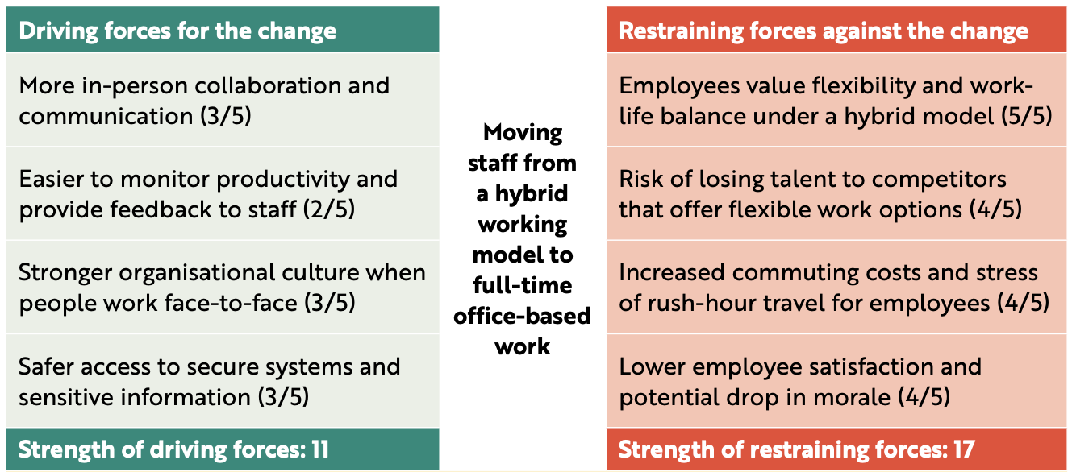
Back In Business
Force-Field Analysis Example

Slide 47
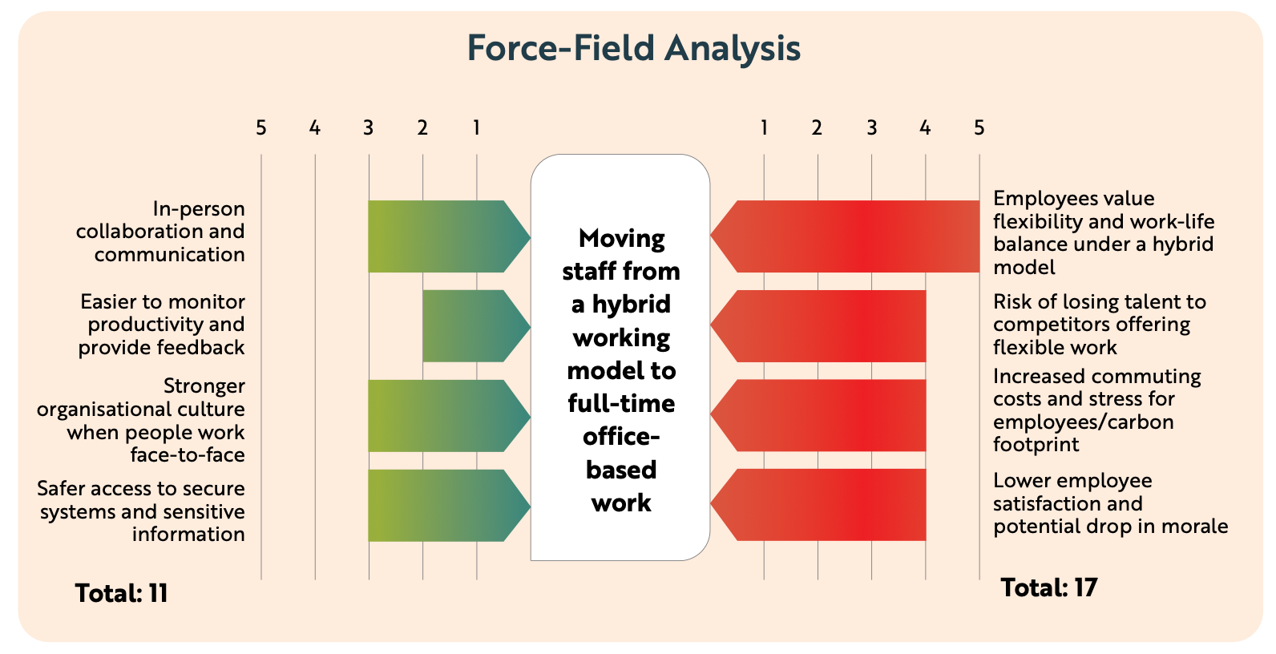
Back In Business
Force-Field Analysis Example Visually

Slide 48
Back In Business
Force-Field Analysis Example
Outcome:
In this case, the strength of the restraining forces (17) clearly outweigh the strength of the driving forces (11). Based on this Force-Field Analysis, a decision to return to full-time office-work may create more problems than benefits for the business, especially around staff satisfaction, retention,
and work-life balance. A business could look at alternative options, such as a three-day week in the office, which may reduce the restraining forces they face in bringing staff back to office-based work.

Slide 49
Suggested Activities for LO 16.7
Sample Papers
HL2 Q1 (d): Use a Force Field Analysis to examine the potential effects of this decision on the business.
OL1 Q1 (c): Using examples from the text, identify two driving forces and two restraining forces relating to the expansion of EverGlow Organics Ltd.
OL2 Q2 (e): Indicate whether each of the following statements is a driving force or a restraining force: Moving to a hybrid working model … (1) may result in employees feeling isolated, (2) may bring about a higher likelihood of confidentiality breaches, (3) may lead to difficulty in monitoring employee productivity, (4) would fulfil an element of the Corporate Wellness Programme
Activity Book Qs
HL Q4

Slide 50
Learning Outcome 16.8
16.8 Explain what is meant by contingency planning in terms of crisis management in an organisation.
Back In Business

Slide 51

Back In Business
Contingency Plan
A contingency plan is a backup plan that an organisation prepares in advance to deal with unexpected events or emergencies that could disrupt business operations.
It outlines the steps a business will take if something goes wrong,
helping to protect staff, customers, finances, and reputation.

Slide 52
Back In Business
The importance of contingency planning for effective crisis management
Businesses operate in uncertain environments. A good contingency plan helps a business to:
📌 Respond quickly in a crisis, reducing panic and confusion.
📌 Protect staff and assets in an emergency so there will be less ongoing disruption.
📌 Maintain operations where possible or restore them quickly.
📌 Minimise damage to finances, brand reputation or supply chains.

Slide 53
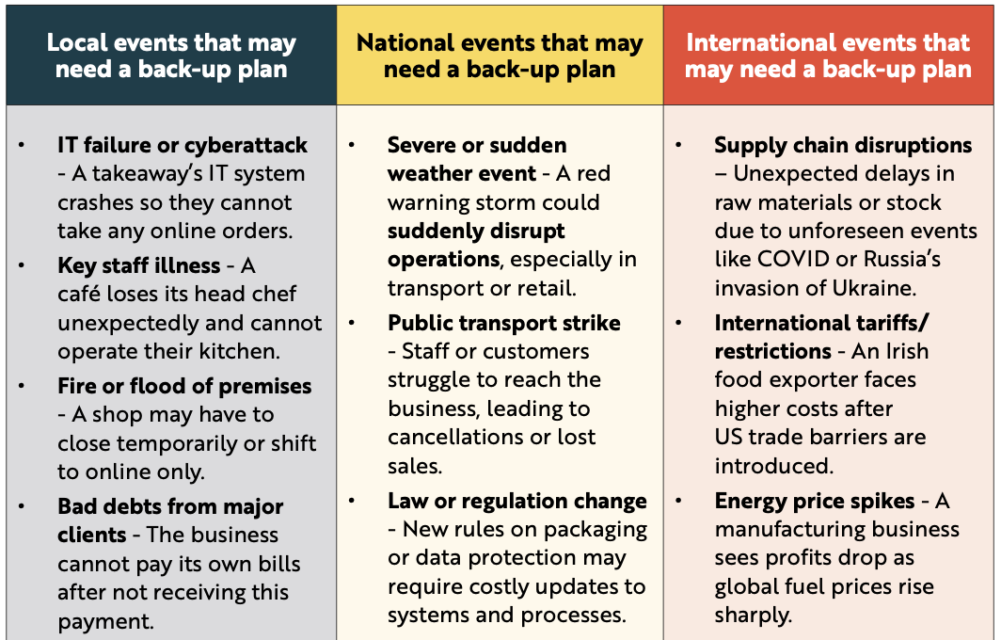
Back In Business
The importance of contingency planning for effective crisis management

Slide 54
Suggested Activities for LO 16.8
Sample Papers
OL2 Q4 (e): Explain the term contingency planning.
Activity Book Qs
HL Q5
OL Q6

Slide 55
Learning Outcome 16.9
16.9 Discuss the factors that should be considered when developing a contingency plan.
Back In Business

Slide 56
Back In Business
Key Factors To Consider When Developing A Contingency Plan
Cost
• Contingency planning may require spending money on training, backup systems or alternative suppliers.
• The business must weigh this cost against the much larger financial damage that could occur if no plan is in place.
• A good contingency plan should show that the cost of preparation is lower than the cost of disruption.

Slide 57
Back In Business
Key Factors To Consider When Developing A Contingency Plan
Timing
• Some risks need an immediate response, while others allow more preparation time.
• A good contingency plan should match the urgency of the threat so the business can act without delay.
• Acting quickly can prevent a small disruption from becoming a major crisis, which reduces overall cost and damage.

Slide 58
Back In Business
Key Factors To Consider When Developing A Contingency Plan
Risk
• Not every risk is equally likely or equally severe, so businesses must prioritise the most serious threats.
• High-impact or high-probability risks should receive the most detailed planning.
• Focusing resources on the biggest risks makes the plan more effective and prevents wasted time on low-impact events.

Slide 59
Back In Business
Key Factors To Consider When Developing A Contingency Plan
Communication
• Clear communication during a crisis reduces confusion and helps the business respond faster.
• The plan should outline who needs to be contacted, how messages will be delivered and who is responsible for updates.
• Strong communication prevents mistakes, protects the business’s reputation and supports a faster recovery.

Slide 60
Suggested Activities for LO 16.9
Sample Papers
OL2 Q4 (f): Discuss one factor that should be considered when developing a contingency plan.
Activity Book Qs
HL Q6
OL Q6

