Slide 1

Strand 3
Chapter 14
Leading And Managing People
Back In Business

Slide 2
Learning Outcomes (a)
14.7 Explain what is meant by human capital management and outline how the organisational environment is a factor in its development.
14.1 Discuss the internal and external factors that impact on workforce planning.
14.2 Outline the key stages in the recruitment process and suggest how organisations might adopt ethical approaches to recruitment.
14.3 Evaluate how digital technologies influence the process of recruitment and selection.
14.4 Investigate the factors that impact on employee motivation.
14.5 Describe what is meant by effective employee appraisal.
Back In Business

Slide 3
Learning Outcomes (b)
14.6 Identify a number of approaches to appraisal and analyse how these approaches might contribute to employee motivation.
14.8 Investigate the different types of training and professional development that may be offered to employees and outline why ongoing training and professional development is an important aspect of human capital management.
14.9 Appreciate the opportunities and challenges associated with working in teams for both employees and employers.
14.10 Outline how employers and employees can work together to create a more sustainable workplace.
Back In Business

Slide 4
Learning Outcomes (c)
14.11 Investigate how digital technology impacts on the workplace.
14.12 Identify the opportunities and challenges associated with remote and blended working arrangements for both employees and employers.
14.13 Analyse the ethical and sustainability issues associated with remote and blended working.
14.14 Outline the importance of corporate wellness* and investigate the impact of corporate wellness on employee motivation and organisational culture.
14.15 Identify the role of leadership in promoting corporate wellness.
Back In Business

Slide 5

Back In Business
Priming activity
1. What makes a workplace a good place to work?
2. Name businesses you would like to work for, and give reasons why.
3. Do you know any businesses that find it hard to keep their staff?
4. What do you think makes it hard for a business to attract staff?

Slide 6

Back In Business
Starter Activity
LINK
WORKSHEET

Slide 7
Learning Outcome 14.7
14.7 Explain what is meant by human capital management (HCM) and outline how the organisational environment is a factor in its development.
NB: This learning outcome appears here intentionally for the flow of the chapter, even though the numbers are out of sync.
Back In Business

Slide 8
Back In Business
Human Capital Management
Human capital management
The strategic process of planning, recruiting, developing, motivating, and
retaining employees to maximise their contribution to the organisation’s
goals while also supporting their personal and professional growth.

Slide 9

Back In Business
How The Organisational Environment Is A Factor In The Development Of Human Capital Management (HCM)
1. Positive Workplace Culture
Openness, trust, and continuous improvement encourage staff engagement in training, collaboration, and appraisal activities.
2. Leadership Support
Visible commitment from leaders provides direction, resources, and motivation for employee growth and wellness initiatives.

Slide 10

Back In Business
How The Organisational Environment Is A Factor In The Development Of Human Capital Management (HCM)
3. Structure and Communication
Open communication across departments ensures employees understand HCM goals and work together effectively.
4. Pro-Innovation Culture
A flexible, tech-friendly environment helps organisations adopt new tools and approaches that enhance HCM impact.

Slide 11
Suggested Activities for LO 14.7
Sample Papers
-
-
Activity Book Qs
HL Q1
OL Q1

Slide 12
Learning Outcome 14.1
14.1 Discuss the internal and external factors that impact on workforce planning
Back In Business

Slide 13
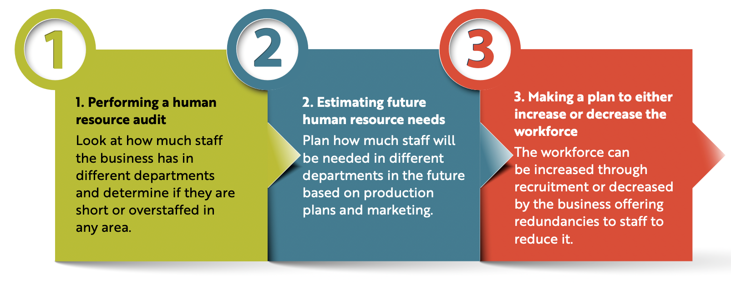
Back In Business
Workforce Planning

Slide 14
Back In Business
Workforce Planning
Implications of being understaffed
Too few employees can reduce quality, cause delays, and frustrate customers.
Implications of being overstaffed
Too many employees increase costs but may help retain skilled staff for future demand.

Slide 15

Back In Business
The Range Of Factors That Impact Workforce Planning In An Organisation
Internal Factors
Corporate Objectives – Business goals shape staffing needs; expansion requires more staff or retraining, while cost-cutting may lead to downsizing.
Staff Turnover – High turnover increases recruitment and training costs; strong motivation and wellness initiatives help retain employees.
Skills and Capabilities – Workforce skill levels guide hiring and training; skills audits identify gaps to decide between upskilling staff or recruiting new talent.

Slide 16
Back In Business
The Range Of Factors That Impact Workforce Planning In An Organisation
External Factors
Labour Market Conditions – Skill shortages may require higher pay, more training, or recruiting from a wider area.
Economic Indicators and Trends – Inflation, interest rates, and recessions can reduce demand, leading businesses to cut staff or delay hiring.
Technological Advancements – Automation and AI shift skill needs, reducing some roles while creating new technical opportunities.
Government Decisions – Employment laws, wage changes, and immigration policies influence labour costs, productivity, and workforce availability.

Slide 17
Suggested Activities for LO 14.1
Sample Papers
-
-
Activity Book Qs
HL Q2
OL Q2

Slide 18
Learning Outcome 14.2
14.2 Outline the key stages in the recruitment process and suggest how organisations might adopt ethical approaches to recruitment.
Back In Business

Slide 19

Back In Business
Workforce Planning
When a business has decided to recruit a worker, they may look to fill the role from within (internal recruitment) or by hiring a worker from outside of their organisation (external recruitment). Each has its benefits and drawbacks.

Slide 20

Back In Business
Key Stages In Recruitment
1. Identification
2. Application
3. Selection

Slide 21
Back In Business
The Key Stages In Recruitment
1. Identification
Assessing workforce needs
Before advertising, businesses analyse whether the vacancy should be filled internally or externally, considering workforce planning, future skill needs, and cost.
Drawing up a job description
A job description outlines the purpose of the role, the key responsibilities, who the employee will report to, and where the job fits within the organisational structure. It focuses on the role itself, not the person.
Creating a person specification
A person specification details the qualifications, skills, experience, and personal qualities a candidate should possess.

Slide 22
Back In Business
The Key Stages In Recruitment
2. Application
Advertising the vacancy: The job can be advertised:
📌 Internally (through noticeboards, emails, intranet)
📌 Externally (using recruitment websites, social media, agencies, or newspaper advertisements)
Receiving and reviewing applications: Candidates submit their CVs or application forms showing how they meet the requirements set out in the job description and person specification.
Shortlisting of candidates: Applications are screened based on their CVs and application forms, and the strongest candidates are shortlisted for selection.

Slide 23
Back In Business
The Key Stages In Recruitment
3. Selection
Interviewing and assessing candidates: Shortlisted candidates attend interviews, often with more than one interviewer to ensure fairness and reduce bias. Businesses may also use presentations, aptitude tests or simulations.
Offering the role and informing candidates: The best candidate is offered the position. Unsuccessful applicants are informed, respectfully, that they were unsuccessful to maintain a positive perception of the business, and some may be earmarked to contact for future roles.

Slide 24
Back In Business
How Organisations Might Adopt Ethical Approaches To Recruitment
Equality
All candidates must be treated fairly and assessed on merit. Discrimination based on factors like gender, age, race, or religion is prohibited under the Employment Equality Acts 1998–2015.
Diversity
Ethical recruitment encourages a wide range of applicants, promoting varied backgrounds and perspectives through inclusive advertising and fair shortlisting (guided by IHREC).
Inclusion
Employers must ensure all candidates feel welcome and supported, making reasonable adjustments under the Disability Act 2005 and IHREC guidance to provide equal access during recruitment.

Slide 25
Suggested Activities for LO 14.2
Sample Papers
-
-
Activity Book Qs
HL Q3
OL Q3

Slide 26
Learning Outcome 14.3
14.3 Evaluate how digital technologies influence the process of recruitment and selection.
Back In Business

Slide 27

Back In Business
Evaluate how digital technologies influence the process of recruitment and selection.
Identification
Digital platforms such as LinkedIn and IrishJobs.ie let businesses advertise roles instantly, reach a large pool of candidates, and build talent pipelines. Workforce planning tools help identify future staffing needs more accurately.
Evaluation: This makes recruitment faster and more targeted but can be costly, and competition for top candidates online is high.

Slide 28

Back In Business
Evaluate how digital technologies influence the process of recruitment and selection.
Application
Most recruitment now happens online, with tools like Applicant Tracking Systems (ATS) (e.g. Greenhouse) scanning CVs for keywords and shortlisting applicants automatically.
Evaluation: This saves time and money but risks filtering out strong candidates who use different wording, and businesses must ensure fairness, human oversight, and GDPR compliance.

Slide 29

Back In Business
Evaluate how digital technologies influence the process of recruitment and selection.
Selection
Video interviews and digital assessments through Zoom, Microsoft Teams, or HireVue help businesses assess candidates efficiently across locations.
Evaluation: While this improves access and reduces travel costs, it may overlook soft skills or disadvantage candidates who are less comfortable with technology.

Slide 30
Suggested Activities for LO 14.3
Sample Papers
HL1 Q4 (c): Evaluate how digital technologies can influence the recruitment and selection process for businesses.
Activity Book Qs
HL Q4
OL Q3

Slide 31
Learning Outcome 14.4
14.4 Investigate the factors that impact on employee motivation.
Back In Business

Slide 32
Back In Business
Employee Motivation
Employees are motivated by different factors at different times, depending on their circumstances. Managers need to understand what drives each worker to perform at their best.
Maslow’s Hierarchy of Needs provides a useful way to examine the various needs that influence motivation and how businesses can meet these needs to encourage performance.

Slide 33
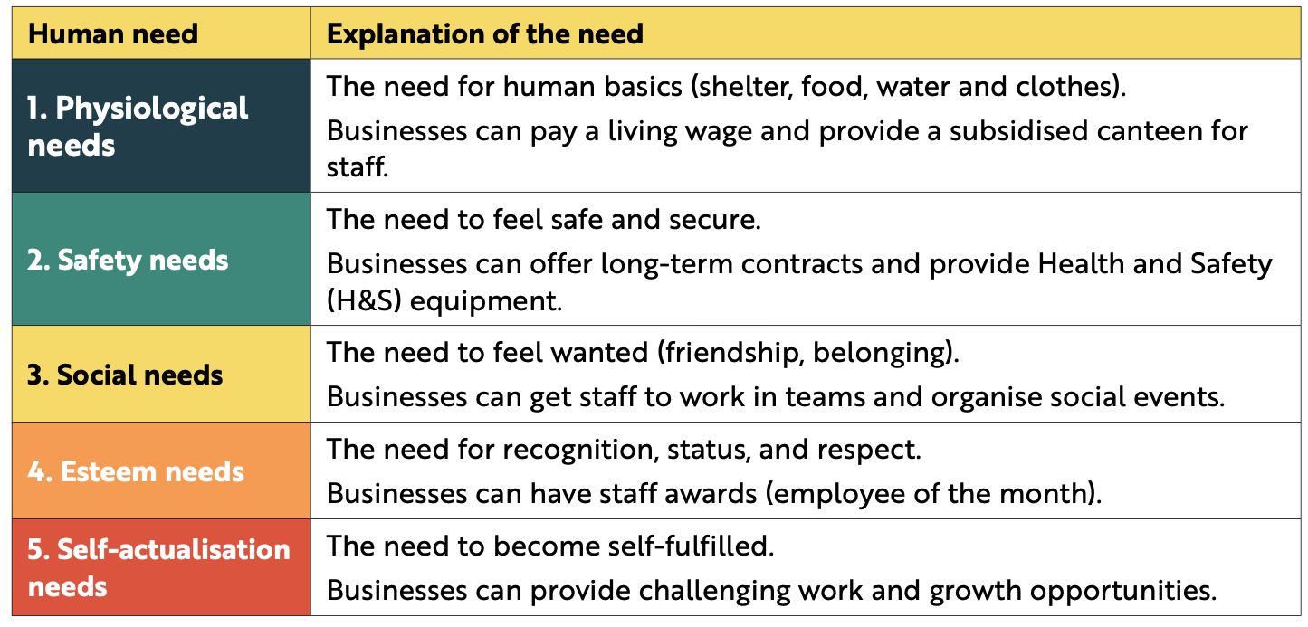
Back In Business
Maslow’s Hierarchy Of Needs

Slide 34
Back In Business
Factors That Can Improve Employee Motivation In An Organisation (a)
Pay & Rewards
Competitive salaries and performance-based bonuses motivate employees by linking effort to reward and encouraging higher performance.
Positive Working Conditions and Contracts
A secure, supportive environment and longer-term contracts help employees feel stable and focused, boosting satisfaction and productivity.
Teamwork and Collaboration
Collaborative workplaces build belonging and shared purpose, motivating employees to contribute to team and organisational success.

Slide 35
Back In Business
Factors That Can Improve Employee Motivation In An Organisation (b)
Recognition and Praise
Regular, fair recognition of good work increases morale, loyalty, and motivation, but it must remain meaningful to stay effective.
Career Progression Opportunities
Clear routes for promotion and professional development motivate employees to grow and remain committed to the organisation.

Slide 36
Back In Business
Types of Financial Rewards To Motivate Staff
Type of Pay | Description
Time Rate | Employees are paid a fixed hourly wage, with extra pay (e.g. time and a half or double time) for overtime hours worked.
Piece Rate | Pay is based on the number of items produced or tasks completed, boosting productivity but sometimes reducing quality if employees rush.
Commission | Employees earn a percentage of their sales in addition to base pay, directly motivating stronger sales performance.
Salary | A fixed annual wage paid in regular instalments, regardless of the number of hours worked.

Slide 37
Back In Business
Types of Financial Rewards To Motivate Staff
Type of Pay | Description
Benefit in Kind (if taxable) | Non-cash rewards such as company cars, subsidised housing, or low-interest loans provided to employees.
Bonus | Extra payments for meeting or exceeding specific performance or production targets.
Profit-Sharing Scheme | Employees receive a portion of company profits, encouraging them to help increase overall business success.
Employee Share Purchase Plan | Staff can buy company shares at a discount, linking their personal gain to the firm’s long-term performance.

Slide 38
Back In Business
Types of Non-Financial Rewards To Motivate Staff
Type of Pay | Description
Benefit-in-Kind (Perk or Fringe Benefit) | Non-cash rewards such as free parking, gym membership, or meal vouchers. Many MNCs offer free meals, snacks, or recreational facilities like pool tables and PS5s to boost morale.
Flexi-Time | Employees can choose their working hours or work remotely to better balance work with personal responsibilities or lifestyle preferences.
Job Sharing | Two employees share one full-time role, each working part-time. This helps staff manage family or leisure priorities while remaining employed.
Job Enlargement / Rotation / Satisfaction | Expanding employee roles, rotating tasks, and encouraging teamwork increase engagement, skill variety, and job satisfaction.

Slide 39
Suggested Activities for LO 14.4
Sample Papers
OL1 Q3 (e): Outline two factors, apart from pay, that can improve employee motivation in the workplace.
Activity Book Qs
HL Q5
OL Q4

Slide 40
Learning Outcome 14.5
14.5 Describe what is meant by effective employee appraisal.
Back In Business

Slide 41

Back In Business
Employee Appraisal
Employee appraisal is the process of evaluating the performance, progress, contribution and effectiveness of an employee over a period of time by their employer.

Slide 42
Back In Business
Ways A Business Can Try To Ensure That The Employee Appraisal Process Is Effective
Hold Regular and Ongoing Appraisals
Feedback should be continuous, not limited to once a year. Regular check-ins help employees improve steadily and prevent surprises during formal reviews.
Promote Open, Two-Way Communication
Appraisals should be collaborative, allowing employees to share their views and feedback. This builds trust, engagement, and mutual understanding.
Set SMART Goals Together
Agreeing on Specific, Measurable, Achievable, Relevant, and Time-bound goals makes expectations clear and ensures performance is judged on objective results.

Slide 43
Suggested Activities for LO 14.5
Sample Papers
HL2 Q2 (b): Explain two ways to ensure an effective appraisal process.
OL2 Q5 (e): (i) Explain the term employee appraisal. (ii) Describe how an effective employee appraisal process could lead to a more motivated and productive workforce. (covered in LO 14.6 also)
Activity Book Qs
HL Q5
OL Q4

Slide 44
Learning Outcome 14.6
14.6 Identify a number of approaches to appraisal and analyse how these approaches might contribute to employee motivation.
Back In Business

Slide 45

Back In Business
Approaches To Appraisal
Self-Appraisal
  Employees assess their own performance, reflecting on achievements and challenges.
  They identify strengths, areas for improvement, and next steps before a formal review.
Contribution to Motivation:
  Builds ownership, accountability, and confidence in personal growth.
  Encourages engagement and self-awareness in goal setting.
  Caution: Can lower morale if employees lack confidence or are overly self-critical.

Slide 46
Back In Business
Approaches To Appraisal
Formative Appraisal
  An ongoing, informal process where managers provide continuous feedback and guidance.
  Focuses on learning, support, and development rather than formal evaluation.
Contribution to Motivation:
  Helps employees feel valued and supported throughout their work.
  Encourages continuous improvement and reduces uncertainty.
  Caution: Too much feedback or a critical tone can make employees feel micromanaged.

Slide 47
Back In Business
Approaches To Appraisal
Summative Appraisal
  A formal, scheduled review assessing overall performance and achievement of set goals.
  Typically occurs quarterly or at the end of major projects.
Contribution to Motivation:
  Creates clear performance goals linked to rewards like bonuses or promotions.
  Reinforces achievement and goal-driven behaviour.
  Caution: A purely results-focused approach may overlook effort and teamwork.

Slide 48
Back In Business
Approaches To Appraisal
360-Degree Approach
  Collects feedback from multiple sources, such as managers, peers, subordinates, and customers.
  Provides a balanced, all-round perspective on an employee’s performance and impact.
Contribution to Motivation:
  Broader recognition helps employees feel genuinely valued and respected.
  Encourages personal growth through diverse feedback and insights.
  Caution: Negative or poorly delivered peer feedback may reduce confidence.

Slide 49
Suggested Activities for LO 14.6
Sample Papers
-
-
Activity Book Qs
HL Q6
OL Q4

Slide 50
Learning Outcome 14.8
14.8 Investigate the different types of training and professional development that may be offered to employees and outline why ongoing training and professional development is an important aspect of human capital management.
Back In Business

Slide 51
Back In Business
Different Types Of Training & Professional Development That May Be Offered To Employees
Type of Training | Explanation (with Examples)
Induction Training / Onboarding | Introduces new employees to the workplace culture, policies, and structure. A mentor may support them through shadowing and guidance to help them settle in quickly and reduce first-day anxiety.
On-the-Job Training | Conducted within the workplace under supervision, using practical methods like job rotations, workshops, or shadowing. For example, a retail assistant learning till procedures from an experienced colleague.
Off-the-Job Training | Takes place outside the regular workplace through external courses or workshops. For instance, sending staff to a digital marketing seminar to gain new skills or qualifications.
Professional Development | A long-term approach focused on building transferable skills like leadership, communication, and problem-solving. Examples include management training programmes or online learning platforms such as LinkedIn Learning.

Slide 52
Back In Business
Why Ongoing Training And Professional Development Is An Important
Aspect Of Human Capital Management.
1. Learning Through Experience
On-the-job training lets employees learn by doing, supported by experienced colleagues. This practical approach strengthens problem-solving skills, builds confidence, and encourages continuous improvement.
2. Building a Skilled and Adaptable Workforce
Off-the-job training exposes employees to new technologies, methods, and industry insights. It helps businesses stay competitive by developing flexible, knowledgeable staff ready to meet changing demands.
3. Boosting Morale and Engagement
Professional development shows employees that the business values their growth. This investment in leadership and communication skills increases motivation, loyalty, and long-term commitment.

Slide 53
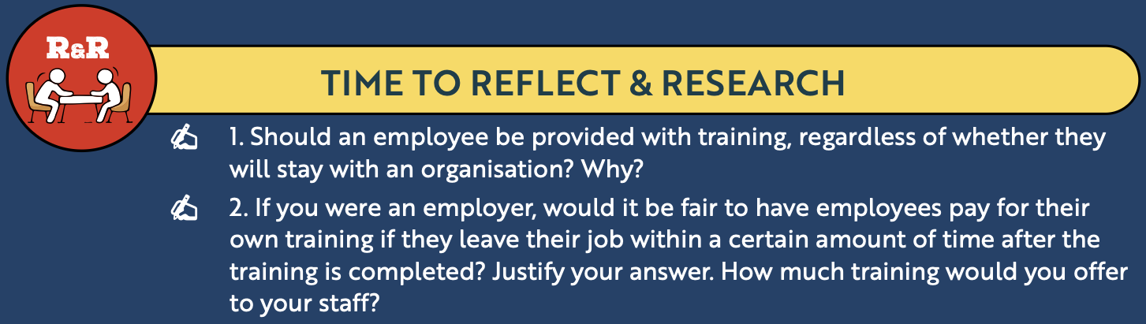
Back In Business
Reflect & Research Pg 258

Slide 54
Suggested Activities for LO 14.8
Sample Papers
OL2 Q1 (d): (i) Name and explain two different types of training that may be offered to employees. (ii) Outline one reason why ongoing training and professional development of employees is an important aspect of human capital management.
Activity Book Qs
HL Q7
OL Q6

Slide 55
Learning Outcome 14.9
14.9 Appreciate the opportunities and challenges associated with working in teams for both employees and employers.
Back In Business

Slide 56
Back In Business
Teamwork
Collaboration through teamwork offers significant opportunities and challenges for both employees and organisations. Understanding these impacts helps businesses manage teams more effectively and helps employees to succeed in a collaborative environment.

Slide 57
Back In Business
Opportunities & Challenges Of Working In Teams For Employees
Opportunities | Challenges
Increases Job Satisfaction and Morale Teamwork fulfils employees’ social needs and helps them feel recognised and valued for their contributions. | Potential for Conflict Differences in personalities, working styles, or opinions can cause tension and misunderstandings.
Develops Interpersonal Skills Working with diverse personalities builds communication, collaboration, and leadership abilities. | Free-Rider Problem Uneven contribution levels from different members can frustrate productive team members and damage trust.
Reduces Pressure in Decision-Making Shared responsibility helps reduce stress and encourages more balanced, confident decisions. | Dependence on All Members Poor performance by one team member can affect the group’s success and overall outcomes.

Slide 58
Back In Business
Opportunities & Challenges Of Working In Teams For Employers
Opportunities | Challenges
Improves Creativity and Problem-Solving Teams bring together diverse skills and perspectives, leading to more innovative and effective solutions. | Conflicts Need to Be Managed Managers may need to intervene in disputes, which can disrupt workflow and reduce productivity.
Increased Productivity Well-organised teams divide work according to strengths, completing tasks faster and maintaining high quality. | Can Be Inefficient Poor communication, unclear roles, or lack of team training can cause confusion and slow progress.
Strengthens Workplace Culture Collaboration fosters a positive environment, boosting engagement, morale, and retention. | Takes Manager’s Time Effective teamwork requires supervision, training, and coordination, adding to management workload and costs.

Slide 59
Back In Business
Reflect & Research Pg 260
LINK

Slide 60
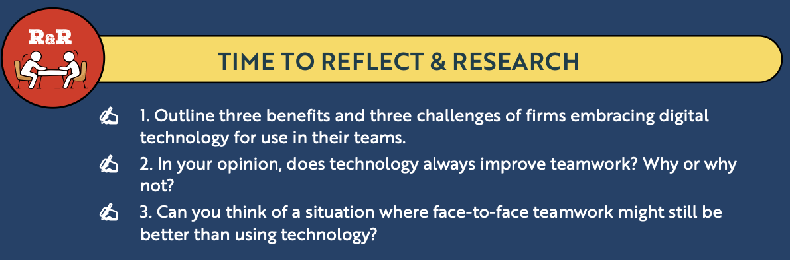
Back In Business
Reflect & Research Pg 260

Slide 61
Suggested Activities for LO 14.9
Sample Papers
OL2 Q4 (d): Outline two benefits that teamwork brings to an organisation
Activity Book Qs
HL Q8
OL Q7

Slide 62
Learning Outcome 14.10
14.10 Outline how employers and employees can work together to create a more sustainable workplace.
Back In Business

Slide 63
Back In Business
A sustainable workplace
A sustainable workplace is one where employees are supported to thrive and where the business acts responsibly towards society and the environment.
This requires a joint effort from both employers and employees - working together to improve the culture, ethics, and impact of the organisation on their business environment.
A sustainable workplace will also strive to achieve living and working conditions that support people in engaging and remaining in work throughout an extended working life.

Slide 64
Back In Business
How employers and employees can build an environment for a more sustainable workplace.
1. Supporting Environmental Sustainability
Employers: Lead green initiatives such as reducing waste, cutting energy use, and promoting remote work or green commuting.
Employees: Go paperless, conserve energy, suggest eco-friendly improvements, and take part in workplace sustainability projects.
2. Health, Safety, and Wellbeing Initiatives
Employers: Maintain strong health and safety policies, offer regular training, and support physical and mental wellbeing programmes.
Employees: Follow safety procedures, report hazards, and engage in wellbeing activities to foster a caring, responsible workplace.

Slide 65
Back In Business
How employers and employees can build an environment for a more sustainable workplace.
3. Building a Respectful, Ethical, and Inclusive Workplace
Employers: Set clear ethical standards, ensure fair hiring and equal opportunities, and support diversity and inclusion in all decisions.
Employees: Act with integrity, show respect to others, and collaborate across diverse teams to strengthen workplace culture.
4. Investing in Continuous Learning and Future Skills
Employers: Provide upskilling opportunities, mentoring, and access to learning platforms to prepare staff for future challenges.
Employees: Take initiative in training, stay open to learning, and help the organisation remain adaptable and innovative.

Slide 66
Suggested Activities for LO 14.10
Sample Papers
-
-
Activity Book Qs
HL Q9
OL Q8

Slide 67
Learning Outcome 14.11
14.11 Investigate how digital technology impacts on the workplace.
Back In Business

Slide 68
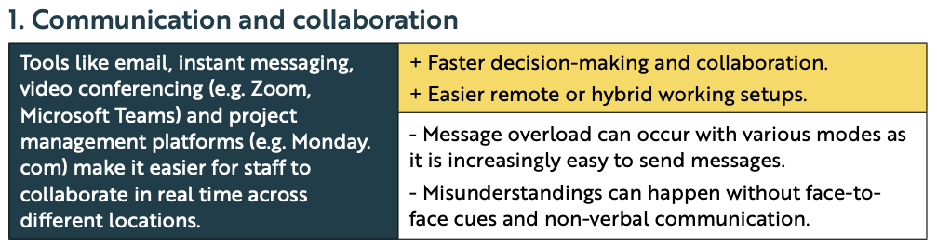
Back In Business
How Digital Technology Impacts On The Workplace

Slide 69
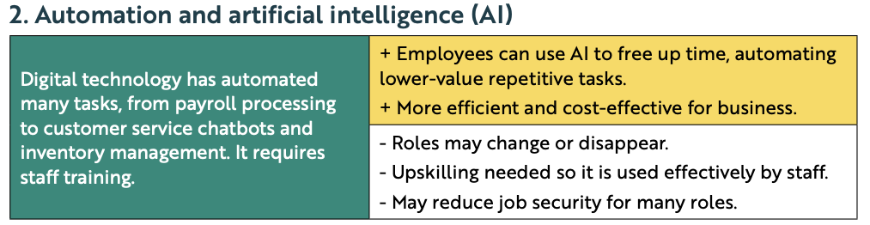
Back In Business
How Digital Technology Impacts On The Workplace

Slide 70
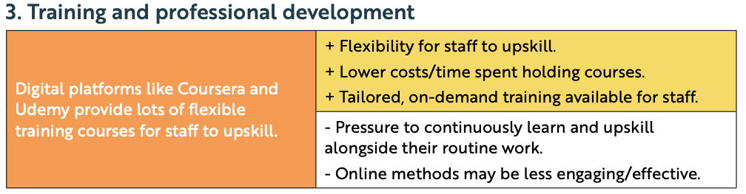
Back In Business
How Digital Technology Impacts On The Workplace

Slide 71
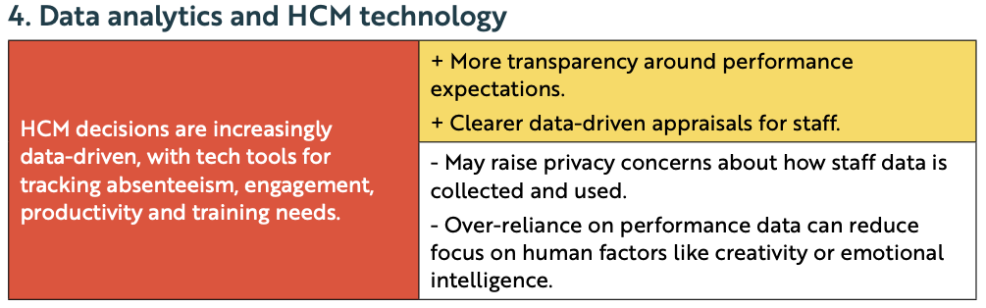
Back In Business
How Digital Technology Impacts On The Workplace

Slide 72
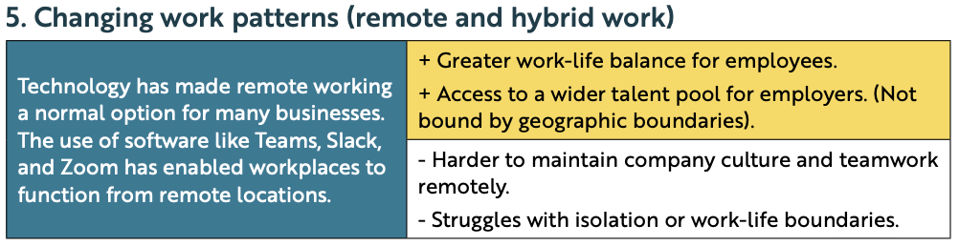
Back In Business
How Digital Technology Impacts On The Workplace

Slide 73
Suggested Activities for LO 14.11
Sample Papers
HL2 Q2 (e): Evaluate how digital technologies have impacted the modern workplace.
Activity Book Qs
HL Q10

Slide 74
Learning Outcome 14.12
14.12 Identify the opportunities and challenges associated with remote and blended working arrangements for employees and employers.
Back In Business

Slide 75
Back In Business
Remote & Blended Working
LINK

Slide 76
Back In Business
Remote & Blended Working: Opportunities & Challenges For Employers
Opportunities | Challenges
Wider Talent Pool Employers can recruit staff from anywhere, not just locally, expanding access to skilled candidates. | Maintaining Team Cohesion Communication and collaboration can feel less natural, making it harder to build team spirit.
Reduced Rent and Overheads Remote work cuts costs on office space, utilities, and in-office perks, improving profitability. | Data and Technology Risks Remote systems increase the risk of cyberattacks or data breaches, requiring strong security measures.
Improved Working Conditions Offering flexible or remote options enhances job satisfaction and employee retention. | Monitoring Performance Supervising staff and maintaining consistent productivity is more difficult without in-person oversight.

Slide 77
Back In Business
Remote & Blended Working: Opportunities & Challenges For Employees
Opportunities | Challenges
Greater Flexibility Employees can better balance work and personal life by avoiding long commutes and choosing hours that suit their lifestyle or family commitments. | Isolation and Reduced Social Interaction Working remotely can cause loneliness and make employees feel disconnected from colleagues and workplace culture.
Increased Autonomy Employees have more control over how and when they complete tasks, allowing them to work at their most productive times. | Work–Life Balance Difficulties It can be hard to switch off from work when the home becomes the workplace, leading to blurred boundaries and increased stress.
Access to Wider Job Opportunities Remote work enables employees to apply for roles beyond their local area, expanding career options and access to better opportunities. | Technology Skills and Dependency Reliable internet, suitable equipment, and strong digital skills are essential, which are challenges not all employees can easily overcome.

Slide 78
Suggested Activities for LO 14.12
Sample Papers
HL1 Q1 (b): Identify three challenges for ProjectOne with their current working arrangements (blended working).
OL1 Q3 (b): Identify two benefits and two challenges associated with remote working for an employee.
Activity Book Qs
HL Q10
OL Q9

Slide 79
Learning Outcome 14.13
14.13 Analyse the ethical and sustainability issues associated with remote and blended working.
Back In Business

Slide 80
Back In Business
Ethical Issues Associated With Remote & Blended Working
Data Privacy And Protection
  Remote access to company systems increases the risk of data breaches and cyberattacks.
  Employees may use unsecured home networks or personal devices without proper safeguards.
  Businesses must enforce strict data protection policies and provide training on secure practices.
Equal Access and Fairness
  Some employees lack suitable home workspaces or reliable internet connections.
  Working from home can create hidden costs (e.g. heating, electricity, furniture).
  Employers should provide fair support or resources to ensure equal working conditions.

Slide 81

Back In Business
Ethical Issues Associated With Remote & Blended Working
Mental Health and Work–Life Balance
  Blurred boundaries between home and work can lead to burnout or overworking.
  The “always-on” culture can increase stress and reduce overall wellbeing.
  Clear communication, flexible scheduling, and wellbeing policies can help protect balance.

Slide 82
Back In Business
Sustainability Issues Associated With Remote & Blended Working
Lower Long-Term Engagement and Connection
  Employees may feel isolated or less connected to company culture.
  Reduced social interaction can lower morale and team cohesion.
  Employers should organise regular check-ins, team events, and in-person meetups to maintain connection.
Positive Environmental Impact
  Fewer commutes and less office energy use reduce emissions and waste.
  Remote work can help companies meet sustainability targets and lower costs.
  Employers can encourage greener home practices, such as using energy-efficient devices and reducing paper use.

Slide 83
Suggested Activities for LO 14.13
Sample Papers
-
-
Activity Book Qs
HL Q10
OL Q9

Slide 84
Learning Outcome 14.14
14.14 Outline the importance of corporate wellness and investigate the impact of corporate wellness on employee motivation and organisational culture.
Back In Business

Slide 85
Back In Business
Corporate Wellness
An organisational focus on equality, diversity, inclusivity and the overall
wellbeing of the workforce. Its goal is to nurture a diverse, inclusive, and
healthy workplace where employees can thrive personally and professionally.
LINK → Case studies on businesses that have been awarded the Keep Well mark from IBEC

Slide 86
Back In Business
Examples Of Corporate Wellness Initiatives
Flexible Working Hours
Fitness Classes Or Centres
Financial Wellbeing Workshops
Wellness Challenges
Mental Health Support
Healthy Eating Initiatives
Diversity & Inclusion Programmes
Health Screenings

Slide 87
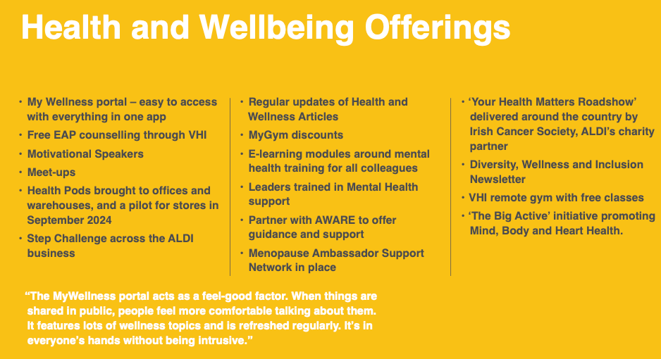


Back In Business
Examples Of Corporate Wellness Initiatives

Slide 88
Back In Business
The Importance Of Corporate Wellness
  Improves Employee Wellbeing – Supports physical, mental, and emotional health, reducing stress, absenteeism, and burnout.
  Boosts Motivation and Productivity – Employees who feel cared for are more engaged, focused, and perform at a higher level.
  Enhances Talent Attraction and Retention – Strong wellness programmes make a business more appealing to potential hires and help retain existing staff.
  Promotes a Positive, Inclusive Culture – Encourages fairness, belonging, and respect by supporting diversity and inclusion within the workplace.

Slide 89

Back In Business
The Impact Of Corporate Wellness On Organisational Culture
Builds a Culture of Loyalty and Care
  Genuine wellbeing support shows employees they are valued.
  Strengthens loyalty and long-term commitment.
Supports Positive Day-to-Day Experiences
  Perks like flexible hours or fitness classes boost daily satisfaction.
  Creates a happier, more balanced, and engaged workforce.

Slide 90

Back In Business
The Impact Of Corporate Wellness On Organisational Culture
Strengthens Teamwork and Collaboration
  Group wellness or charity activities build stronger connections.
  Improves communication and team morale.
Builds Trust
  Real action on wellbeing fosters pride and respect.
  Authenticity builds trust; token efforts damage it.

Slide 91
Back In Business
The Impact Of Corporate Wellness On Employee Motivation
Makes Staff Feel Valued and Supported
  Wellness initiatives show genuine care for employees’ wellbeing.
  Builds commitment and motivates staff to perform at their best.
Reduces Stress and Improves Work–Life Balance
  Flexible working and mental health supports ease personal pressures.
  Lower stress leads to better focus, energy, and motivation.

Slide 92

Back In Business
The Impact Of Corporate Wellness On Employee Motivation
Improves Physical and Mental Health
  Programmes like fitness classes or health screenings boost wellbeing.
  Healthier staff have more energy and resilience at work.
Builds Relationships and Belonging
  Team wellness and inclusion activities create stronger connections.
  A supportive community increases engagement and loyalty.

Slide 93
Back In Business
LINK

Slide 94
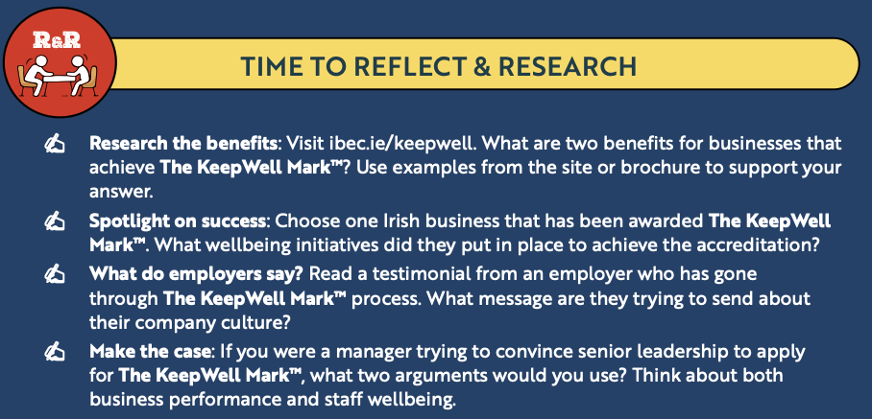
Back In Business
Reflect & Research Pg 268

Slide 95
Suggested Activities for LO 14.14
Sample Papers
HL1 Q4 (d): Discuss four ways employee motivation can be influenced by corporate wellness initiatives.
OL2 Q1 (e): PJ is committed to Corporate Wellness. (i) Identify evidence of this in his business. (ii) Outline one benefit to a business of maintaining a focus on wellbeing in the workplace.
Activity Book Qs
HL Q11

Slide 96
Learning Outcome 14.15
14.15 Identify the role of leadership in promoting corporate wellness.
Back In Business

Slide 97
Back In Business
Identify The Role Of Leadership In Promoting Corporate Wellness.
Lead By Example
  Leaders should actively take part in wellness initiatives and model healthy habits.
  Visible participation shows employees that wellbeing is genuinely valued.
Allocate Resources to Support Initiatives
  Ensure funding, staff, and time are dedicated to wellness programmes.
  Investment in facilities and activities proves leadership’s real commitment.

Slide 98
Back In Business
Identify The Role Of Leadership In Promoting Corporate Wellness.
Foster a Supportive and Inclusive Environment
  Create a culture where employees feel safe discussing stress or burnout.
  Encourages openness and early support for wellbeing challenges.
Communicate a Clear Message on Wellness
  Regularly share updates and celebrate wellness successes.
  Reinforces that wellbeing is central to company values, not just a box-ticking exercise.

Slide 99
Suggested Activities for LO 14.15
Sample Papers
OL1 Q3 (c): State two ways a manager can promote corporate wellness.
Activity Book Qs
HL Q11
OL Q9

