Slide 1

Strand 3
Chapter 15
The Importance Of Communication
Back In Business

Slide 2
Learning Outcomes
15.1 Explain the importance of communication in an organisation.
15.2 Identify different modes of communication and analyse the efficacy of each mode as an approach within an organisation.
15.3 Discuss how technology enables communication in organisations.
15.4 Discuss how communication might be improved in an organisation.
Back In Business

Slide 3

Back In Business
Priming activity
  Have you ever misunderstood a message that someone else thought was clear? What caused the confusion?
  What communication apps or tools have you seen used in school or work? What were some of their advantages or disadvantages?
  How does your choice of communication method change between different groups (friends, family, teachers, coaches, etc.)? Why?

Slide 4
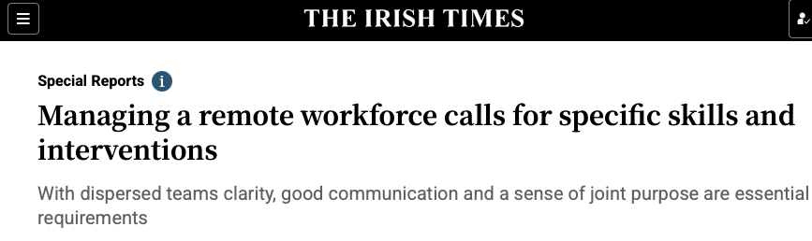


Back In Business
Starter Activity
DOWNLOAD
WORKSHEET HERE
  Before Reading – Think
  What communication challenges might arise when team members work from different locations?
  What skills do you think managers need to keep remote teams connected and motivated?
Original article here

Slide 5
Learning Outcome 15.1
15.1 Explain the importance of communication in an organisation.
Back In Business

Slide 6

Back In Business
The Importance Of Communication
Communication in a business is the process of sharing information, ideas, and messages with employees and external stakeholders. When it is clear and well-timed, it helps people take informed action that supports business goals.

Slide 7
Back In Business
The Principles Of Effective Communication
  Correct timing – Deliver messages at the right moment & method
  Accuracy – Ensure information is correct
  Appropriate language – Match tone to audience/context
  Use of visuals – Simplify complex information in graphs etc..
  Confidentiality – Protect sensitive information
  Record if required – Keep formal written proof if needed
  Allows for feedback – Encourage two-way communication

Slide 8

Back In Business
The Importance Of Communicating Effectively In An Organisation
Supports collaboration
Clear communication keeps teams aligned and focused on shared goals. It allows people to share ideas, solve problems efficiently, and work together productively.
Helps avoid conflict
Open, respectful communication reduces misunderstandings between staff and management. It builds stronger relationships and prevents small issues from escalating.

Slide 9
Back In Business
The Importance Of Communicating Effectively In An Organisation
Increases engagement
When employees understand their role and feel heard, motivation and job satisfaction improve. This leads to higher morale and better performance.
Promotes a positive culture
Fair and transparent communication builds trust and respect. Over time, it creates a supportive, open workplace environment.

Slide 10
Back In Business
The Importance Of Communicating Effectively In An Organisation
Helps manage change
Explaining what’s happening and why during times of change reduces uncertainty. It makes employees more confident and willing to adapt.
Promotes innovation
When people feel safe to share ideas and challenge existing ways of working, creativity and improvement thrive across the organisation.

Slide 11
Suggested Activities for LO 15.1
Sample Papers
HL2 Q4 (c): Explain three reasons, apart from avoiding conflict, why effective communication is important in an organisation.
Activity Book Qs
HL Q1, Q6
OL Q1, Q2

Slide 12
Learning Outcome 15.2
15.2 Identify different modes of communication and analyse the efficacy of each mode as an approach within an organisation.
Back In Business

Slide 13
Back In Business
Verbal Communication
Verbal communication is the exchange of information using words, either spoken or written, face-to-face, in writing, or through technology.
It is effective for sharing detailed or complex messages, gaining quick feedback, or reaching large groups.
However, it can also face challenges with tone, interpretation, or delayed responses in some formats.

Slide 14




Back In Business
Types Of Verbal Communication
Face-To-Face
Conversations
Emails, Letters, Memos, Reports, Proposals
Phone Calls, Voice Messages, Audio Notes
Instant Messaging (Slack, Microsoft Teams)
Video Calls (Zoom / Microsoft Teams)
Meetings And Presentations

Slide 15
Back In Business
Efficacy Of Verbal Communication
Benefits of Verbal Communication | Challenges of Verbal Communication
Quick feedback and clarification Video or phone calls allow instant questions and responses, helping solve problems and make faster decisions. | No automatic record Conversations may be forgotten if not written down afterwards; follow-up notes are needed.
Builds relationships and trust Clear, respectful conversations strengthen trust and help teams collaborate and resolve issues effectively. | Can be misinterpreted Without written context or tone, spoken messages can be misunderstood or sound abrupt.
Flexible and adaptable Speakers can adjust tone or wording in real time to suit the listener and situation. | Can be influenced by emotions Emotional responses or rushed comments can cause confusion or unclear commitments.

Slide 16


Back In Business
Non-Verbal Communication
Non-verbal communication involves using body language, facial expressions, tone of voice, and visual aids like graphs or charts to send messages without words. It can powerfully support spoken and written communication, and help simplify complex data, but may also be misinterpreted or go unnoticed.

Slide 17
Back In Business
Types Of Non-Verbal Communication
Facial
Expressions
Workplace Signs That Use Images
Body Postures And Gestures
Charts, Graphs, Infographics

Slide 18
Back In Business
Efficacy Of Non-Verbal Communication
Benefits of Non-Verbal Communication | Challenges of Non-Verbal Communication
Conveys emotion and urgency quickly Facial expressions, gestures, and tone can instantly show feeling or urgency, speeding up understanding. | Prone to misinterpretation Non-verbal signals can mean different things in different cultures or contexts, causing misunderstanding.
Enhances the impact of verbal messages Eye contact, posture, and gestures reinforce what is said, helping to build trust and show interest. | Lacks a permanent record Body language or visuals are not usually documented, so key points may be forgotten or misrepresented later.
Simplifies complex information Charts and visuals help present data or comparisons clearly and make trends easy to see at a glance. | May oversimplify or confuse Poorly designed visuals or missing context can mislead or cause poor decisions based on incomplete information.

Slide 19
Back In Business
Factors A Business Should Consider When Choosing An Appropriate Mode Of Communication
Urgency of the message
Fast verbal methods like phone calls, instant messaging, or face-to-face discussions are best for urgent matters. When time allows, less immediate written methods such as emails or reports can be used instead.
Complexity of the information
Complex or detailed information should be shared through structured written formats to allow review and clarity. Simple updates can be communicated quickly through verbal exchanges or short written messages.

Slide 20
Back In Business
Factors A Business Should Consider When Choosing An Appropriate Mode Of Communication
Formality / Nature
Formal communication, such as policy changes or legal updates, should use written formats like reports or structured emails. Informal updates can use verbal communication or short, casual written messages.
Audience size and location
Large or remote groups often need a combination of verbal, non-verbal, and written modes to reach everyone effectively. Smaller teams or individuals can be addressed directly through meetings or one-to-one contact.

Slide 21
Back In Business
Factors A Business Should Consider When Choosing An Appropriate Mode Of Communication
Sensitivity / confidentiality
Sensitive topics should be handled privately through verbal methods such as face-to-face or video meetings.
Need for a record
When proof or documentation is required, written formats like emails or reports should be used. Verbal communication alone may not be enough if formal evidence is needed.

Slide 22
Suggested Activities for LO 15.2
Sample Papers
HL2 Q5 (a) (i): Outline two considerations that should be taken into account when choosing an appropriate mode of communication in a business setting.
OL2 Q5 (c): (i) Calculate difference in a bar chart
(ii) Analyse two benefits of using non-verbal communication (such as a bar chart) for a business.
Activity Book Qs
HL Q2
OL Q3, Q4

Slide 23
Learning Outcome 15.3
15.3 Discuss how technology enables communication in organisations.
Back In Business

Slide 24
Back In Business
How Technology Enables Communication In Organisations
Transforms the modes of communication
Tools like Zoom, Google Meet, and Microsoft Teams combine verbal, non-verbal, and written elements into one multimodal interaction. Presentation platforms such as Canva and Prezi make it easier to share ideas clearly with engaging visuals and structure.
Increases the speed of communication
Instant-messaging and collaboration apps like Slack, Teams, and email allow real-time updates and quick decisions. This immediacy helps teams solve problems faster and stay responsive in fast-paced work environments.

Slide 25

Back In Business
How Technology Enables Communication In Organisations
Reduces costs
Shared online spaces like Google Drive and Slack eliminate printing, postage, and admin costs. They allow teams to edit and communicate instantly, keeping operations efficient and affordable.
Improves access to messages
Centralised platforms such as Notion and Microsoft Teams give employees on-demand access to key files, policies, and updates. This ensures consistency across departments and saves time searching for information.

Slide 26

Back In Business
How Technology Enables Communication In Organisations
Increases collaboration opportunities and efficiency
Collaboration tools like Google Workspace, Monday.com, and Trello support real-time file sharing and task tracking. They help teams plan projects, assign responsibilities, and monitor progress efficiently.
Promotes sustainable business practices
Digital tools such as DocuSign and Zoom reduce paper use and travel for meetings. Cloud storage like Google Drive supports lower carbon emissions and more sustainable daily operations.

Slide 27

Back In Business
How Technology Enables Communication In Organisations
Increases productivity
Task-management tools like Asana and Notion allow teams to track deadlines and manage workloads effectively. Scheduling apps like Google Calendar minimise missed meetings and wasted time.
Strengthens security around communication
Secure apps such as Signal and DocuSign protect confidential messages and documents. Encryption and audit trails ensure sensitive information is safely transmitted and stored.

Slide 28

Back In Business
Reflect & Research Pg 282
LINK

Slide 29
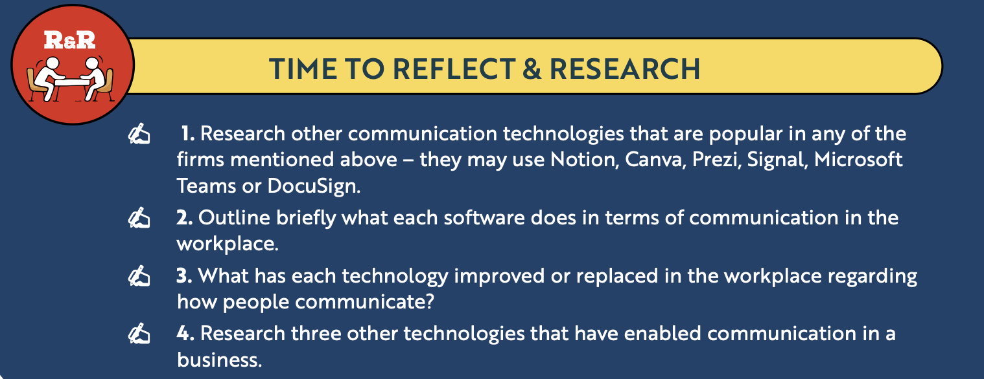
Back In Business
Reflect & Research Pg 282

Slide 30
Suggested Activities for LO 15.3
Sample Papers
OL1 Q1 (g): Discuss the ways EverGlow Organics Ltd can use technology to overcome the potential communication challenges as described above.
Activity Book Qs
HL Q3, Q5
OL Q5

Slide 31
Learning Outcome 15.4
15.4 Discuss how communication might be improved in an organisation.
Back In Business

Slide 32
Back In Business
Barriers To Communication
📌 The use of jargon and over-complicated or technical terms
📌 Information overload that dilutes the key message
📌 An inappropriate mode being used (in terms of security or formality)
📌 Poor timing (incorrect time of delivery, not providing enough time to be acted upon)
📌 Not allowing feedback (which can cause confusion and a lack of c!arity. Employees can feel disregarded or ignored if they are not allowed to give their input)

Slide 33

Back In Business
How To Improve Communication In An Organisation
Set clear goals
Clear goals make communication focused and purposeful. When a message has a specific objective, it is easier for the receiver to understand what action is expected.
Listen actively
Active listening ensures the other person feels heard and understood. Managers who ask clarifying questions and show openness to feedback can prevent misunderstandings early.

Slide 34

Back In Business
How To Improve Communication In An Organisation
Ensure ongoing engagement
Regular updates, check-ins, and team discussions keep communication continuous and two-way. This helps staff stay informed, involved, and confident to share ideas or raise issues.
Choose the correct mode of communication
Selecting the right method helps ensure clarity and the appropriate tone. Urgent or sensitive topics may need a meeting or call, while routine updates can be handled by email or chat.

Slide 35

Back In Business
How To Improve Communication In An Organisation
Seek feedback to assess effectiveness
Businesses should regularly ask employees for feedback on clarity, timing, and tone. Listening to this input allows managers to adjust and improve communication methods across the organisation.

Slide 36
Suggested Activities for LO 15.4
Sample Papers
HL2 Q5 (a) (ii): Explain two ways, apart from choosing the correct mode, how communication might be improved in an organisation.
Activity Book Qs
HL Q4, Q6

Slide 37


Back In Business
Flashcards and Kahoots
click the image to start

