Slide 1
Strand 1
Chapter 05
Irish Business Globally And Internationally
Back In Business

Slide 2

Resources
Chapter plan
Activity Book solutions
Sample Paper Solutions
Class Test
Starter Worksheet

Slide 3
Priming Activity
What are the benefits of an Irish business sourcing foreign stock or raw materials?
Can you think of any negatives of Ireland being a member of the EU for Irish businesses?
How does technology allow Irish brands to compete internationally?

Slide 4

Starter Activity
LINK
WORKSHEET

Slide 5
Learning Outcomes
5.1 Explain what is meant by a trading bloc and discuss why these are important for businesses in the Irish economy.
5.2 Identify the trading blocs most relevant for Irish businesses.
5.3 Evaluate Ireland’s membership of the EU from the perspective of the economy, businesses, and consumers.
5.4 Outline the factors to be considered when trading internationally.
5.5 Explain why Irish businesses trade globally with reference to Ireland’s open economy and compare the challenges and benefits of trading in an international environment.
5.6. Distinguish between balance of payments and balance of trade and calculate both based on figures given.

Slide 6
Learning Outcomes
5.7. Evaluate the impact of Irish organisations trading internationally, with a focus on both positive and negative impacts and the social and environmental impact of globalisation.
5.8. Explain how globalisation can increase interdependence* and evaluate the consequences of this for both businesses and consumers.
5.9. Evaluate the role of technology in globalisation.
5.10 Explain what is meant by Foreign Direct Investment and investigate how the Irish government promotes Foreign Direct Investment.
5.11 Outline the contribution of Foreign Direct Investment to the Irish economy.
Back In Business

Slide 7
Learning Outcome 5.1
5.1 Explain what is meant by a trading bloc and discuss why these are important for businesses in the Irish economy.
Back In Business

Slide 8

Back in Business
Open Economies
Trading Bloc
A group of participating countries which allows free trade between them. There are no tariffs or trade barriers in place between the participating countries.
The World Trade Organisation
The World Trade Organisation (WTO) manages and regulates
trading blocs, while trying to promote global free and fair trade.

Slide 9
Back in Business
Types Of Trading Blocs
📌 Free trade area: In a free trade area, member countries trade freely with each other by reducing or removing tariffs and trade barriers. E.g. USMCA (the United States-Mexico-Canada Agreement).
📌 Customs union: This is more advanced than a free trade area. In a customs union, member countries agree to trade freely with each other without tariffs and impose common tariffs on countries that are outside the union. E.g. Mercosur is a customs union made up of Brazil, Argentina, Paraguay, and Uruguay.
📌 Common market: A ‘common market’ (or single market) represents deeper economic integration. Member countries allow the free movement of goods, services, capital and !abour between member states. E.g. The European Union is a common market.

Slide 10
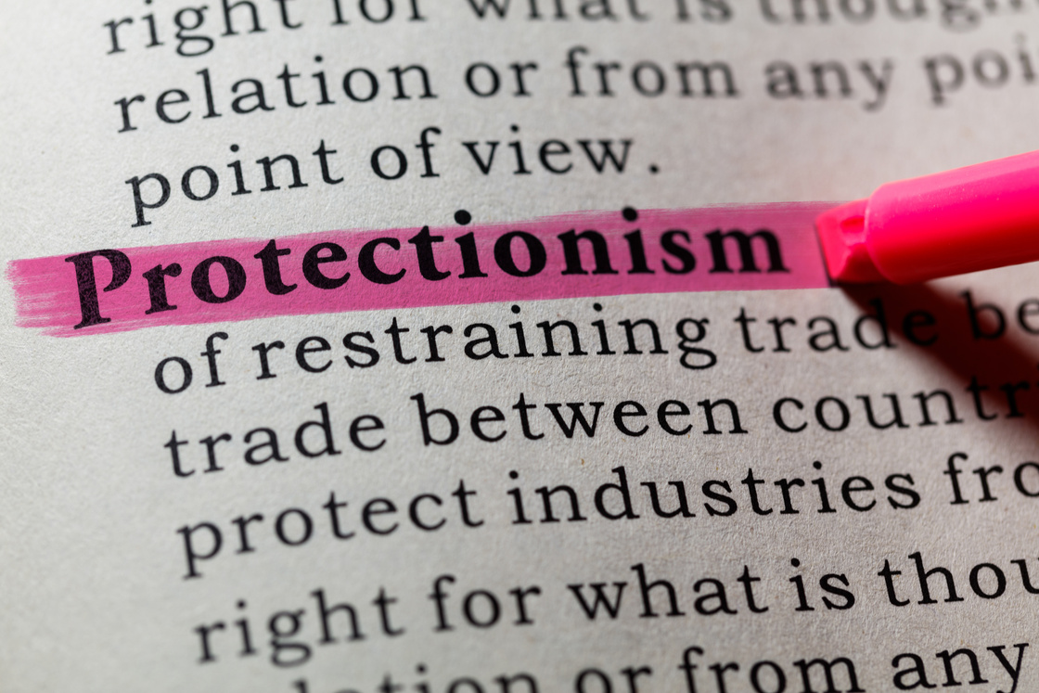
Back in Business
Protectionism
Some governments try to protect their home industries by restricting foreign competition using barriers to trade. This is called protectionism as the country is trying to make foreign imports more expensive reative to their domestically produced output in the hope that demand will increase in the domestic market, creating jobs and economic growth.

Slide 11


Back in Business
Protectionism
A a tax on imports that raises the selling price of foreign goods and discourages consumers from buying them.
The United States introduced tariffs on imported electric vehicles in 2025 to protect local car production
Tariff
A total ban on trade with a particular country or product, often for political or ethical reasons.
The European Union placed an embargo on certain Russian goods following the invasion of Ukraine.
Embargo
Limits the amount of a product that can be imported or exported, helping protect domestic producers.
The EU set quotas on steel imports to prevent oversupply from cheaper non-EU markets.
Quota

Slide 12

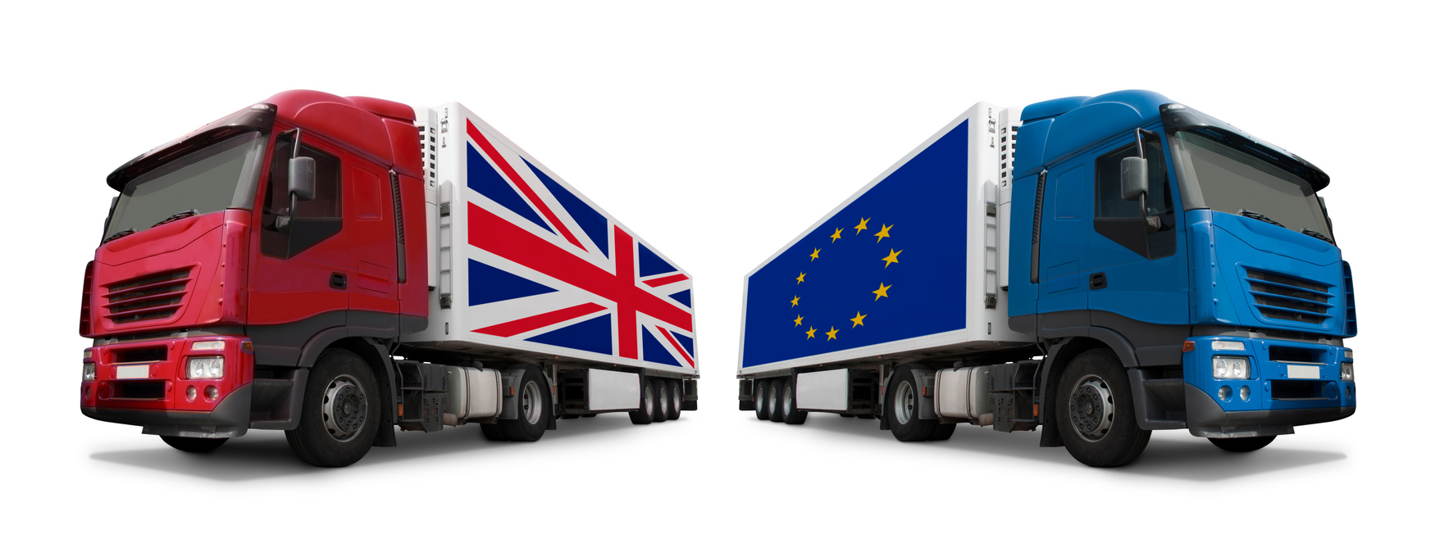
Back in Business
Protectionism
A subsidy is government financial support to local firms to lower production costs and make domestic goods more competitive.
The Irish government offers renewable-energy grants to support local clean-tech producers.
Subsidy
Extra checks, paperwork, or customs delays can make importing slower and more expensive, discouraging trade.
Since Brexit, many UK exporters have faced longer customs procedures when selling to EU countries.
Administrative Regulations

Slide 13


Back in Business
The Importance Of Trading Blocs For Businesses In The Irish Economy
EU membership gives free access (no barriers) to over 450 million consumers.
Easier to export for Irish firms, and also attracts MNCs like Google and Pfizer to locate here.
Access To Larger Markets
No tariffs or customs checks between EU members.
Irish firms can source cheaper raw materials and stock, improving profits and competitiveness, and move them quicker without customs delays.
Lower Costs & Greater Efficiency

Slide 14

Back in Business
The Importance Of Trading Blocs For Businesses In The Irish Economy
Free Movement Of Labour & Capital
Workers and investment can move freely between EU countries.
Helps Irish businesses fill skill gaps and access funding for growth.
Once a product meets EU rules, it can be sold across all member states.
Reduces admin and costs for Irish firms selling into different EU markets.
Common Standards & Regulations

Slide 15
Suggested Activities for LO 5.1
Sample Papers
HL2 Q4 (b) (i): Explain what is meant by the term trading bloc.
OL1 Q1 (a) (ii): (T/F) - The European Union (EU) is an example of a trading bloc; A tariff is a ban on specific goods being imported into a country.
Activity Book Qs
HL Q1
OL Q1

Slide 16
Learning Outcome 5.2
5.2 Identify the trading blocs most relevant for Irish businesses.
Back In Business

Slide 17

Back in Business
Identify The Trading Blocs Most Relevant For Irish Businesses
The EU
Ireland is part of the European Union (EU), so it can trade freely with other member states in the EU. This trading bloc is the most important for Ireland in terms of the value of goods exported. In 2023, 37% of Irish exports went to EU member countries.

Slide 18
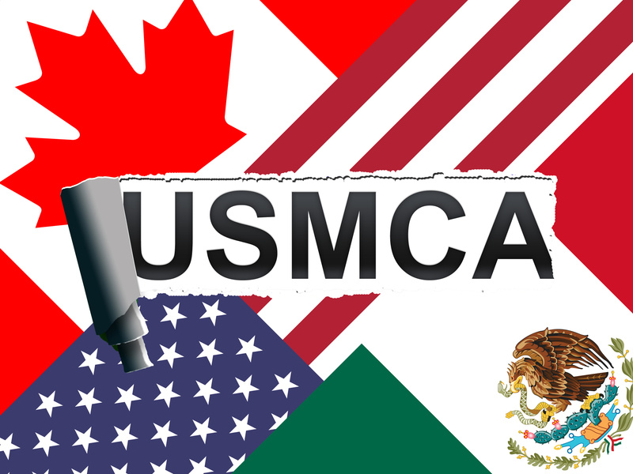
Back in Business
Identify The Trading Blocs Most Relevant For Irish Businesses
USMCA (United States-Mexico-Canada Agreement)
Although Ireland is not a member, the bloc is very relevant because the US is Ireland’s biggest single export destination.
In 2023, about 30% of all Irish exports went to the United States, especially in sectors like pharmaceuticals, IT services, and financial services.

Slide 19
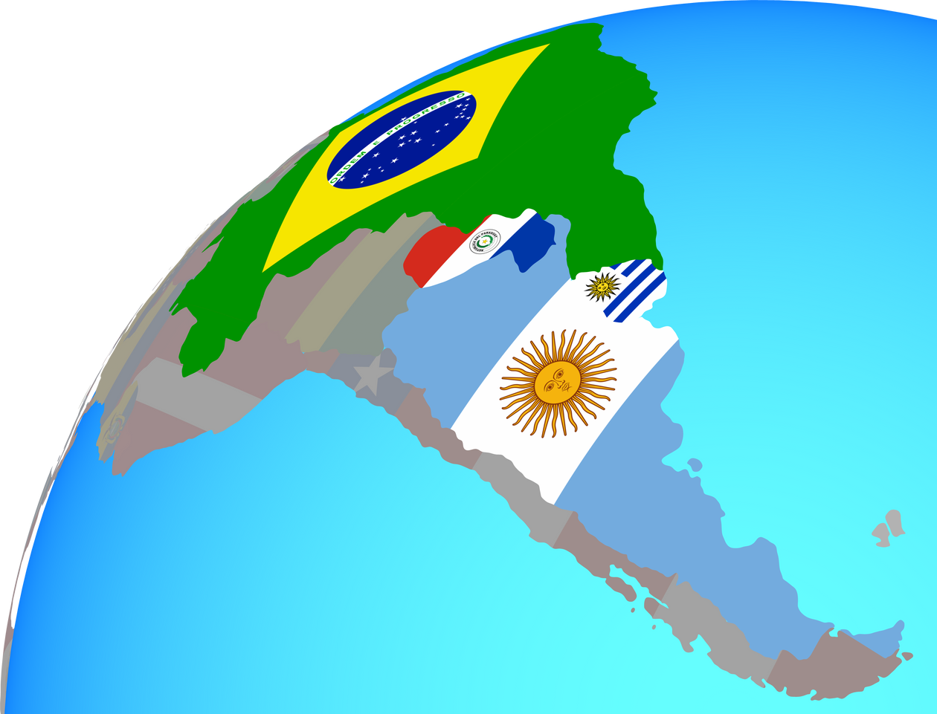
Back in Business
Identify The Trading Blocs Most Relevant For Irish Businesses
Mercosur
Mercosur"is a South American trading bloc made up of Brazil, Argentina, Uruguay, and Paraguay, focused on promoting trade and economic cooperation. In 2023, imports from South America into Ireland totalled just over €1 billion, including significant quantities of animal feed from Argentina.

Slide 20
Suggested Activities for LO 5.2
Sample Papers
HL2 Q4 (b) (ii): Identify one trading bloc, apart from the EU and Mercosur, that is relevant to Irish businesses.
Activity Book Qs
HL Q1
OL Q1

Slide 21
Learning Outcome 5.3
5.3 Evaluate Ireland’s membership of the EU from the perspective of the economy, businesses, and consumers.
Back In Business

Slide 22
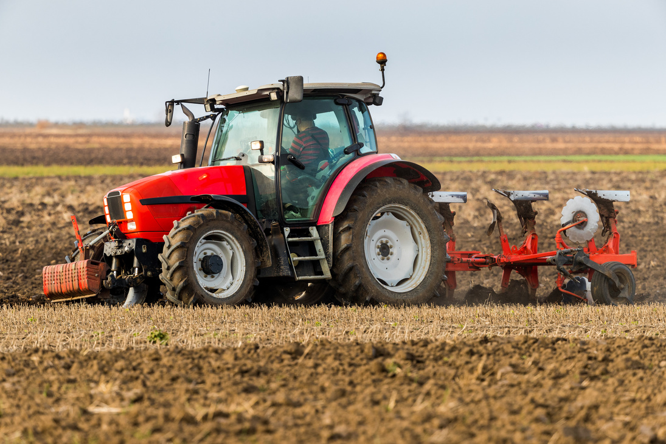
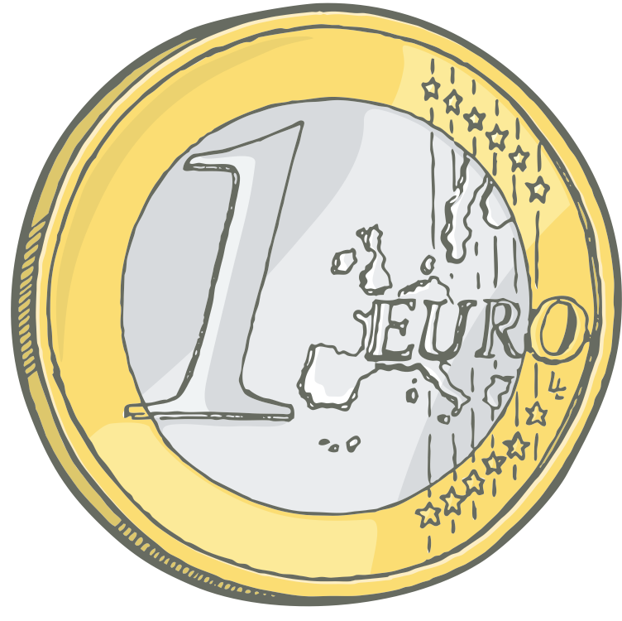
Back in Business
Impact Of Ireland’s Membership Of The EU On The Irish Economy
Access to the EU Single Market allows free movement of goods, services, capital and people.
This has driven strong economic growth for Ireland.
Economic Growth
EU funding supports farming (CAP), regional development and major infrastructure projects, improving transport and connectivity.
Improved Infrastructure
Membership attracts US tech and pharma MNCs seeking an English-speaking, educated base inside the EU.
Increased FDI
Some decision-making powers rest with the EU.
EU laws and ECB monetary policy can take priority over national decisions, which may not always suit Ireland’s needs.
Loss of Sovereignty

Slide 23
Back in Business
Impact Of Ireland’s Membership Of The EU On The Irish Business
Irish firms can trade freely with other EU countries, no tariffs or customs checks are in place. Access to over 450m consumers.
Increases Sales
Free movement of workers across the EU helps Irish businesses fill skill gaps and access new talent.
Labour Mobility
A common currency removes exchange-rate risk and transaction costs. Its also easier to compare prices to source cheaper stock.
Use Of Euro Currency
Businesses must follow EU rules, which can add cost or slow production. But once standards are met, products can be sold across all member states.
Increased Regulations
Irish sellers face competition from lower-cost EU retailers such as Aldi and Lidl, pressuring prices and margins.
Increased Competition

Slide 24
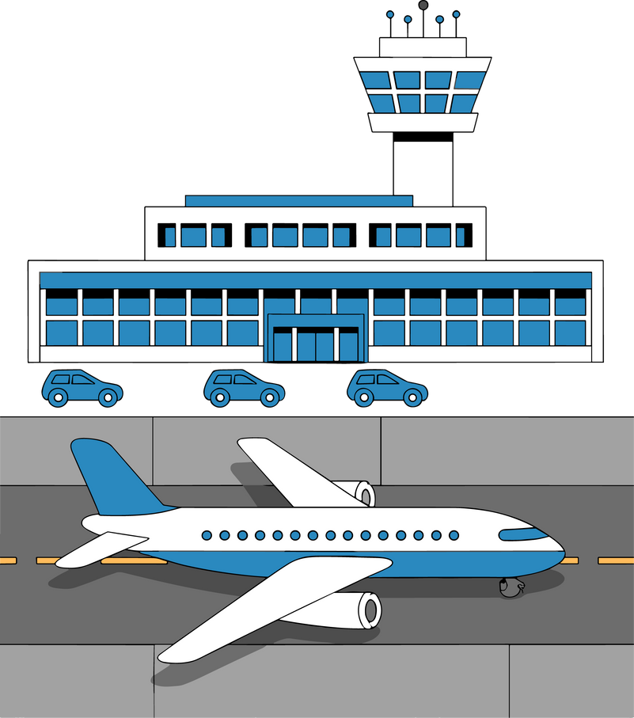
Back in Business
Impact Of Ireland’s Membership Of The EU On Irish Consumers
Consumers benefit from more choice and lower prices due to EU-wide competition.
They can shop freely across Europe without import taxes.
Increased Choice and Lower Prices
EU laws strengthen consumer protection, including GDPR, product returns, air passenger rights, and clearer food labelling.
Improved Rights
Irish citizens can travel, study, and work across EU countries without needing visas, offering more personal and career opportunities.
Increased FDI

Slide 25
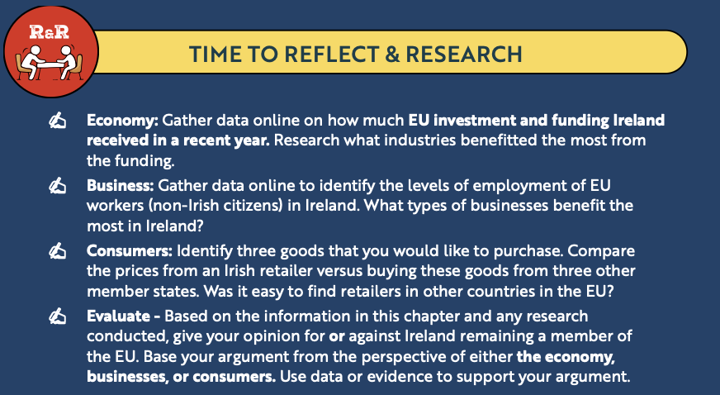
Back in Business
Reflect & Research

Slide 26
Suggested Activities for LO 5.3
Sample Papers
OL1 Q3 (g): Describe two benefits of EU membership to the Irish economy.
OL2 Q3 (e): Outline two benefits of Ireland’s EU membership for Irish businesses.
Activity Book Qs
HL Q2, Q3
OL Q2, Q3

Slide 27
Learning Outcome 5.4
5.4 Outline the factors to be considered when trading
internationally.
Back In Business

Slide 28
Back in Business
Taxes And Tariffs
Businesses must understand any import (or custom) duties, VAT differences, or special trade deals that may affect costs. Import duties are an extra tax imposed on goods or services from outside a trade area. E.g. An Irish dairy exporter might face high tariffs selling to the US but benefit from tariff-free access
when selling within the EU.

Slide 29

Back in Business
Increased Costs
Expanding abroad involves extra costs - transportation, storage, marketing, and local staffing. The time taken to ship goods globally can also impact the competitiveness of Irish firms.
E.g. An Irish clothing brand entering the Australian market needs to invest in shipping, local promotion, and possibly renting retail space.

Slide 30
Back in Business
Exchange Rate Fluctuations
Within the Eurozone, businesses don’t face the risk of the euro changing in value against a foreign currency.
If the dollar weakened against the euro, the demand for Irish exports would fall as they become relatively more expensive for shoppers in Britain and America.

Slide 31
Back in Business
Varying Regulations
Countries have different rules on product safety, data protection, and labour laws. Irish businesses may need to adjust production and packaging to comply, adding time and costs.
E.g. An Irish food producer must meet EU food safety standards when exporting within the EU but may face different packaging or health rules in Asia.

Slide 32
Back in Business
Increased Competition
Businesses must research local and international competitors to understand how to price and position their products. Market research is required as different markets have different norms and levels of competition.
E.g. An Irish gin company entering the UK market competes with dozens of local and international brands.

Slide 33
Back in Business
Language & Culture Adjustments
Cultural awareness and local communication styles can make or break international success. Advertising or product names often need to be adapted for new audiences.
E.g. A Donegal-based tech firm expanding into the Middle East must translate its website and adjust its marketing approach for local preferences.

Slide 34
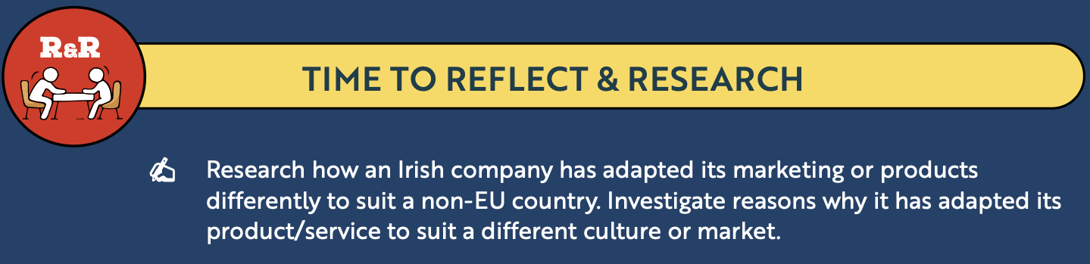
Back in Business
Reflect & Research

Slide 35
Suggested Activities for LO 5.4
Sample Papers
HL1 Q2 (c): Outline three factors that Grá Chocolates should consider before expanding into the international market.
Activity Book Qs
HL Q4
OL Q4

Slide 36
Learning Outcome 5.5
5.5 Explain why Irish businesses trade globally with reference to Ireland’s open economy and compare the challenges and benefits of trading in an international environment.
Back In Business

Slide 37
Back in Business
Ireland’s Open Economy
Ireland has a small population (just over 5 million), so domestic demand is limited.
Our open economy relies on international trade to drive growth, exports, and jobs.
Selling abroad helps Irish firms:
  Achieve economies of scale
  Reduce dependence on the home market
  Access new customers and markets
International trade is vital for Ireland’s long-term success and competitiveness.

Slide 38

Back in Business
Benefits Of International Trade For Irish Business
Ireland’s small population limits domestic demand.
Selling into larger markets like Europe or Asia increases sales and profits.
Example: Flipdish, an Irish food-ordering platform, is expanding globally using digital tools.
Increased Sales
Producing and selling in bulk lowers unit costs and boosts competitiveness.
Larger markets allow firms to operate more efficiently.
Greater Economies of Scale

Slide 39
Back in Business
Benefits Of International Trade For Irish Business
Exposure to new markets and competitors helps Irish firms find fresh ideas and reduce dependence on the home market.
New Opportunities
Trading internationally spreads risk.
A slowdown in one market can be balanced by growth in another, helping long-term stability.
Reduced Risk / Diversification

Slide 40
Suggested Activities for LO 5.5
Sample Papers
-
-
Activity Book Qs
HL Q5
OL Q5

Slide 41
Learning Outcome 5.6
5.6 Distinguish between the balance of payments and the
balance of trade and calculate both based on the figures
given.
Back In Business

Slide 42



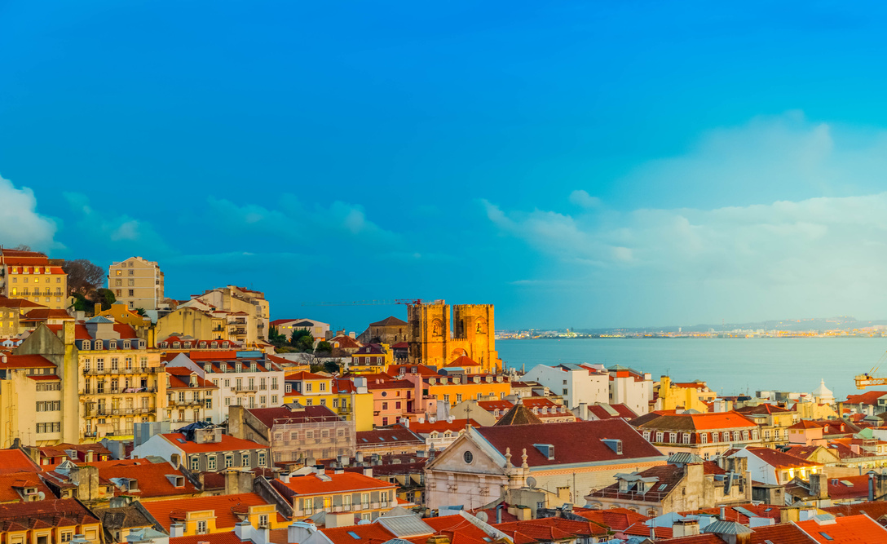
Back in Business
Exports And Imports
Visible Export | The purchase of physical Irish goods by a foreign based customer. | Kerrygold exported to Germany
Invisible Exports | The purchase of an Irish service by a foreign based customer. | Irish consumers buying a Toyota (Japanese car)
Visible Imports | The purchase of a foreign good by someone in Ire!and. | A US company paying for software services from an Irish IT firm.
Invisible Imports | The purchase of a foreign service by someone in Ire!and. | An Irish family booking accommodation for a holiday in Portugal.

Slide 43

Back in Business
The Balance Of Trade
The balance of trade is the difference between the value of visible exports and the value of visible imports during a time period.
If visible exports > visible imports = balance of trade surplus.
If visible exports < visible imports = balance of trade deficit.

Slide 44
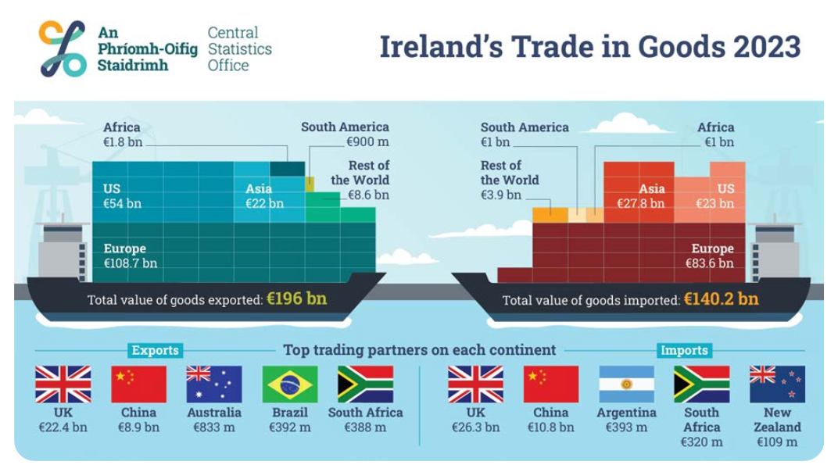
Back in Business
Calculate The Balance Of Trade

Slide 45
Back in Business
Calculating The Balance Of Trade
Goods Exported:€196 Billion
Goods Imported: €140.2 Billion
Balance Of Trade Surplus:
€55.8 Billion

Slide 46
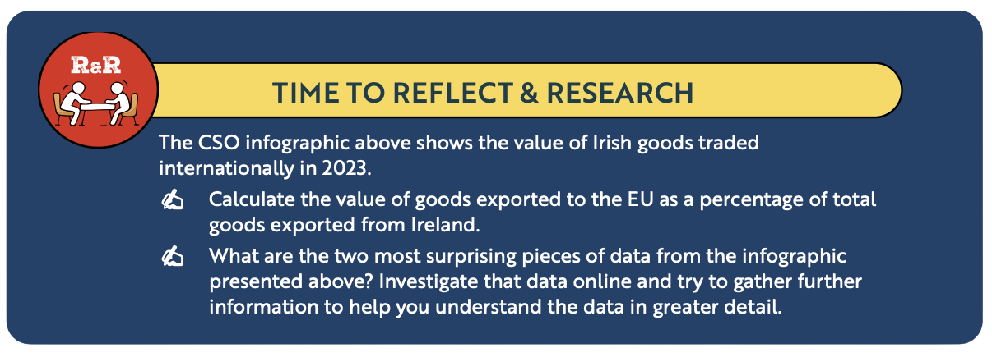
Back in Business
Reflect & Research

Slide 47

Back in Business
Calculate the Balance of Trade when given the value of total exports or imports and the value of invisible exports or imports

Slide 48
Back in Business
When given the value of total exports or imports and the value of invisible
exports or imports
Total exports are made up of visible exports and invisible exports. If we know total exports are €100bn and invisible exports are €30bn, we would be able to calculate visible exports (€100bn - €30bn) as €70bn.
If total imports are €90bn and invisible imports are €40bn, we would be able to calculate visible imports (€90bn - €40bn) as €50bn.
The balance of trade can then be calculated as €70bn - €50bn = a €20bn trade surplus.

Slide 49
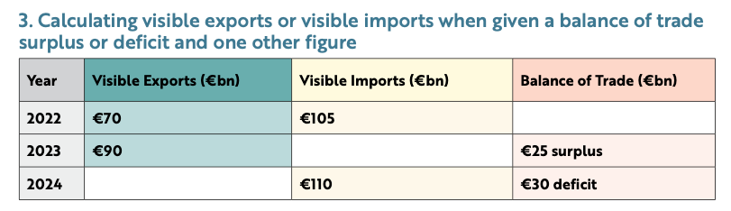
Back in Business
When given the value of total exports or imports and the value of invisible
exports or imports

Slide 50
Back in Business
When given the value of total exports or imports and the value of invisible
exports or imports
Use the formula: Visible Exports – Visible Imports
Calculation: €70bn – €105bn = €35bn trade deficit
Imports were greater than exports, resulting in a deficit.
2022
Given: Balance of Trade €25bn surplus, Visible Exports €90bn
A surplus means exports are higher than imports.
Calculation: €90bn – €25bn = Visible Imports €65bn
2023
Given: Balance of Trade €30bn deficit, Visible Imports €110bn
A deficit means imports are higher than exports.
Calculation: €110bn – €30bn = Visible Exports €80bn
2024

Slide 51
Back in Business
The Balance Of Payments
The balance of payments refers to the difference between the value of total exports and the value of total imports in a country for a time period.

Slide 52
Back in Business
The Balance Of Payments
If total exports are greater than total imports, we are said to have a balance of payments surplus.
If total exports are less than total imports, we are said to have a balance of payments deficit.

Slide 53
Back in Business
Calculate The Balance Of Payments
Visible exports €55bn
Visible imports €27bn
Invisible exports €53bn
Invisible Imports €86bn

Slide 54
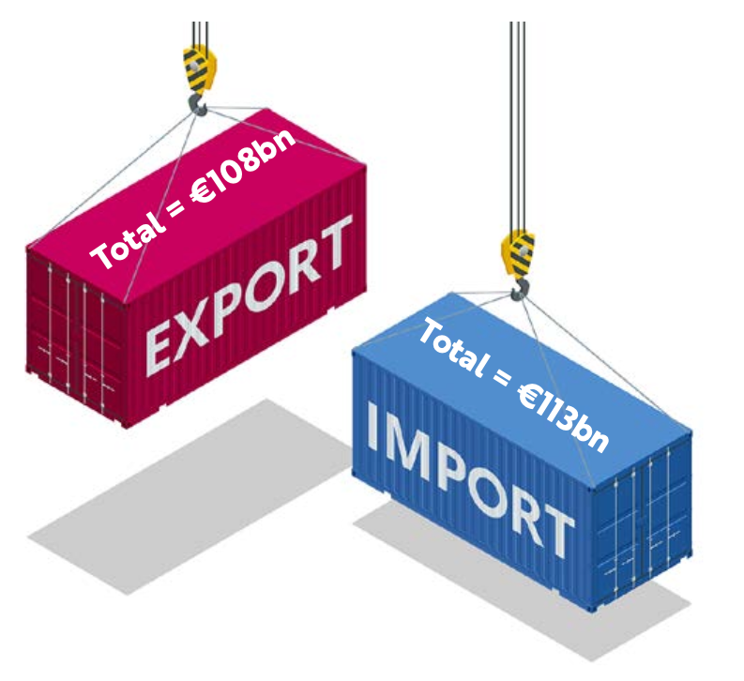
Back in Business
Calculating The Balance Of Payments
Total Exports:
€108 Billion
Total Imports:
€113 Billion
Balance Of Payments Deficit: €5 Billion

Slide 55
Suggested Activities for LO 5.6
Sample Papers
OL1 Q1 (a) (ii): T/F - An increase in exports by EverGlow Organics Ltd will improve Ireland's balance of payments.
Activity Book Qs
HL Q6
OL Q6

Slide 56
Learning Outcome 5.7
5.7 Evaluate the impact of Irish organisations trading internationally, with a focus on both positive and negative impacts and the social and environmental impact of globalisation.
Back In Business

Slide 57
Back in Business
Globalisation
LINK

Slide 58
Back in Business
Globalisation
The growing interdependence and interconnectedness of the world’s economies, cultures and populations arising from cross-border trade in goods, services, digital technology and the movement of investment, people, data, and information.

Slide 59
Back in Business
The Positive Impacts Of Globalisation On Irish Businesses
Irish firms can sell to global markets beyond Ireland’s small domestic economy, increasing sales and growth potential.
Example: Kerrygold now exports to over 110 countries worldwide.
Increased Market Access
Globalisation encourages multinationals to locate in Ireland, boosting jobs, technology, and local supply chains.
Example: Intel’s investment has driven demand for Irish suppliers and created skilled employment.
Foreign Direct Investment
Trading globally allows Irish businesses to scale up and cut unit costs through economies of scale, making exports more competitive.
Example: Pfizer manufactures and exports medicines at large scale from Ireland.
Improved Competitiveness

Slide 60
Back in Business
The Negative Impacts Of Globalisation On Irish Businesses
Financial
Risks
Changes in exchange rates can reduce profits when trading in non-euro markets.
If the euro strengthens against the US dollar, Irish exports become more expensive for American buyers.
Face Greater Competition
Irish firms face strong competition from larger global brands that may offer lower prices or greater marketing power.
Irish clothing producers competing with fast-fashion imports from Asia.
Cultural
Barriers
Different languages, customs, and business expectations can cause misunderstanding or affect sales.
Marketing that appeals to Irish customers may not suit other cultures.
International conflict, trade sanctions, or policy changes can disrupt exports and investment.
Tensions between major economies can lead to tariffs or supply chain uncertainty.
Political
Risks

Slide 61
Back in Business
The Social Consequences Of Globalisation
📌 Impact on local communities
While global trade creates jobs, it can also lead to outsourcing and the decline of local industries.
Some Irish manufacturers are replaced by cheaper imports or foreign multinationals producing at lower cost.
📌 Labour issues abroad
Irish companies relying on overseas suppliers may face ethical concerns if those suppliers do not follow fair labour standards.
Imports from non-EU countries may come from regions with weaker worker protections.
📌 Cultural homogenisation
Global brands can overshadow local culture and traditions.
The spread of international retail chains may replace local shops and reduce community identity.

Slide 62
Back in Business
The Environmental Consequences Of Globalisation
📌 Increased Carbon Emissions
International transport of goods contributes to higher greenhouse gas emissions.
Consumers choosing cheaper options from far away instead of local products adds to overall carbon output.
Exporting goods by air or sea creates a larger carbon footprint than selling locally.
📌 Resource Use and Waste
Global production and consumption can lead to overuse of natural resources and environmental damage.
The rapid growth of data centres in Ireland has increased pressure on the energy grid and environmental targets.
📌 Pressure on Sustainability
Irish firms trading internationally may face stronger expectations to meet global environmental standards.
For example, Irish firms selling into France may need to disclose their carbon emissions to meet consumer expectations.

Slide 63
Back in Business
Reflect & Research
LINK
LINK

Slide 64
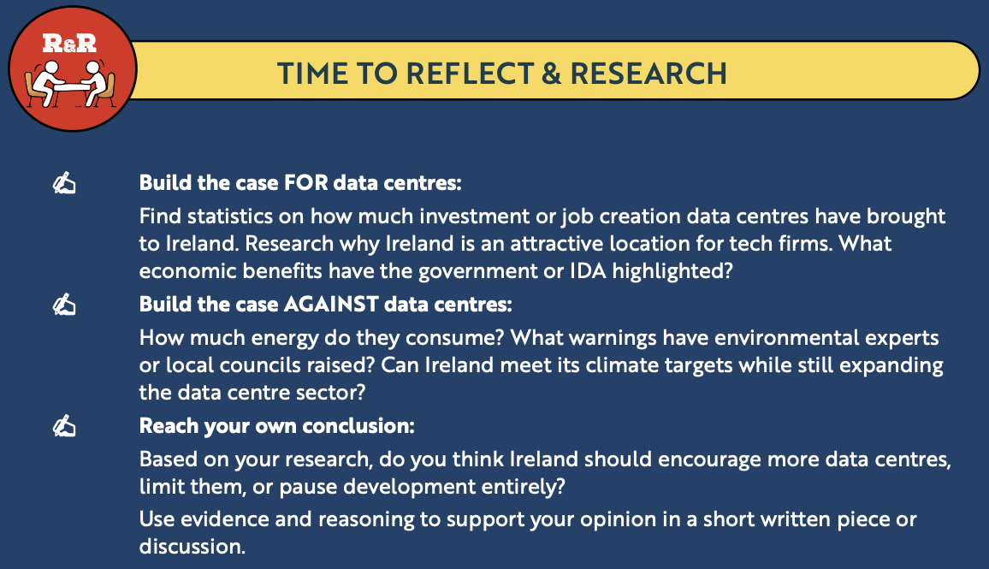
Back in Business
Reflect & Research

Slide 65
Suggested Activities for LO 5.7
Sample Papers
-
-
Activity Book Qs
HL Q7
OL Q7

Slide 66
Learning Outcome 5.8
5.8 Explain how globalisation can increase interdependence
and evaluate the consequences for both businesses and
consumers.
Back In Business

Slide 67
Back in Business
Globalisation Interdependence
Interdependence arises when one group depends on another for the supply of necessary goods and services.
Globalisation increases interdependence between economies and countries as the world is being treated like one marketplace. The world is becoming increasingly interconnected as a result of
massively increased trade and cultural exchange.

Slide 68
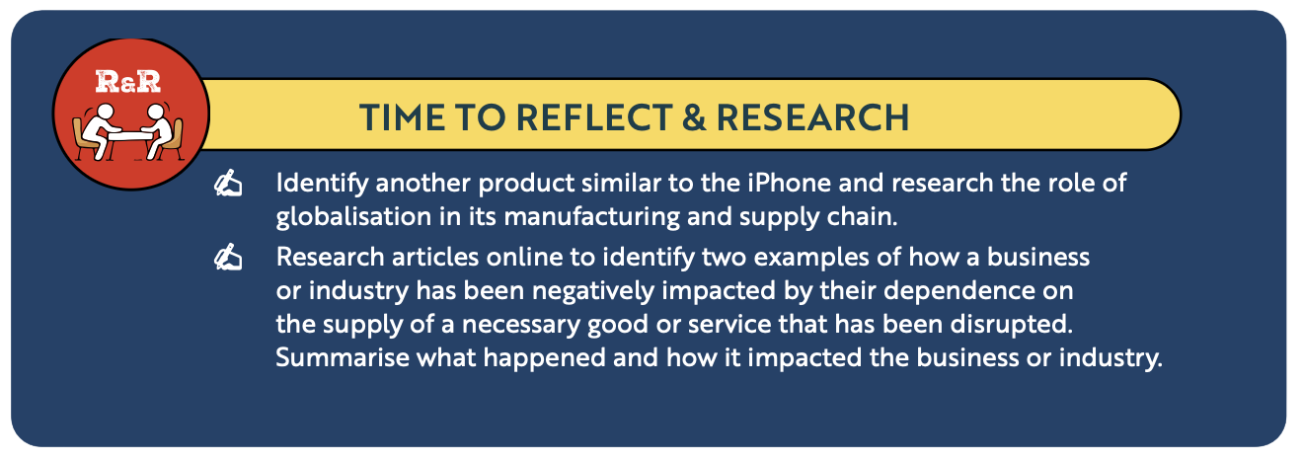
Back in Business
Reflect & Research

Slide 69
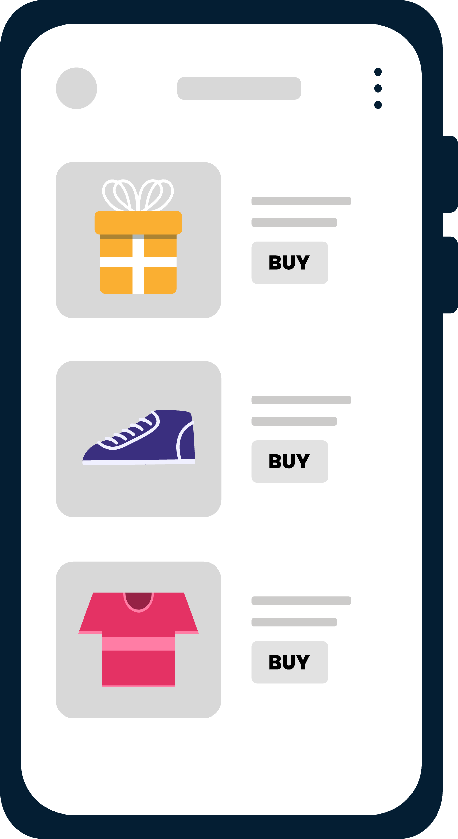
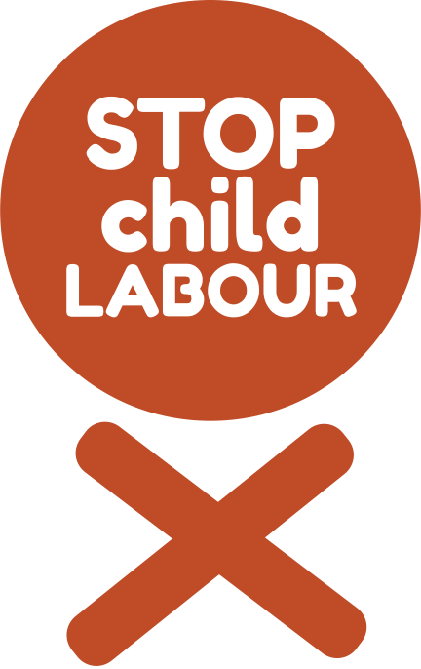
Back in Business
The Consequences Of Globalisation/Interdependence For Businesses
Access To Larger Markets
Irish firms can sell to millions more customers worldwide through e-commerce and trade links.
Interdependence boosts growth potential but also exposes smaller firms to tougher competition and market risks.
Irish food and tech exporters now trade freely across the EU and beyond.
Global supply chains reduce costs and improve quality, but create reliance on foreign producers.
Poor labour or environmental standards abroad can damage reputation.
Many Irish retailers import textiles from Bangladesh or Vietnam to stay competitive.
Access To Cheaper Or Better Suppliers

Slide 70
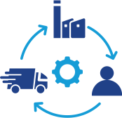
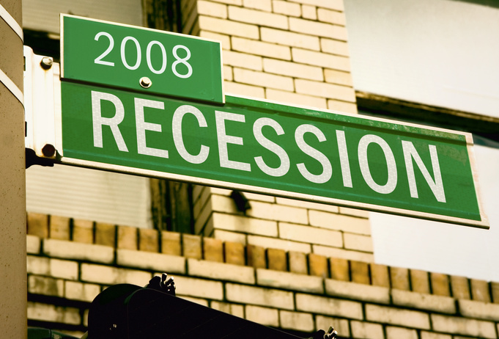

Back in Business
The Consequences Of Globalisation/Interdependence For Businesses
Greater Exposure To Suppply Chain Disruptions
When global suppliers face conflict, natural disasters, or shipping delays, Irish firms feel the impact immediately.
Recent shortages in timber and steel delayed Irish construction and drove up costs.
Vulnerability To Financial Shocks
Interconnected economies mean global downturns quickly affect Ireland.
The 2008 financial crisis, starting in the US, caused major slowdowns and investment losses here.
Increased International Competition
Global trade opens new markets but increases pressure from low-cost producers and global brands.
Irish clothing companies struggle to compete with fast-fashion giants like Shein.

Slide 71
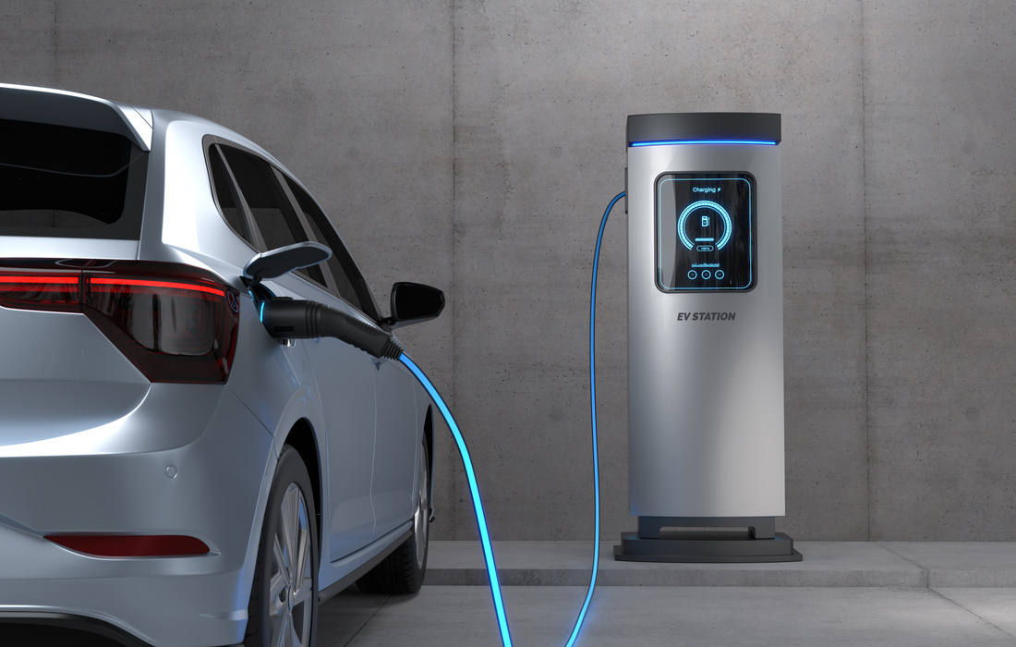
Back in Business
The Consequences Of Globalisation For Consumers
Irish consumers can now access products from around the world, offering more variety and brands than ever before.
Australian fashion label White Fox has become hugely popular among Irish shoppers.
Increased Choice
Stronger competition between global brands leads to cheaper prices and better value.
Chinese car manufacturer BYD entering the Irish market has helped lower electric vehicle prices.
Lower Prices

Slide 72
Back in Business
The Consequences Of Globalisation For Consumers
Cheaper global goods encourage consumers to buy more and replace items quickly, increasing waste.
Fast-fashion sites like Shein promote high consumption and short product lifespans.
Less Ethical Consumption
Global brands dominate, reducing demand for traditional and local goods.
The arrival of Amazon’s Irish store may threaten smaller Irish retailers and local shopping culture.
Cultural Homogenisation
Less Environmentally Friendly Choices
Shipping goods over long distances increases global emissions.
Ordering from China or Australia instead of buying Irish-made goods raises the carbon footprint.

Slide 73
Suggested Activities for LO 5.8
Sample Papers
HL2 Q2 (d): Outline three challenges that consumers in Ireland face as a result of the country’s reliance on globalisation.
Activity Book Qs
HL Q8
OL Q8

Slide 74
Learning Outcome 5.9
5.9 Evaluate the role of technology in globalisation.
Back In Business

Slide 75
Back in Business
How The Role Of Technology Impacts Trade
Improved Distribution through ICT
Advances in information and communication technology (ICT) allow real-time tracking of shipments and better coordination across global supply chains.
Digital platforms reduce delays, improve logistics, and lower transport costs for Irish exporters.
AI-Enabled Forecasting
Artificial intelligence (AI) helps businesses plan inventory and manage supply chains more efficiently.
AI systems can predict demand, reduce waste, and keep stock levels accurate, improving profit margins and delivery reliability.

Slide 76
Back in Business
How The Role Of Technology Impacts Work Practices
Remote Collaboration and Flexibility
Cloud computing and video-conferencing tools such as Zoom and Google Meet let teams work together across countries.
Businesses can manage global offices from Ireland, while employees can work remotely or even live abroad.
New Working Models
Technology supports freelancing and gig-based employment through accessible online platforms.
Sites like Fiverr allow people to offer services worldwide, creating new income opportunities outside traditional employment.

Slide 77
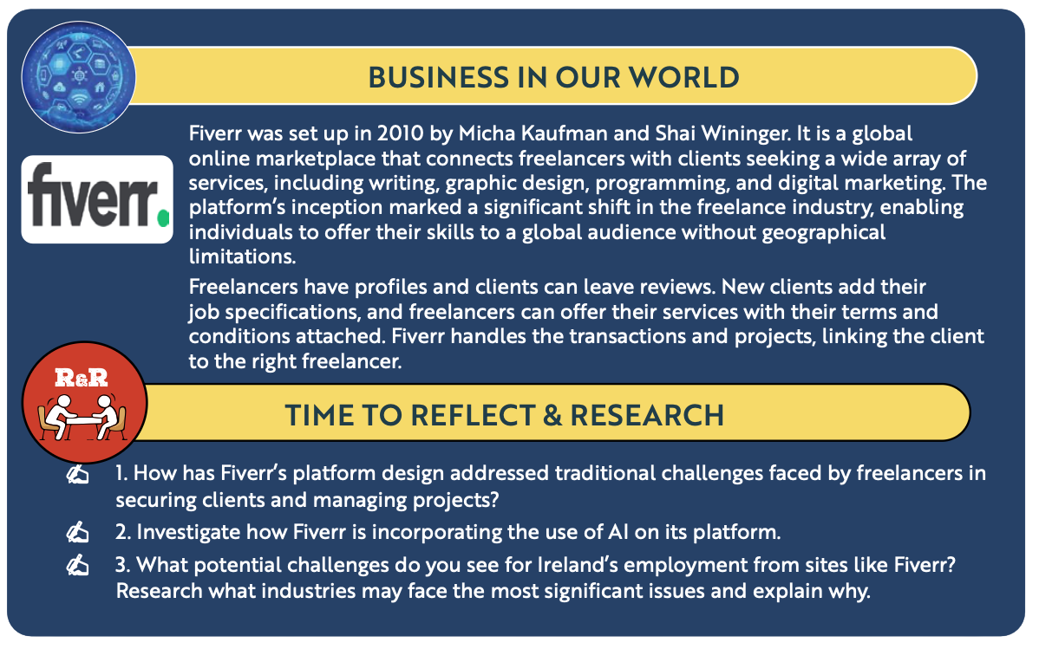
Back in Business
Reflect & Research

Slide 78

Back in Business
How The Role Of Technology Impacts Business Operations
Improved Marketing
Social media platforms such as Facebook, Instagram, and Snapchat keep businesses connected to customers 24/7.
They allow targeted advertising and help build brand loyalty across different market segments.
Market Research
Online tools let businesses research markets, competitors, and suppliers quickly.
E-commerce platforms and Google Analytics give instant feedback on consumer behaviour, leading to faster, data-driven decisions and cost savings.

Slide 79
Back in Business
How The Role Of Technology Impacts Business Operations
E-Commerce Expanding Market Reach
Platforms like Shopify and WooCommerce help small Irish businesses sell globally.
Faster delivery systems and lower distribution costs make it easier for even local stores to trade internationally.
New Industries
Digital technology continues to create new industries and transform traditional ones.
Spotify, for example, reshaped the global music market through online streaming innovation.

Slide 80
Suggested Activities for LO 5.9
Sample Papers
-
-
Activity Book Qs
HL Q9

Slide 81
Learning Outcome 5.10
5.10 Explain what is meant by Foreign Direct Investment and
investigate how the Irish government promotes Foreign Direct Investment.
Back In Business

Slide 82

LINK

Slide 83
Back in Business
What Is Foreign Direct Investment (FDI)?
Foreign Direct Investment (FDI) occurs when a company or individual from one country invests directly in facilities, operations, or businesses in another country.
This could involve setting up a new office or factory, acquiring a business, or expanding existing operations.
FDI usually involves long-term involvement of a business abroad in the business operations of the host country. US tech company Apple’s investment in its Cork operations, creating jobs and long-term infrastructure, is an example of FDI in Ireland.
FDI plays a crucial role in Ireland’s economy, supporting thousands of jobs, contributing to tax revenues, and boosting innovation. Through investment in human capital, supportive policies, strategic EU access, and a focus on research and development, Ireand continues to be a leading global hub for foreign investment.

Slide 84
Back in Business
How Ireland Attracts Foreign Direct Investment
LINK

Slide 85
Back in Business
How Ireland Attracts Foreign Direct Investment
Human Capital Development
📌 Ireland invests heavily in education and training, especially in areas like technology, science, and engineering.
📌 Partnerships between universities and industry help ensure a skilled and adaptable workforce.
📌 For example, Irish universities and institutes of technology offer courses in artificial intelligence, pharmaceuticals, and data analytics that are developed in consultation with industry to meet the talent needs of multinational companies.

Slide 86
Back in Business
How Ireland Attracts Foreign Direct Investment
Pro-Enterprise Policy
📌 Ireland offers a"low corporation tax rate (12.5%), which attracts multinational companies. Large multinationals with annual revenue greater than €750m are charged 15% on their profits in corporation tax.
📌 Government agencies like IDA Ireland actively promote investment opportunities and provide support to foreign companies setting up in Ireland.
📌 Business-friendly regulations and ease of doing business make it attractive for companies to operate here.

Slide 87
Back in Business
How Ireland Attracts Foreign Direct Investment
Access To Markets
📌 Ireland is an English-speaking member of the EU, providing full access to the European Single Market.
📌 It serves as a gateway to Europe for companies from the US, Asia, and beyond.
📌 After Brexit, Ireland remains the only EU country with English as a first language, increasing its strategic appeal.

Slide 88
Back in Business
How Ireland Attracts Foreign Direct Investment
Research, Development, and Innovation
📌 Ireland encourages FDI by supporting R&D activities through grants, tax credits, and innovation hubs.
📌 Many multinational companies establish research centres in partnership with Irish universities.
📌 For instance, Google, Intel, and Pfizer all carry out R&D work in Ireland, supported by national research initiatives.

Slide 89
Back in Business
The Role Of IDA Ireland
IDA Ireland provides key data on Ireland’s business environment, property options, and sector performance.
This helps potential investors choose suitable locations and understand the advantages of operating in Ireland.
Provide key data / information
The agency connects international investors with local businesses, government departments, and research partners.
These introductions make it easier for new companies to set up quickly and build relationships in Ireland.
Industry / Govt Networking
IDA Ireland works with universities and research centres to align skills and innovation with investor needs.
This ensures a strong pipeline of talent and supports research and development partnerships across sectors.
Link Industry to Education

Slide 90
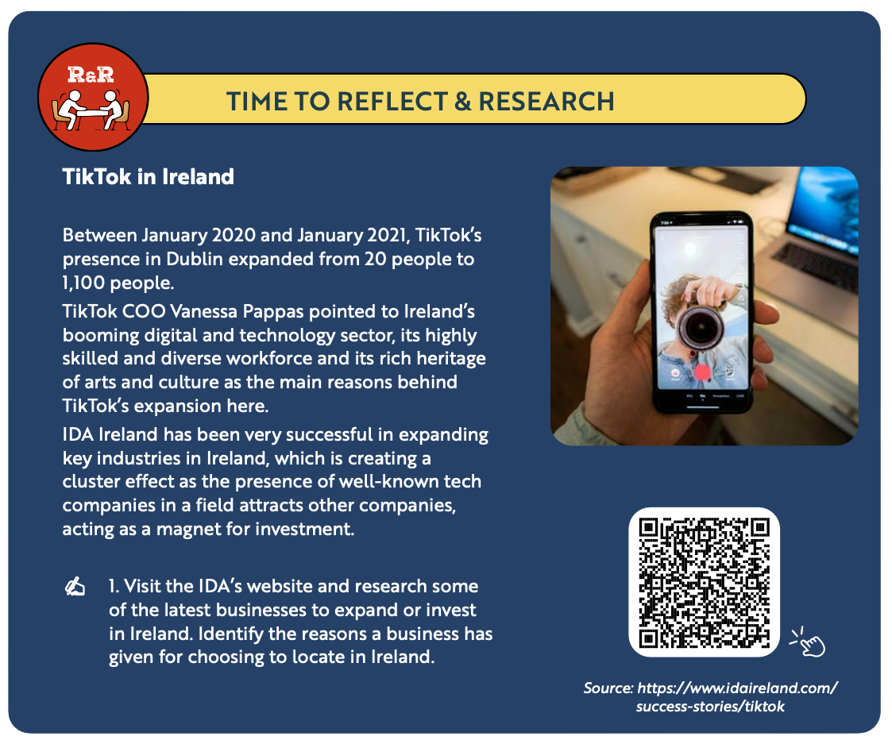
Back in Business
Reflect & Research

Slide 91
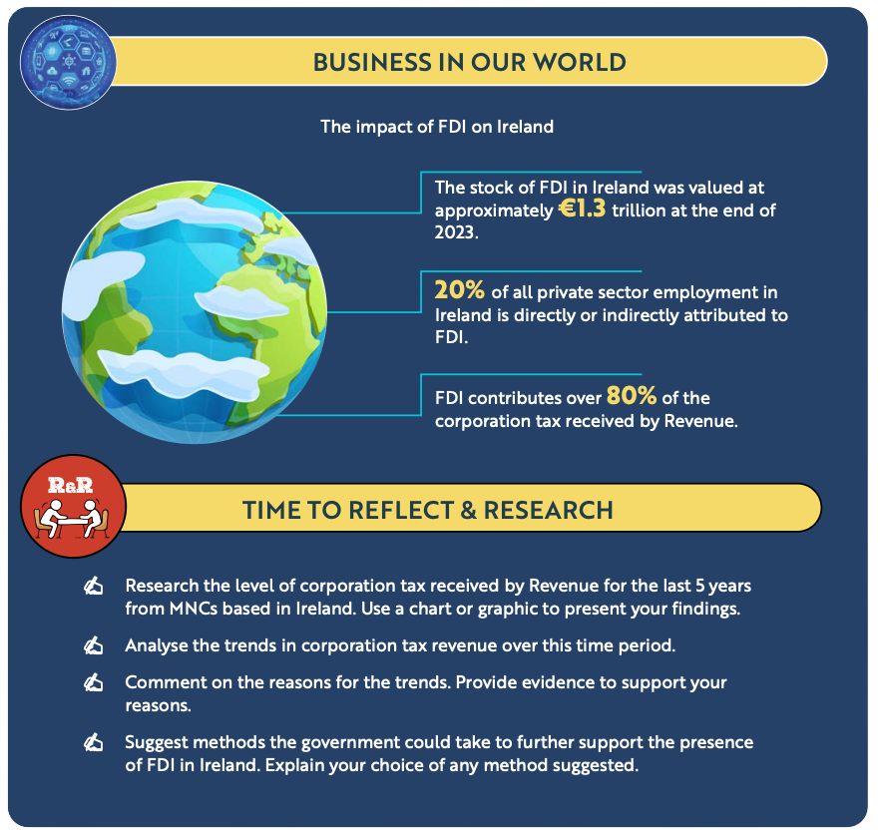
Back in Business
Reflect & Research

Slide 92
Suggested Activities for LO 5.10
Sample Papers
HL1 Q4 (a): Outline two reasons why a business such as Dexcom, would locate in Ireland.
Activity Book Qs
HL Q10, Q11
OL Q9, Q10

Slide 93
Learning Outcome 5.11
5.11 Outline the contribution of Foreign Direct Investment to the Irish economy.
Back In Business

Slide 94
Back in Business
Opportunities For Ireland Of FDI In Ireland
Employment | Over 300,000 people are directly employed by multinational companies (MNCs). FDI supports regional development, with over half of new investment located outside Dublin.
Revenue | MNCs contribute over 80% of Ireland’s total corporation tax receipts. Their presence also generates indirect revenue through local suppliers and supporting industries.
Research | Ireland has become a leading location for R&D-focused FDI, especially in pharmaceuticals, medical devices, and technology. The government provides strong support and incentives for R&D through agencies such as IDA Ireland
Infrastructure | IDA Ireland develops enterprise zones and business parks to support regional investment. FDI-driven tax revenue enables government investment in transport, communications, and utilities.
Innovation | FDI introduces new technologies, management practices, and international expertise to Ireland. This supports the growth of innovation clusters and strengthens Ireland’s knowledge economy.

Slide 95
Back in Business
Challenges For Ireland Of FDI In Ireland
Employment | Automation and relocation threaten jobs in certain sectors. Recent global tech layoffs and policies encouraging US firms to return home may impact Irish-based employment.
Revenue | The OECD’s global minimum corporate tax rate of 15% may reduce Ireland’s tax advantage in attracting FDI. A small number of large firms account for much of Ireland’s tax income, so losing them would significantly affect the economy.
Research | Skills shortages in high-tech sectors have increased wages and made it harder for Irish-owned firms to compete for talent.
Infrastructure | Infrastructure pressures, particularly in housing and energy, make it harder to attract and retain skilled workers. Data centres supporting FDI operations place additional strain on Ireland’s energy supply.
Innovation | Over-reliance on foreign-owned companies for innovation leaves Ireland vulnerable if R&D operations are relocated abroad.

Slide 96
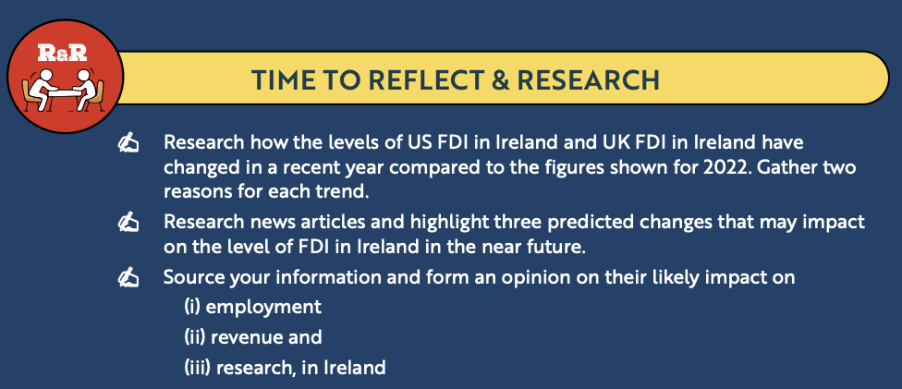
Back in Business
Reflect & Research

Slide 97
Suggested Activities for LO 5.11
Sample Papers
HL1 Q4 (b): Outline two opportunities and two challenges of Foreign Direct Investment (FDI) for Ireland.
Activity Book Qs
HL Q12
OL Q11

