Slide 1

Strand 2
Chapter 9
The Target Market
Back In Business

Slide 2
Chapter Links
Starter worksheet
Chapter plan
Activity book solution
Sample Paper workpack
Class exam
Flashcards

Slide 3


Back In Business
Starter Activity
Spot the Target Market
A business creates a marketing mix for their product or service based on the 7 P’s. They will adjust these P’s based on their target market - e.g. the group of customers that they feel are most likely to buy their product or service e.g. parents of young kids, rich people interested in luxury cars, budget-conscious young adults...
Based on the examples shown for each product/service, suggest what the target market is for each brand, and justify it based on one of the P’s:
Product/service, Pricing, Promotion, People, Packaging, Process, and Place.

Slide 4

Introduction
Starter Activity
1
Herbert Park Hotel
https://www.youtube.com/watch?v=ad13WYntPtU

Slide 5
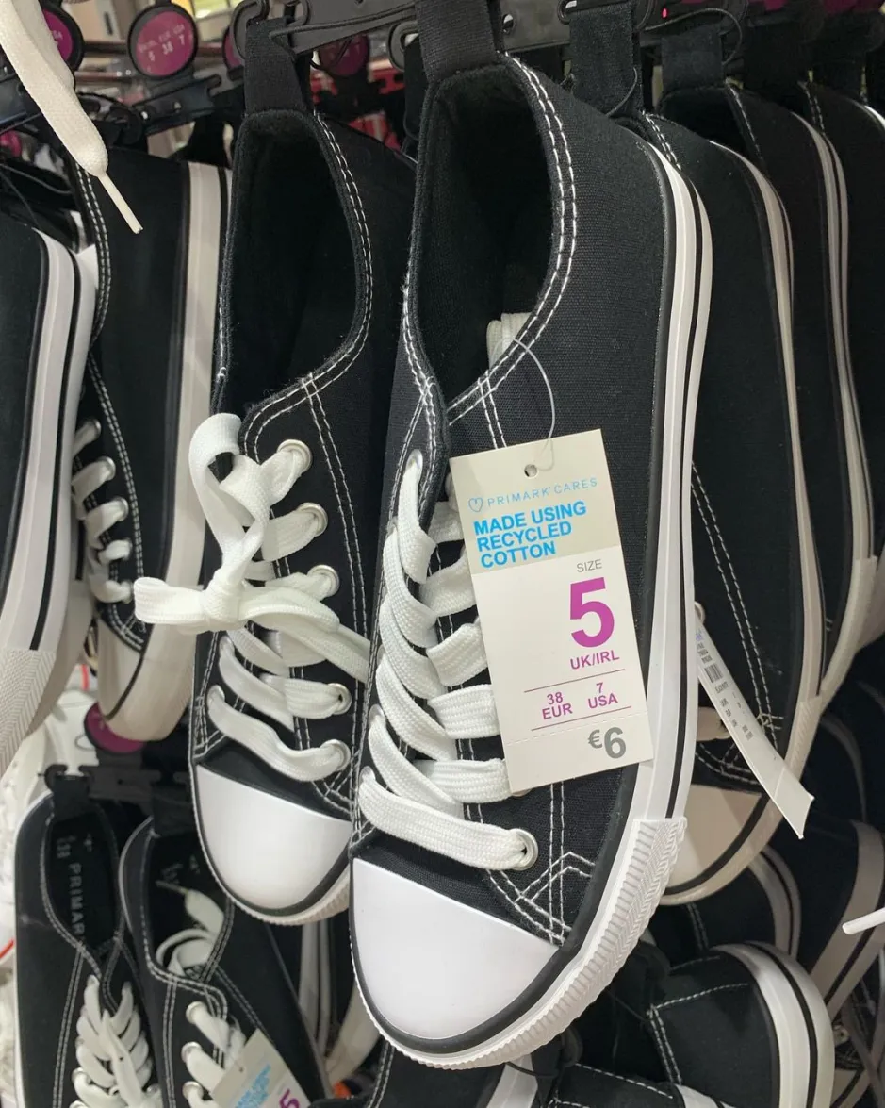
Starter Activity
2
Penneys
Credit: Social Media Collect

Slide 6

Starter Activity
3
McDonalds
https://www.youtube.com/watch?v=WVHbtqyJ2IE

Slide 7
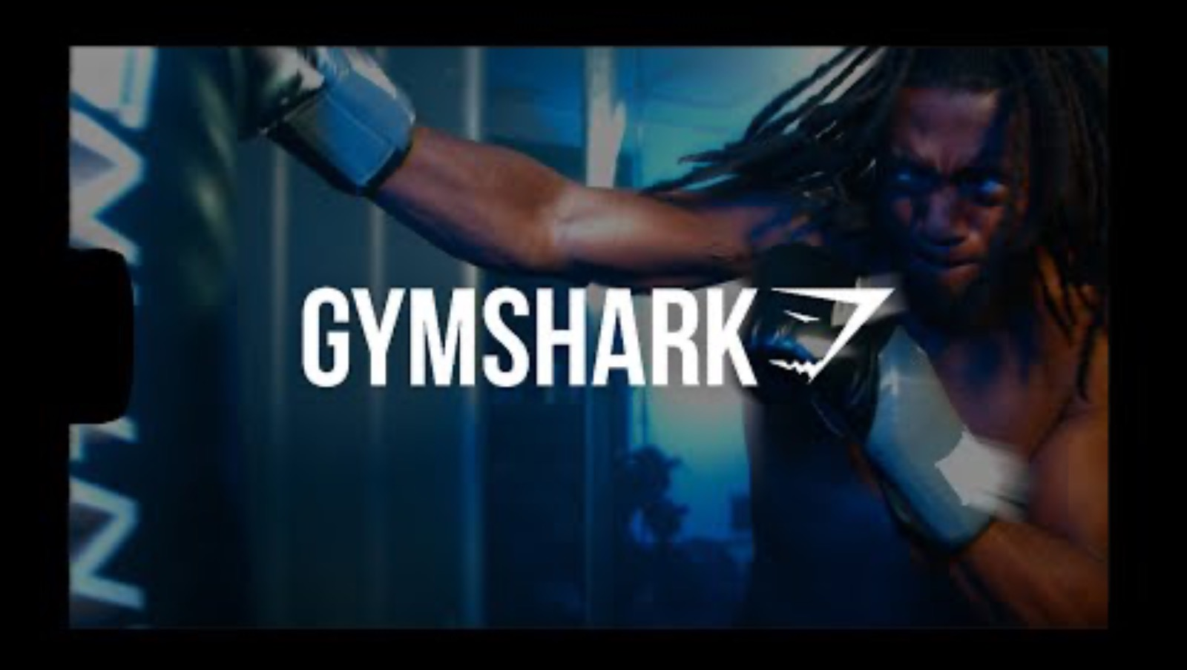
Starter Activity
4
GYMSHARK
https://www.youtube.com/watch?v=YXXa9oYrPCI

Slide 8
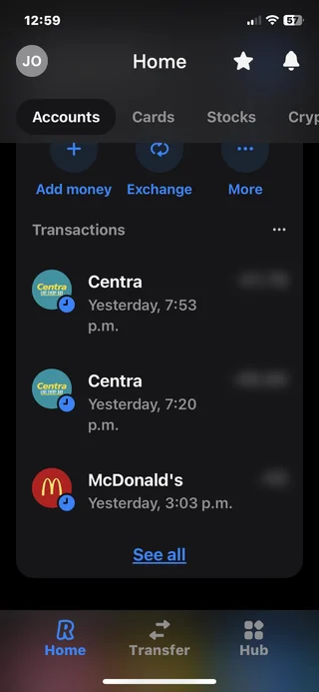
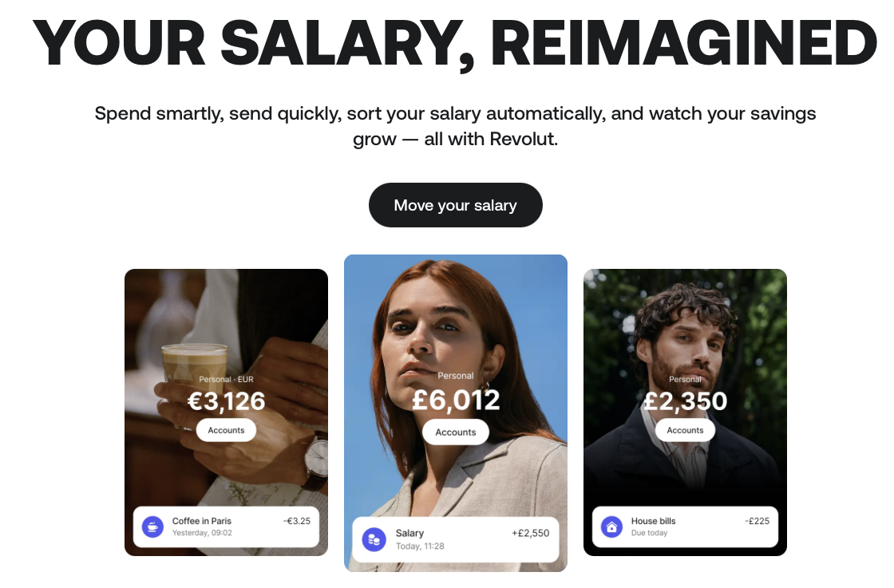
Starter Activity
5
REVOLUT

Slide 9
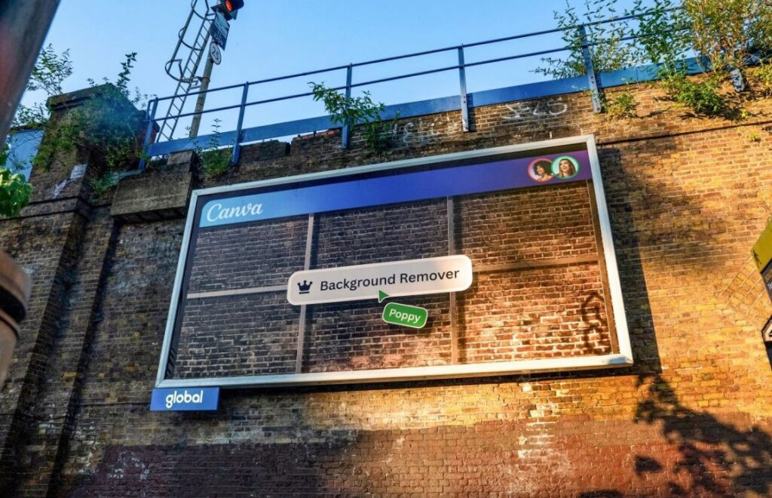
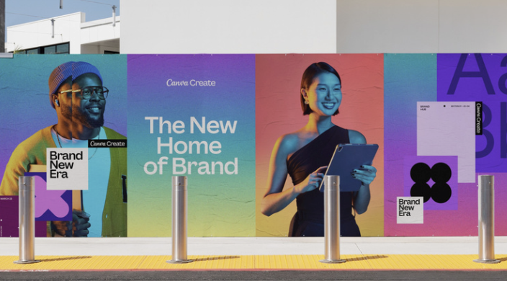
Starter Activity
6
CANVA
Source: https://www.famouscampaigns.com/2025/06/when-creative-chaos-meets-canva-in-ooh-campaign/

Slide 10
Back In Business
Primer Questions
  Who is your favourite brand aimed at?
  What about the brand makes you think that?
  Has packaging ever influenced your decision to buy a product?
  What brands are you loyal to, and why?
  Can you name a brand or product that didn’t succeed? Where do you think they went wrong?
  How would you have changed the way they marketed their product or service?

Slide 11

Learning Outcome 9.1
9.1 Appreciate the importance of market research in identifying the target market and discuss how businesses conduct market research.

Slide 12

Back In Business
The target market
This is the specific segment or group of customers that a business is trying
to sell to, usually defined by common characteristics such as age, gender,
income, location, lifestyle, habits, and interests.
It can be based on shared needs, preferences, or characteristics.
A strong marketing strategy starts with knowing who you are selling to.
E.g. Teens interested in fitness, urban professionals, price-conscious families.

Slide 13

Back In Business
The Importance of Identifying the Target Market
Stronger Brand Identity
Helps shape the name, logo, and tone to match customer preferences.
E.g. Mooju targets 16–24-year-old males with fun, youthful branding.
Better Product Design
Products can be tailored to suit customer needs and lifestyles.
E.g. Nobó created dairy-free ice cream for health-conscious consumers.

Slide 14
Back In Business
The Importance of Identifying the Target Market
Smarter Marketing Choices
Enables businesses to select the best platforms and messages.
E.g. Chupi uses Instagram and email to reach fashion-conscious customers looking for jewellery.
Improved Customer Loyalty
Matching expectations builds trust and encourages repeat purchases.
E.g. SuperValu adapts product ranges to reflect local community needs.

Slide 15
Back In Business
Market Segmentation
Market segmentation means dividing a market into smaller, distinct groups that have common characteristics.
It helps identify which segment a business should target based on customer needs and behaviours.
Once identified, businesses can tailor their marketing strategies to reach that group more effectively.
Market segmentation helps support clearer brand messaging, better product fit, and improved marketing results.

Slide 16
Back In Business
Types of Market Segmentation
Demographic Segmentation
  Based on age, gender, income, family size, and occupation.
  Useful for mass marketing where traits are easily grouped.
  E.g. Ads targeting high-income adults using CSO income data.
Geographical Segmentation
  Based on location like county, region, or country.
  Reflects local cultures, languages, or media habits.
  E.g. Regional radio ads tailored for rural or urban audiences.

Slide 17

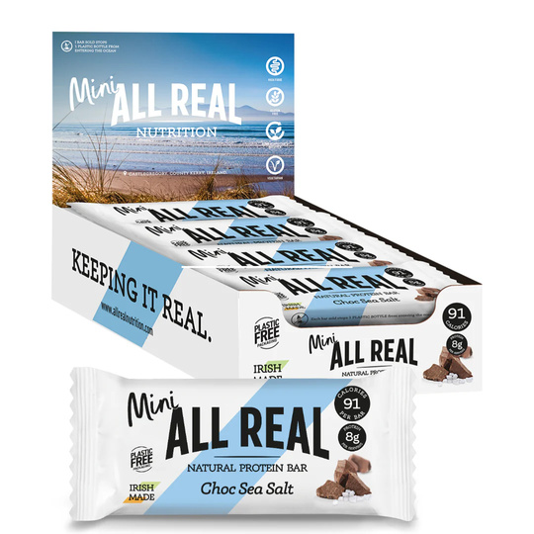
Back In Business
Types of Market Segmentation
Behavioural Segmentation
  Focuses on attitudes, product knowledge, or usage habits.
  E.g. Impulse buying, value seekers, seasonal product appeal.
Psychological Segmentation
  Based on lifestyle or personality traits. Examples of this include
    Lifestyle: Health-conscious buyers of protein bars.
    Ethical: Shoppers choosing FairTrade products.
    Sustainable: Customers loyal to eco-brands like Patagonia.

Slide 18

Reflect & Research (Pg 144)
https://www.youtube.com/watch?v=7YejpU3juqo&t=1s
https://www.youtube.com/watch?v=kPK-ldnC6Xs&t=2s
https://www.youtube.com/watch?v=zlgVtFdOo3s
https://www.youtube.com/watch?v=ypA_me9jHVk

Slide 19
REFLECT & RESEARCH Pg 144
1. Point out different parts of Mooju’s marketing strategy that show they are targeting teenagers (design, packaging, logos, branding, promotions...)
2. Choose a product that either you or people your age love. Visit the brand’s website and social media platforms. Identify the different ways that they target your age group (packaging, brandings, slogans, logo, flavours), or engage or interact with their target market. (e.g. Instagram polls, limited editions, collaborations).

Slide 20
Back In Business
Reasons for Carrying Out Market Research
Estimate Market Size and Trends - Helps businesses understand if a market is growing and what its key features are.
Analyse Competitors - Reveals rivals’ strengths and weaknesses to improve competitive positioning.
Shape the Marketing Mix - Guides decisions on product design, pricing, promotion, and sales strategy.
Test and Improve Products - Research shows what customers value, reducing the risk of failed products.

Slide 21
Back In Business
https://www.youtube.com/watch?v=HtPCyQaMeu8&embeds_referring_euri=https%3A%2F%2Fhubblecontent.osi.office.net%2F&source_ve_path=Mjg2NjY

Slide 22
Back In Business
Field Research
Collecting new, first-hand information (primary information) directly from customers to guide business decisions.
Types of Field Research:
Surveys: Customers are asked specific questions using interviews, polls, or questionnaires to gather both facts and opinions.
Observation: Staff or digital tools watch customer behaviour in shops or online to see what works and what doesn’t, without asking questions that may bias the response.

Slide 23


Back In Business
Field Research
Customer Feedback: Feedback is collected at the point of sale (e.g. smiley buttons, ratings) to improve products or services.
Focus Groups: Small groups of customers discuss a product or campaign in depth before launch, giving businesses valuable insights.

Slide 24
Back In Business
Field Research
ADVANTAGES
Allows a business to collect the most up-to-date information available.
Data gathered can be highly specific and tailored to the business’s needs.
DISADVANTAGES
It can be expensive to gather and analyse, although digital methods are reducing these
costs.
It can be time-consuming to collect, organise,
and interpret data.

Slide 25
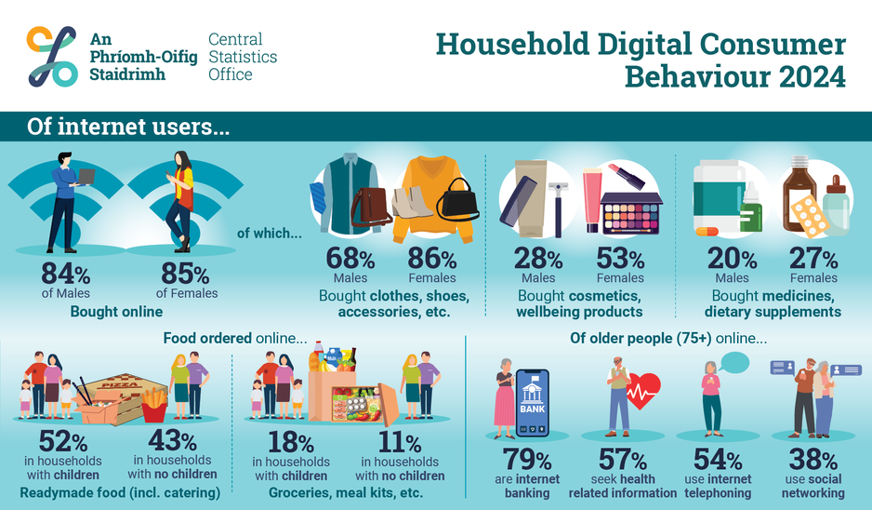
Back In Business
Desk Research
Desk research involves using existing information that has already been collected by others. It is quicker and cheaper than field research, though not always fully tailored to a business's needs.
Types of Desk Research:
Internal Reports: Information already held by the business, such as past sales data, customer records, or previous surveys.
Government Publications: Publicly available data
from sources like the CSO, including population
trends, income levels, and regional demographics.

Slide 26
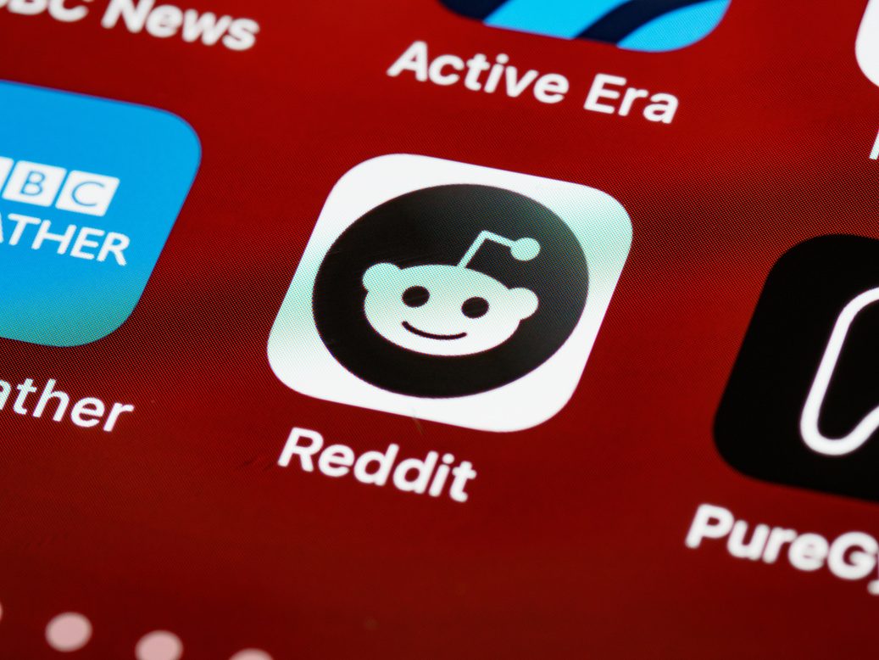

Back In Business
Desk Research
Online Sources: Information from websites, databases, and competitors’ online content (e.g. social media, reviews).
Industry Reports & Market Studies: Research from agencies or trade bodies that show consumer trends and market forecasts.

Slide 27
Back In Business
Desk Research - advantages
Quick and Low Cost
Desk research is faster and less expensive than field research, as the information already exists.
Easily Accessible
Data from websites, government sources, and internal reports can be accessed without needing new collection tools.
Useful for Trend Analysis
Secondary data helps businesses spot broad trends and compare markets over time.

Slide 28
Back In Business
Desk Research - disadvantages
May Be Outdated or Inaccurate
Information might not reflect current market conditions or customer behaviour.
Not Always Specific to Business Needs
General data may not fully match a business’s target market or goals.
Limited Insight into Customer Motivation
Desk research shows what is happening, but not always why it’s happening.

Slide 29
Suggested Activities for LO 9.1
Sample Papers
OL1 Q1 (d) – Discuss two types of market research EverGlow Organics Ltd may use before expanding their business.
OL2 Q2 (i) - Identify the intended target market for the game advertised above.
Activity Book Qs
HL Q1
OL Q1, Q2

Slide 30
Learning Outcome 9.2
9.2 Outline the elements of the marketing mix and explain their significance for a business, and how they are influenced by the target market.

Slide 31
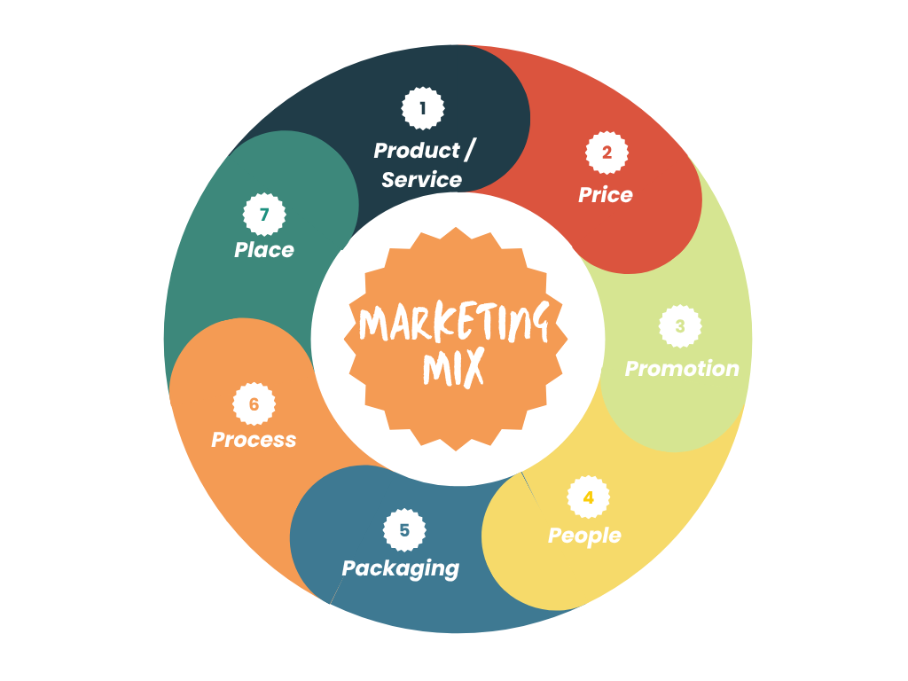
Back In Business
The Marketing Mix - 7 P’s
The marketing mix is developed and then adapted to suit its target market’s preferences and habits.

Slide 32
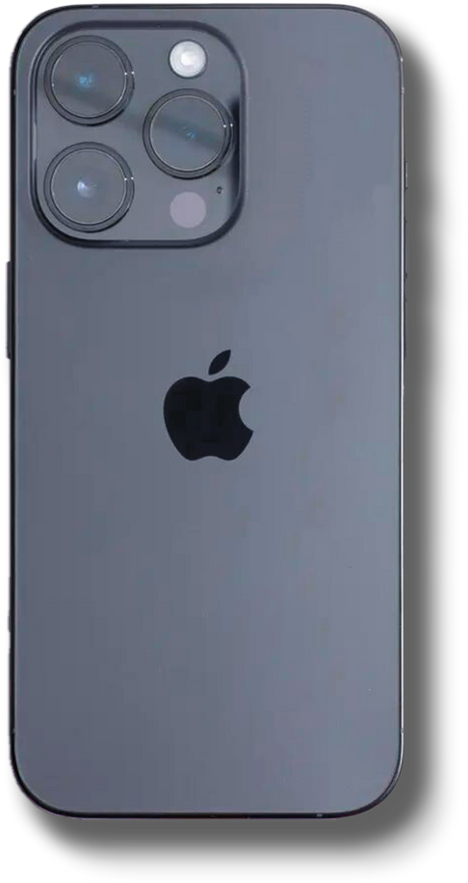
Back In Business
Product/Service - 1. The USP, 2. Branding
1. The USP
This is the differentiating feature that distinguishes a product or service from its competitors.
2. Branding
Branding differentiates a company’s products from those of its rivals by giving them a name (e.g. Apple’s iPhone), a design (e.g. the distinctive shape of the iPhone), or a logo (e.g. the Apple logo). Businesses can also use slogans, like Nike’s ‘Just Do It’, to support their branding.

Slide 33
Reflect & Research (Pg 150) (46 mins)
https://www.youtube.com/watch?v=m1FXWFSjYB4&t=1s

Slide 34
Back In Business
Product/Service - 3. Product Design
  Core Features – The design must meet the basic needs of the product (e.g. time for a smartwatch), with added features to attract the target market (e.g. fitness tracking).
  Branding – Design can give a visual identity and message (name, logo, packaging, store design) that reflect the brand's values and appeal.
  Target Market Appeal – Design should match customer preferences in shape, size, and usability (e.g. bold packaging for busy health-conscious adults).

Slide 35
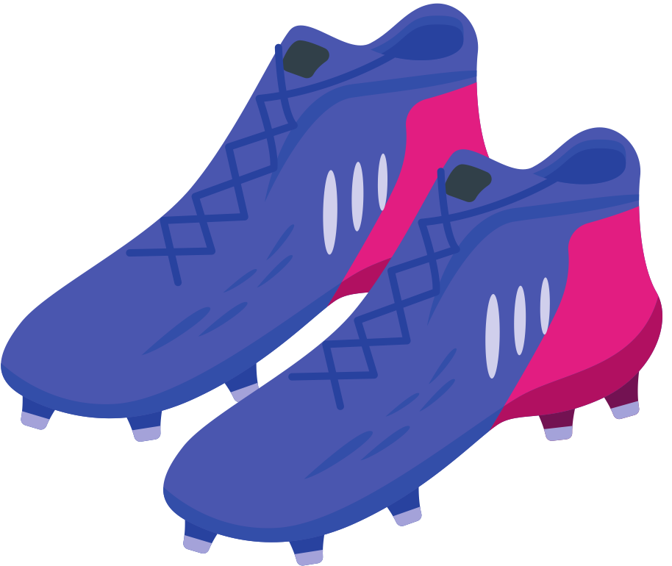

Back In Business
Product/Service - 3. Product Design
  Quality – Affects durability and reputation; must balance cost with customer expectations (e.g. reliable GAA boots).
  Sustainability & Ethics – Reflects brand values; can build loyalty (e.g. compostable packaging, plant-based meals).

Slide 36
Back In Business
How the target market can influence the product
1. The USP
The USP must match what the target market values most. E.g. Spotify offers personalisation for convenience-seeking listeners.
2. Branding
The brand’s name and look should reflect the lifestyle and tastes of its audience. E.g. Chupi appeals to style-conscious gift buyers.
3. Product Design
Design must suit the target market’s needs in style, price, and usability. E.g. IKEA designs for young adults setting up their first home.

Slide 37
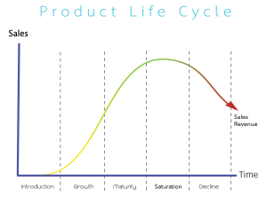
Back In Business
Product/Service - 4. Product Life Cycle
The"product life cycle" charts the stages a product goes through from launch to eventual withdrawal
from the market, by showing the expected levels of sales for each stage.

Slide 38
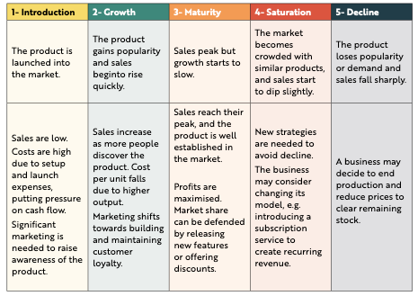

Slide 39
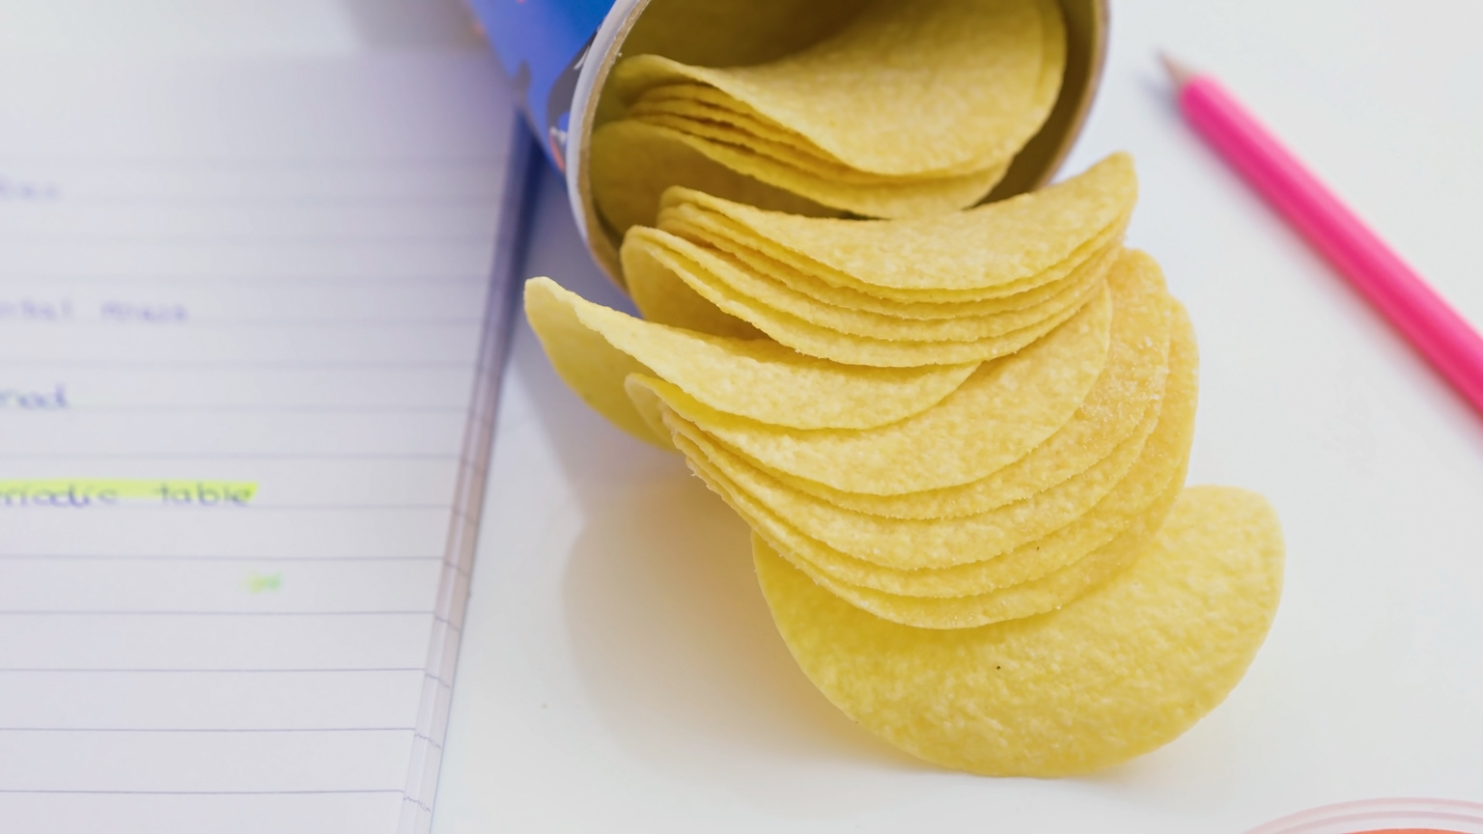
Back In Business
Product/Service - 4. Product Life Cycle
Businesses will look to extend the life cycle of a product by adjusting their marketing mix to try to prevent a decline in stages.
They will adjust one or more of the 7 P’s to try to keep sales high.
Let’s look at how Pringles might try to extend the life-cycle for their crisps.

Slide 40
Back In Business
Extending the Product Life Cycle
1. Product (New Flavours or Limited Editions):
Introduce seasonal or limited-time flavours (e.g. "Spicy Garlic Summer Edition") to spark renewed interest and attract loyal and new customers.
2. Price (Special Offers or Bundle Deals):
Offer multi-buy deals or family-sized packs to encourage more frequent or larger purchases, especially in value-driven markets.
3. Place (Expand Availability):
Increase distribution by targeting new markets or outlets (e.g. convenience stores, airports, or international supermarkets).
4. Promotion (Influencer Marketing or Nostalgia Campaigns):
Run social media campaigns or team up with influencers to refresh the brand's image. Alternatively, re-release retro packaging to appeal to nostalgic consumers.

Slide 41
REFLECT & RESEARCH Pg 150
1. Identify a product or service for each stage in the product life cycle, and justify your choice by referring to the information above.
2. For a product and a service of your choice, recommend three methods that could be used to extend their product life cycle.
Make sure to refer to a different ‘P’ for each method given i.e. don’t write two points about pricing strategies for one of the products or services.

Slide 42

Back In Business
Factors a Business Considers when Setting a Price
Target Market (Demographics & Size)
  Income levels affect what customers are willing to pay.
  Customers expect standard prices (e.g. €3.50–€4 for coffee).
  Higher income = potential for higher pricing.
Cost of Production
  Prices must cover costs (materials, wages, rent) and leave a profit.
  Small businesses may charge more as they lack economies of scale so have a higher cost per unit for each good sold.

Slide 43
Back In Business
Factors a Business Considers when Setting a Price
Competitor Prices
  Must stay competitive or offer value to justify price compared to alternative goods.
  Can use premium pricing (e.g. Rolex) or low-cost pricing (e.g. Penney’s) depending on strategy in the market.
Economic Conditions
  In a strong economy, businesses may increase prices (e.g. hotels).
  During a recession, prices may drop to keep sales steady.

Slide 44


Back In Business
Pricing - Types of pricing strategies
Pricing Strategies
Penetration Pricing
  Low price to enter a market and gain customers/market share quickly.
  E.g. HelloFresh offered deep discounts to attract first-time users.
Price Skimming
  Price high to start to target early adopters, then drop the price later.
  E.g. Sony PlayStation consoles launch at a premium before price cuts.
Premium Pricing
  High price to signal superior quality or status of a luxury good.
  E.g. Lululemon charges more for premium activewear.
Cost-Plus Pricing
  Price = total cost + markup for profit.
  E.g. A local bakery adds 40% markup to cover costs and profit

Slide 45
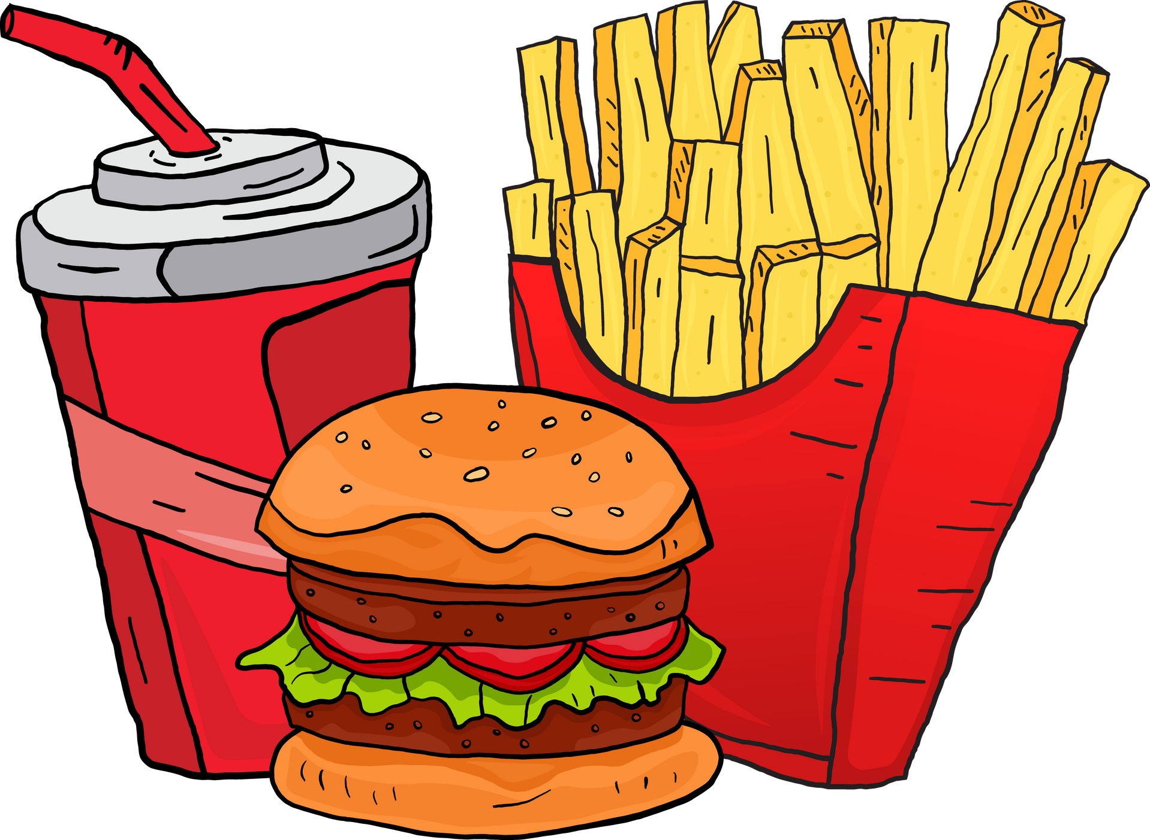

Back In Business
Pricing - Types of pricing strategies
Pricing Strategies
Bundle Pricing
  Discount when items are bought together.
  E.g. McDonald’s meal deals cost less than buying items separately.
Tiered Pricing
  Multiple versions at different prices to suit different budgets.
  E.g. Spotify offers Free, Premium, and Family plans.
Price Discrimination
  Different prices for different groups (not based on cost).
  E.g. Cineworld offers student and senior discounts.

Slide 46
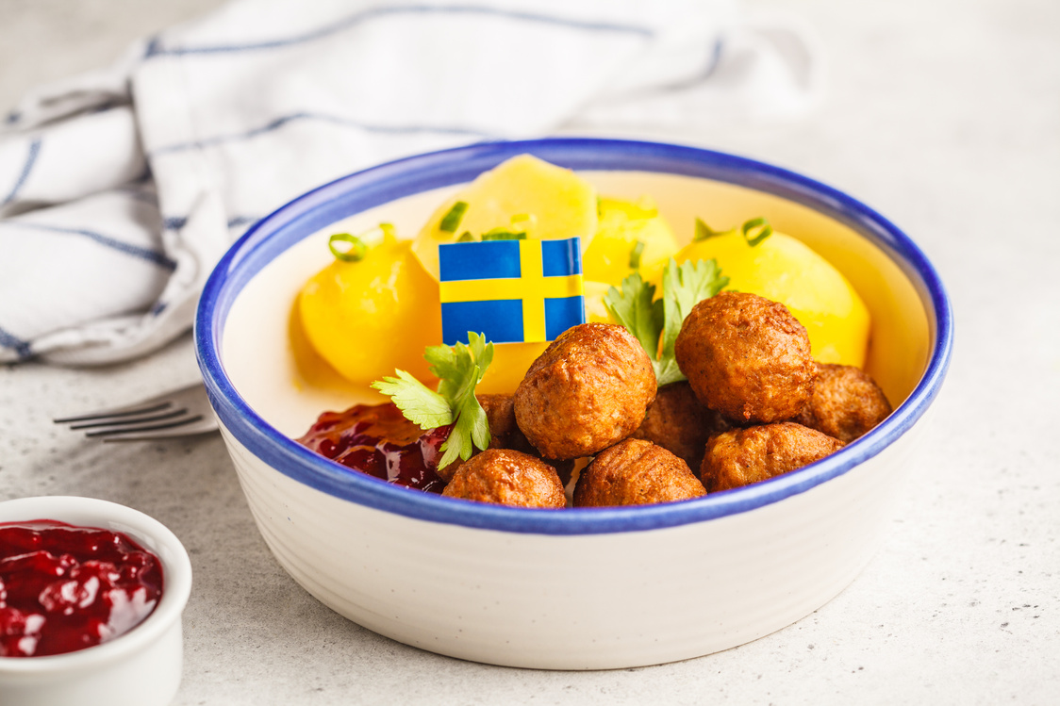

Back In Business
Pricing - Types of pricing strategies
Pricing Strategies
Predatory Pricing
  Temporarily low price to eliminate rivals.
  E.g. Amazon underpriced books to challenge bookstores.
Loss Leader
  Product sold below cost to attract customers.
  E.g. IKEA sells hot dogs cheaply to boost overall footfall.
Dynamic Pricing
  Prices change based on demand, time, or customer profile.
  E.g. Oasis concert ticket prices were very high based on high demand. Prices can go up and down - Initial seats at the 2025 FIFA Club World Cup were priced at up to US$473, but costs declined by more than 95% for under‑attended matches during the tournament.

Slide 47
Back In Business
Pricing - Types of pricing strategies
How the target market can influence the price charged
1. Disposable Income
Higher-income areas allow for higher pricing.
E.g. A boutique in a wealthy area may charge more than one in a low-income area.
2. Perceived Value and Expectations
Customers expect to pay a typical range for a product or service.
E.g. A protein bar company charging under €2.50 might be seen as lower quality.
3. Price Sensitivity
Some groups prioritise value (e.g. students), others pay for brand image.
E.g. Teens might pay more for a White Fox hoodie than a similar Penneys one.

Slide 48
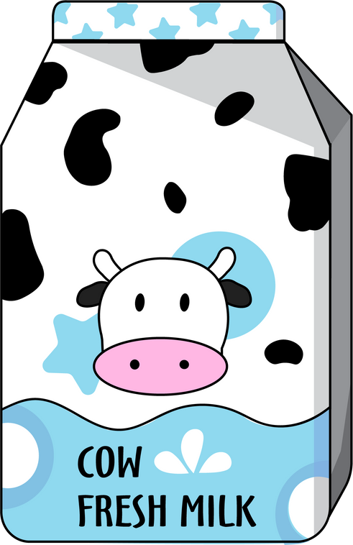
Back In Business
Pricing - Types of pricing strategies
Promotion Strategies - Advertising
What is it? Paid messages through media like TV, social media, radio, or billboards.
Types of Advertising:
  Informative – Gives facts, not designed to persuade.
  E.g. Cereal recall notice due to peanut risk.
  Persuasive – Highlights how a product improves your life.
  E.g. Actimel ads showing health benefits.
  Generic – Promotes an entire product type, not one brand.
  E.g. National Dairy Council milk/cheese campaigns.
  Competitive – Compares to rival products.
  E.g. Lidl comparing prices to SuperValu.
Who regulates it? The ASAI (Advertising Standards Authority of Ireland) ensures all ads in Ireland are legal, decent, honest, and truthful.

Slide 49
Back In Business
Pricing - Types of pricing strategies
Promotion Strategies - Public Relations
What is it? Managing a brand’s image and public relationship to build trust and reputation.
Types of PR Strategies:
  Press Releases – Announce new products or events to media.
  Sponsorships – Link the brand to a team/event. E.g. Kingspan Stadium
  Community Initiatives – Fundraisers or clean-ups.
  E.g. Olympian Gymnastics raising €100k for Barnardo’s.
  Crisis Response – Manage negative publicity or complaints.
Tech Update:
PR now includes instant updates via email or social media. E.g. real-time customer updates during service issues.

Slide 50
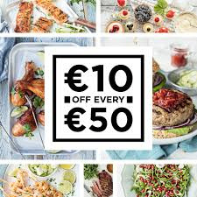
Back In Business
Pricing - Types of pricing strategies
Promotion Strategies - Sales Promotions
What is it? Short-term gimmicks/offers to boost immediate sales and attract new or returning customers.
Types of Sales Promotion Techniques:
  Discounts – Limited time price cuts.
  E.g. Dunnes: €10 off €50 spent.
  Buy One Get One Free – Common in food and personal care.
  Loyalty Cards – Earn points/stamps toward rewards.
  E.g. Free coffee after 6 purchases.
  Competitions – Win prizes by buying or engaging online.
Tech Update:
Promo codes & social media partnerships often amplify impact.

Slide 51

Back In Business
Pricing - Types of pricing strategies
Promotion Strategies - Direct Marketing
What is it? One-to-one communication with customers by email, SMS, post, or app.
Types of Direct Marketing
  Email platforms like Mailchimp/Klaviyo
  Customer segmentation – Different messages for different audiences
  A/B Testing – See which version of a message works best
  Push notifications – App alerts when a sale starts
Tech Update:
Build relationships and encourage direct purchases. Can reach target market directly and quickly and track success rates of campaigns with data.

Slide 52
Back In Business
Pricing - Types of pricing strategies
Promotion Strategies - Digital Marketing
What is it? Using digital influencers and content creators to promote products.
Why it works: Emotional storytelling + mass exposure = stronger brand engagement.
Works best with influencers who match the brand’s image and values.
Casey Neistat’s viral video for Nike’s #Makeitcount campaign was a big success for Nike to help drive their values and brand image

Slide 53
Back In Business
Pricing - Types of pricing strategies
Promotion Strategies - Personal Selling
What is it? Face-to-face or online guidance from a salesperson to help the customer decide.
E.g. Staff in Currys help choose a laptop for Leaving Cert students by explaining features.
Why it works: Builds trust, especially for expensive or complex purchases.
Tech Update:
AI-powered chatbots and live video consultations now allow businesses to deliver personal selling online.
E.g. Dell offers real-time chat with tech advisors to help customers choose laptops tailored to their needs.

Slide 54

Back In Business
Pricing - Types of pricing strategies
How the target market can influence the promotion used
Advertising
Businesses select media platforms and ad styles based on where their target market spends time/their habits and behaviours.
E.g. A skincare brand targeting Gen Z might use Snapchat ads and short-form video tutorials over print or radio.
Public Relations
PR activities are chosen to match the values and lifestyle of the intended audience.
E.g. A fitness-focused brand might sponsor charity runs
or mental health events to connect with
wellness-conscious consumers.

Slide 55

Back In Business
Pricing - Types of pricing strategies
How the target market can influence the promotion used
Sales Promotions
Promotions used should reflect what drives that target market to act fast, such as urgency or value.
E.g. Students might be attracted to flash sales with 20% off shared on student discount apps, while parents look for multi-buy savings in supermarkets.
Direct Marketing
The format and tone of direct messages are tailored to audience preferences and habits.
E.g. A retirement investment firm may post brochures to older adults, while a fashion brand targets young adults via stylised email campaigns.

Slide 56

Back In Business
Pricing - Types of pricing strategies
How the target market can influence the promotion used
Digital Promotion
Online engagement tools are shaped by how and where the audience interacts digitally.
E.g. A surf brand might use TikTok videos from popular coastal
influencers to appeal to adventure-seeking teens.
Personal Selling
Tailored advice is used where buyers expect expert help or reassurance before purchasing.
E.g. A kitchen design company offers virtual consultations to help homeowners pick layouts, based on space and lifestyle needs and often offer 3D visuals of designs.

Slide 57

Back In Business
People
Pricing - Types of pricing strategies
People
Who are 'People' in the Marketing Mix?
Everyone involved in delivering the product/service - store staff, delivery drivers, online support, customer care, influencers, etc.
Why they matter:
People shape the customer experience. For service
businesses especially, the staff are the product.
Target Market Influence:
Businesses recruit and train staff to suit their audience.
E.g. A youth fashion brand may hire relatable, TikTok-savvy staff, while a luxury hotel trains staff to be formal and discreet.

Slide 58

Back In Business
Pricing - Types of pricing strategies
People - How the target market impacts People
Customer Experience
Must match what the customer expects - casual or formal, fun or refined.
E.g. A Bundoran beach ice cream shop hires outgoing, friendly staff to create a holiday vibe.
Knowledge and Skills
Staff must understand and support customers appropriately.
E.g. Pharmacy staff trained in empathy for discussing personal health concerns.
Appearance and Behaviour
Staff should reflect the brand and appeal to the audience.
E.g. Trendy clothing store staff should wear fashionable outfits and express their personality.

Slide 59
Reflect & Research (Pg 160)
BikeRowSki
After watching the video, describe how the ‘People’ suit the brand and product. What values do they reflect for the brand?
What other elements of the marketing mix do you notice in the video for BikeRowSki?
https://www.youtube.com/watch?v=285siIS8Kr4

Slide 60
REFLECT & RESEARCH Pg 160
1. What store did you visit where the staff did not match your expectation? Why?
2. Research articles online to identify a business that has faced reputational issues for their hiring policies or treatment of the people working for them. How did the business respond?
3. You are opening a luxury supermarket. Create a concept for what type of people you would hire, what they would wear, and how they would interact. Justify your choices.

Slide 61

Back In Business
Pricing - Types of pricing strategies
5. Packaging / Physical Evidence
  For products, packaging creates a first impression and helps attract customers.
  It also shapes how the product is perceived compared to competitors.
  For services, where nothing physical is sold, businesses use physical evidence to build trust.
  E.g. A restaurant’s stylish interior or a spotless taxi give customers instant confidence in service quality.

Slide 62
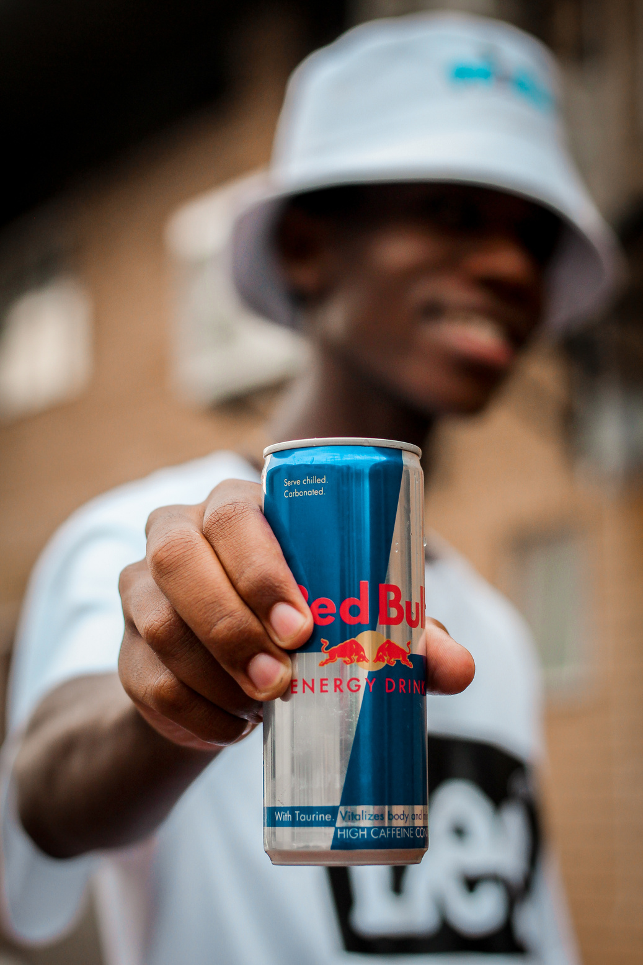
Back In Business
5. Packaging - Functions of packaging
Pricing - Types of pricing strategies
5. Functions of Packaging
Protection
Protects the product during delivery and storage.
E.g. Childproof lids on medicine bottles prevent accidents.
Information
Includes essential product info like use-by dates or allergens.
E.g. Energy drinks show caffeine content clearly.
Point of Differentiation
Helps the product stand out and become brand-recognisable.
E.g. Pringles’ tube is instantly identifiable.
Ethics and Sustainability
Recyclable or ethically sourced packaging can boost appeal.
E.g. Ballygowan bottles now made from 100% recycled plastic.

Slide 63

Back In Business
5. Packaging - Functions of packaging
Pricing - Types of pricing strategies
How the Target Market Influences Packaging
Design and Style Match
Kids’ products use fun colours; luxury brands go for clean, elegant looks.
Relevant Messaging
Fitness products use bold text like “Fuel Your Goals” with nutritional details and benefits clearly shown.
Convenience and Functionality
Busy parents want resealable, time-saving packaging options.
Ethics and Environment
Eco-aware customers look for recycled or compostable packaging, clearly labelled.

Slide 64
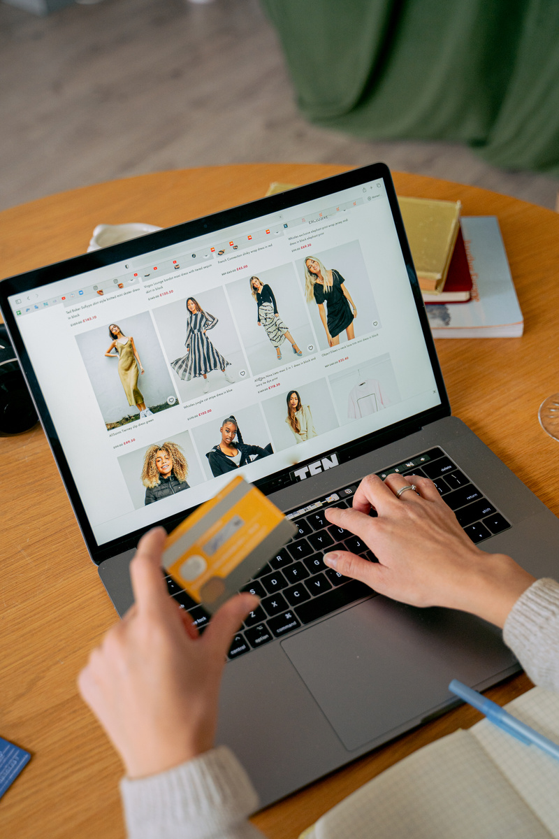

Back In Business
5. Packaging - Functions of packaging
Pricing - Types of pricing strategies
Process - What is the ‘Process’ in the Marketing Mix?
  The process refers to every step the customer goes through, from first contact with the business to after-sales service.
  A smooth, efficient process builds trust, saves time, and encourages repeat purchases.
  A slow or confusing process leads to frustration, poor reviews, and lost sales.
Example Flow (Online Shopping):
Browsing → Add to Cart → Checkout → Payment → Delivery Updates → Returns Support

Slide 65
Back In Business
5. Packaging - Functions of packaging
Pricing - Types of pricing strategies
How the Target Market Influences the Process
Speed and Convenience
Fast food chains like McDonald’s use order kiosks and streamlined systems to serve busy customers quickly.
Ease of Use
Less tech-savvy customers need a clear, guided experience.
E.g. Clothing stores may include return labels to simplify sending items back.
Research the impact the introduction of these kiosks have had on McDonald’s revenues. VIEW VIDEO.

Slide 66
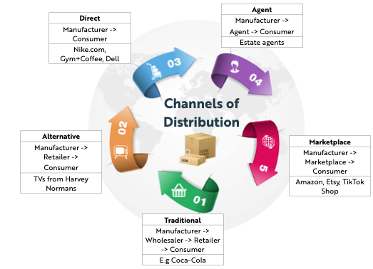
Back In Business
5. Packaging - Functions of packaging
Pricing - Types of pricing strategies
Place
Place refers to how a product or service reaches the customer. It includes the channels of distribution, sales platforms, and both physical and digital locations where customers can access the product.

Slide 67
Back In Business
5. Packaging - Functions of packaging
Pricing - Types of pricing strategies
Place - Factors Impacting Distribution Channels
Cost
Each intermediary adds a markup, so items with bigger profit margins allow for more intermediaries.
E.g. Adidas try to sell more items directly to consumers on their site and app to boost profit and control pricing.
Nature of the Product
Perishable goods need fast delivery; luxury brands value exclusivity.
E.g. Fresh flowers go straight to retailers; Rolex sells through exclusive stores.
Market Reach
Smaller brands often sell directly online; mass-market goods need retail partners.
E.g. Niche skincare brands use Instagram Shops; Coca-Cola uses supermarkets for scale.

Slide 68
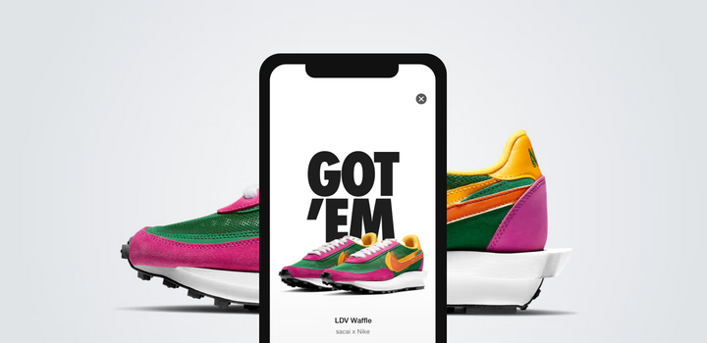
Back In Business
5. Packaging - Functions of packaging
Pricing - Types of pricing strategies
Place - Benefits and Challenges of Selling Directly for a Start-Up Business
Benefits
  Higher profit margins: No retailer or platform taking a cut so the full sale goes to the business.
  Lower overheads: An e-commerce website or Instagram Shop is cheap to run.
  Full control: The business controls pricing, branding, and customer experience.
  Access to customer data: Helps build a loyal customer base through targeted promotions with online data.
Challenges
  Limited reach: Harder to get noticed without a big marketing budget.
  Logistics burden: The business must manage payments, delivery, and customer service.
  Lack of credibility: Customers may hesitate to buy from unknown or new brands or shops.

Slide 69
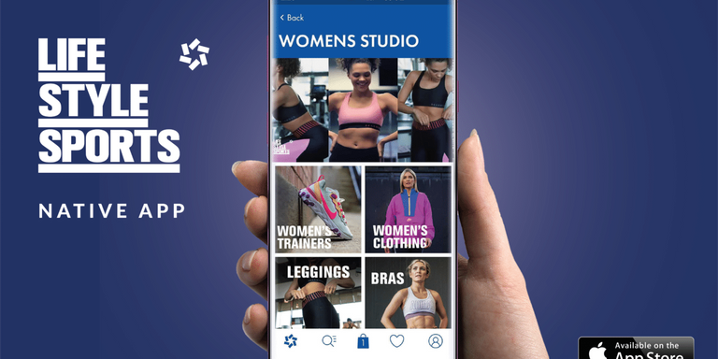
Back In Business
5. Packaging - Functions of packaging
Pricing - Types of pricing strategies
Selling Through a Marketplace or Retailer – Benefits and Challenges
Benefits
  Large reach: Marketplaces and retailers already have loyal customers, increasing exposure.
  No need for own store: Sales, payments, and delivery are handled by the platform or retailer.
Challenges
  Lower profit margins: A percentage of each sale goes to the retailer or platform.
  Competition risk: Popular products may be copied as own-brand alternatives by the retailer.

Slide 70

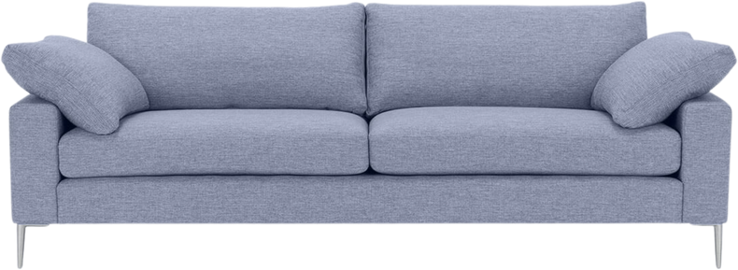
Back In Business
5. Packaging - Functions of packaging
Pricing - Types of pricing strategies
How the Target Market Influences Place
Convenience and Speed
Gen Z expects instant access via apps or online platforms with fast delivery and easy returns. Direct channels allow businesses to manage relationships more efficiently.
Buying Habits and Preferences
Consumers looking to buy new furniture may prefer visiting a store like Harvey Norman to physically see, test, and handle the furniture before making a purchase.
Type of Product and Brand Experience
Luxury brands often sell directly to maintain brand control and exclusivity, appealing to customers who value personalised service and premium experiences.

Slide 71
Suggested Activities for LO 9.2
Sample Papers
OL1 Q4 (e) Explain two promotion strategies used by businesses.
OL2 Q2 (g) (ii) Outline two ways the target market for a product or service might influence the promotion element of the marketing mix.
OL2 Q3 (a) Fill in the remaining Five P’s of the marketing mix.
Activity Book Qs
HL Q2, Q3
OL Q3, Q4, Q5

Slide 72
Learning Outcome 9.3
9.3 Develop a marketing mix for a product and a service of choice and provide a USP analysis for each.

Slide 73
Back In Business
5. Packaging - Functions of packaging
Pricing - Types of pricing strategies
USP analysis
A Unique Selling Point Analysis helps a business to identify and highlight the unique benefits and features that it can offer its consumers, that they desire, and that their competitors don’t do as well as them.
To create a USP analysis for a product or service, a business needs to clarify three things:
1. What they do well - using analysis and feedback.
2. What the customer wants - using market research (sales data, surveys...)
3. What their competition does well - (surveys, online threads, user boards, ratings...)
A business should build their marketing mix to focus on the features/benefits they offer that their target market want, and their competitors don’t offer.

Slide 75
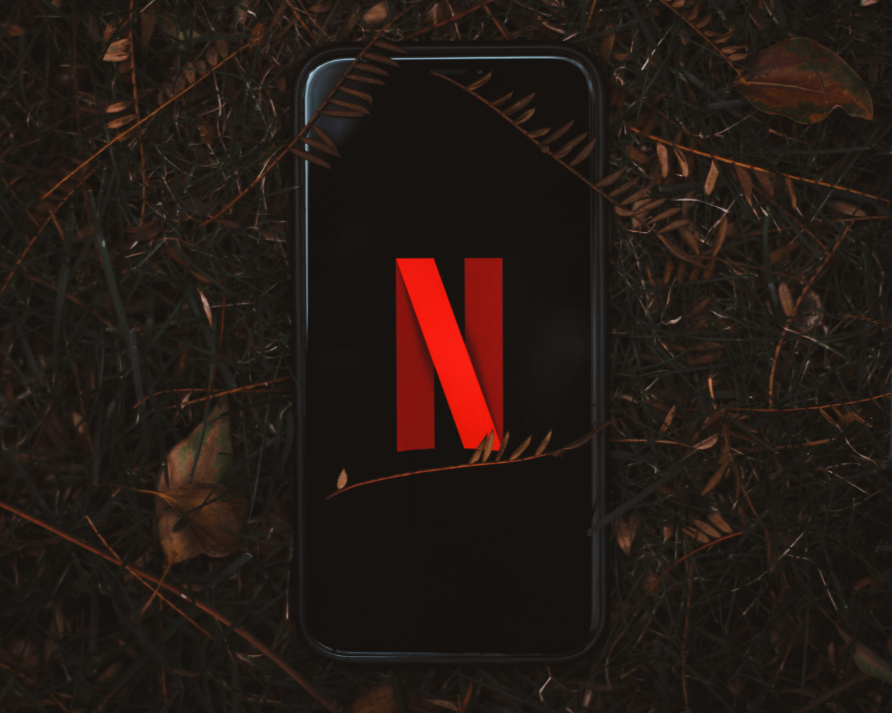

Back In Business
5. Packaging - Functions of packaging
Pricing - Types of pricing strategies
USP analysis - Netflix vs Disney Plus
(What Netflix does well + what the target market wants – and Disney+ doesn’t do well)
  Strong global slate of original content across genres and cultures (e.g. Squid Game, The Crown, Stranger Things).
  Binge-watching model – entire seasons released at once.
  Sophisticated recommendation algorithm to personalise user experience.
  Broad content appeal for teens and adults, not limited to family-focused entertainment.
Netflix should focus their marketing on these features.

Slide 76
Back In Business
5. Packaging - Functions of packaging
Pricing - Types of pricing strategies
USP analysis - Netflix vs Disney Plus
It’s hard to stand out by marketing these features
(What both Netflix & Disney+ do well + what the target market wants)
  High-definition and 4K streaming across multiple devices.
  Offline downloads for watching content on the go.
  Multiple user profiles and parental controls.
  Mobile and Smart TV compatibility.
Important features for their target market but not a differentiator against competition so not that useful in marketing.

Slide 77
Back In Business
5. Packaging - Functions of packaging
Pricing - Types of pricing strategies
USP analysis - Netflix vs Disney Plus
Avoid marketing these features
(What Disney+ does well + what the target market wants – but Netflix doesn’t do well)
  Exclusive access to iconic franchises (e.g. Marvel, Star Wars, Pixar) – a key Disney+ advantage.
  Strong appeal to families with young children due to recognisable characters and safe content.
  Lower entry price point in some markets.
Avoid referencing any of these features in marketing.

Slide 78
REFLECT & RESEARCH
1. Complete the marketing mix for a product of your choice.
2. Conduct a USP analysis on them.
Look at their core product, brand image, packaging, pricing strategies (e.g. premium vs budget ranges), where and how they sell (sales channels), and how they interact with customers during the sales process. Next, compare these features with their competitors to help identify what makes the product or service unique, that their target market cares about, to identify their Unique Selling Point (USP).
3. Choose a service of your choice and repeat steps 1 and 2 above.

Slide 79
Suggested Activities for LO 9.3
Sample Papers
-
Activity Book Qs
HL Q3 (ii)

Slide 80
Learning Outcome 9.4
9.4 Evaluate and suggest ways of improving an existing marketing mix.

Slide 81
Back In Business
5. Packaging - Functions of packaging
Pricing - Types of pricing strategies
How to Evaluate and Improve a Business’s Marketing Mix
Don’t just say what to element to change, explain why that change would work.
Support your suggestion with clear reasoning. Use evidence like customer feedback, trends, or what competitors are doing.
Always link it back to the target market and the brand’s USP.
You could build your suggestions to:
• Show clear understanding of the target market - match their needs, habits or preferences.
• Link to current trends such as high-protein products or sustainability, or to something that is working well for a competitor.
• Make a realistic suggestion that fits with the brand’s image and available resources.
• Explain how the suggestion would increase sales, improve customer loyalty, or build the brand’s reputation.

Slide 82
Back In Business
5. Packaging - Functions of packaging
Pricing - Types of pricing strategies
How to Evaluate and Improve a Business’s Marketing Mix
Let’s look at an example of evaluating McDonalds Marketing Mix and looking at ways to improve it
Evaluation of McDonald’s Current Marketing Mix
Product: McDonald’s product range is heavily focused on more indulgent, high-calorie meals, with fewer options for health-conscious or fitness-oriented customers. Promotions: still centre around value meals and family-friendly deals rather than nutrition or wellness trends.
Place: While the McDelivery and app platform are strong
Overall: The menu lacks targeted offerings for the growing segment of consumers seeking high-protein, lower-calorie options. This creates a clear opportunity to expand into a more health-aware market with clear branding aimed at fitness-oriented customers.

Slide 83

Back In Business
5. Packaging - Functions of packaging
Pricing - Types of pricing strategies
Ways to Improve McDonalds’s Marketing Mix
1. Product - Introduce the MacroChicken Wrap – a grilled chicken wrap with added fibre, 35g+ protein, and under 500 calories. → Appeals to fitness-conscious and health-focused customers seeking a quick, nutritious option.
2. Promotion - Run targeted app and Instagram campaigns featuring fitness influencers trialling the MacroChicken Wrap. → Positions it as credible and desirable to health-minded Gen Z and millennial audiences.
3. Packaging - Use clean, eco-friendly packaging clearly labelled with calories, macros, and a QR code linking to sourcing and nutrition info. → Builds transparency and trust with health-conscious customers and supports McDonald’s sustainability goals.

Slide 84
Suggested Activities for LO 9.4
Sample Papers
9.4 Evaluate and suggest ways of improving an existing marketing mix.
Activity Book Qs
HL Q4
OL Q6

Slide 85
Learning Outcome 9.5
9.5 Demonstrate an understanding of the disruptive impact and influence of digital technology on market research and marketing.

Slide 86
Disruptive impact refers to how digital technology changes the way businesses operate (including within the workplace) and how consumers interact with businesses. It can have both positive and negative effects.

Slide 87
Back In Business
5. Packaging - Functions of packaging
Pricing - Types of pricing strategies
Impact of Digital Technology on Market Research
Real-Time Feedback
  Online polls and social listening let businesses gather instant feedback from customers.
  This allows quick reactions to trends and more agile decision-making.
Big Data & AI Analysis
  AI tools analyse huge volumes of data from searches, reviews, and behaviour patterns.
  This has replaced slower, traditional research with faster, deeper insights.
More Affordable Tools
  Platforms like Google Analytics and Meta Suite give small firms access to detailed data.
  This disrupts the old gap between large and small businesses in market insight.

Slide 88
Back In Business
5. Packaging - Functions of packaging
Pricing - Types of pricing strategies
Impact of Digital Technology on Marketing
More Targeted Campaigns
  Platforms like TikTok and Google Ads allow precise targeting by age, interests, and habits.
  This makes marketing more personal and cost-effective.
Measurable Results
  Digital tools show exact ad performance (clicks, sales, views). A/B testing compares versions.
  This lets businesses refine campaigns based on real-time data.
Creative, Low-Cost Options
  Memes, influencer content, and viral videos allow small brands to market widely on low budgets.
  This challenges the dominance of traditional big-budget advertising.

Slide 89
REFLECT & RESEARCH
1. Read through the Flexera case study on page xiv and xv. Describe three ways that Hannah used developments in technology to help her in both market research and marketing of her Pilates machines.
2. Outline two different methods that businesses you know have used technology in their marketing or market research. Or refer to the other case studies to spot examples.

Slide 90
Suggested Activities for LO 9.5
Sample Papers
-
Activity Book Qs
HL Q5

Slide 91
Learning Outcome 9.6
9.6 Evaluate the influence of ethics and sustainability on marketing.

Slide 92
Back In Business
5. Packaging - Functions of packaging
Pricing - Types of pricing strategies
Ethics and Sustainability in Marketing
Why It Matters
Customers increasingly expect businesses to be honest, fair, and eco-conscious. This shapes product design, packaging, advertising language, and brand reputation.
Watch the video

Slide 93
Back In Business
5. Packaging - Functions of packaging
Pricing - Types of pricing strategies
Positive Influence of Ethics and Sustainability on Marketing
Builds Trust and Loyalty
Customers support brands that reflect their values.
E.g. Tony’s Chocolonely champions fair trade cocoa, building a loyal following.
Creates Powerful Marketing Stories
Ethical actions give brands strong content.
E.g. SuperValu’s support of TidyTowns aligns with its sustainable message.
Can Be a Competitive Advantage
Eco-friendly efforts help brands stand out.
E.g. Ballygowan promotes its fully recycled bottle to win eco-conscious customers.

Slide 94
Back In Business
5. Packaging - Functions of packaging
Pricing - Types of pricing strategies
Challenges of Ethics and Sustainability on Marketing
Increased Costs
Sustainable materials and ethical sourcing often cost more and can impact profit margins.
Risk of Greenwashing
Overstating eco-claims without real action can damage trust.
E.g. Some fast fashion brands were criticised for promoting ‘green’ lines while remaining unsustainable.
Evaluation: Ethics and sustainability can build brand loyalty, trust, and competitive advantage, but only when its authentic. But customers are quick to spot dishonesty, so businesses must align their marketing with real actions and avoid greenwashing.

Slide 95
Suggested Activities for LO 9.6
Sample Papers
HL1 Q5 (b) Outline three ways ethics is an important consideration when designing a marketing strategy.
Activity Book Qs
HL Q6 Q7
OL Q7

Slide 96
Learning Outcome 9.7
9.7 Use a power-interest grid to analyse customer interest and adjust the marketing mix as necessary.

Slide 97
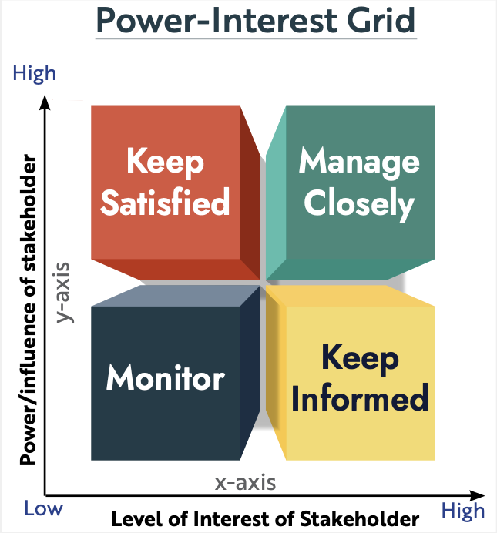
Back In Business
5. Packaging - Functions of packaging
Pricing - Types of pricing strategies
Using a power-interest grid to analyse customer interest
A business can use a power-interest grid to decide how to treat different segments or groups of their customers based on power (how much influence they have on the business) and interest (how much they care about the business).
They can then adjust their marketing mix to target the groups that need the most attention.

Slide 98
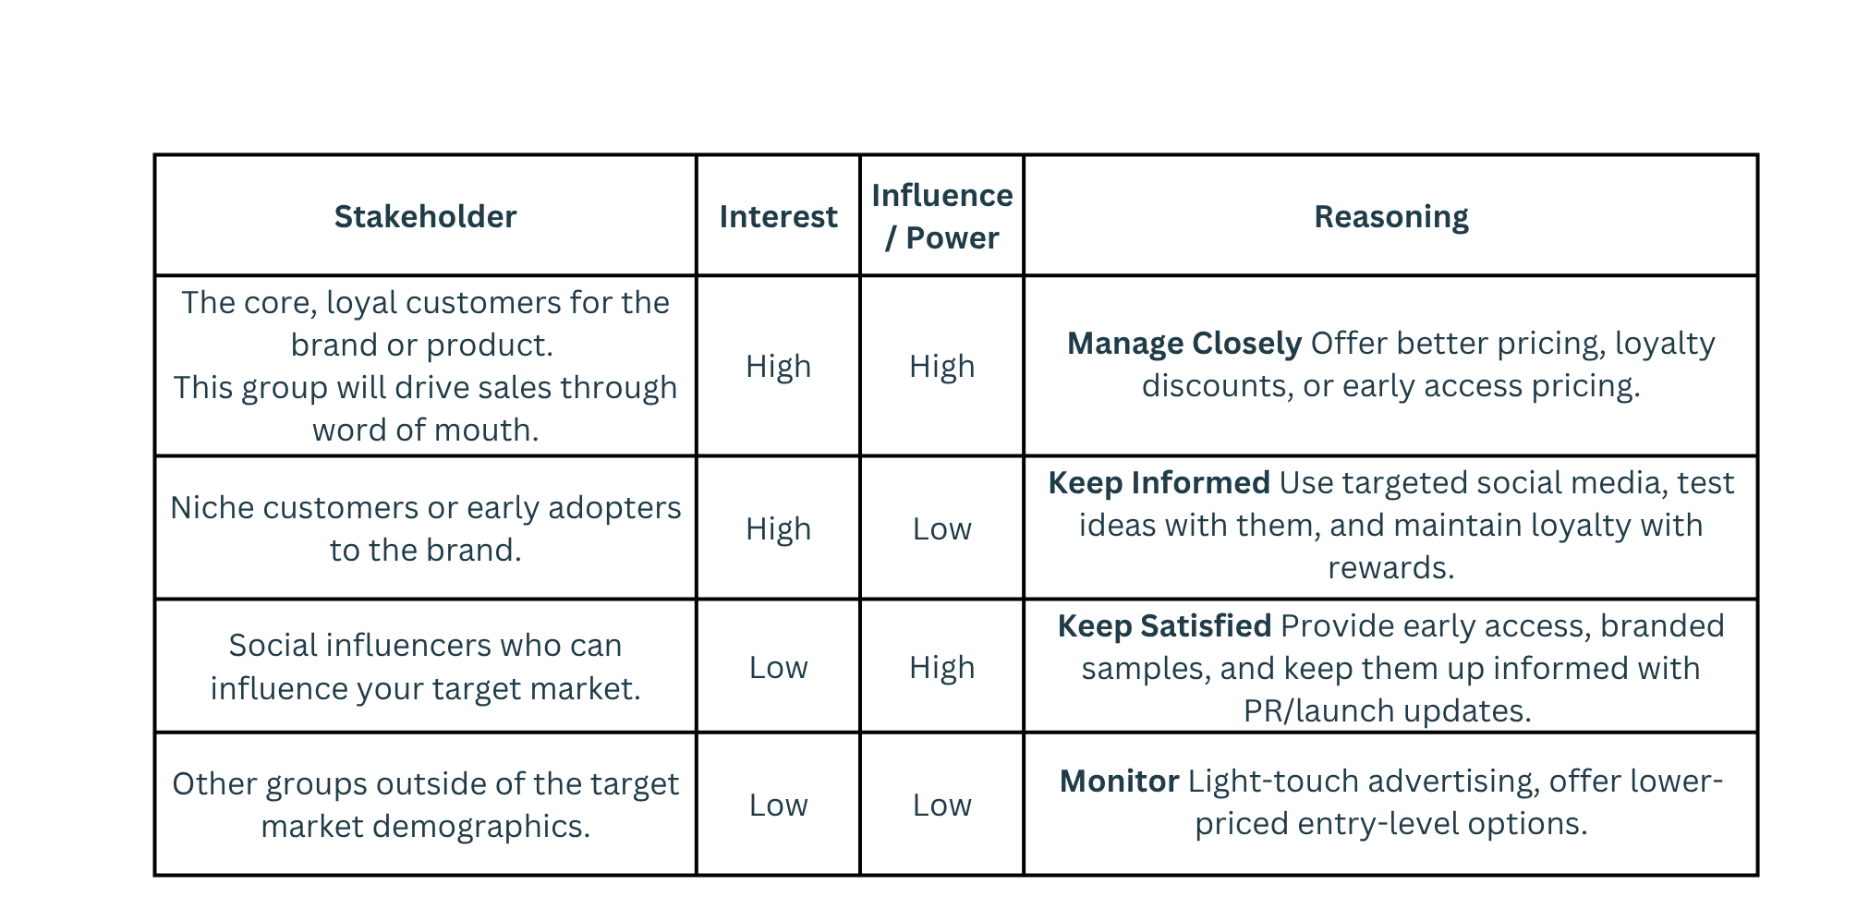
Back In Business
5. Packaging - Functions of packaging
Pricing - Types of pricing strategies
Using a power-interest grid to analyse customer interest

Slide 99
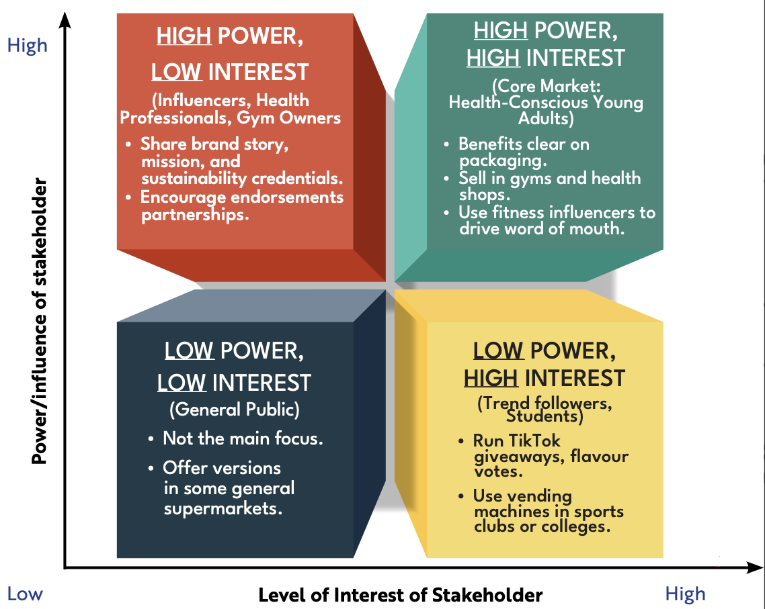

Slide 100
Suggested Activities for LO 9.7
Sample Papers
-
Activity Book Qs
HL Q8

Slide 101
Learning Outcome 9.8
9.8 Conduct a STEEPLE analysis to develop greater understanding of the external environment and identify issues of concern for a business.

Slide 102
Back In Business
5. Packaging - Functions of packaging
Pricing - Types of pricing strategies
Conducting a STEEPLE Analysis
What is it?
A STEEPLE analysis helps businesses understand the wider environment they operate in, focusing on external influences beyond their control.
By identifying key opportunities and threats, this tool supports better planning and decision-making, allowing businesses to
  Spot new opportunities for growth
  Identify threats that may disrupt operations
  Adapt their strategy to stay competitive and compliant

Slide 103

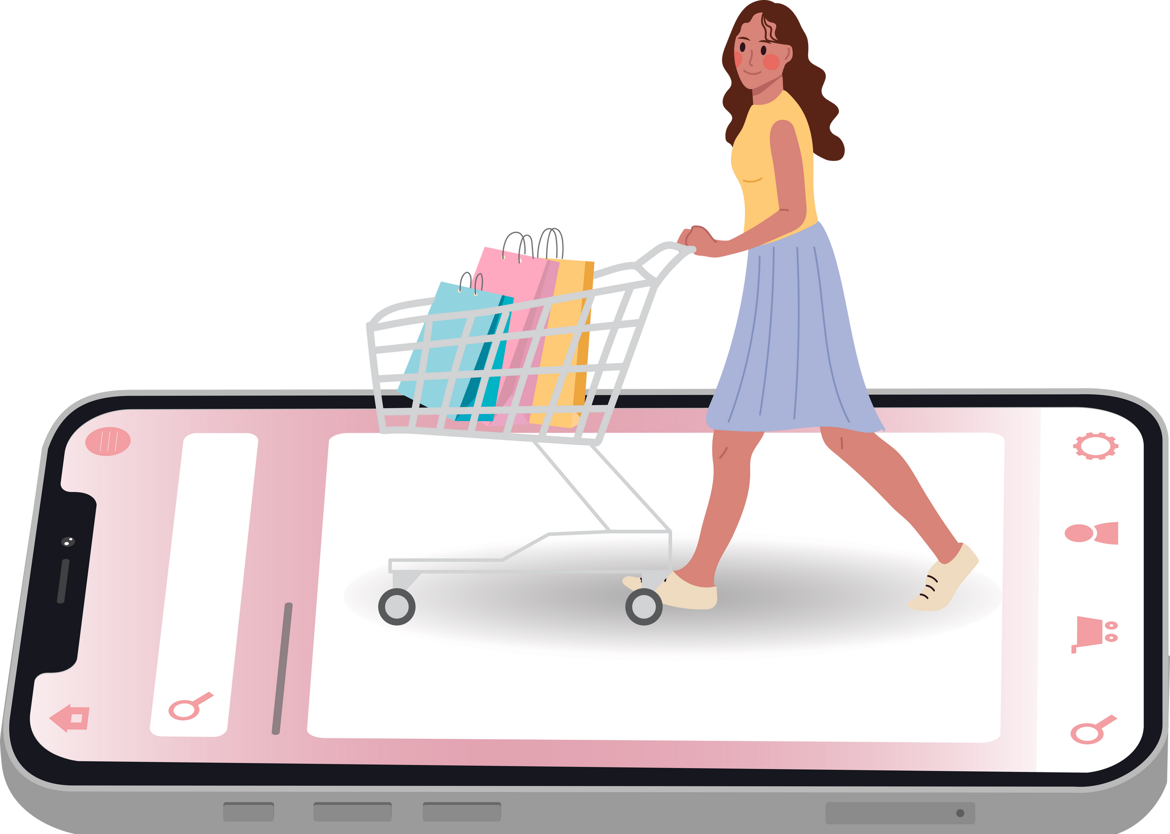
Back In Business
5. Packaging - Functions of packaging
Pricing - Types of pricing strategies
Conducting a STEEPLE Analysis
Social Factors - What it means:
  Changes in lifestyle, attitudes, and values in society affect what customers want.
  Businesses must stay relevant by responding to shifts in consumer expectations.
  Example: A fast-food chain might launch a vegan or low-calorie menu to appeal to more health-conscious Gen Z customers.
Technological Factors - What it means:
  New technologies, platforms, and automation influence how businesses sell and how customers shop.
  Companies need to embrace innovation to stay competitive.
  Example: A clothes shop without an easy-to-use mobile app may lose younger customers to online retailers with smooth digital checkout.

Slide 104
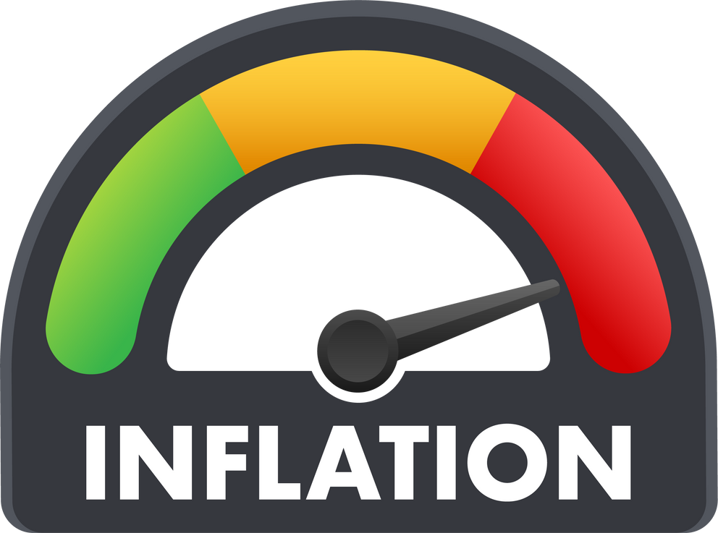

Back In Business
5. Packaging - Functions of packaging
Pricing - Types of pricing strategies
Conducting a STEEPLE Analysis
Economic Factors - What it means:
  Things like inflation, interest rates, and consumer confidence impact buying behaviour.
  During tough times, people may cut back on spending or switch to cheaper alternatives.
  Subscription services may see more cancellations during economic downturns.
Environmental Factors - What it means:
  Growing awareness of climate change and sustainability affects how businesses operate and package products.
  Consumers increasingly expect brands to minimise waste and emissions.
  A water company might face backlash if it keeps using single-use plastic bottles.

Slide 105
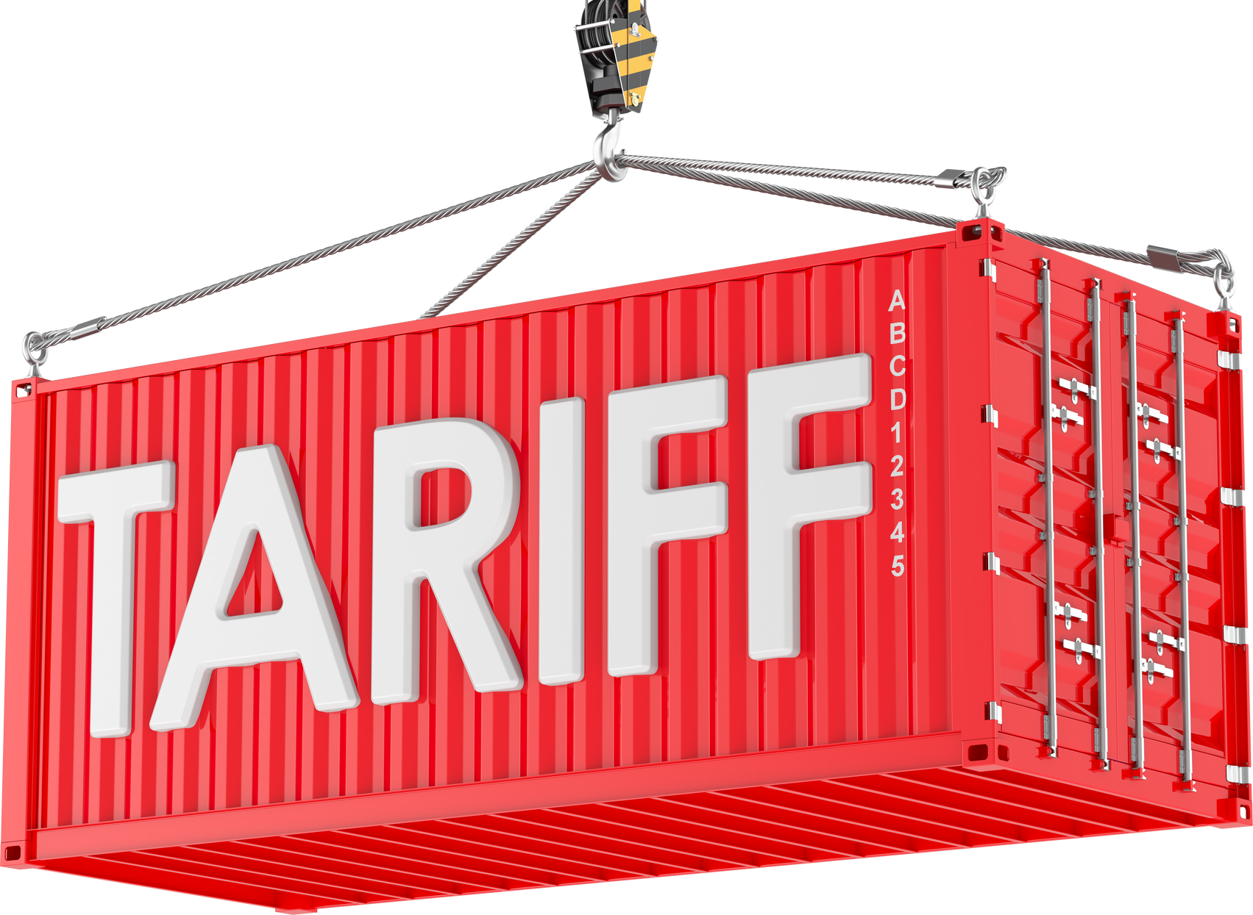

Back In Business
5. Packaging - Functions of packaging
Pricing - Types of pricing strategies
Conducting a STEEPLE Analysis
Political Factors - What it means:
  Government policies, international relations, and tax changes can impact business decisions, especially for exporters.
  Political events can disrupt supply chains or costs.
  Example: A hike in import duties could make it more expensive for an Irish tech company to buy parts from abroad.
Legal Factors - What it means:
  Businesses must follow laws on employment, safety, advertising, and consumer protection.
  Legal changes can add new responsibilities or penalties.
  Example: A gym collecting personal data must follow GDPR rules or risk fines and reputational damage.

Slide 106

Back In Business
5. Packaging - Functions of packaging
Pricing - Types of pricing strategies
Conducting a STEEPLE Analysis
Ethical Factors - What it means:
  Ethical factors relate to a business’s values and treatment of people, animals, and the environment.
  Customers want brands that are honest, fair, and responsible.
  Example: A clothing brand exposed for using unethical factories may lose public trust.

Slide 108
Student Activity
Case Study: Solánna Skincare – Irish Exporter to the US
Solánna Skincare, a natural cosmetics company based in Cork, saw rapid growth selling online to US customers. However, during the Trump administration’s trade war with the EU, new tariffs made exporting more expensive. Rising inflation and a weak euro helped keep their products competitively priced. Solánna invested in AI tools to automate customer service and launched an eco-friendly refill scheme to meet growing environmental expectations. They also had to update their US website to comply with new data protection regulations and faced criticism after a marketing campaign was seen as culturally insensitive.
Identify and categorise at least five STEEPLE factors (e.g. political, economic, technological, environmental, legal, ethical).

Slide 109
Student Activity
Political: New US tariffs during the Trump administration increased export costs, showing the impact of international trade policy on Irish exporters.
Economic: Rising inflation and a weak euro kept prices competitive in the US, highlighting how economic conditions like exchange rates influence pricing.
Technological: Solánna adopted AI tools to automate customer service, reflecting how technological innovation improves efficiency.

Slide 110
Student Activity
Environmental: The company introduced a refill scheme in response to demand for sustainable packaging, showing adaptation to environmental expectations.
Legal: Solánna had to update its US website to comply with data protection laws, demonstrating how businesses must meet legal standards in foreign markets.
Ethical: The business faced criticism for a culturally insensitive campaign, emphasising the importance of ethical marketing and cultural awareness.

Slide 111
Suggested Activities for LO 9.8
Sample Papers
OL2 Q3 (a) (ii) STEEPLE Analysis match a factor to an element
Activity Book Qs
HL Q9
OL Q9

