Slide 1
Strand 1
Chapter 04
The Influence Of National And EU Policy
Back In Business

Slide 2

Priming Activity
1. Who do you think influences government decisions the most – politicians, businesses, workers, or the public? Why?
2. What is the difference between a rule/policy and a law?
3. Can you think of a rule/policy that isn’t enforced?
4. Do you think all EU countries should follow the same rules? Why or why not?

Slide 3

Starter Activity
Starter sheet here
Teacher sheet here
Link to video

Slide 4
Starter Activity
Starter sheet here
Teacher sheet here
Link to article here
Link to video

Slide 5
Learning Outcomes
4.1 Outline three Irish government policies that impact on three different sectors of the economy in Ireland.
4.2 Explain the difference between government policy and legislation.
4.3 Outline the role played by business in the development of national policy.
4.4. Identify the key decision-makers in European policy development.
4.5 Distinguish between European regulations, directives, and opinions.
4.6 Evaluate the effect of one EU regulation of their choice and one EU directive of their choice on business activity in Ireland.
Back In Business

Slide 6
Learning Outcome 4.1
4.1 Outline three Irish government policies that impact on three different sectors of the economy in Ireland.
Back In Business

Slide 7

Back in Business
Goals Of Government Policies
📌 Economic growth and job creation, to help improve the standard of living for citizens in Ireland.
📌 Improve environmental sustainability and help achieve climate goals.
📌 Development of infrastructure (including transport, housing, and digital) to improve economic competitiveness and quality of life for Irish citizens.
📌 Enhanced public services and social equality by increasing the access to health, education and social protection, thereby reducing inequality.
📌 Innovation that encourages entrepreneurship, research, and technological advancements to maintain and improve Ire!and’s global competitiveness.

Slide 8
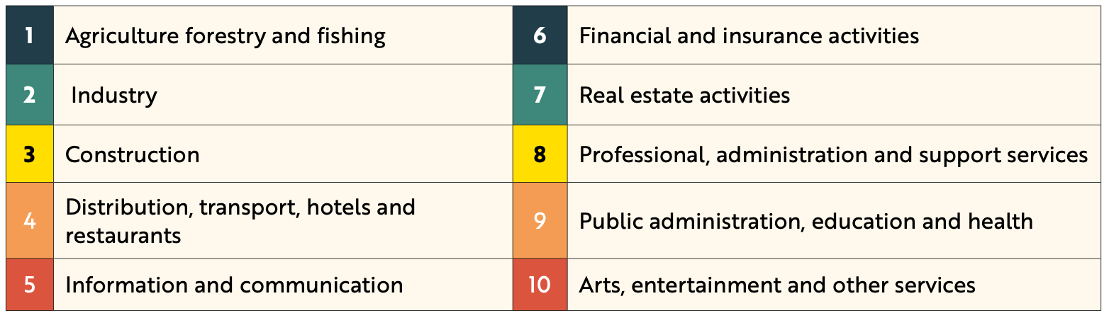
Back in Business
Sectors Of The Irish Economy
Dividing the economy into sectors allows for a detailed analysis of how each performs, making it easier to identify and address trends in specific areas.

Slide 9
Back in Business
Policy: Climate Action Plan, 2024
The 2024 Climate Action Plan outlines strategies and sets a clear path towards a sustainable, low-carbon, and climate-resilient future. Achieving a carbon-neutral economy by 2050 requires ambitious targets across all key sectors, including energy, transportation, agriculture, and industry.

Slide 10

Back in Business
The Impact Of The ‘Climate Action Plan’ On Agriculture, Forestry & Fishing
Increased
Exports
Market opportunities can appear, with greater demand for sustainably produced food and timber; potential export premium.
Increased
Funding
Access to grants and schemes for low-carbon practices and on-farm efficiency.
Finance Will Be Needed
Investment required by farmers to adapt to new technologies and changes in land use.
Higher
Taxes
Exposure to higher carbon-related taxes and tighter emissions ceilings could reduce profits.

Slide 11

Back in Business
Policy: Housing For All
The aim of this government policy is to deliver over 300,000 new homes by the end of 2030, including a projected 90,000 social homes, 36,000 affordable purchase homes, and 18,000 cost-rental homes. It represents the largest State-led home-building programme in Irish history.

Slide 12
Back in Business
The Impact Of The ‘Housing For All’ Policy On The Construction Sector
Increased Demand And Jobs
A larger pipeline of housing projects raises demand for contractors and trades, supporting sustained employment growth in construction.
Increased
Regulation
Stronger planning, building quality and sustainability requirements mean firms must meet tighter standards on every build.
Increased Supply & Lower Prices
As more homes are delivered, additional supply is intended to ease pressure on the housing market and help stabilise prices over time.
Labour
Shortages
Skills gaps and limited labour availability can delay projects and make scheduling more difficult for builders.
Increased Costs Of Production
Higher input and compliance costs (materials, labour, and standards) raise the overall cost of delivering new homes.

Slide 13
Back in Business
Policy: AI: Here For Good, 2021
This policy positions Ireland as a global leader in artificial intelligence while ensuring ethical and responsible use across Irish businesses. It supports Irish business in adopting AI technologies to increase productivity, efficiency, and innovation. The strategy also focuses on developing digital skills in the
workforce.

Slide 14
Back in Business
The Impact Of The ‘AI: Here For Good’ Policy On The Manufacturing Industry
Increased Innovation & Productivity
AI adoption streamlines production, improves quality control, and speeds up R&D, lifting output per worker and reducing errors.
Increased Funding & Grants Are Available
Targeted supports help firms pilot AI tools and upskill teams, lowering the upfront cost of implementation.
Impact On
Staff
Some roles are redesigned or reduced due to automation, creating a need for re-skilling while new, higher-skill tech roles may emerge.
Regulations & Ethical Considerations
Manufacturers must manage data responsibly and follow ethical guidelines for AI use, adding governance and compliance tasks.

Slide 15

Back in Business
Policy: National Digital Strategy
The objective of this strategy is to encourage the digital transformation of Irish SMEs. It includes improving infrastructure to provide high-speed broadband for Irish businesses and offering grants and supports to help them adopt technologies such as cloud computing, big data, and artificial intelligence.

Slide 16
Back in Business
The Impact Of The ‘National Digital Strategy’ On The Services Sector
Service firms can invest in online sales and customer support tools through government support, to reach more customers and offer 24/7 services.
Investment In e-Commerce Platforms
Higher Speed
Broadband
Better connectivity for Irish SMEs improves reliability of digital services, enabling cloud software better online presence.
Loss Of
Jobs
Automation of routine tasks (e.g. customer queries or bookings) can reduce some roles, requiring retraining for affected staff.
Difficulty Competing For Smaller SMEs
Without sufficient funding or skills, smaller firms can struggle to match the digital capabilities of larger competitors.

Slide 17
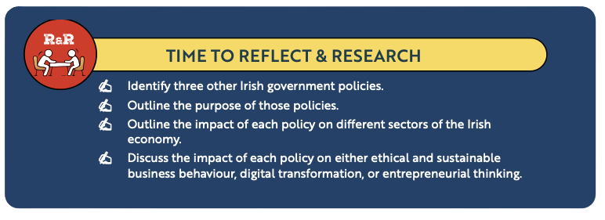
Back in Business
Reflect & Research

Slide 18
Suggested Activities for LO 4.1
Sample Papers
OL1 Q4 (f) (ii): Identify one government policy and describe the impact this policy may have on any sector of the Irish economy.
Activity Book Qs
HL Q1
OL Q1

Slide 19
Learning Outcome 4.2
4.2 Explain the difference between government policy and legislation.
Back In Business

Slide 20
Back in Business
What Is Government Policy?
A policy is an action or statement of guidance adopted by the government to support its decision-making.
Policies shape how the government responds to economic, social, or environmental issues. The government consults with experts, businesses, and stakeholders when developing policies.

Slide 21
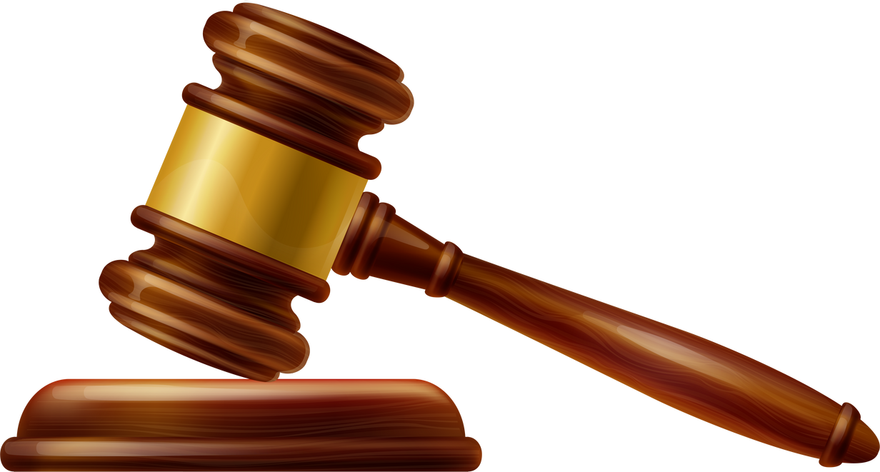
Back in Business
What Is Government Legislation?
Legisation must be passed by the Oireachtas to become legally binding on businesses. Legislation can be created in line with policies so that businesses must comply or face penalties or
fines.

Slide 22
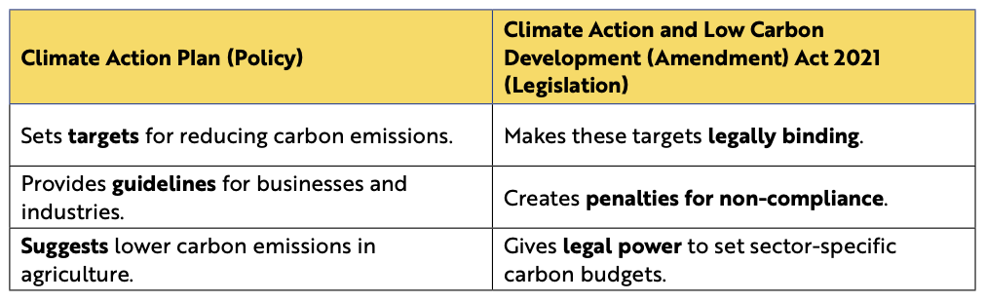
Back in Business
How Government Policy & Legislation Work Together
Policies provide guidance and set out the government’s intentions, while legislation ensures that those guidelines are followed. Most policies require accompanying legislation in order to have a real impact. The Climate Action Plan (policy) and the Climate Action and Low Carbon Development Act 2021 (legislation) should work together to achieve the government’s objectives:

Slide 23
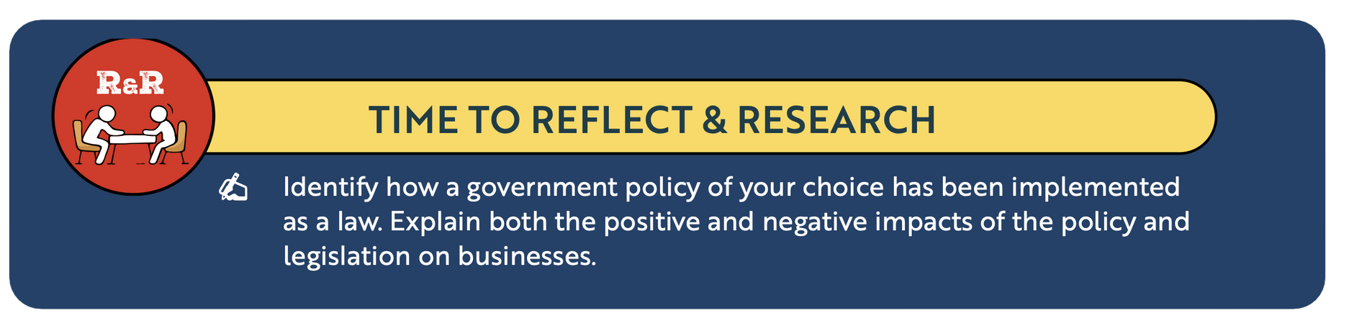
Back in Business
Reflect & Research

Slide 24
Suggested Activities for LO 4.2
Sample Papers
OL1 Q4 (f) (i): Choose the correct words: (symbols, laws, plans) for Government policies are __________ that outline the government’s intention. Legislation refers to __________ , which must be followed by all individuals and organisations.
Activity Book Qs
HL Q2
OL Q2

Slide 25
Learning Outcome 4.3
4.3 Outline the role played by business in the development of national policy.
Back In Business

Slide 26
Back in Business
The Role Of Business In The Development Of National Policy
To design effective policies and reduce negative impacts, the government often consults businesses to understand how proposed changes may affect them.
Businesses themselves often actively seek to influence government decisions to ensure that new policies align with their interests and needs.

Slide 27
Back in Business
Actions Businesses Can Take To Influence Government Policy
Meet with ministers and officials, submit position papers, and present sector data to influence proposals before decisions are made.
Lobbying Government
Public Awareness Campaigns
Use media and social channels to explain business impacts and build public support that puts pressure on policymakers.
Responding To Public Consultations
Complete consultation responses with evidence, case studies, and practical recommendations; attend briefings where invited.
Joining Advisory Or Working Groups
Participate in departmental forums or taskforces so industry expertise shapes draft policy from an early stage.

Slide 28
Back in Business
Interest Groups
Interest groups are organisations that represent the common viewpoint, objectives, and goals of a particular group of stakeholders. Interest groups are also known as pressure groups or lobby groups. Examples of interest groups that represent businesses in Ireland include:
📌 IBEC (Irish Business and Employers Confederation) represents Irish employers across many sectors. It lobbies on issues like tax policy, employment law, & economic development.
📌 ISME (Irish Small and Medium Enterprises Association) represents small and medium businesses in Ireland and lobbies on issues like employment costs, access to finance, and regulatory reform.
📌 Sector-specific associations such as the Irish Farmers’ Association for agriculture and the Irish Hotels Federation for tourism lobby for sector-specific interests.

Slide 29
Suggested Activities for LO 4.3
Sample Papers
-
-
Activity Book Qs
HL Q3
OL Q3

Slide 30
Learning Outcome 4.4
4.4 Identify the key decision-makers in European policy development.
Back In Business

Slide 31
Back in Business
The European Decision Making Process
LINK

Slide 32
Back in Business
The European Commission
The Commission is made up of one commissioner from each EU country, and their job is to defend the interests of the EU as a whole, rather than their national interests. They oversee the day-to-day management of the EU.
📌 They propose new laws for discussion and adoption by the European Parliament and the Council of the EU.
📌 They implement EU laws through regulations, directives, and decisions.
📌 They also manage and allocate the EU budget.

Slide 33
Back in Business
The European Parliament
The Members of the European Parliament (MEPs) are directly elected by voters in all Member States to represent the people’s interests with regard to EU law-making and to ensure other EU institutions are working democratically.
📌 The European Parliament represents EU citizens through direct elections every five years.
📌 They discuss, debate and amend proposed new legislation and the EU budget from the European Commission.
📌 They approve new legislation through co-decision with the Council of the European Union.

Slide 34
Back in Business
Council Of The European Union
The Council is the main decision-making body of the EU. In the Council, government ministers from each EU country meet to discuss, amend, and adopt laws, and to coordinate policies. The ministers have the authority to commit their government to the actions agreed during meetings.
📌 They are the main decision-making body of the EU.
📌 They adopt new laws jointly with the European Parliament in a process called co-decision.
📌 They approve the EU budget, set goals, and co-ordinate policy.

Slide 35
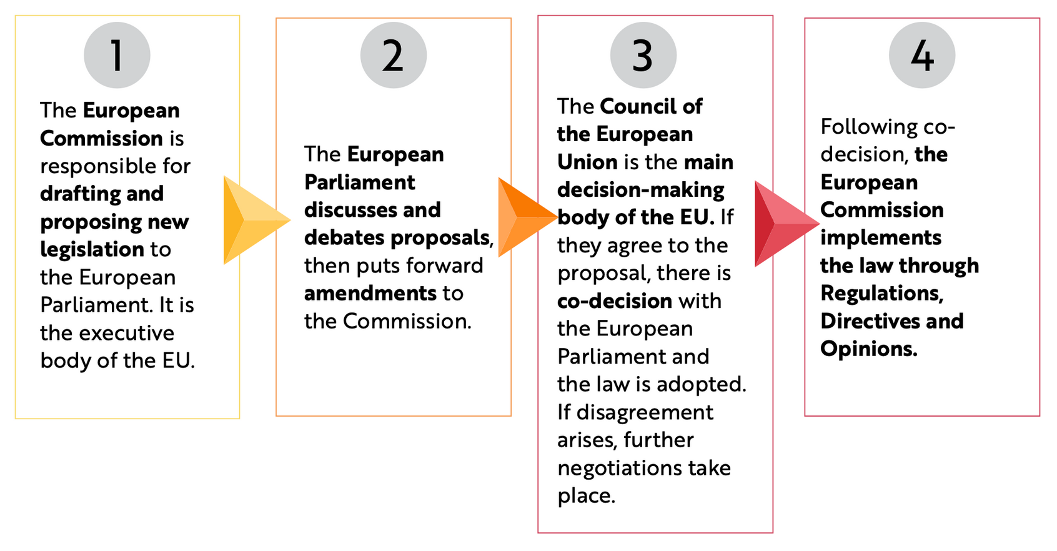
The Decision Making Process Of The EU
Back in Business

Slide 36
Back in Business
The European Central Bank (ECB)
The ECB is the body responsible for monetary policy"in the
eurozone. Their goal is to maintain price stability and control inflation in the eurozone, ensuring a stable and predictable economy. A moderate level of inflation, ideally close to but below 2%, is considered optimal for economic growth, and the ECB uses
monetary policy to try to achieve this. The main tool they use is adjusting interest rates...

Slide 37
Back in Business
The European Central Bank (ECB)
When inflation is too high, they increase interest rates to try to control it by making it more expensive for people to borrow money to spend on goods and services, which lowers demand, leading to lower prices. During times of high inflation, increased interest rates make expansion more difficult and reduce consumer spending, negatively impacting Irish businesses.

Slide 38
Back in Business
The Role Of Special Interest Groups In EU Decision Making
Special Interest Groups are organisations with a common interest that are not part of the political decision-making structure but seek to influence decision-making in the EU, particu!arly during the consultation stage. Lobbying ensures that the needs of Special Interest Groups are reflected in the drafting stage of policy formation, which may have been overlooked if they weren’t involved. e.g. IFA (Irish Farmers’ Association).

Slide 39
Suggested Activities for LO 4.4
Sample Papers
OL1 Q3 (f) (i): Identify two European Union (EU) policy making institutions.
Activity Book Qs
HL Q4
OL Q4

Slide 40
Learning Outcome 4.5
4.5 Distinguish between European regulations, directives, and opinions.
Back In Business

Slide 41


Back in Business
EU Regulation
What it is: A legislative act that becomes law immediately and in full in all member states and takes precedence over national law.
How the Irish Government must respond: No additional Irish legislation is required; it applies automatically.
Example: Common EU rules on airline passenger compensation for delays/cancellations apply the same in every member state.

Slide 42

Back in Business
EU Directive
What it is: A law that sets a target for all member states within a timeframe, but lets each country decide how to achieve it.
How the Irish Government must respond: Pass or amend Irish laws/policies to meet the directive’s objectives (including how to monitor compliance and apply fines).
Example: The EU common charger directive ends the need for multiple device chargers; USB-C works across devices, with states deciding enforcement.

Slide 43

Back in Business
EU Opinion
What it is: Non-binding advice or recommendations from an EU institution. There is no legal requirement for member states to act.
How the Irish Government must respond: Consider the advice; action is optional.
Example: A Commission opinion to Ireland urged faster investment in wind and solar projects to meet climate goals.

Slide 44
Suggested Activities for LO 4.5
Sample Papers
OL1 Q3 (f) (ii): Circle the correct option in each of the following statements: An EU directive / regulation applies to all EU member states and has immediate effect. An EU opinion / regulation allows an EU institution to make a statement that is not legally binding.
Activity Book Qs
HL Q5
OL Q5

Slide 45
Learning Outcome 4.6
4.6 Evaluate the effect of one EU regulation of their choice and one EU directive of their choice on business activity in Ireland.
Back In Business

Slide 46
Back in Business
Evaluation Of The Effect Of GDPR (EU Regulation) On Business Activity In Ireland
Purpose: Protect personal data and strengthen privacy rights across the EU.
Implementation in Ireland: Applies directly in full; enforced nationally by the data protection authority.
Positive impacts (stakeholders):
  Businesses: Stronger data governance builds customer trust and a level playing field across the single market.
  Consumers: Clear rights (access, correction, consent) increase confidence when buying online or sharing data.
  Government/Regulator: Consistent EU-wide rules simplify oversight and cross-border cooperation.

Slide 47
Back in Business
Evaluation Of The Effect Of GDPR (EU Regulation) On Business Activity In Ireland
Negative impacts (stakeholders):
  SMEs: Compliance programmes, documentation, and training add cost and time pressures.
  All firms: Risk of penalties for breaches increases the need for ongoing monitoring and specialist support.
Ethics/Technology link: Encourages ethical handling of data and investment in secure digital systems.
Judgement: Overall, GDPR improves trust and digital readiness, but firms, especially SMEs, face higher compliance costs that reduce their profits.

Slide 48
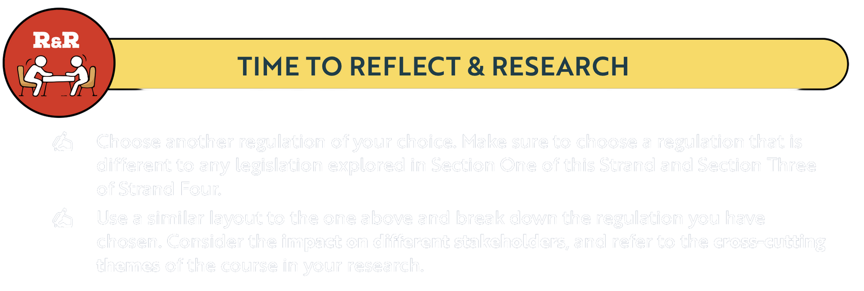
Back in Business
Reflect & Research

Slide 49
Back in Business
Evaluation Of The Effect Of An EU Directive On Business Activity In Ireland:
Single-Use Plastics (SUP) Directive
Purpose: Reduce plastic waste and litter by targeting certain single-use plastic products and promoting circular practices.
Implementation in Ireland: National measures include item bans, labelling and the deposit-return scheme to meet EU targets.
Positive impacts (stakeholders):
  Manufacturers/Retailers: Opportunities to innovate with reusable or sustainable packaging and to differentiate on sustainability.
  Consumers/Communities: Less litter and waste; clearer information on environmental impact.
  Government/Regulator: Progress toward environmental targets with measurable impact in the deposit-return scheme.

Slide 50
Back in Business
Evaluation Of The Effect Of An EU Directive On Business Activity In Ireland
Negative impacts (stakeholders):
  SMEs: Transition costs to redesign packaging, adjust supply chains, and manage take-back/return systems.
  Consumers: Increased hassle of storing and returning used plastic bottles to get back their deposits.
Ethics/Technology link: Drives sustainable practice and can accelerate adoption of new materials and innovative solutions.
Judgement: The directive supports environmental goals and opens new green-business opportunities, but implementation demands and costs can be significant, particularly for smaller firms.

Slide 51
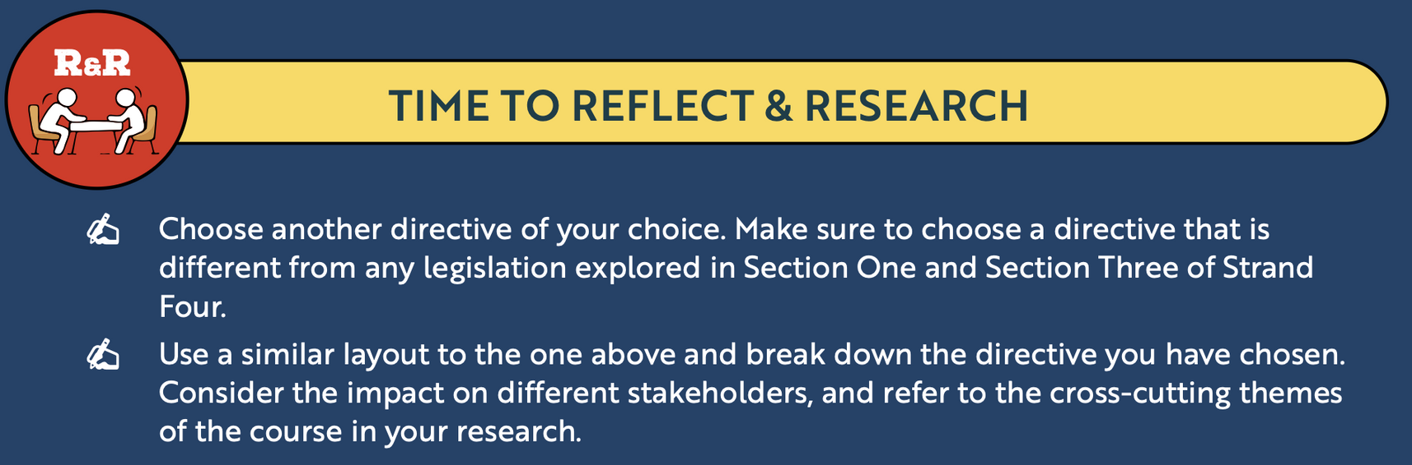
Back in Business
Reflect & Research

Slide 52
Suggested Activities for LO 4.6
Sample Papers
HL1 Q5 (c): (i) Name an EU regulation you have studied and explain how it has been implemented in Ireland. (ii) Examine two positive and two negative impacts the EU regulation you named above has on different stakeholders in Ireland.
HL2 Q5 (d): (i) Name an EU directive you have studied, and explain the purpose of this EU directive. (ii) Evaluate how this EU directive impacts on business activity in Ireland.
Activity Book Qs
HL Q6
OL Q6 & Q7

