Slide 1
Strand 1
Chapter 03
Business And The Economy
Back In Business

Slide 2

Priming Activity
Are interest rates currently higher or lower than the average for the last five years?
Are there any industries where they cannot find workers?
Where does Ireland rank in terms of the value of our economy compared to other EU countries?

Slide 3

Starter Activity
LINK
STARTER SHEET

Slide 4
Learning Outcomes
3.1 Explain how economic indicators can impact on business development and growth.
3.2 Outline the value of the business economy in Ireland.
Back In Business

Slide 5
Learning Outcome 3.1
3.1 Explain how economic indicators can impact on business development and growth.
Back In Business

Slide 6

Back in Business
The Rate Of Inflation
Meals on Wheels in Ireland is a non-profit, part-funded by government, part by local fundraising and contributions, with volunteers playing a crucial role in keeping the service viable that they carry out - providing affordable or subsidised meals, reducing isolation, and supporting independent living for older and vulnerable people.
LINK

Slide 7
Back in Business
The Rate Of Inflation
Inflation refers to a rise in the average level of prices from one period to the next.
Inflation causes money to lose value, because people can buy less with the same amount of money than they could have done previously.
Businesses feel inflation with an increase in costs of production, which can limit profitabilty and expansion opportunities.

Slide 8
Back in Business
How Is Inflation Measured By The C.P.I?
CPI – Consumer Price Index
  Measures the overall change in prices of goods and services that households typically buy.
  The CSO tracks prices of 612 items in a “CPI basket” each month.
  Each item is weighted by how much of household income is usually spent on it.
  Monthly changes are compared with previous months to calculate the inflation rate.
  Results are published regularly by the CSO with graphics and data trends.
  The CSO will remove items that people no longer buy and add in new items e.g. Air Fryers
Example: If electricity bills and food prices rise more than clothing or electronics, they will have a bigger impact on the CPI figure as a higher percentage of income is spent on those.

Slide 9
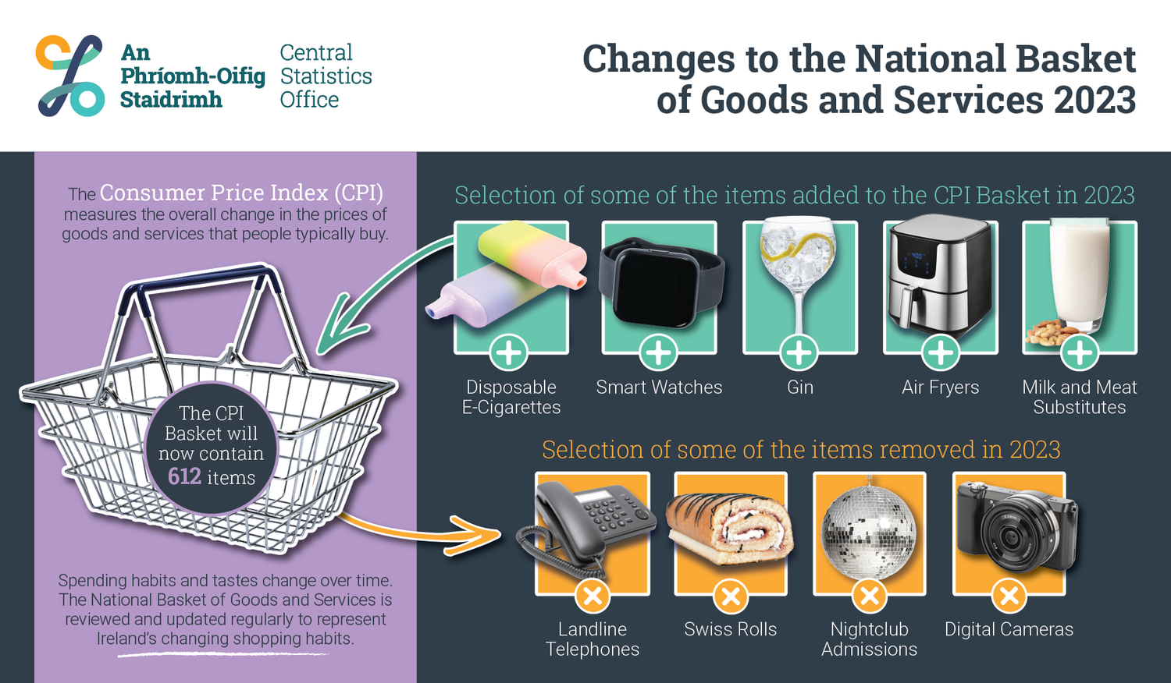
Back in Business
How Is Inflation Measured By The C.P.I?

Slide 10
Back in Business
How High Inflation Impacts Business Development & Growth
Greater Wage
Demands
  Staff may seek cost-of-living pay rises.
  Strikes or higher wages increase costs and limit expansion opportunities.
Higher Production Costs
  Raw materials, energy, and inputs become more expensive.
  Businesses face reduced profit margins or must raise prices, which can limit development and growth.
  If Ireland’s inflation is higher than in other countries, exports become relatively more expensive abroad.
  Irish goods lose competitiveness in foreign markets, limiting export growth abroad.
Less Competitive
Exports

Slide 11
Back in Business
How High Inflation Impacts Business Development & Growth
Take Home Point
High inflation reduces certainty for businesses, raising costs and weakening competitiveness.

Slide 12
Back in Business
Employment Rates
The rate of employment measures the percentage of people in the labour force (the total population aged 15-64 years) who are in paid employment.
LINK

Slide 13
Back in Business
How High Employment Rates Impact Business Development & Growth
Increased Demand For Goods & Services
  More people in work → higher incomes and consumer spending.
  Creates opportunities for businesses to expand.
Labour
Shortages
  Certain skills (e.g. chefs, programmers, hospitality staff) may be in short supply.
  Makes it harder for businesses to recruit and expand.
  With fewer workers available, employees can push for higher wages.
  This increases costs and may reduce profit margins and lead to price hikes, limiting growth opportunities.
Higher Wage
Demands

Slide 14
Back in Business
Employment Rates
Take Home Point
High employment boosts spending and demand which helps expansion, but can also create staff shortages and lead to rising wage costs which could limit growth for some businesses.

Slide 15
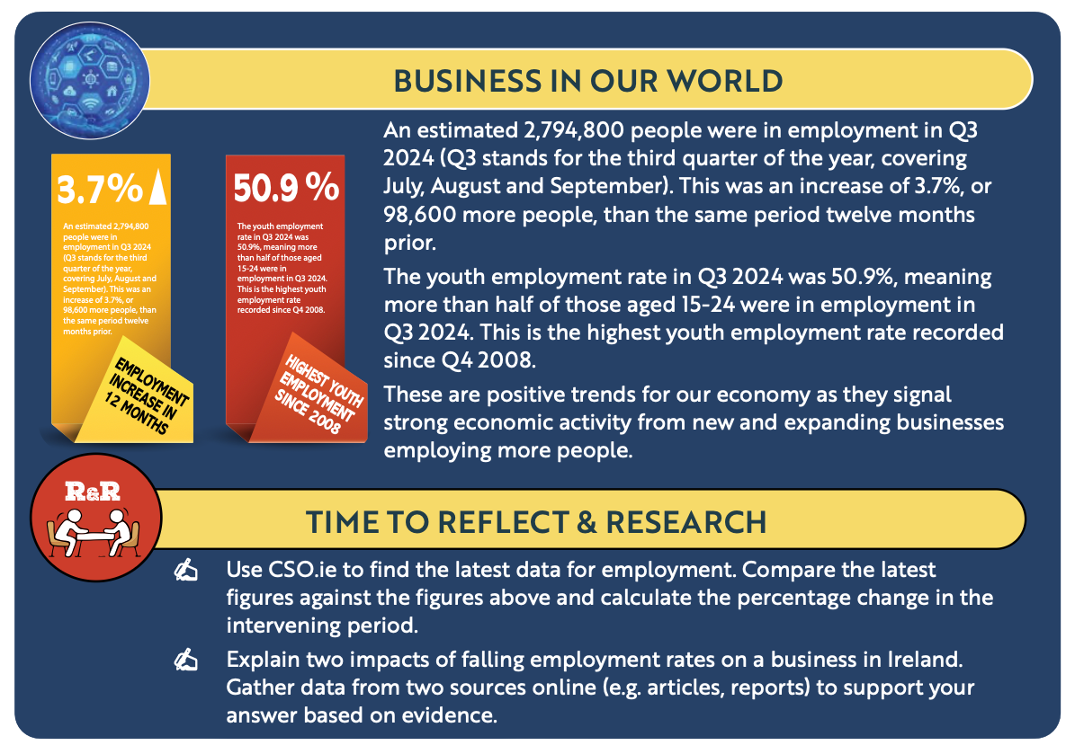
Back in Business
Reflect & Research

Slide 16
Back in Business
Interest Rates
This refers to the cost of borrowing capital expressed as a percentage of the amount borrowed.
Set in the euro area by the European Central Bank (ECB).

Slide 17
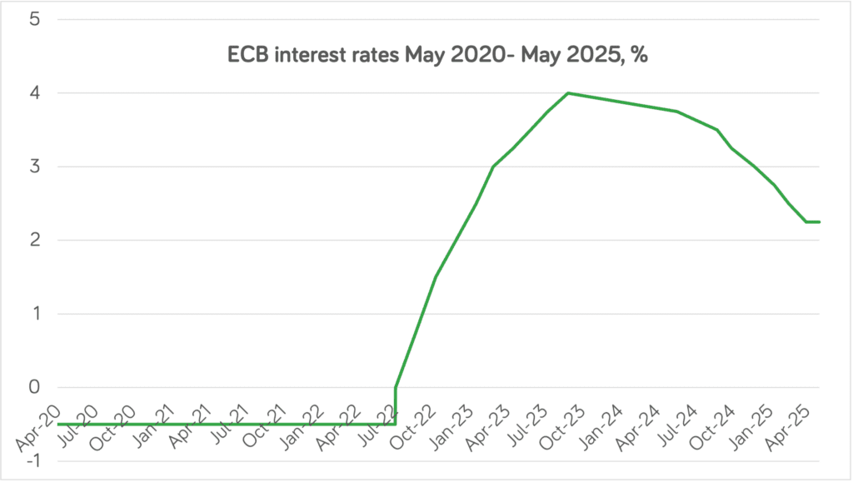
Back in Business
Interest Rates
Increases in interest rates (July 2022 - October 2023) increase the cost of borrowing for businesses, as well as making it more expensive for consumers to use loans to purchase items.
Source

Slide 18
Back in Business
How High Interest Rates Impact Business Development & Growth
  Businesses face higher loan repayments, raising overall expenses.
  Profit margins shrink, making it harder to reinvest and gain access to loans to expand.
Increased Costs &
Reduced Profits
  Consumers have less disposable income due to higher mortgage and loan repayments.
  Lower demand reduces revenue for businesses, especially in non-essential goods, limiting expansion.
Decrease In
Sales
  Expansion plans are postponed as borrowing becomes too expensive.
  Investors and banks are more cautious around the future performance of the business, limiting access to finance.
Business Confidence
Falls

Slide 19
Back in Business
Interest Rates
Take Home Point
High interest rates reduce consumer spending and raise borrowing costs, making businesses less likely to invest and expand.

Slide 20
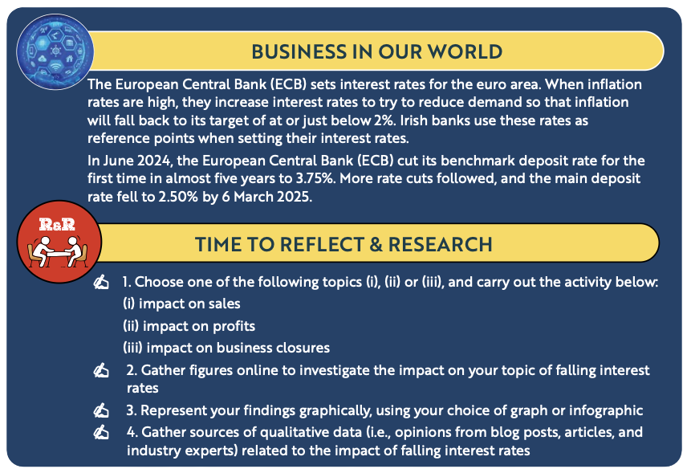
Back in Business
Reflect & Research

Slide 21
Back in Business
Economic Growth And Development
Economic growth refers an increase in the value of goods and services produced in a country from one period to the next.
Economic development refers to an increase in the value of goods and services produced in a country from one period to the next, accompanied by a structural shift in society.

Slide 22
Back in Business
Economic Growth And Development
Economic growth is commonly measured as the percentage growth in Gross Domestic Product (GDP) or Gross National Product (GNP) over a specific period.
In Ireland, GDP would overestimate the value of goods and services produced due to the large multinational presence here.
When comparing our economy against other countries, GNP would better represent our economy.

Slide 23
Back in Business
Economic Growth And Development
The definition of a recession is two consecutive quarters of negative economic growth. E.g. during COVID Ireland briefly entered a recession with back to back negative economic growth in the first and second quarter of 2020.
Economic development includes improvements in peoples’ standard of living (better health services, improved education and quality of life) and is measured using the Human Development Index (HDI).

Slide 24
Back in Business
The Impact Of Economic Growth On Business Development & Growth
  Higher incomes during growth lead to stronger demand for goods and services.
  Businesses benefit from higher sales, encouraging expansion.
Increased Consumer
Spending
Increased
Investment
  Growth creates optimism and confidence in the economy.
  Firms are more likely to invest in new products, technology, and markets.
Easier To Access
Finance
  Banks are more willing to lend during periods of strong growth.
  Expansion projects become more affordable and less risky.
  Higher tax revenue allows for better infrastructure / grants.
  This reduces barriers to growth and supports long-term development.
Increased Government
Expenditure & Support

Slide 25
Back in Business
Economic Growth
Take Home Point
Economic growth fuels consumer demand, investment, finance, and government support, creating a positive environment for businesses to expand.

Slide 26
Back in Business
Exchange Rates
This is the price or cost of one currency expressed in terms of another currency

Slide 27
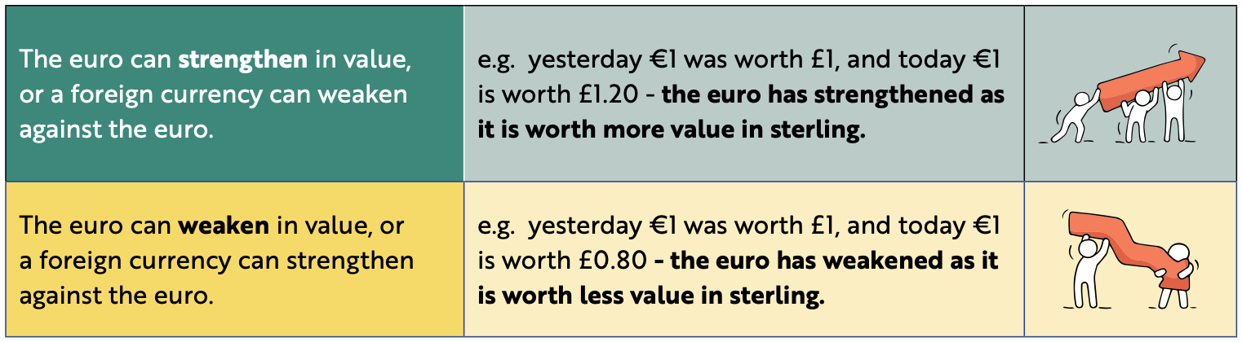
Back in Business
Exchange Rates

Slide 28
Back in Business
The Impact Of Exchange Rates On Business Development & Growth
More Expensive In
Export Markets
  A stronger euro makes Irish goods costlier abroad.
  Reduces competitiveness and limits sales growth.
  A weaker euro makes imports (e.g. oil, machinery) more expensive.
  Businesses face higher production costs and squeezed margins if hit with more expensive imports.
Increased Cost Of Raw
Materials / Stock
  A stronger euro makes imports from abroad cheaper.
  Irish consumers may switch to foreign goods, reducing local sales.
Lower Domestic
Demand
  Fluctuating exchange rates make pricing and forecasting difficult.
  Businesses may delay or cancel expansion plans.
Creates Uncertainty
For Planning

Slide 29
Back in Business
Exchange Rates
Take Home Point
Exchange rate movements can boost or restrict Irish business growth.
Strong euros hurt exports, weak euros raise import costs, and volatility makes planning harder.

Slide 30
Back in Business
Consumer Confidence
LINK

Slide 31
Back in Business
Consumer Confidence
1. What does Charlie Weston say is the main reason people aren’t spending more on holidays now?
2. How does this consumer caution reflect consumer confidence, and why is it important for businesses?
3. Which types of businesses are most affected by cautious holiday spending?
4. If consumer confidence improved, what changes would you expect in spending and in business activity?

Slide 32
Back in Business
Consumer Confidence
Consumer confidence measures the degree of optimism, or pessimism consumers feel about the overall state of the economy and their personal financial situations.
It is used to reflect their future willingness to spend money on goods and services in an economy

Slide 33
Back in Business
Consumer Confidence
  Consumer confidence measures how optimistic or pessimistic people feel about the economy and their personal finances.
  It is used as an indicator of how willing people are to spend money on goods and services.
  The Irish League of Credit Unions (ILCU), with Core Research, produces a monthly Consumer Sentiment Index.

Slide 34
Back in Business
Consumer Confidence - key factors
  Economic outlook: Do consumers feel the economy is improving or weakening?
  Household finances: How confident people feel about paying bills and managing expenses.
  Job security: Optimism about keeping employment or finding new jobs.
  Spending intentions: Willingness to make major purchases like cars or holidays.

Slide 35
Back in Business
How High Consumer Confidence Impacts Business Development & Growth
  Optimistic households are more willing to buy non-essential goods and services.
  Higher demand boosts sales in sectors like retail, leisure, and hospitality.
Increased Consumer
Spending
  Positive consumer outlook encourages firms to open new outlets or launch products.
  Businesses hire more staff and scale operations with confidence.
Increased Business
Expansion
  Banks and investors are more willing to provide loans and capital if they believe consumers will spend.
  Strong demand signals reduce perceived risk, supporting growth plans.
Easier To Raise Capital
To Start-Up / Expand

Slide 36
Back in Business
Exchange Rates
Take Home Point
When consumers feel confident, businesses benefit from higher sales, easier financing, and greater incentives to expand.

Slide 37
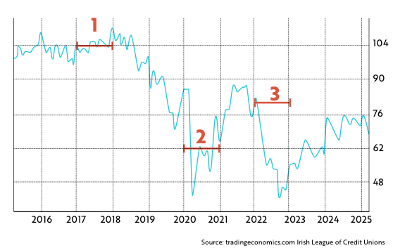
Back in Business
Reflect & Research

Slide 38
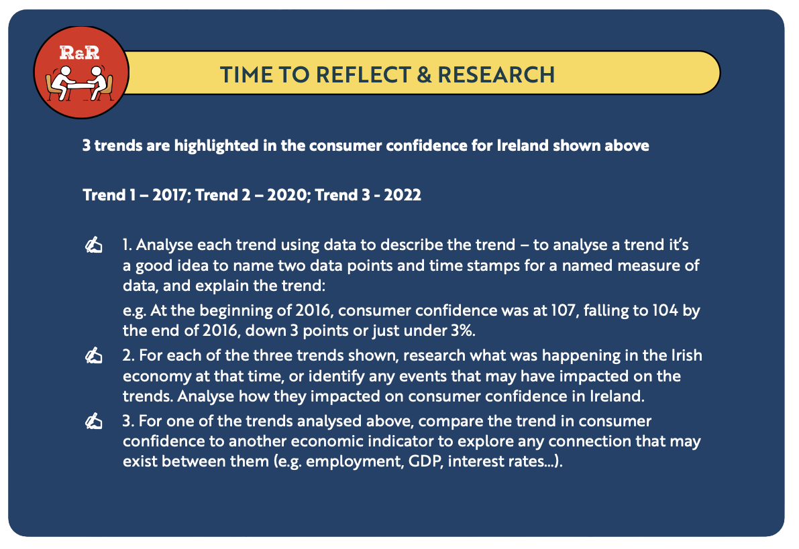
Back in Business
Reflect & Research

Slide 39
Suggested Activities for LO 3.1
Sample Papers
HL1 Q2 (d): Explain the impact of three economic indicators on business growth.
HL2 Q5 (c)(i): Explain the economic indicator most relevant to the infographic above. (Inflation)
OL1 Q5 (d): Outline one impact inflation may have on Alice's business.
OL2 Q2 (c): Choose one of these and explain how it may impact on business development and growth in Ireland: Inflation; Employment/ Unemployment Rates;
Interest Rates
Activity Book Qs
HL Q1 - Q5
OL Q1 - Q5

Slide 40
Learning Outcome 3.2
3.2 Outline the value of the business economy in Ireland.
Back In Business

Slide 41
Back in Business
The Business Economy
The business economy refers to the economic activities of industry, construction, distributive trades and services in Ireland. Trends in this data can help guide policymakers, businesses and investors when making strategic decisions.

Slide 42
Back in Business
The Business Economy
Examples of Each Section Include...
Industry
Construction
Manufacturing / Energy
Construction Industry
Distributive Trade
Services
Wholesale & Retail
Transport, Accommodation, Financial & Insurance

Slide 43
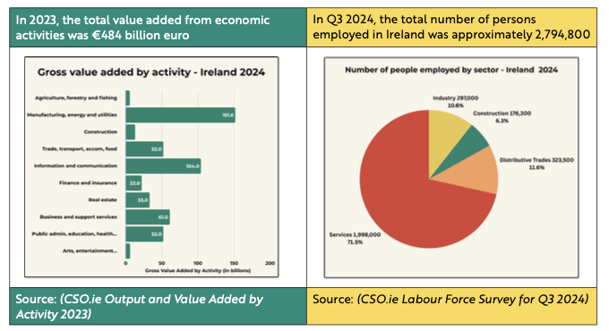
Back in Business
Data for the Business Economy

Slide 44
Back in Business
Uses For Government
Labour Market Strategies
Changes in employment figures help the Government pan for education and workforce training to align skills with industry needs.
Help Attract FDI (Foreign Direct Investment)
Positive trends in the value of Ireland’s turnover can be used to show potential FDI that Ireland is a strong economy, encouraging them to establish a base in Ire!and.

Slide 45
Back in Business
Uses For Business
Market Trends
Turnover data helps businesses identify growing sectors and market opportunities.
Sector Comparisons
Allows businesses to benchmark their performance against competitors and industry averages.

Slide 46
Suggested Activities for LO 3.2
Sample Papers
-
Activity Book Qs
HL Q6

