Slide 1

Strand 2
Chapter 11
Growth, Development, And Expansion
Back In Business

Slide 2
Learning Outcomes
11.1 Demonstrate an understanding of the importance of identifying competition in the market.
11.2 Use Porter’s five forces model to identify and analyse competition in the market and use these findings to identify the competitive advantage of business.
11.3 Outline the strategies employed by a business to adapt or expand.
Back In Business

Slide 3
Learning Outcomes
11.4 Appreciate the potential of technology to support adaption and expansion.
11.5 Conduct a cost-benefit analysis to analyse the implications of business expansion.
11.6 Outline strategies that a business may employ to adapt based on their marketing mix and/or business model.
Back In Business

Slide 4

Introduction
Back In Business
Priming activity
Name some businesses you know that have expanded; how did they grow?
Choose businesses you know that really stand out from competitors; what makes them stand out?
How are smaller Irish businesses adapting or expanding through the use of technology? (Think of the case studies at the start of your book for examples)

Slide 5

Introduction
Back In Business
Starter Activity - watch then answer these questions
Link
  Spotify uses a “freemium” model. What does this mean, and why might it attract so many users compared to rivals?
  How has Spotify tried to grow beyond just music streaming? Do you think this gives them an advantage?
  What challenges does Spotify face in making money from music streaming?
  How important are podcasts in Spotify’s business strategy? Why might they see podcasts as different from music?
  Based on the video, what do you think gives Spotify its strongest competitive advantage right now?
Worksheet here for after the video

Slide 6
Learning Outcome 11.1
11.1 Demonstrate an understanding of the importance of identifying competition in the market.
Back In Business

Slide 7

Back In Business
Why Analyse Competition?
Helps a business understand who its direct and indirect competitors are in the market.
Direct competitors are businesses offering the same or very similar products to the same target market. Indirect competitors are businesses offering different products or in different ways, but satisfying the same customer need.
Example: A bakery’s direct competition might be another bakery in the village, while indirect competition could be the local supermarket that sells bread and pastries at their deli.

Slide 8

Back In Business
Why Analyse Competition?
Provides insights into what strategies have worked or failed for competitors
By studying competitors’ past decisions, businesses can avoid repeating mistakes and build on proven ideas.
Example: If another bakery nearby tried to sell elaborate celebration cakes but failed, a new bakery might instead focus on everyday bread and small treats that have steady demand.

Slide 9

Back In Business
Why Analyse Competition?
Reveals current consumer preferences in the market
Analysing competitors’ products highlights what customers are buying and valuing right now. This helps businesses adapt their offerings to meet those preferences.
Example: If gluten-free products are selling well in supermarkets, a bakery can introduce its own gluten-free range to stay relevant.

Slide 10
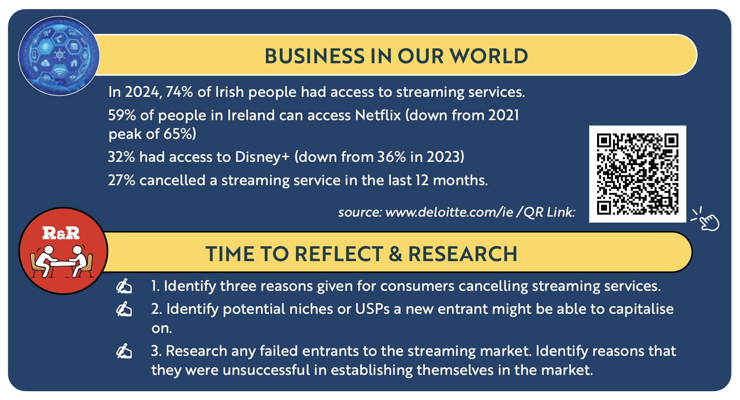
Back In Business

Slide 11


Back In Business
The Significance Of a Business’s Competitive Advantage And
How A Business Can Capitalise On It
Helps Create A Clear USP
A competitive advantage sets a business apart from its competitors. It can be found within a specific product feature, unique service, quality focus, or brand experience.
A clear differentiating feature or value proposition needs to be established so a business can base all of its actions on this unique selling point.
Build A Loyal Customer Base
When a business offers something that customers value and cannot easily find elsewhere, it fosters
loyalty and encourages repeat business.
Low fare journeys keep customers returning to Ryanair when looking for flights for their next holiday.

Slide 12
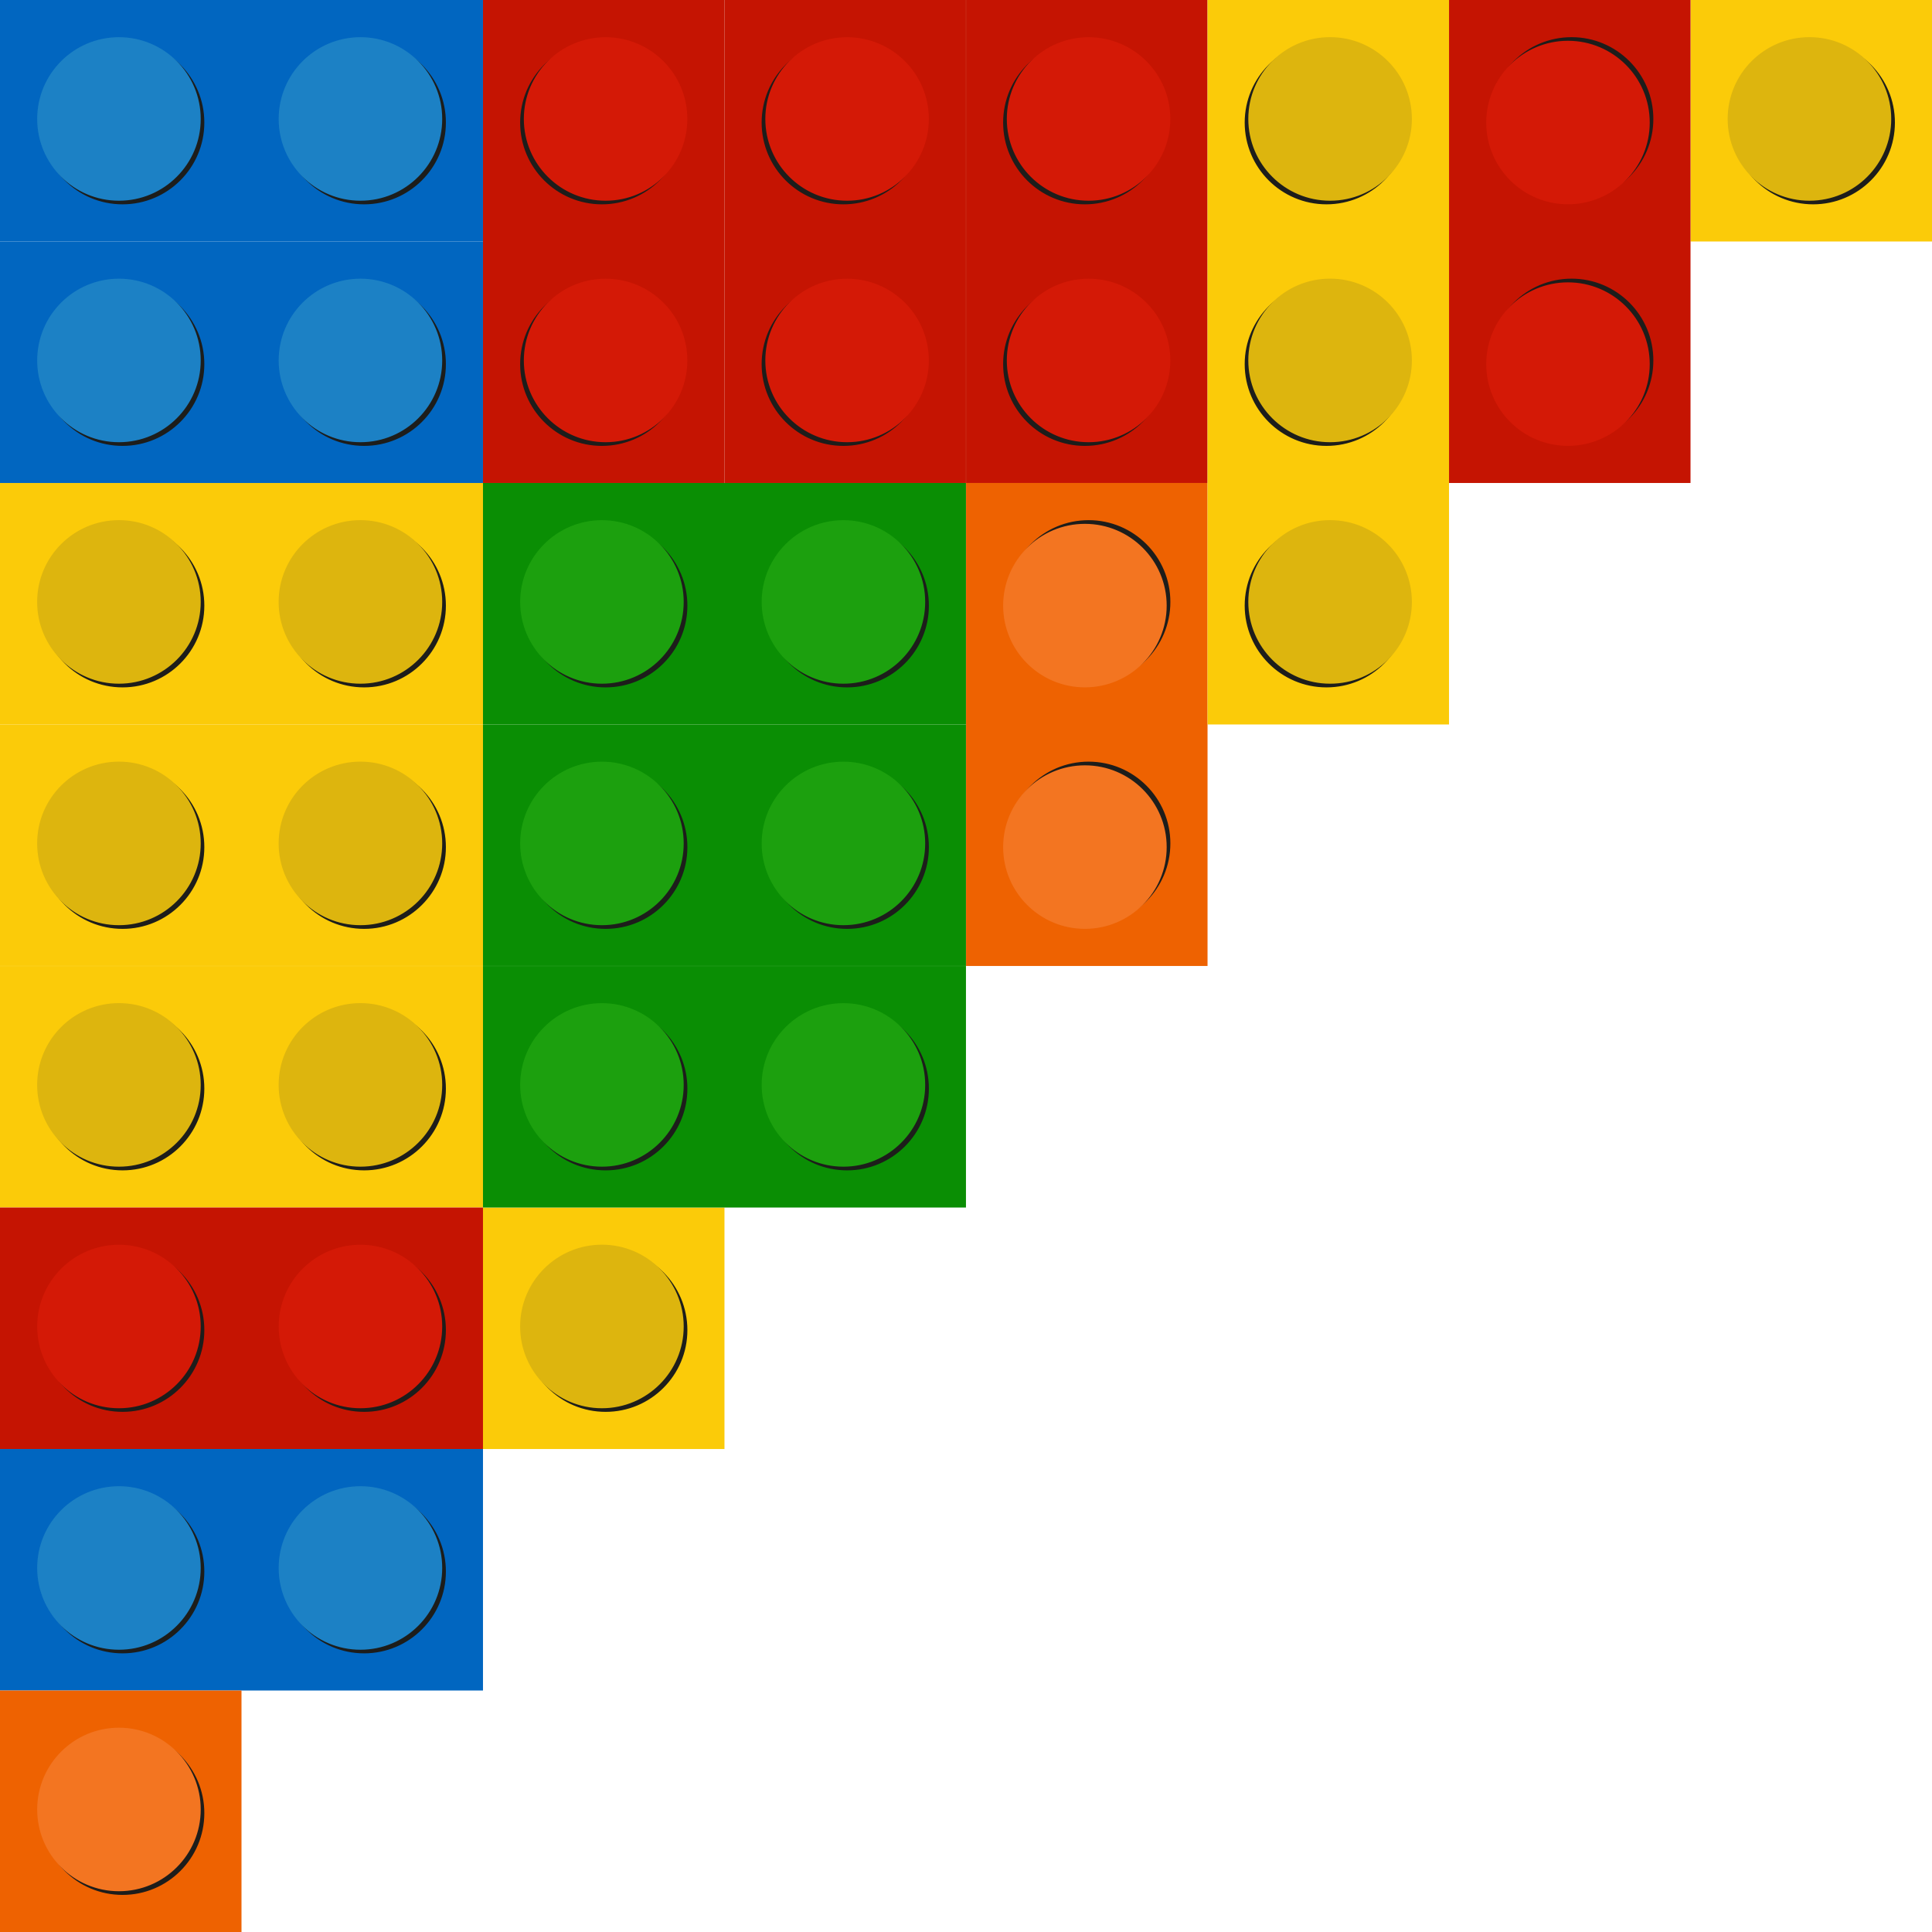
Back In Business
The Significance Of a Business’s Competitive Advantage And
How A Business Can Capitalise On It
Help Improve the Marketing Mix
A business should make sure that customers know exactly what makes it different - this message can be shared through advertising, social media, in-store branding, packaging, or even how staff speak about the brand.
Lego have developed more products around Marvel and Disney characters and movies to leverage their competitive advantage of being partnered with lots of popular movies.
Develop Their Competitive Advantage
A business should keep improving what it is best at. If it has an advantage in customer service, it needs to make sure that it continues to train staff well. A competitive advantage is not permanent, what works today may not work tomorrow. Businesses must monitor what their competitors are doing
and be ready to change.

Slide 13

Back In Business
Examples Of Competitive Advantages A Business Might Have
Lower
Prices
Customer
Service
Free
Returns
Best
Technology
Higher
Quality
Next Day
Delivery
Convenient
Location
Latest
Designs

Slide 14
Suggested Activities for LO 11.1
Sample Papers
HL1 Q1 (e): Identify Glow Inc's potential competitive advantage and, based on this advantage, recommend an appropriate strategy for launching their new product on the market.
Activity Book Qs
HL Q1
OL Q1, Q2

Slide 15
Learning Outcome 11.2
11.2 Use Porter’s five forces model to identify and analyse competition in the market and use these findings to identify the competitive advantage of a business.
Back In Business

Slide 16
Back In Business
Link

Slide 17
Back In Business
Porter’s model includes five forces which support deeper understanding
of the competitive forces within business which drive how economic
value is divided amongst stakeholders. The five forces with Porter’s model include the threat of new entrants, the bargaining power of suppliers, the bargaining power of customers, the threat of substitutes and competitive rivalry.

Slide 18
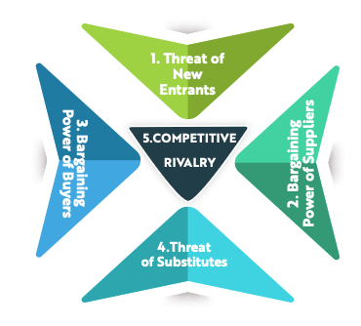
Back In Business
A Business Can Use Porter’s Model To...
📌 Identify areas of strength (consumer loyalty, unique suppliers, few substitutes)
📌 Highlight risks that they face (new competitors, increased rivalry)
📌 Identify their competitive advantage over rivals so that they can capitalise on it.

Slide 19
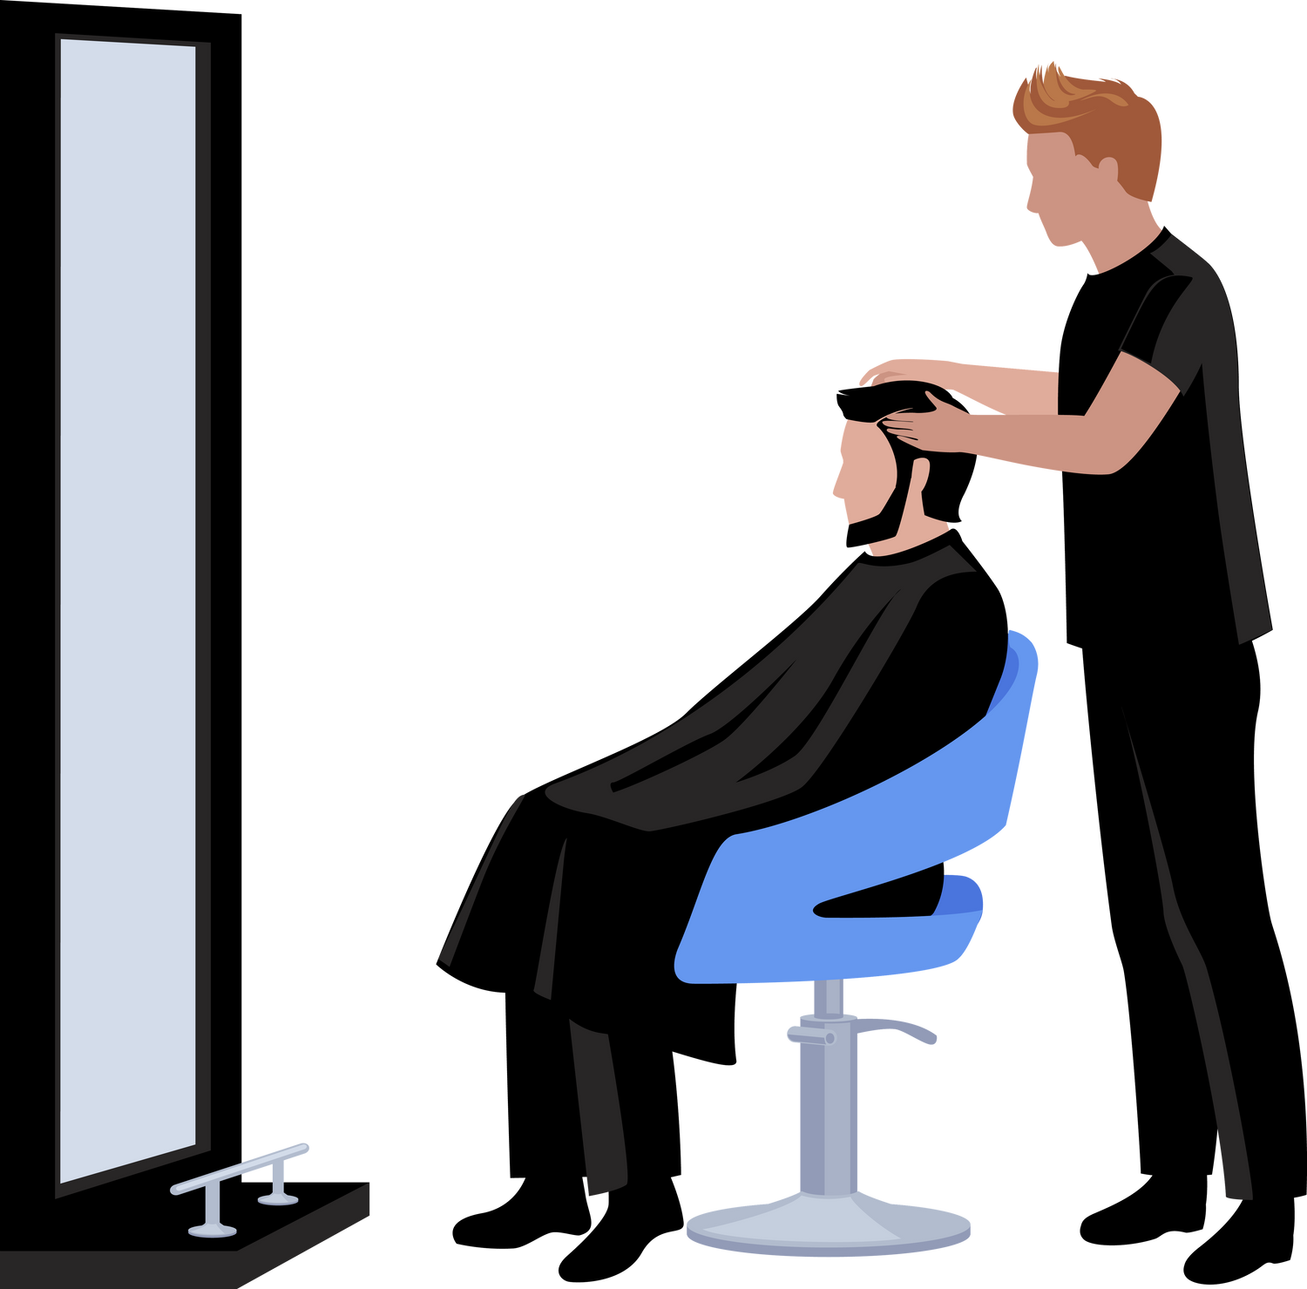
Back In Business
Porter’s Five Forces 1.Threat Of New Entrants
This force looks at how easy or difficult it is for new businesses to enter a market. If barriers to entry are high, profits are more protected for the existing business.
Low Threat Example: McDonald’s –> opening a national chain requires huge capital, strong branding, and supply networks, so threat is low.
High Threat Example: A local barber shop –> anyone with basic skills and a premises can open nearby, so threat is high.

Slide 20
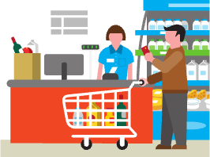
Back In Business
Porter’s Five Forces 2. Bargaining Power Of Suppliers
Suppliers have power if businesses depend on them and have few alternatives. Low supplier power helps firms keep costs down.
Low Bargaining Power Of Suppliers Example: Supermac’s –> can source potatoes, dairy, and meat from many Irish suppliers, giving it strong negotiating power.
High Bargaining Power Of Suppliers Example: A small Irish cake maker that sells a large amount of their produce to Aldi for sale in their stores - if they rely on Aldi, it gives Aldi more power negotiate lower prices

Slide 21
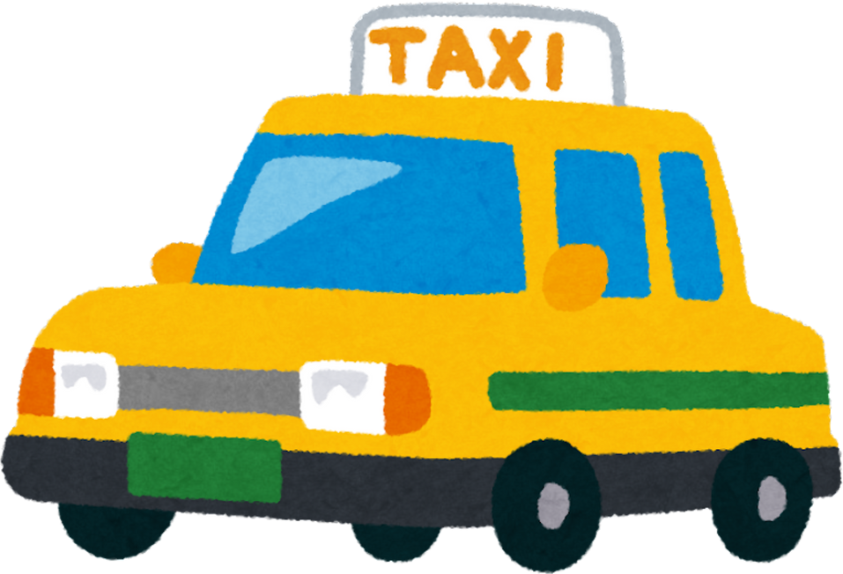
Back In Business
Porter’s Five Forces 3. Bargaining Power Of Buyers
Customers have power when they can easily switch or demand lower prices. High customer power reduces profitability.
Low Bargaining Power Of Buyers Example: Apple iPhone –> loyal customers have little influence on price as they will want to keep buying Apple products regardless, so Apple keeps strong margins.
High Bargaining Power Of Buyers Example: A taxi company –> customers can switch instantly to Uber, FreeNow, or another local taxi firm, so buyer power is high.

Slide 22

Back In Business
Porter’s Five Forces 4. Threat Of Substitutes
This force looks at whether customers can find alternative ways to meet the same need. More substitutes mean lower profitability.
Low Threat Example: Electricity supply –> few practical substitutes for households exist, so threat is low. This may change as solar becomes cheaper and more efficient.
High Threat Example: Spotify –> customers can use YouTube, Apple Music, radio, or podcasts, so the threat of substitutes is high.

Slide 23
Back In Business
Porter’s Five Forces 5. Competitive Rivalry
This force examines the intensity of competition between existing businesses in the market. High rivalry usually means price wars and heavy promotions are used to attract and retain customers.
Low Threat Example: Irish Rail –> limited competition on intercity train routes, so rivalry is low.
High Threat Example: Circle K vs Applegreen –> forecourt sector is highly competitive, with price cuts, loyalty apps, and strong food partnerships, so rivalry is high.

Slide 24
Back In Business
Porter’s Five Forces applied to Dunnes Stores
Force | Dunnes Stores (Ireland)
Threat of New Entrants | Low – barriers to entry are high, as building a nationwide supermarket chain requires huge investment in stores, logistics, and branding.
Bargaining Power of Suppliers | Low – Dunnes has scale and can negotiate with many Irish and international suppliers, reducing supplier influence on prices/profits.
Bargaining Power of Customers | High – Irish customers can easily switch between Dunnes, Tesco, Aldi, Lidl, and SuperValu, forcing Dunnes to use loyalty schemes and promotions like they’re popular €10 off €50 spend which keeps customers returning to stores.
Threat of Substitutes | Medium – customers could buy from convenience stores, farmers’ markets, or use meal delivery services, though supermarkets remain the most convenient option.
Competitive Rivalry | High – rivalry is fierce among the big five retailers. Dunnes competes using the €10 off €50 spend and having in store brands that other shops don’t have as well as its mix of groceries with clothing and homeware.

Slide 25
Back In Business
How Businesses Use Porter’s Model To Identify A Competitive Advantage
A business with a low threat of new entrants and strong consumer loyalty has the scope to increase its prices or expand its business.
Another business facing high rivalry or threats of new entrants due to changes in technology might delay expansion due to these threats and invest in marketing and innovation instead to protect itself from the risks
identified.

Slide 26
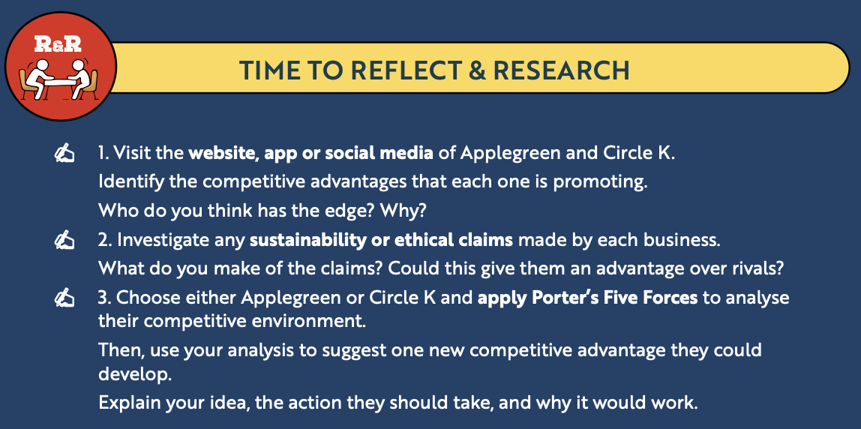
Back In Business
Porter’s Model

Slide 27
Suggested Activities for LO 11.2
Sample Papers
HL1 Q1 (e): Analyse the competitive forces in the market for Glow Inc using Porters Five Forces Model.
OL2 Q2 (d): Porter’s Five Forces Model. Name the two forces missing from the diagram. Write your answers in the space below.
Activity Book Qs
HL Q2
OL Q3

Slide 28
Learning Outcome 11.3
11.3 Outline the strategies employed by a business to adapt or expand.
Back In Business

Slide 29
Back In Business
Businesses Must Evolve To Survive
A business is not static. The market and world we live in are constantly evolving, and a business needs to adapt and expand in order to survive and thrive. This means it needs to update how it operates, what it offers and where it competes.

Slide 30
Back In Business
Adaptation Strategies A Business Can Use To Stay Competitive
Updating Products Or Services
Businesses may improve or redesign their products or services to meet changing customer needs, keep
up with trends, or stay ahead of competitors.
McDonald’s added vegan burgers to adapt to growing demand for plant-based food.
Entegrating New Segments
A business may target a new customer group to grow sales and reduce reliance on its existing market.
A gym launches a low-impact fitness programme for older adults.

Slide 31

Back In Business
Adaptation Strategies A Business Can Use To Stay Competitive
Reducing Costs Through Automation Or A.I
Technology can replace repetitive tasks and free staff for higher-value work.
A hotel uses a chatbot to handle booking enquiries, reducing reception workload.
Diversifying To Remove Risks
Businesses may expand into new products or markets so they are not reliant on one source of income.
A soft drinks company adds flavoured sparkling water for health-conscious consumers.

Slide 32

Back In Business
Adaptation Strategies A Business Can Use To Stay Competitive
Investing In Staff Development
Training staff and encouraging innovation helps businesses adapt and stay competitive.
A retail chain trains staff in digital tools and rewards new ideas that improve customer experience.
Improving Sustainability Or Branding
To adapt to customer expectations and social responsibility, a business may improve how it sources
materials, reduces waste, or positions its brand.
A clothing brand switches to organic cotton and labels its carbon footprint to attract eco-conscious shoppers.

Slide 33
Back In Business
Organic Expansion
📌 Increasing the product range or entering new markets: A business can grow by offering more products or expanding into new locations or customer groups.
This spreads risk and opens up new revenue streams.
📌 E-commerce expansion: Selling products or services online allows a business to reach more customers without needing extra physical locations. It also helps them stay competitive in a digital-first world. (All Real Nutrition to America)
📌 Franchising: Franchising allows a business (the franchisor) to grow its brand by allowing other businesses to open and operate new outlets using their brand name, logo, products, and systems in return for a fee. (E.g. Bike Row Ski)

Slide 34
Back In Business
Strategies A Business Can Use To Expand - Organic Expansion
Benefits of using Franchising to expand | Challenges of using Franchising to expand
Allows rapid expansion with lower costs, since franchisees fund and manage their own outlets. | Quality and customer experience can vary if franchisees do not follow standards consistently.
Franchisees bring local knowledge and motivation, helping the business succeed in different regions. | Loss of control, as decisions are shared with many independent franchise owners.
Provides a steady income stream through franchise fees and royalties. | Risk to brand reputation if one franchisee delivers poor service or faces negative publicity.

Slide 35
Back In Business
Strategies A Business Can Use To Expand - Inorganic Expansion
Takeover / Acquisition
A takeover or acquisition is when one business takes control of another by
buying over 50% of its shares. It may be a hostile takeover if the directors
of the company recommend to its shareholders that they do not accept the
takeover offer given to them.
E.g. Meta took over Instagram and Whatsapp

Slide 36
Back In Business
Strategies A Business Can Use To Expand - Inorganic Expansion
Takeover / Acquisition
Benefits of a Takeover | Challenges of Takeover
Rapid Market Access – The business can instantly enter new markets or product areas without building them from scratch. | High Capital Requirement – Takeovers often require paying more than market value to convince shareholders to sell.
Eliminates Competition – By taking over a rival, the business removes a threat and gains a larger share of the market. | Hostility with Stakeholders – A hostile takeover may increase resistance from directors and staff, damaging morale.
New Assets – The acquiring business gains technology, patents, or customer bases that would take years to develop internally. | Regulatory Issues – If the takeover gives too much market power to one firm, it may be blocked or face stricter regulation.

Slide 37
Back In Business
Strategies A Business Can Use To Expand - Inorganic Expansion
Mergers
A merger is a voluntary amalgamation of two or more firms for their
mutual benefit. A single new legal entity is formed once it is approved by
shareholders, and neither entity has control over the other. E.g. Kraft & Heinz merged and became KraftHeinz.

Slide 38
Back In Business
Strategies A Business Can Use To Expand - Inorganic Expansion
Mergers
Benefits of Mergers | Challenges of Mergers
Shared Resources – Two businesses can combine their assets, expertise, and technology to strengthen operations. | Culture Clashes – Differences in management style or workplace culture may cause conflict and reduce efficiency.
Economies of Scale – Mergers can lower costs by pooling purchasing power and spreading fixed costs across a larger business. | Job Redundancies – Overlapping roles may lead to job losses, damaging staff morale.
Stronger Market Position – A merger can increase market share and create a stronger competitor. | Complex Integration – Combining systems, processes, and staff can take time and may disrupt operations.

Slide 39
Back In Business
Strategies A Business Can Use To Expand - Inorganic Expansion
Strategic Alliances
A business alliance is an agreement between two or more businesses to pool resources and/or expertise to work together over a specified period of time or to complete a specified project, while all parties maintain their separate identities.
Uber and Spotify had agreed an alliance for Uber customers to be able to stream their Spotify songs during Uber rides.

Slide 40
Back In Business
Strategies A Business Can Use To Expand - Inorganic Expansion
Benefits of Strategic Alliances | Challenges of Strategic Alliances
Shared Expertise – Businesses can pool skills, technology, or knowledge to achieve goals more effectively. | Unequal Contribution – One partner may invest more resources or effort, creating tension.
Market Access – Alliances allow businesses to enter new markets or reach new customers without a full takeover or merger. | Loss of Control – Businesses must share decision-making, which may limit independence.
Lower Risk – Costs and risks of a project are shared, making expansion more affordable. | Conflicting Objectives – Partners may have different goals, leading to disagreements or failure of the alliance.

Slide 41
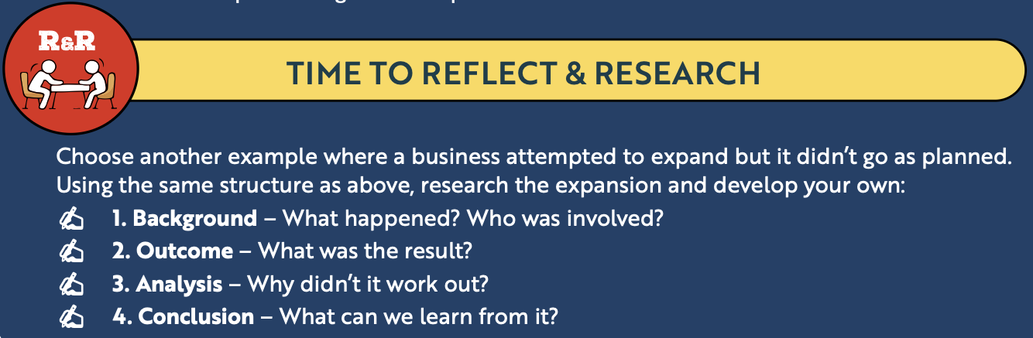

Slide 42
Suggested Activities for LO 11.3
Sample Papers
-
-
Activity Book Qs
HL Q4
OL Q4

Slide 43
Learning Outcome 11.4
11.4 Appreciate the potential of technology to support adaption and expansion.
Back In Business

Slide 44
Back In Business
How A Business Can Use Technology To Support Adaptation & Expansion
Meeting Customer Expectations For Speed & Convenience
Technology Used: Mobile apps and online ordering systems
Customers want to browse, order, and pay quickly - often from their phone. Apps or websites streamline this process, increase sales, and improve the customer experience.
Expanding Reach To A Larger Audience
Technology Used: E-commerce p!atforms (e.g. Shopify, WooCommerce)
Online stores reduce and even remove the need for physical locations being something necessary for a business, allowing businesses to sell nationally or internationally at low cost.

Slide 45
Back In Business
How A Business Can Use Technology To Support Adaptation & Expansion
Understanding Customer Behaviour To Improve The Process
Technology Used: Data analytics tools (e.g. Google Analytics, in-app data tracking)
By analysing what customers buy, view, or click, or where they visit the store from, businesses can
improve products, personalise offers, and p!an better marketing strategies.
Reducing Costs And Increasing Efficiency
Technology Used: Automation and smart systems (e.g. AI/ChatGPT, Canva, chatbots)
Automating tasks saves time, reduces errors, and frees up staff for more valuable work.

Slide 46
Back In Business
How A Business Can Use Technology To Support Adaptation & Expansion
Building Brand Awareness And Customer Relationships
Technology Used: Social media p!atforms (e.g. Instagram, TikTok) and content tools
Digital platforms let businesses promote themselves, engage with customers, and build loyalty without
big advertising budgets.
Access Finance Online
Technology used: Crowdfunding p!atforms (e.g. Kickstarter, Fundit, GoFundMe)
Crowdfunding platforms allow businesses to raise funds directly from the public, often in small
amounts from a large number of backers.

Slide 47
Suggested Activities for LO 11.4
Sample Papers
-
-
Activity Book Qs
HL Q3

Slide 48
Learning Outcome 11.5
11.5 Conduct a cost-benefit analysis to analyse the implications of business expansion.
Back In Business

Slide 49
Back In Business
The Importance Of Using A Cost-Benefit Analysis When Making Decisions
When a business considers expanding, it must weigh up the potential benefits and potential costs, both short-term and long-term. This is known as cost-benefit analysis. It helps ensure that growth decisions are strategic, sustainable, and realistic by ensuring that there is a net benefit of the decision (this means the sum of the benefits outweigh the sum of the costs of a decision).

Slide 50

Back In Business
Potential Benefits Of Business Expansion
Increased Revenue (Increases Profit)
Expanding allows a business to reach more customers, access new markets, and sell additional products or services. This can raise overall revenue and improve profitability if demand is strong.
All Real Nutrition expanded into the US through their e-Commerce platform on Shopify, boosting international sales.
Economies Of Scale (Reduces Costs)
As a business grows, it can spread its fixed costs over a larger output, lowering the cost per unit. Larger businesses can also negotiate better deals with suppliers, improving efficiency.
Ryanair benefits from economies of scale by operating one of the largest fleets in Europe, which keeps costs per passenger among the lowest in the industry.

Slide 51
Back In Business
Potential Benefits Of Business Expansion
Stronger Market Presence (Lowers Risk)
Growth can make a business more dominant in its industry by capturing a larger share of the market. This can reduce the influence of rivals and create long-term security.
Aldi’s steady expansion across Ireland increased its market share and forced Tesco and Dunnes to adapt with price-matching schemes.
Access To New Skills & Products (Diversification)
Expansion can add resources such as new technology, intellectual property, or skilled staff that strengthen a business through a takeover or strategic alliance.
Facebook’s purchase of Instagram gave it access to a younger audience and a powerful new platform for advertising.

Slide 52
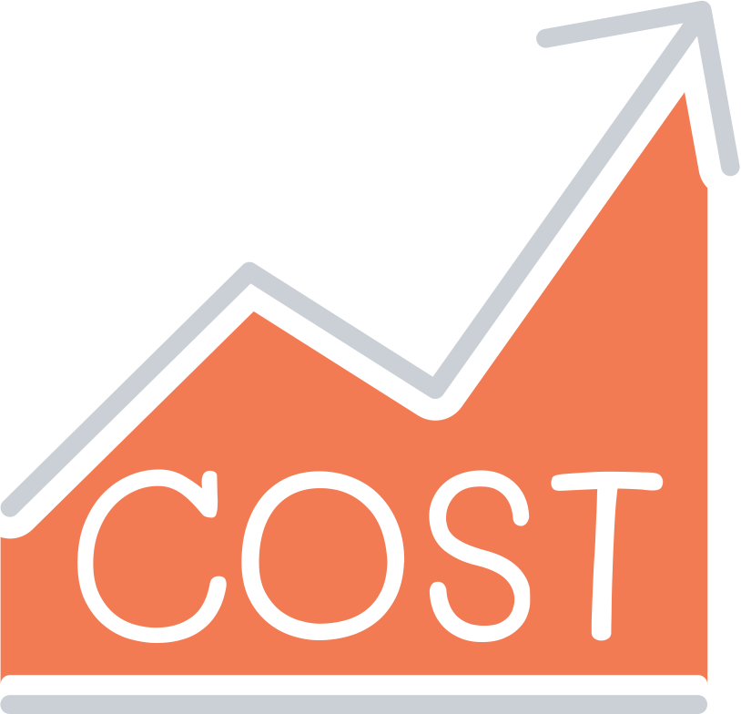
Back In Business
Potential Costs Of Business Expansion
High Capital Investment Required (Financial)
Expanding often requires large amounts of capital for property, equipment, staff, and marketing. Businesses may need to borrow heavily, which increases financial pressure on cash flow.
Tesco’s Fresh & Easy expansion into the US cost over £1 billion but ultimately failed, leaving the company with major losses.
Regulatory Risks
Large expansions may face extra scrutiny from governments and regulators, especially if they reduce competition or risk creating a monopoly. This can delay or even block a planned move.
Facebook faced strict regulatory investigations when it acquired WhatsApp, raising questions about competition in the social media messaging market.

Slide 53
Back In Business
Potential Costs Of Business Expansion
Culture Clashes Or Poor Integration (Culture)
When businesses expand through mergers or takeovers, they must integrate different systems, processes, and workplace cultures. If this is poorly managed, it can create inefficiency and conflict.
The AOL–Time Warner merger is often cited as one of the worst in history because of cultural clashes and management disagreements.
Loss Of Focus Or Quality (Operations)
Rapid expansion can distract managers from the core business that originally made the company successful. This can weaken customer loyalty and damage the brand.
Nokia’s late and unfocused move into smartphones led it to lose its dominant position in the mobile phone market.

Slide 54
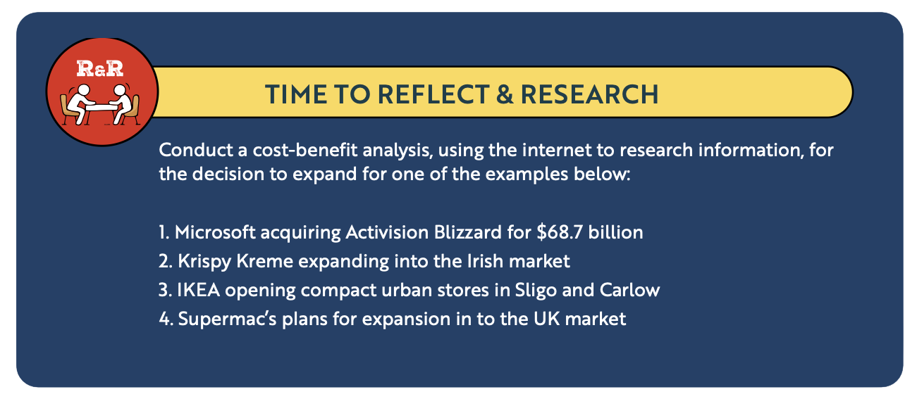

Slide 55
Suggested Activities for LO 11.5
Sample Papers
HL2 Q5 (b): Conduct a cost-benefit analysis of the proposed move by Mars. (takeover of Pringles).
Activity Book Qs
HL Q5
OL Q5

Slide 56
Learning Outcome 11.6
11.6 Outline strategies that a business may employ to adapt based on their marketing mix and/or business model.
Back In Business

Slide 57
Back In Business
How Can a Business Address External Drivers by Adjusting Its Marketing
Mix or Its Business Model
Customer Demographics
Businesses adapt to shifts in age, lifestyle, and values to meet changing demand.
Marketing Mix Example: Ben & Jerry’s introduced non-dairy ice cream flavours to appeal to vegan and lactose-intolerant customers, changing the product and adding promotion around the new range. They also added logos to packaging to show these options.
Business Model Example: All Real Nutrition added its online subscription service to set up recurring payments for consumers to add convenience so they don’t have to keep re-ordering. This also adds a steady consistent revenue stream for them.

Slide 58
Back In Business
How Can a Business Address External Drivers by Adjusting Its Marketing
Mix or Its Business Model
Competition
Businesses must respond to rivals’ actions in order to remain competitive in the market.
Marketing Mix Example: Burger King launched its plant-based Whopper in Ireland to match McDonald’s vegan burger, adapting the product and using strong promotion around being flame-grilled to stand out.
Business Model Example: Disney created Disney+ to stream its own films and shows directly to customers, shifting from licensing content to competitors like Netflix. This gave Disney greater control over distribution and a new subscription revenue stream.

Slide 59
Back In Business
How Can a Business Address External Drivers by Adjusting Its Marketing
Mix or Its Business Model
Economic Factors
Businesses adapt pricing and delivery methods when customer spending power changes due to inflation, interest rates, or economic downturns.
Marketing Mix Example: Lidl expanded its “Lidl Plus” loyalty app, offering digital coupons and discounts to adapt its pricing strategy for more cost-conscious shoppers.
Business Model Example: Irish gyms introduced hybrid memberships during COVID-19, allowing customers to combine in-person training with online classes. This adaptation gave flexibility to customers and created a new blended revenue model.

Slide 60
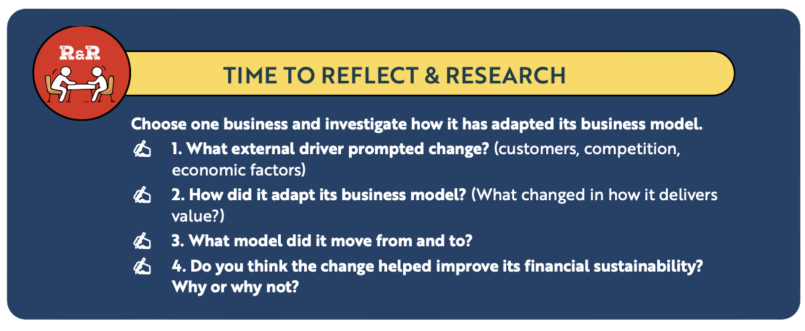
Back In Business

Slide 61
Suggested Activities for LO 11.6
Sample Papers
-
-
Activity Book Qs
HL Q6
OL Q6

