Slide 1

Strand 2
Chapter 6
Enterprise in action
Back In Business

Slide 2

Introduction
Back In Business
Useful chapter links
Starter Worksheet here → here
Chapter plan → here
Workbook solutions → here
Sample Paper Q solutions → here
Class exam → here

Slide 3


Introduction
Back In Business
Starter Activity
We will look at reasons why someone might start a business in this chapter - mostly we think of people wanting to make money - but there are other reasons!
We Make Good is a social enterprise based in Dublin 1 that designs, creates and sells a range of handmade crafts, art, and unique gifts. It was founded by Quality Matters, a charity focused on creating solutions for vulnerable groups.
Printable Worksheet here → https://backinbusinesshub.com/wp-content/uploads/2025/06/Starter-worksheet-Chapter-6.pdf
Info on We
Make Good
Click here to watch

Slide 4
Introduction
Back In Business
Priming activity
Can you think of a time when someone you know (a parent, friend, coach, teacher) came up with a smart idea, fixed a problem, or improved how something was done?”
Write it down. Was it an example of...:
  Entrepreneurship – starting something new?
  Innovation – improving something?
  Intrapreneurship – solving a problem inside a workplace or team?

Slide 5
Learning Outcome 6.1
6.1 Identify examples of innovation, intrapreneurship, and entrepreneurship in their local community, nationally and internationally, and explain the importance of innovation for business, the economy and society.
Back In Business

Slide 6
Back In Business
Innovation and Intrapreneurship
  Innovation means coming up with something new or better – this could be a product, service, process or even a new way to sell to different customers e.g. online, or to earn revenue e.g. switching to a subscription model.
  An intrapreneur is an employee who brings new ideas to life within an existing business. They don’t take the personal risk but still act creatively to improve or grow the business.
  Innovation and intrapreneurship are essential in every business – they help it stay competitive and respond to change.

Slide 7

Back In Business
Entrepreneurship/Entrepreneurs
  Entrepreneurship is when someone takes a personal or financial risk to create or grow a business or social enterprise.
  An entrepreneur is the person who drives that business idea forward, usually from scratch.
  Hannah Joyce set up Flexera, a pilates equipment business when she spotted a gap for home pilates equipment in Ireland the UK
  Extension: Read Hannah’s case study in the front of the book to learn more about her story.

Slide 8
Back In Business
Examples of each
  Entrepreneur – Hannah Joyce setting up Flexera selling at home pilates equipment
  Intrapreneur – At SuperValu, a team member in the deli department suggests a new “grab & go breakfast box” for commuters. The idea is trialled in their store, sells out quickly, and is then rolled out to multiple locations.
  Innovation – Netflix switched from DVDs to streaming, changing how entertainment is delivered.

Slide 9

Back In Business
Reflect & Research Pg 103
1. Identify two examples of innovation shown in your local community or school.
2. Identify two examples of entrepreneurship at a local and a national level.
3. Research and identify two examples of intrapreneurship that has occurred within an Irish business.

Slide 10

Back In Business
Reasons for Starting an Enterprise - Personal Motives
  To be their own boss: Wanting control, independence, and the ability to make all decisions.
  Need for achievement: Enjoying the challenge of success and building something lasting.
  Made redundant: Starting a business after losing a job to regain income and direction.

Slide 11

Back In Business
Reasons for Starting an Enterprise - Financial Motives
  Earn more income: Seeking financial independence and the potential to earn more than a regular salary.
Reasons for Starting an Enterprise - Societal Motives
  Solve a social problem: Wanting to tackle social inequality, promote sustainability, or create ethical products/services like We Make Good.

Slide 12
Watch
Back In Business
Click here to watch
Lets Get Checked - About Us

Slide 13

Back In Business
LetsGetChecked is an Irish health technology company that provides at-home diagnostic testing and virtual healthcare services, including lab tests for fertility, hormones, and general health.
By exporting its services to international markets, LetsGetChecked:
  Brings income into Ireland, supporting economic growth.
  Creates high-skilled jobs
  Positions Ireland as a leader in digital health innovation, strengthening its global business reputation.

Slide 14
Back In Business
1. What are some reasons Peter set up Lets Get Checked for?
2. What are the benefits to society of a business like Lets Get Checked being innovative?
3. What are the benefits to Lets Get Checked of creating an innovative new product?

Slide 15


Back In Business
The importance of innovation and enterprise for business
  Gain a Competitive Advantage – Stand out by offering better, cheaper, or more unique products and services.
  Expand into New Markets – Use digital tools and platforms to reach global customers, even without a physical store.
  Improve Efficiency – Adopt tools like AI or automation to reduce costs, increase quality, and speed up delivery.

Slide 16
Back In Business
The importance of innovation and enterprise for the economy
  Drives Economic Growth – Increases business productivity and GDP, supporting public services through higher tax revenues.
  Creates Jobs – Leads to new industries (e.g. green tech, digital health), offering future-proof careers and regional employment. Innovation can also reduce the reliance on traditional sectors.
  Boosts Exports – Enables Irish innovations to solve global problems and generate income from international markets, strengthening the domestic economy.

Slide 17
Back In Business
Innovation benefits society by:
  Solving Social Challenges – Addresses issues like homelessness, addiction, and digital exclusion using scalable models.
  Supporting Environmental Goals – Drives eco-innovation such as circular packaging and sustainable production.
  Empowering Communities – Provides access to tools, funding, and support to solve local problems from the ground up.

Slide 18
Back In Business
Reflect & Research Pg 104
Research a social or environmental initiative in Ireland that uses innovation to make a difference.
1. What social problem or challenge are they trying to solve?
2. What was the innovation they have used? Who benefits from the innovation?
3. Do you think this innovation could work in another business or industry?
(Link to suggested answers here)

Slide 19
Suggested Activities for LO 6.1
Sample Papers
OL P2 Q5 (a) Tick box, story about intrapreneur, tick that or circular economy or entrepreneur
Activity Book Qs
HL Q1, Q2, Q3
OL Q1, Q2

Slide 20
Learning Outcome 6.2
6.2 Identify the competencies of innovators and outline why these are significant when starting a business.
Back In Business

Slide 21
Back In Business
COMPETENCIES
The integration of knowledge, skills, values and dispositions that support and foster innovation.

Slide 22

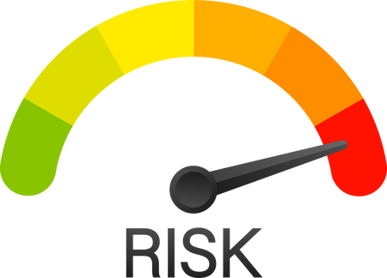


Competencies of Innovators
Back In Business
Link the competency ⟶ with how it can help start/expand a business
Entrepreneurs take on the personal and financial risk involved in starting a business.
Taking risks is essential when launching a new business or expanding into uncertain markets where success is not guaranteed.
Risk-Taker
Innovators think outside the box and come up with new ideas or spot a gap in the market.
Creative thinking helps a business develop unique products or services that stand out and attract early customer interest when growing or scaling.
Being Creative
Decision-making
Entrepreneurs analyse situations and make well-judged decisions by consulting the right people.
Effective decision-making is vital for overcoming early challenges and making strategic choices when expanding a business.

Slide 23


Competencies of Innovators
Back In Business
Link the competency ⟶ with how it can help start/expand a business
They take initiative rather than waiting for change, always looking for ways to improve.
Being proactive allows a business to stay ahead of competitors and respond quickly to new opportunities in the market.
Proactive
Being Realistic
Innovators see situations as they really are and make balanced, unbiased decisions.
A realistic outlook ensures achievable goals, wise resource use, and avoids overestimating early success during business growth.
They don’t give up easily and are determined to overcome setbacks to succeed.
Resilience helps a new or expanding business handle early failures or challenges without giving in.
Resilient

Slide 24

Competencies of Innovators
Back In Business
Human Relations
They communicate well and build strong networks of people who can help them.
Good people skills support funding, loyalty, and team-building, all critical for sustainable business expansion.
They are confident making decisions and taking control without constant reassurance.
Independence helps new or growing businesses move quickly, trust their judgement, and avoid delays from overreliance on others.
Independent
Entrepreneurs adapt to change, customer feedback, and unexpected challenges.
Flexibility enables a business to respond effectively during growth or expansion, especially in fast-changing markets.
Flexible
Entrepreneurs prioritise tasks, manage time well, and use resources efficiently.
Time management is vital when juggling responsibilities, especially in early-stage or growing businesses with limited staff.
Time Management

Slide 25


Back In Business
Reflect & Research Pg 106 - All Real Nutrition
Read the Business In Our World section on page 106 then answer the following questions:
1. What key competencies would Niall and Ross need to have shown to develop their business?
2. Identify how they are using the digital technology to help their business
3. What are the main innovations they have come up with for their business?
4. Do you think that the focus on ethics and sustainability matters to their target market?

Slide 26
Suggested Activities for LO 6.2
Sample Papers
HL1 Q2 (a) (i) Identify four key competencies that innovators such as Gráinne Mullins possess.
OL2 Q1 (b) Identify one of those competencies and outline its importance when starting or expanding a business.
Activity Book Qs
HL Q4
OL Q3

Slide 27
Learning Outcome 6.3
6.3 Investigate the role of government in fostering enterprise and supporting business development and growth.
Back In Business

Slide 28
How the government creates a positive business climate
Back In Business
Back In Business
Government Planning
Create stability through budgets and wage agreements, encouraging investment and reducing industrial disputes.
Capital Expenditure
Spends on infrastructure (e.g. roads, schools) to create jobs, make it easier to do business and to boost demand for business with increased spending in the economy.
Current Expenditure
Increases public sector pay and consumer welfare, boosting disposable income and sales; includes direct business supports.

Slide 29


How the government creates a positive business climate
Back In Business
Back In Business
Taxation / Funding
Offers low corporation tax and tax breaks and financial grants to encourage entrepreneurship and business expansion.
Education & Training
Invests in education and training (e.g. SOLAS) to provide skilled workers and support labour market entry. Offers free third level education to encourage upskilling of workforce.

Slide 30
How the government support local business
Back In Business
Back In Business
Local Enterprise Offices (LEOs): Promote entrepreneurship locally and support start-ups or small businesses with training, funding, and advice.
South Cork Local Enterprise Office Information Video
Watch by link

Slide 31
Services offered to local businesses through their LEO
Back In Business
Back In Business
Provide training: Offer in-person and online courses to help entrepreneurs upskill, including programmes like Start Your Own Business.
Provide mentoring: Match entrepreneurs with experienced mentors to offer one-on-one support in business planning, strategy, finance, and market research.
Provide financial support: Offer grants such as Feasibility and Expansion grants, and help access loans of up to €50,000 through Microfinance Ireland.
Help with networking: Run local events to connect business owners, share insights, and build relationships with others in the community.

Slide 32
Back In Business
Microfinance Ireland
Back In Business
Supported by the Irish government, Microfinance Ireland assists businesses struggling to secure a business loan from a traditional lender. Whether you are starting a new business, expanding your business or just happen to be in a tight spot with your business, we are here to help.
Loans are offered for amounts between €2,000 and €50,000 if a business cannot find funding through a bank.
Short info video
Link here

Slide 33
Back In Business
Other local supports offered to local businesses
Leader: Funds rural projects that support job creation, social inclusion, and environmental sustainability.
Solas: Provides training and education programmes to help people enter or progress in the labour market. Helps business access skilled labour and reduce labour shortages.
Area Partnership Companies (APCs): Support local people in starting businesses to solve community problems through grants, mentoring, and training.

Slide 34


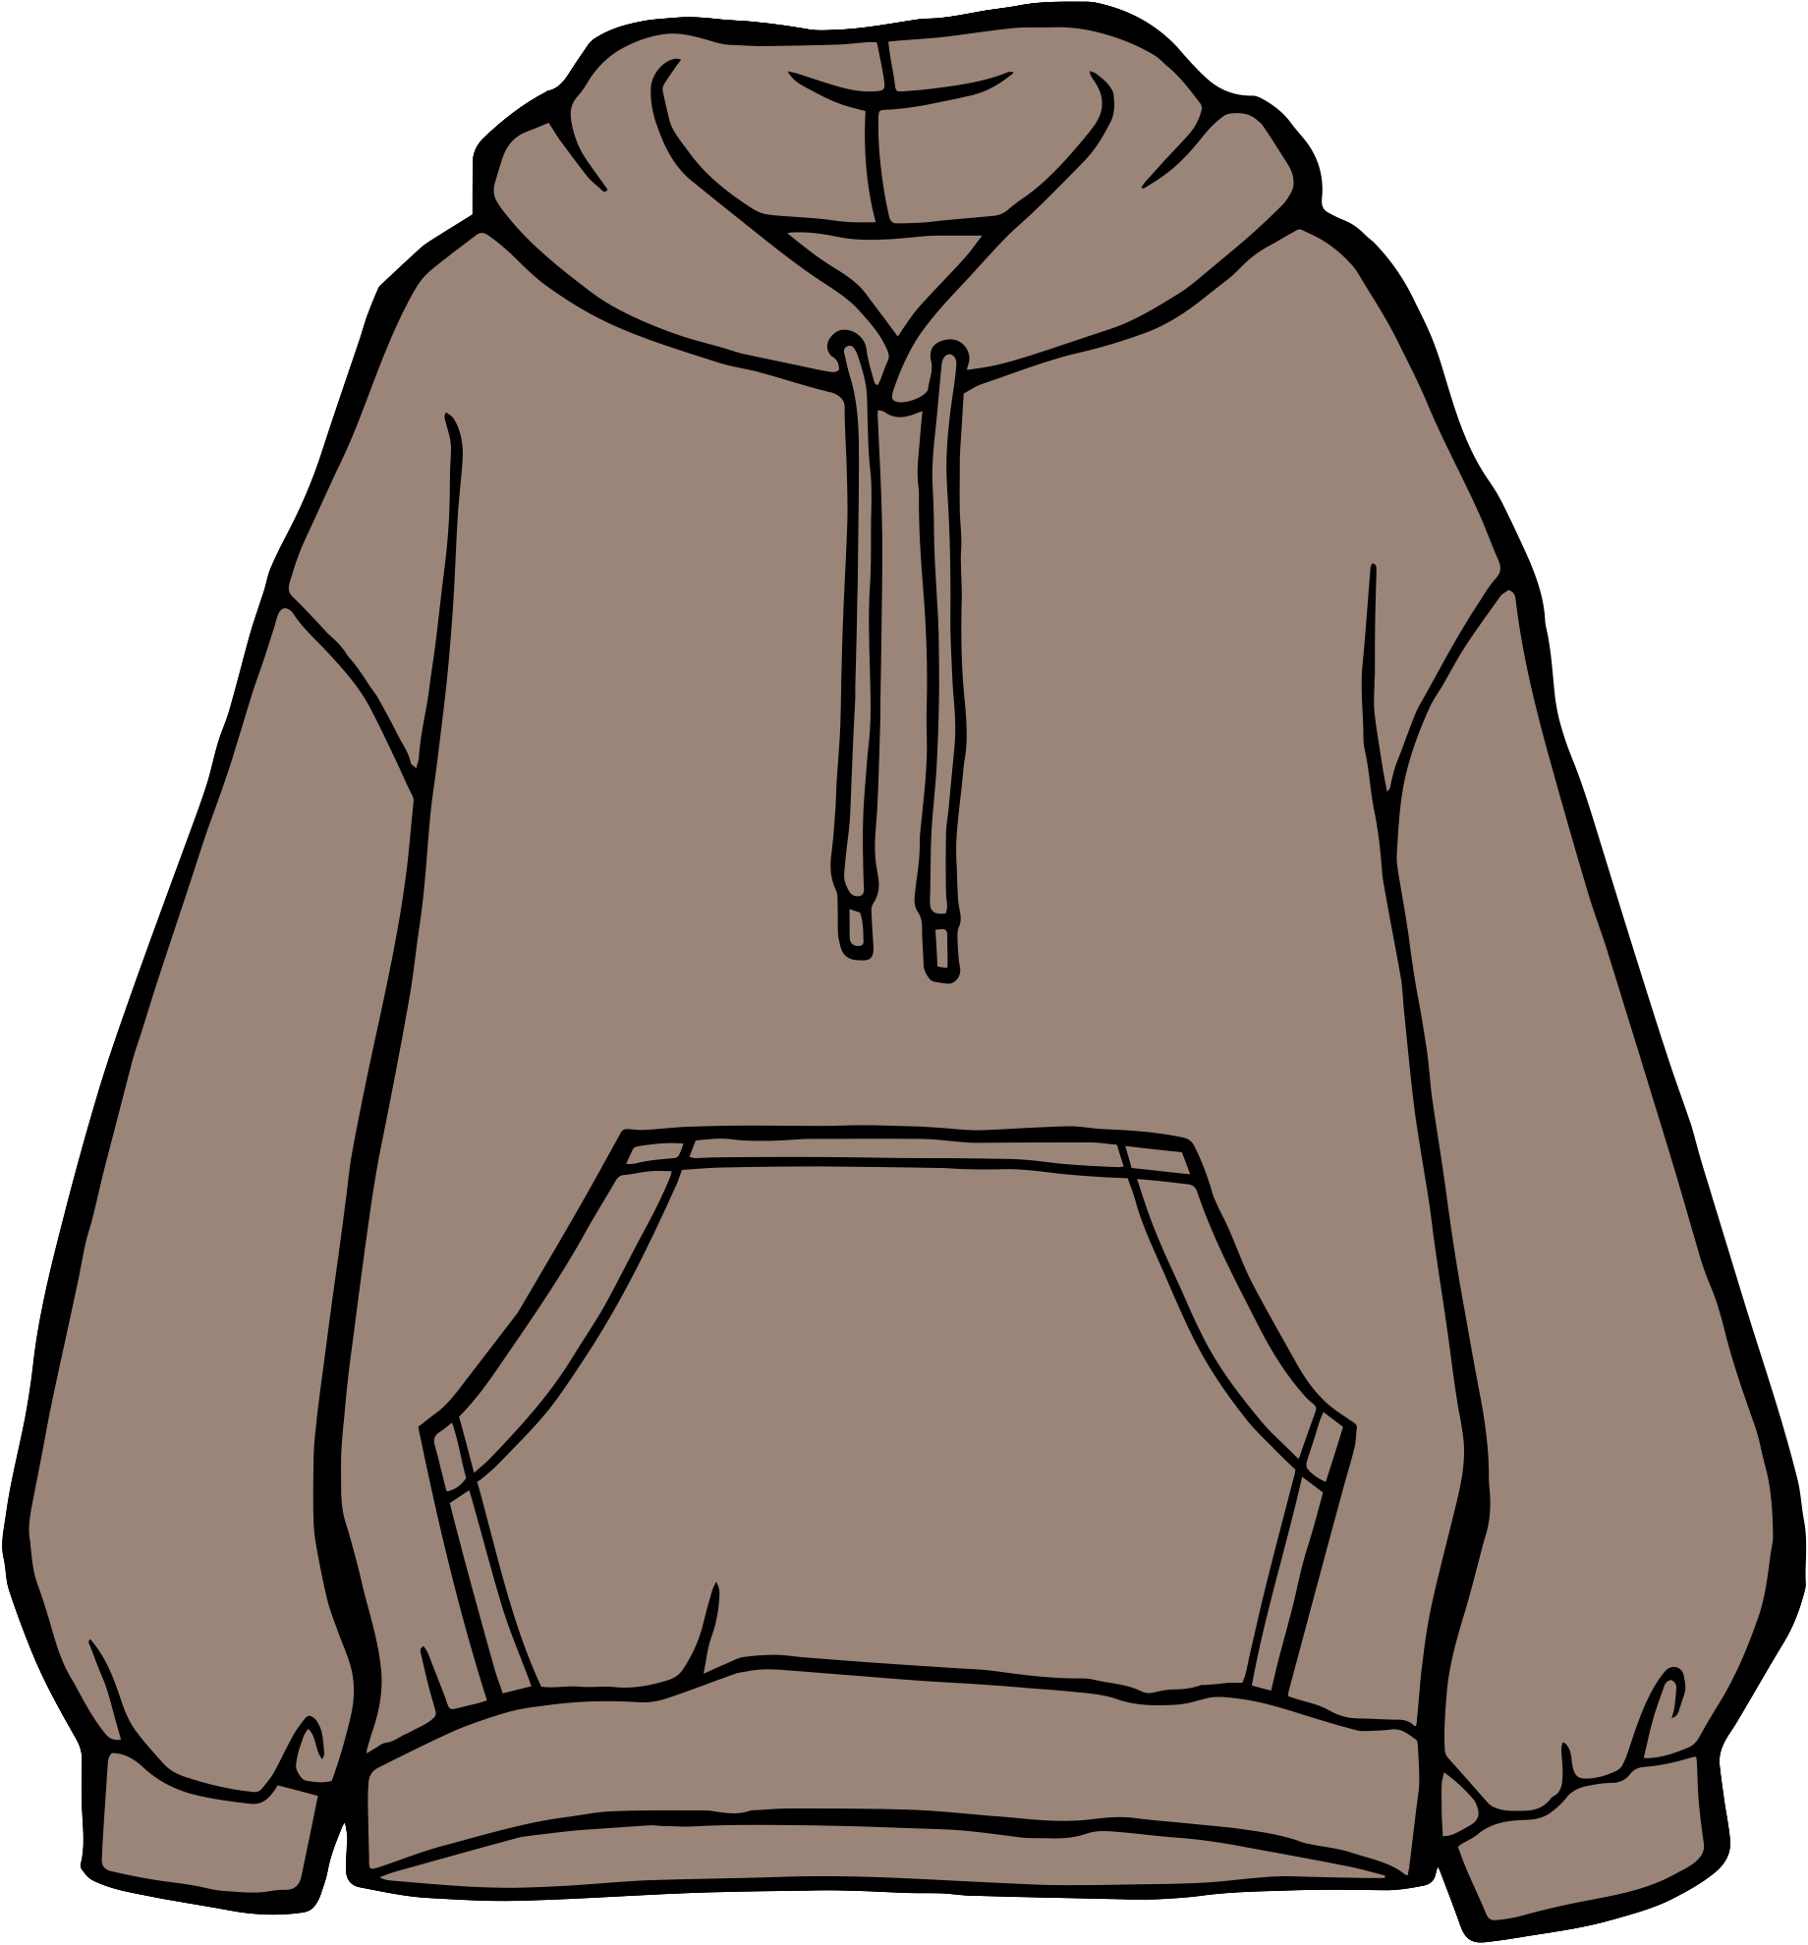
Back In Business
Business In Our World Pg 110 - GYM+COFFEE
https://www.localenterprise.ie/About-Us/Startup-Stories/LEO-Startup-Stories-GymCoffee.pdf

Slide 35

Back In Business
Government support at a national level
Enterprise Ireland is the government agency responsible for developing Irish-owned businesses that aim to grow internationally.
It focuses on supporting businesses with 10 or more employees that are looking to:
  Expand their exports
  Scale their operations
  Innovate for long-term success
Enterprise Ireland plays a key role in helping Irish
businesses compete globally.

Slide 36
Back In Business
Services provided by Enterprise Ireland
Funding: Provides grants and equity investment to support start-ups and business expansion, especially those targeting exports.
International Offices: Operates over 30 global offices that help Irish businesses access foreign markets and connect with buyers.
Research & Development (R&D): Encourages companies to invest in R&D to create new products and improve long-term competitiveness.
Market Research Centres: Gives access to data on market size, competitors, and trends to guide export planning and decision-making.
Events: Organises trade fairs and missions abroad, helping Irish firms meet global clients and government officials.

Slide 37
The National Enterprise Hub – click to watch here

Slide 38
Back In Business
The National Enterprise Hub
  Launched in 2024 as a one-stop support hub for Irish businesses.
  Aims to make it easier for companies to access government-backed services and funding.
  Operated by Enterprise Ireland to boost SME support and reduce complexity.
Key Features:
  Centralised access to over 180 supports from 19+ state bodies.
  Personalised help via web, phone, or live chat from trained advisors.
Purpose:
Supports Ireland’s national strategy to streamline and strengthen growth for small and expanding businesses.

Slide 39
Suggested Activities for LO 6.3
Sample Papers
HL2 Q4 (e) Discuss three ways the Irish government can support businesses such as Spectrum Life.
OL1 Q5 (c) Describe two supports the Irish government can provide to Alice as a new entrepreneur.
OL2 Q3 (b) Enterprise Ireland is a state agency that supports the development and growth of Irish businesses.
(i) Name one other state agency that supports business and enterprise in Ireland.
(ii) Explain how the investment of €24 million supports new business start-ups in Ireland
Activity Book Qs
HL Q3
OL Q3

Slide 40


