Slide 1

Strand 2
Chapter 12
Managing Risk
Back In Business

Slide 2

Learning Outcomes
12.1 Outline the challenges and risks associated with enterprise and entrepreneurship.
12.2 Outline the importance of assessing and managing risks in business.
12.3 Analyse a range of risk management strategies that can be used to respond to the challenges and risks in business.
Back In Business

Slide 3



Challenges in the hospitality industry
Back In Business
Starter Activity
‘It’s desperation’: Ireland’s restaurant
industry facing crisis with daily closures
Th QR code is for an article on the Guardian’s website, with the worksheet linked below with a copy of it and questions
YouTube video here and here (facebook link to VirginMedia)
Link for worksheet is here

Slide 4
Challenges in the hospitality industry
Back In Business
Starter Activity
What financial pressures are Irish restaurants facing right now?
Why are some restaurant owners angry with the government?
What risks are these businesses facing?
How is consumer behaviour contributing to the crisis?
What is the cultural impact of so many restaurants closing?
What examples show how some restaurants are reacting?

Slide 5
Primer Questions
Back In Business
Primer Questions
What challenges do you think someone opening their own make-up studio would face? What type of risks do they face (hint: financial, economic, market, operational)?
What insurance could they take out to reduce the risk of facing large payouts? Can you think of ways, other than taking out insurance, that a business could use to reduce risk?

Slide 6
Back In Business
Learning Outcome 12.1
12.1 Outline the challenges and risks associated with enterprise and entrepreneurship.
Back In Business

Slide 7
Challenges associated with enterprise and entrepreneurship
Back In Business
Raising Finance
  Entrepreneurs may lack the finance needed to start or grow their business.
  Finance can come from equity (reserves or selling shares) or debt (long-term bank loans).
  A strong business plan can impress investors and help raise capital.
  Crowdfunding allows entrepreneurs to raise start-up finance from a large number of people through online platforms like Kickstarter, offering rewards, early products, or shares.

Slide 8

Challenges associated with enterprise and entrepreneurship
Back In Business
Production Methods
  Small businesses may struggle to produce output at a low enough cost to stay competitive.
  Entrepreneurs must assess production levels, automation, staffing, and storage needs.
  For lower volume, unique products, market research is crucial to confirm if the target market will pay a premium price.

Slide 9
Challenges associated with enterprise and entrepreneurship
Back In Business
Choosing Ownership Type
  Different structures (sole trader, private limited company) have different risk, control, ownership, liability, and tax implications.
  Starting as a sole trader is cheapest and easiest; as the business grows, entrepreneurs may switch to a private limited company to benefit from limited liability and lower corporation tax rates.

Slide 10

Challenges associated with enterprise and entrepreneurship
Back In Business
Marketing and Market Penetration
  Advertising a new product can be costly as initial sales are often slow.
  Entrepreneurs must research and choose the right medium to reach their target market.
  A clear USP and strong value proposition are essential to stand out from rivals.

Slide 11
Challenges associated with enterprise and entrepreneurship
Back In Business
Availability of Location or Staff
  Finding the right location can be difficult, especially where rents are high and property is limited, potentially affecting footfall and sales.
  Hiring suitable staff is also a challenge; a shortage of skilled workers or high staff turnover can hurt customer service and product quality.

Slide 12


Reflect & Research – Grá’s Chocolates
https://www.kickstarter.com/projects/grachocolates/chocolate-lovers-destination-in-the-west-of-ireland/creator

Slide 13

REFLECT & RESEARCH
1. Identify three business challenges (other than funding) that Grá’s Chocolates might face as it expands into its new factory and visitor centre.
(Hint: think about staffing, quality control, marketing, production costs, seasonal demand, etc.)
2. Why do you think the public was willing to support Grá’s Chocolates through crowdfunding?
(What makes the business appealing to customers and backers?)
3. How important is a strong brand or story when raising money through crowdfunding?
(Use examples from Grá’s Chocolates’ campaign to support your answer.)

Slide 14

Risks of enterprise and becoming an entrepreneur
Back In Business
Personal & Financial Risk
  Loss of personal savings, assets, or damage to credit rating.
  Impact on reputation, confidence, and future career prospects.
Operational Risk
  Poor management of staffing, logistics, or admin can cause lost sales and reputational harm.

Slide 15

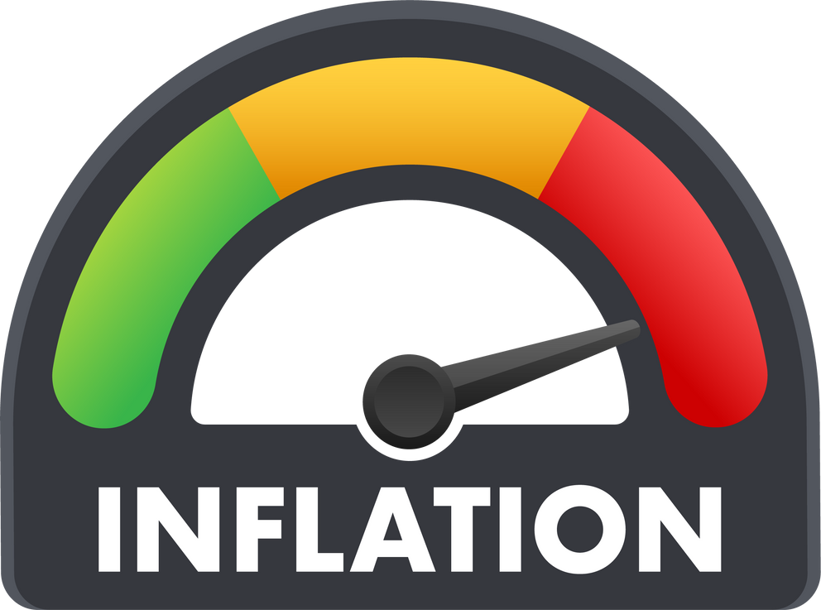
Risks of enterprise and becoming an entrepreneur
Back In Business
Economic Risk
  Inflation, interest rate hikes, and falling consumer confidence can reduce profitability.
  Changes like tariffs can heavily impact business.
Competitor & Market Risk
  New entrants and aggressive competitors can reduce market share.
  Example: Revolut and N26 challenging traditional Irish banks.

Slide 16

Risks of enterprise and becoming an entrepreneur
Back In Business
Compliance Risk
  Failing to meet legal obligations (e.g., tax, health & safety) can result in fines or closure.
Technological & Market Risk
  Cyberattacks, data breaches, and tech failures can disrupt business operations.
  Example: Ardagh Group’s cyberattack disruption in 2021.

Slide 17
Risks of enterprise and becoming an entrepreneur
Back In Business
Ethical & Environmental Risk
  Unethical sourcing or environmental harm can damage brand reputation.
  Example: Boohoo faced backlash over labour practices. In 2020, an investigation by The Sunday Times uncovered that workers in factories supplying Boohoo in Leicester were being paid as little as £3.50 per hour, far below the UK minimum wage of approximately £8.72 at the time

Slide 18

Suggested Activities for LO 12.1
Sample Papers
HL2 Q1 (b) (ii) Discuss two challenges John and Mark may face when introducing new products, and explain how they can address these challenges
OL1 Q5 (e) (e) Outline two challenges, apart from inflation, facing entrepreneurs in Ireland.
Activity Book Qs
HL Q1, Q2
OL Q1, Q2

Slide 19
Learning Outcome 12.2
12.2 Outline the importance of assessing and managing risks in business.
Back In Business

Slide 20
Risk Management
Back In Business
Risk management for a business involves the identification of all possible risks/losses that it faces (e.g. the risk of fire, employer negligence, personal injury loss, legal liability) and taking action to avoid risks or minimise the impact on the business if these risks do occur.

Slide 21

Risk Management – Steps involved
Back In Business
  Identify the risk – Spot potential threats through audits (e.g., injury, theft).
  Assess its impact – Judge likelihood and severity to prioritise action.
  Take action to reduce risk – Train staff, diversify, insure, or avoid high-risk areas.
  Monitor and review – Regularly update plans to tackle new risks like market changes.

Slide 22
Suggested Activities for LO 12.2
Sample Papers
HL2 Q3 (a) Explain two reasons why it is important for a business to manage risks.
Activity Book Qs
HL Q3
OL Q3

Slide 23
Learning Outcome 12.3
12.3 Analyse a range of risk management strategies that can be used to respond to the challenges and risks in business.
Back In Business

Slide 24

Strategy - 1. Avoidance
Back In Business
  Avoidance involves not engaging in an activity that presents significant or unmanageable risk.
  A festival organiser may cancel an outdoor event due to weather warnings, choosing to avoid reputational and financial loss.
  Business application: A food startup may decide not to expand into allergen-sensitive products if it cannot guarantee safety standards.

Slide 25

Strategy - 2. Spread
Back In Business
  Spreading means diversifying products, suppliers, markets, or channels to reduce overreliance on one area.
  A farm that sells both at local markets and via online delivery reduces risk if weather impacts in-person sales.
  Business application: Netflix develops international content (like Squid Game) to reduce reliance on the U.S. market.

Slide 26
Strategy - 3. Prevention
Back In Business
  Prevention means taking proactive steps to reduce the likelihood of risks occurring.
  A hotel trains staff in fire safety and installs sprinklers to prevent a fire from spreading.
  Business application: Apple performs rigorous product testing to prevent battery malfunctions or overheating incidents.

Slide 27

Strategy - 4. Insurance
Back In Business
  Insurance transfers the financial cost of a risk to an insurer in exchange for a premium.
  A tech startup takes out cyber insurance to cover recovery costs from a data breach.
  Business application: Construction companies insure equipment and workers in case of site accidents.

Slide 28
The importance of managing risks for a business
Back In Business
1. Helps avoid costly mistakes
  Identifying risks in advance allows a business to avoid major losses.
  Early action can prevent legal, financial, or reputational harm.
Strategy applied: Prevention
E.g. A manufacturing business can train staff on machinery safety and conduct routine checks to avoid workplace accidents and downtime that would cost the company heavily.

Slide 29
The importance of managing risks for a business
Back In Business
2. Supports better decision-making
  Understanding risk leads to more informed and confident business decisions.
  Helps assess whether opportunities align with the business’s goals and capacity.
Strategy applied: Avoidance
E.g. A small local café might avoid franchising into a saturated city market after weighing the competitive risks, focusing instead on deepening its community roots.

Slide 30
The importance of managing risks for a business
Back In Business
3. Protects resources
  Managing risk protects financial, human, and physical resources from harm.
  This includes equipment, employee safety, and business data.
Strategy applied: Insurance
E.g. An online retailer insures its warehouse stock and customer data systems, so if there's a fire or cyberattack, the company can recover without major losses.

Slide 31
The importance of managing risks for a business
Back In Business
4. Improves financial sustainability
  Businesses that manage risk can adapt better to uncertainty and survive long-term.
  Risk management builds resilience to market shifts or disruptions.
Strategy applied: Spread (Diversification)
E.g. A food brand expands into both retail and online channels, so if supermarket sales dip, it can rely on direct-to-consumer orders to keep revenue flowing.

Slide 32
REFLECT & RESEARCH PG 224
1. Discuss the risk management strategies that Pace Athletic is using to respond to risks it faces in the market.
Use the headings: Avoidance, Spread, Prevention and Insurance
2. In your opinion, which risk strategy is most important for a fast-growing clothing brand today? Justify your answer.
3. What could happen to a business like Pace Athletic if it ignored risk management as it continued to grow?
4. Identify a real athleisure or sportswear brand (e.g. Gym+Coffee, Lululemon, Adidas, Nike).
Research and give one example of how that business has managed risk in each of the following areas: Avoidance, Spread, Prevention and Insurance

Slide 33
The importance of different types of insurance for a business
Back In Business
Public Liability Insurance
Covers injury or damage to customers/property on-site.
Protects against expensive legal claims from someone falling and injuring themselves on the property.
Employer Liability Insurance
Covers employee injuries/illness that have occurred in or from work.
Protects the business from injury claims from staff and high legal fees.

Slide 34

The importance of different types of insurance for a business
Back In Business
Product Liability Insurance
Covers injury to customers from faulty products.
Protects against lawsuits and reputational damage.
Buildings & Contents Insurance
Covers premises and stock damage (e.g., fire, flood, theft).
Supports quick recovery from a loss without severe financial losses.

Slide 35
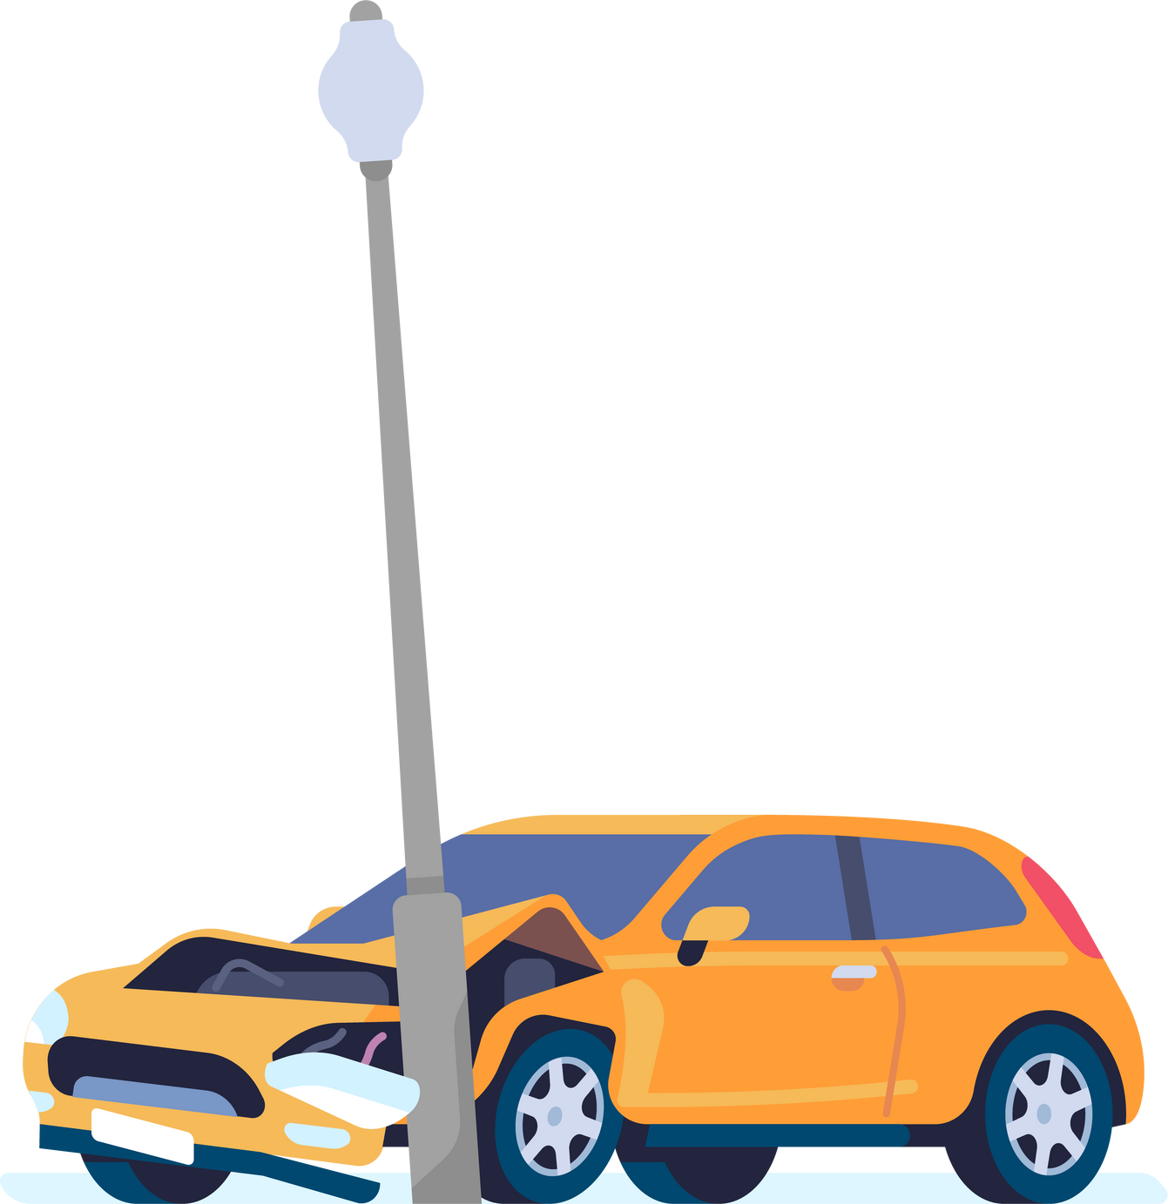
The importance of different types of insurance for a business
Back In Business
Motor Insurance
Covers accidents involving company vehicles.
Legally required; ensures compensation.
Key Person Insurance
Covers loss of vital staff members from their role.
Reduces financial impact on the business.

Slide 36
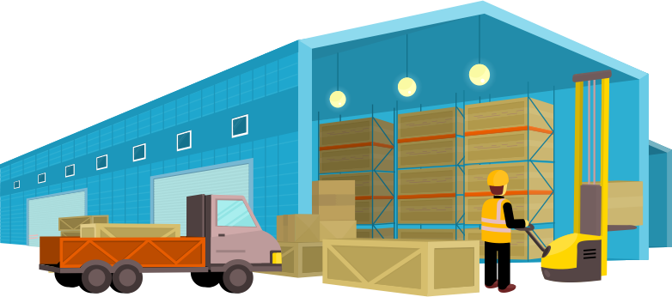
The importance of different types of insurance for a business
Back In Business
Fidelity Guarantee Insurance
Covers internal theft or fraud by employees.
Protects against hard-to-recover financial losses.
Goods in Transit Insurance
Covers loss/damage to goods during transport.
Protects cash flow and customer relationships.

Slide 37

The importance of different types of insurance for a business
Back In Business
Cyber Insurance
Covers cyberattacks, breaches, and IT disruption.
Reduces financial and reputational damage after attacks.
Professional Indemnity Insurance
Covers claims of poor advice or services.
E.g., protects a personal trainer against injury lawsuits.

Slide 38
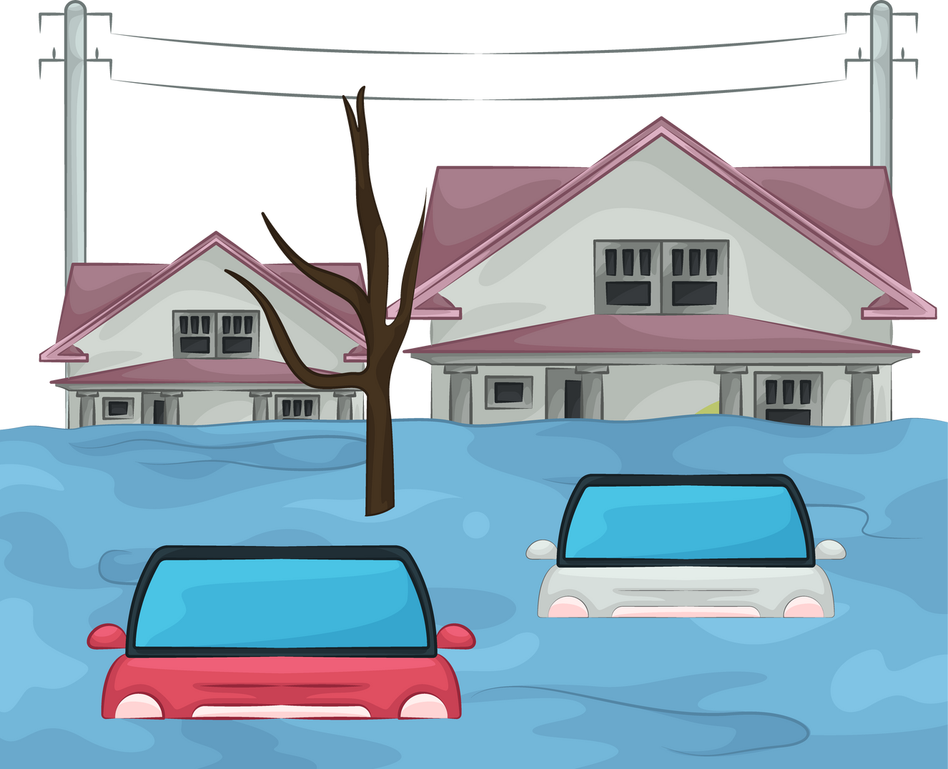

The importance of different types of insurance for a business
Back In Business
Business Interruption Insurance
Covers income loss during closures (fire, flood, pandemic).
Helps businesses survive unexpected shutdowns.

Slide 39
REFLECT & RESEARCH
Sarah recently opened a small bakery café in a busy town centre. She hired two part-time staff and invested in high-quality kitchen equipment. One morning, a customer slipped on a wet floor and injured their arm. A week later, there was an electrical fault in the kitchen, damaging a fridge full of stock. Sarah also delivers birthday cakes locally using her own van.
1. Identify and explain three types of insurance Sarah should have in place for her business based on the information above.
2. Choose a business in a different industry, such as retail, construction, or health care, and identify four types of insurance that they would require, providing reasons why. In each case, also outline the importance of each type of insurance.

Slide 40
Suggested Activities for LO 12.3
Sample Papers
HL1 Q3 (e) Discuss four risk management strategies that can be used by businesses to respond to potential risk.
OL2 Q1 (f) Outline three suitable types of insurance that PJ should consider to protect his business from potential risks.
Activity Book Qs
HL Q4, Q5, Q6
OL Q4, Q5

