Slide 1
Strand 2
Chapter 10
Operations And Finance
Back In Business

Slide 2


Introduction
The starter sheet to use after watching the video is here.
Link to video is here

Slide 3

Back in Business
Primer Questions
Imagine you were selling your own hoodies online. What outside business partners do you think you’d need to rely on to do this (think platform, delivery, marketing, etc.)?
What are the main assets of a business like Disney?
Do you know the difference between short-term and long-term finance?
If a business knows it is likely to run short on cash in three months, what are two things it could do to try to prevent this from happening?

Slide 4
Learning Outcome 10.1
10.1 Outline the main elements that are key to the operational model of a business and explain why these may change over time.
Back In Business

Slide 5
Back in Business
Introduction
The operational model of a business explains how it delivers its product or service to customers in a practical, day-to-day way. It focuses on the key building blocks that keep the business running smoothly and efficiently. In the Business Model Canvas (BMC), three of these core building blocks are:
Key Partners - The external people or organisations a business works with.
Key Activities - The most important tasks the business must carry out.
Key Resources - The essential assets it needs to operate.
Together, these three elements form the backbone of how a business works behind the scenes to deliver value to its customers.

Slide 6
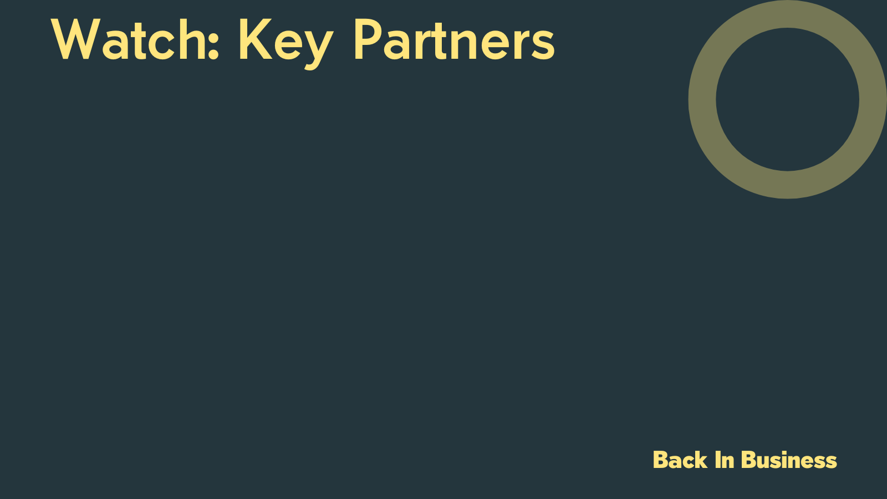
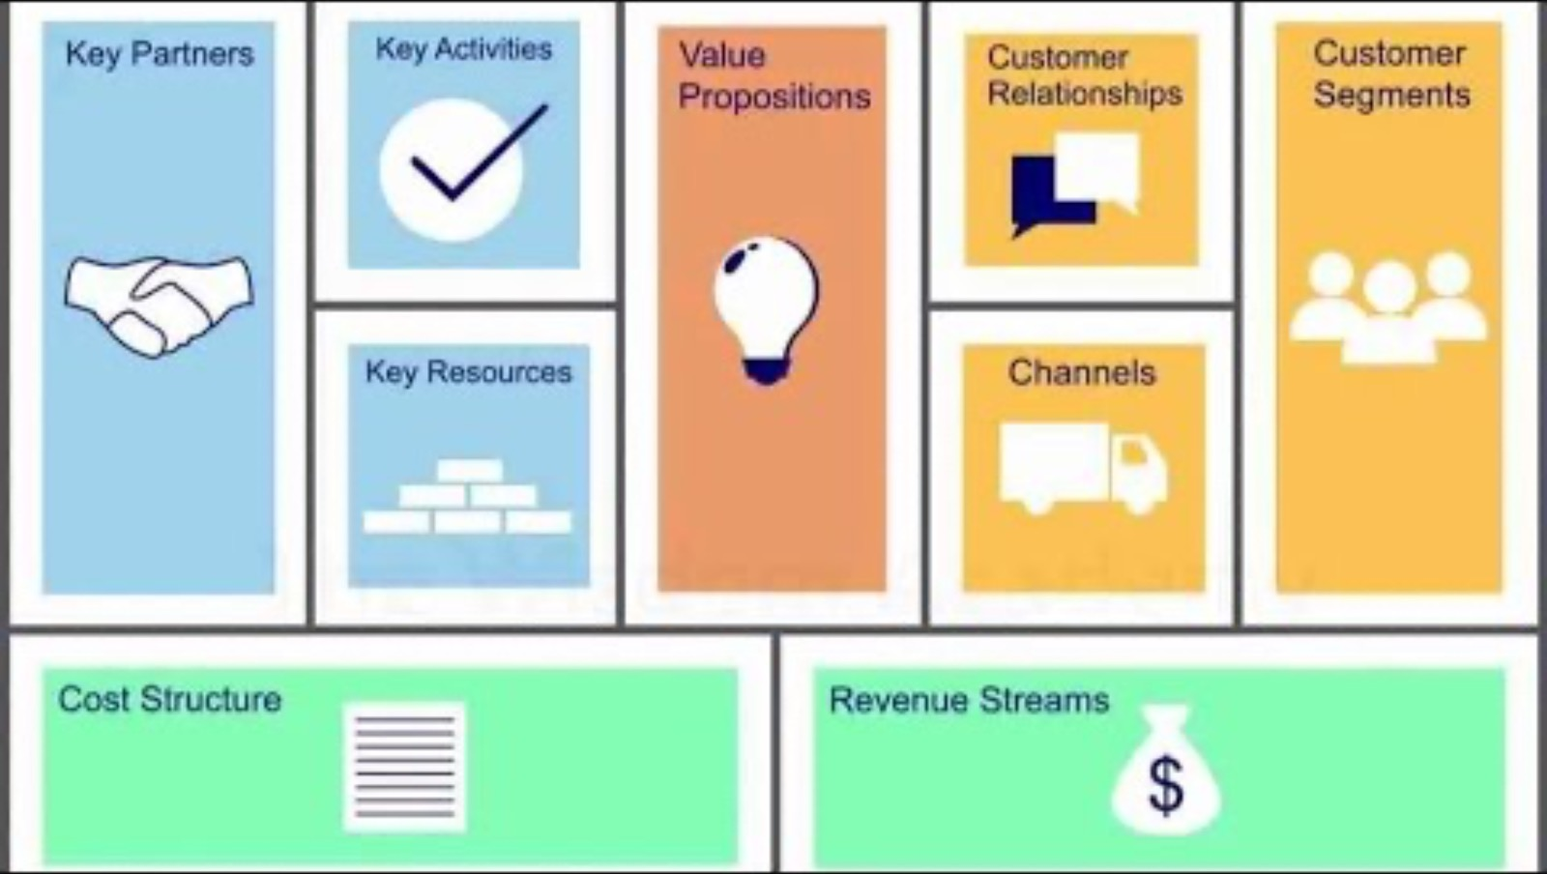
https://www.youtube.com/watch?v=IbCeJKaqmQU

Slide 7
Back in Business
1. Key Partners
Key partners are the external people or organisations a business works with to help it operate effectively. These are not employees, but other parties the business depends on to supply goods, provide services, or support its operations in some way.

Slide 8
Back in Business
Examples Of Key Partners
Suppliers
Businesses rely on suppliers for goods or materials to operate.
A bakery may buy ingredients from a local wholesaler.
A distributor may hold stock in a warehouse and distribute orders for a business - very popular with e-commerce stores.
An online shop might use An Post or DPD for deliveries.
Distributors
Outsourcing / Service Providors
Some tasks are outsourced to specialists instead of doing them in-house.
A start-up may outsource payroll, web management or marketing.

Slide 9
Back in Business
Examples Of Key Partners
Strategic Alliances
A temporary agreement between two businesses who agree to work on a project or for a time period, while remaining separate legal entities. Spotify & Uber once partnered for in-car music.
Two or more firms form a new shared business with joint ownership and goals.
Sony and Ericsson launched a joint phone business.
Joint Ventures
One business pays to use another’s brand, product, or IP under strict terms.
Penneys licenses the use of lots of brands (Disney, Marvel)
Licensing

Slide 10
How Partners Change Over Time
Back in Business
Business growth – May need bigger or more capable suppliers. As the business scales, local partners might not be enough.
Expansion – New markets require new specialist partners. Exporting needs logistics companies or customs agents.
Digital transformation – Digital tools shift partner needs. Online sales require platforms, social media, distribution/fulfilment centres or tech support.
Ethics and sustainability – Partners must meet ethical standards. Sourcing may shift to certified or fair-trade suppliers.
Legal compliance – Regulation changes require expert help. New laws may mean hiring consultants or legal advisors.

Slide 11
2. Key Activities
Back in Business
Key activities in an operational model are the essential tasks and processes a business needs to perform to deliver its value proposition and achieve its objectives, encompassing areas like operations, marketing, production, and problem-solving.
Back In Business

Slide 12
Examples Of Key Business Activities
Back in Business
Product Design & Development
Creating or improving products to meet customer or market needs.
Apple has different R&D departments working on various hardware and software.
Producing goods in-house or through partners using equipment and processes.
A local chocolatier manufacturing small batches in their premises.
Manufacturing
Marketing & Branding
Creating campaigns to attract customers and build recognition through promotion.
Gymshark uses social media/ambassadors to grow its fitness brand.

Slide 13
Examples Of Key Business Activities
Back in Business
Distribution & Logistics
Moving products from production to the customer through warehousing and transport.
An online bookstore uses a courier like UPS for next-day delivery.
Customer Experience & Support
Handling queries, complaints, and building loyalty with after-sales service.
A mobile provider offers 24/7 support via phone, email, and app.
App & Website Development
Designing and updating platforms to improve user access and interaction.
E.g. a business regularly updating its app with new features.

Slide 14
How Key Activities Change Over Time
Back in Business
Business growth – Expanding means adding or changing daily tasks.
New services may need marketing, delivery, or digital support.
Digital transformation – Tools and tech change how tasks are done.
AI and platforms can replace or automate key activities.
Changing customer needs – Businesses must adapt to stay convenient.
May add click-and-collect, loyalty apps, or live chat.
Strategic shifts – New business models need new daily operations.
A subscription model may require onboarding and retention tasks.

Slide 15
3. Key Resources
Back in Business
These are essential assets a business requires to create, deliver and capture value and achieve its objectives. They can include physical assets (machine), human capital (staff), financial resources (investment), and intangible assets (such as brands, software, or licences).
Back In Business

Slide 16
Examples Of Key Resources
Back in Business
Physical
Assets
Tangible items like vehicles, tools, buildings, and inventory.
Fastway couriers relies on a fleet of delivery vehicles and central warehouse/depots to deliver all of their packages.
Financial
Resources
Funding used to manage cash flow or invest in the business.
A new business may need loans or crowdfunding to get started.
Human
Capital
People with skills, leadership, and vision who drive innovation.
A tech start-up depends on developers to design and build software.
Intangible
Assets
Non-physical items like brand, patents, software, or reputation.
Disney licenses its stories/characters/brands; Airbnb relies on its app and data; Vinted has its user base.

Slide 17
How Key Resources Change Over Time
Back in Business
Physical assets often depreciate, they wear out, become outdated,
or need to be replaced.
Human capital evolves as staff gain experience or leave. Businesses must invest in training and retention to keep this resource strong.
Financial resources change as a business grows. Startups rely on external funding, mature firms reinvest profits.
Intangible resources may gain or lose value, a brand can grow stronger with good marketing or lose trust after a scandal.

Slide 18
Suggested Activities for LO 10.1
Sample Papers
-
Activity Book Qs
HL Q1,
OL Q1,Q2

Slide 19
Learning Outcome 10.2
10.2 Identify the key costs and sources of finance for a business and explore why these may change over the product or service’s lifecycle.
Back In Business

Slide 20
Introduction
Back in Business
For this section, we will break the costs of business into two different types:
📌 Variable Costs
📌 Fixed Costs
We will define these costs, giving examples for both, and examine how a business can finance each type and how they change over the lifecycle of the product or service.
Back In Business

Slide 21
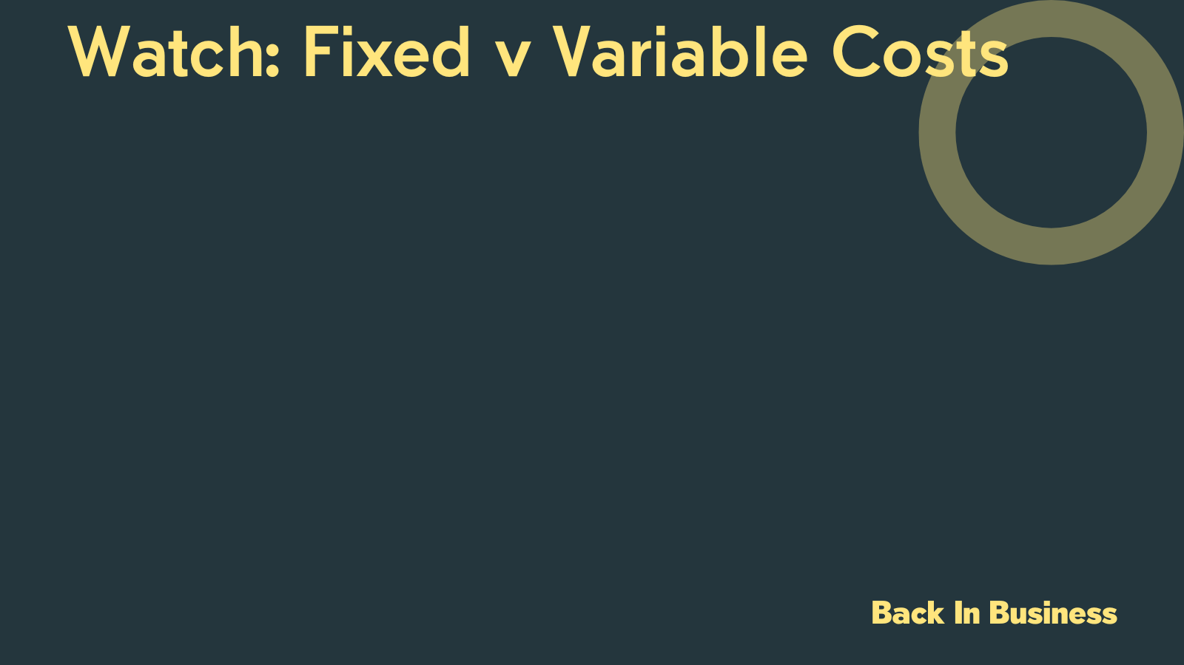
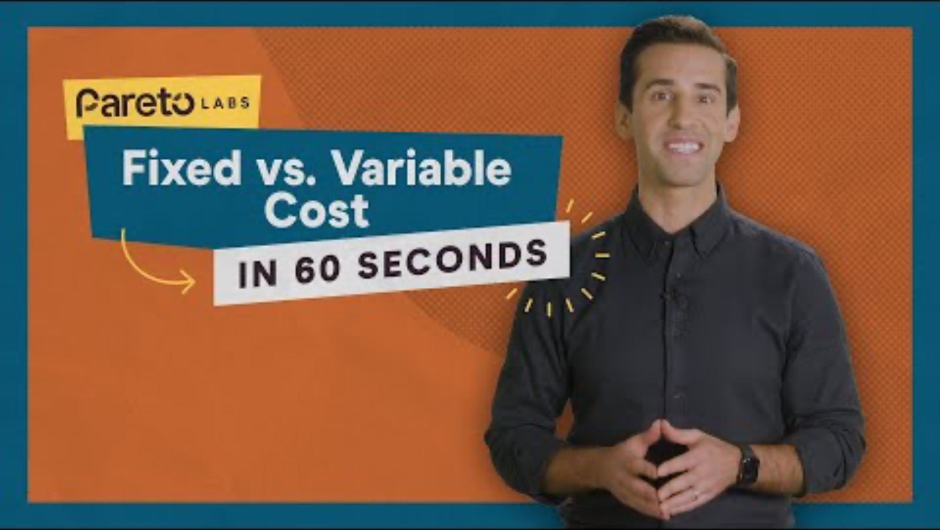

Slide 22

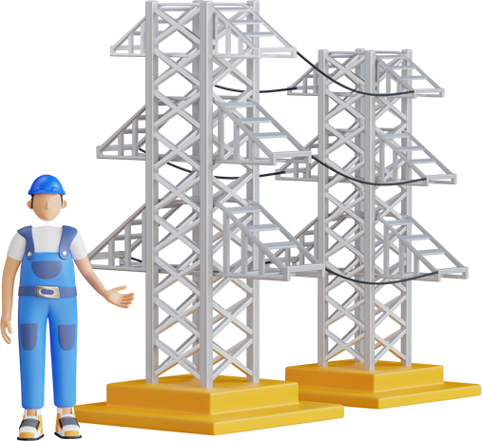

Variable Costs
Back in Business
These costs are linked to the output of a business. They increase as output increases and decrease as output decreases.
Over time, as output increases, the variable cost per unit will likely
fall due to the business benefitting from economies of scale.
Wages
Buying stock
Light and heat

Slide 23
Short-Term Sources Of Finance To Cover Variable Costs
Back in Business
S-T finance is used to pay for day-to-day expenditure (<1 year)
Bank Overdraft
A facility that allows a business to withdraw more money than it has in its current account up to an agreed limit.
Accrued Expenses
Delaying the payment of bills for a short time to use that money to cover payment for another use.
Trade Credit
Allows a business to receive goods within a 30–60 day period, trying to sell the goods before paying for them.
Selling unpaid invoices to a factoring company in exchange for immediate cash. The factoring company then collects the debts and keeps a portion as its fee.
Factoring

Slide 24
How Variable Costs Change Over The Lifecycle Of The Product Or Service
Back in Business
Start-Up
Variable costs are relatively low at this stage because the business is not yet selling at scale.
As demand increases, variable costs rise quickly. More staff, raw materials, and delivery costs are needed.
Growth / Expansion
Maturity
Total variable costs remain high, but the variable cost per unit will decrease as a firm can order in bulk.
Renewal / Exit
Variable costs may decrease as output slows or shifts if the business pivots

Slide 25

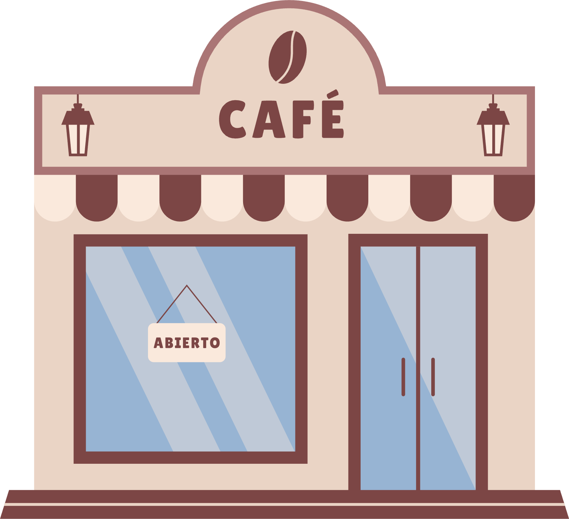
Fixed Costs
Back in Business
Costs that remain the same each month irrespective of changes in output. Fixed costs can increase from time to time (e.g. rent may go up if a lease is renegotiated), but they remain consistent for the agreed period and do not vary with production.
Manager’s salary
Rent

Slide 26

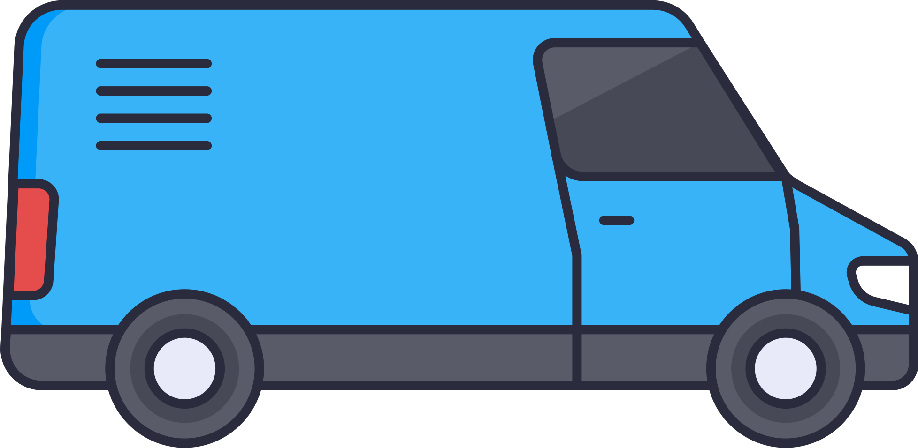
Medium-Term Sources Of Finance To Cover Fixed Costs
Back in Business
M-T finance is used for items that are typically used for 1-5 years
Renting an asset from a finance company rather than purchasing it. The business will never own the asset.
Leasing
A loan from a bank repaid in regular instalments over a set period, usually one to five years.
Term Loan
Laptop
Buying an asset over time, with an initial deposit followed by regular instalments. The business owns the asset"after the final payment"is made.
Higher Purchase
Delivery Van

Slide 27

Long-Term Sources Of Finance To Cover Fixed Costs
Back in Business
L-T finance is used on items that last >5 years
A loan from a bank repaid in regular instalments over a set period, usually more than five years.
Long-Term Loan
A long-term loan secured against a company’s assets. It is usually repaid over 10–15 years and interest must be paid annually.
Debenture
This is money raised by selling shares in the business. In return, the investor becomes a part-owner (shareholder) and may receive a share of profits (dividends).
Expansion
Equity / Share Capital

Slide 28
Long-Term Sources Of Finance To Cover Fixed Costs
Back in Business
Money invested by individuals or firms (venture capitalists) in high-potential, but high-risk start-ups.
Venture Capital
When a business reinvests its past profits (reserves or retained earnings) instead of distributing them to shareholders.
Retained Earnings
Money provided by the government, EU, or other agencies that does not need to be repaid, but strict criteria must be met.
Grants
Continued...

Slide 29
How Fixed Costs Change Over The Lifecycle Of The Product Or Service
Back in Business
Start-Up
Once-off start-up costs might be required.
Costs rise as businesses lease space or expand with large machinery/production facilities.
Growth / Expansion
The business is now profitable and well-established, which allows it to use retained earnings to cover upgrades or reinvest in infrastructure.
Maturity
A business looking to renew itself by pivoting product range or entering a new market, may take on new fixed costs.
Renewal / Exit

Slide 30
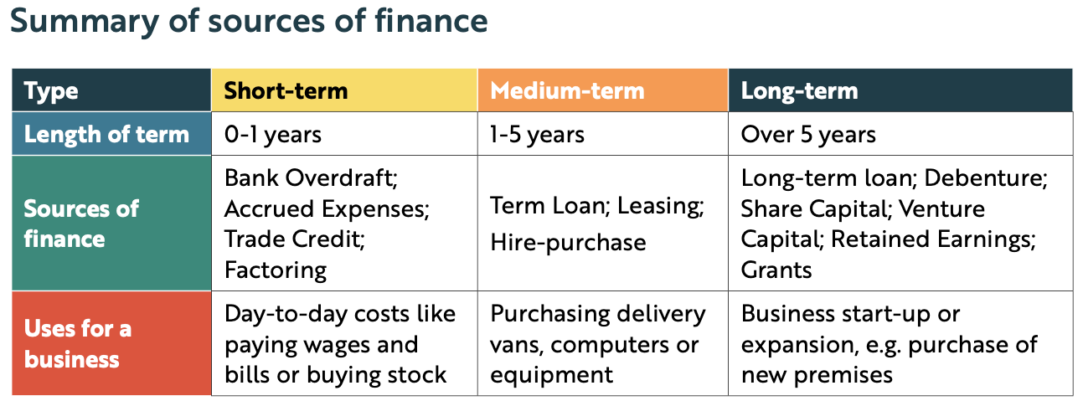
Summary Of Sources Of Finance
Back in Business

Slide 31
Factors A Business Considers In Choosing Sources Of Finance
Back in Business
Cost
A business would compare the APR (Annual Percentage Rate) of different options.
Purpose
Sources of finance must be matched with uses. e.g. A new van should be financed by a medium-term source.
Amount
A business may be limited in how much capital it can access in some forms.
Control
If a business issued ordinary shares, the investors will now have voting rights in the running of the business.
Collateral
The borrower may not want to risk using an essential asset as security in case they end up losing it.

Slide 32
Business In Our World Page 188
https://www.youtube.com/watch?v=-2PgfQ1nw7M

Slide 33

Reflect & Research 188
1. What makes a financial service ‘disruptive’? Find two more examples and explain why they were disruptive.
2. Investigate and explain two advantages and disadvantages of a business accessing funds from Wayflyer for its working capital needs.

Slide 34
Potential Revenue Streams For A Business
Back in Business
Product Sales
Revenue from selling physical goods in-store or online.
A bakery earns income selling cakes, bread, or pastries.
Income from providing time, skills, or labour.
A gym charges fees for individual classes or personal training.
Service Fees
Subscription
Models
Regular payments for ongoing service or content access.
Netflix or a digital newspaper earns through monthly subscriptions.
Advertising
Revenue
Earned by showing ads or promoting branded content.
A YouTuber earns income through video advertisements.

Slide 35
Potential Revenue Streams For A Business
Back in Business
Licensing / Franchise
Fees
Revenue from others using your brand or idea.
A gym brand earns when others use its name or model.
Earned by taking a cut from helping complete a sale.
DoneDeal or Airbnb earns a share from each transaction made.
Commission
Renting / Leasing
Assets
Charged for use of your equipment, space, or tools.
A business earns money renting out offices or venues.

Slide 36
Why A Business May Choose To Adjust Revenue Streams
Back in Business
Changing customer behaviours - As customer preferences change, businesses shift how they earn money.
E.g. A gym moves from pay-per-visit to monthly membership.
Digital transformation - Technology allows new ways to sell or deliver value.
E.g. A publisher adds an online subscription to its textbook sales.
To create more predictable income - Recurring revenue smooths out seasonal or unpredictable income.
E.g. A veg box subscription provides steady income all year instead of relying on single sales each weekend at a market
To compete or diversify - Adjusting revenue helps stay competitive or reduce risk.
E.g. A café rents its space for events to add a new stream.

Slide 37
Adjusting Revenue Steams Over The Lifecycle Of The Product Or Service
Back in Business
Businesses often start with one clear income source to test the idea. Focus may be on building a customer base/proving the concept, not multiple income streams.
Start-Up
New revenue streams (e.g. subscriptions or licensing) are added to scale. Digital platforms or market demand often drive this diversification.
Growth / Expansion
Revenue becomes more stable and may be refined for efficiency.
Trends like automation or bundling help optimise income generation.
Maturity
A business may pivot to new models (like digital) or reduce activity and wind down unprofitable streams.
Renewal / Exit

Slide 38
Suggested Activities for LO 10.2
Sample Papers
OL1 Q1 (f) “EverGlow Organics Ltd is considering various financing options, such as applying for a long term loan or seeking investors.“
Identify a suitable source of finance EverGlow Organics Ltd may use to fund their plans. Give a reason for your choice.
OL1 Q5 (a) (i) Choose whether each example is variable or fixed from the list below
1.Monthly rent for the bakery space
2.Cost of ingredients
Lease payments for equipment
Activity Book Qs
HL Q2-Q4
OL Q3-Q6

Slide 39
Learning Outcome 10.3
10.3 Analyse the cashflow of a business and recommend a suitable course of action for the business to address the issues arising from the analysis.
Back In Business

Slide 40
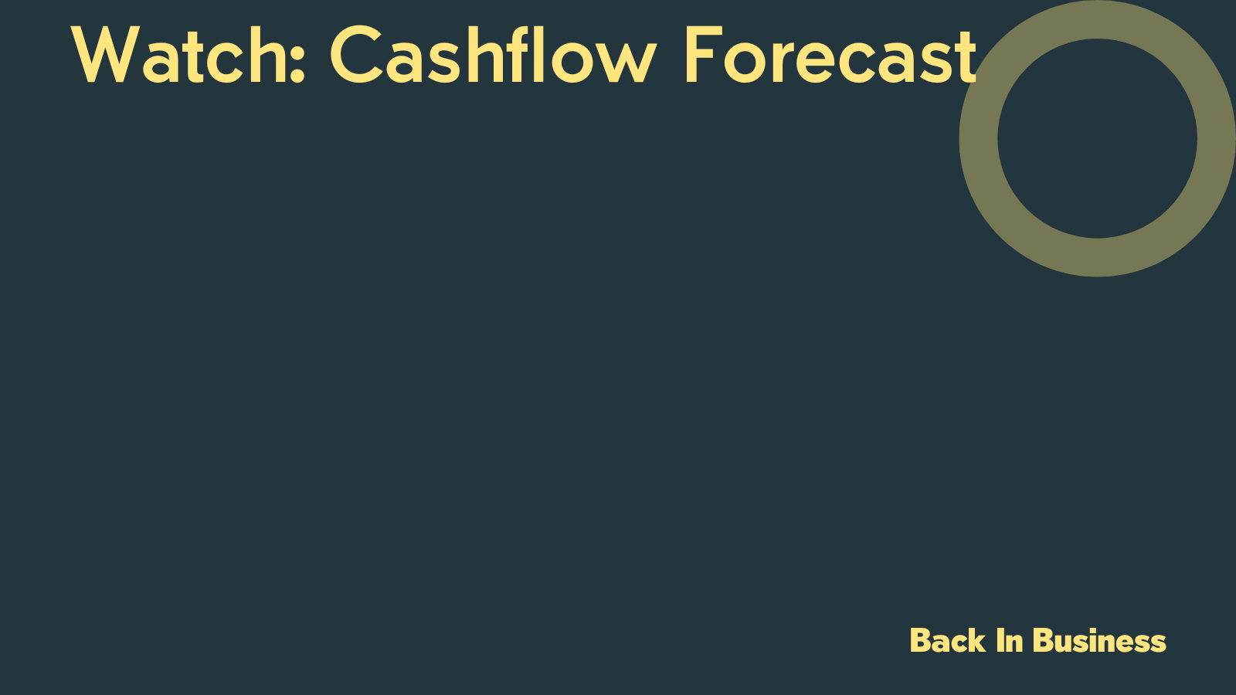
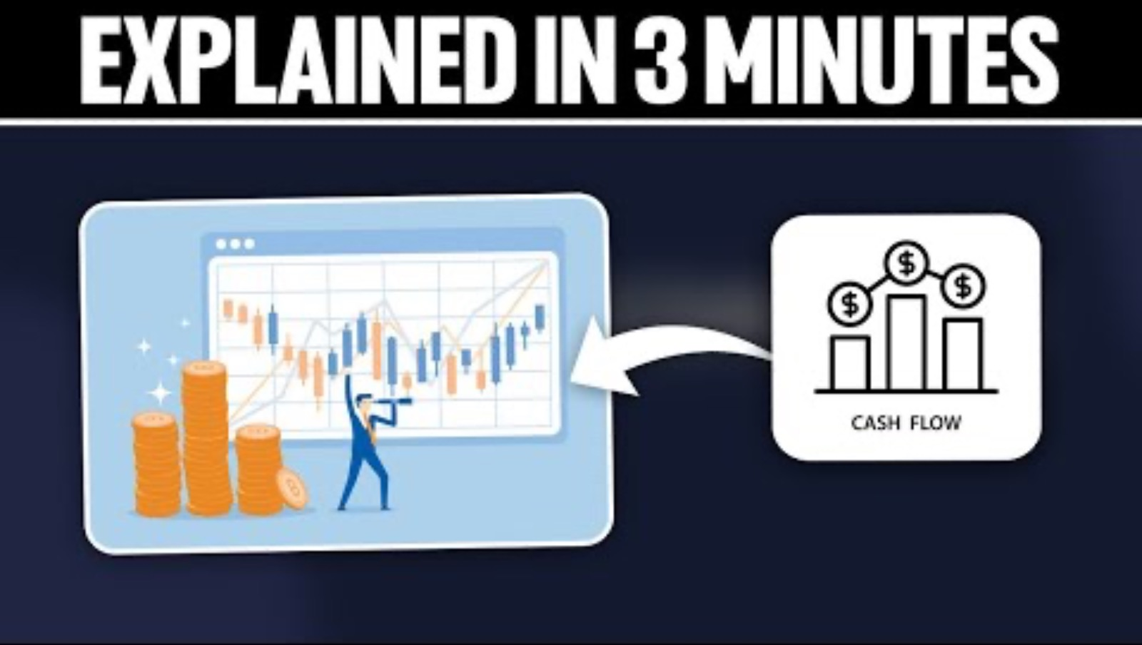
https://www.youtube.com/watch?v=o9FgExxgxgs

Slide 41

Introduction
Back in Business
A cashflow forecast is prepared by a business to plan for the money coming in (receipts) and going out (payments) over a future period. It helps ensure the business has enough cash to cover its day-to-day operations because if it runs
out, a lot of stakeholders could be left unhappy:
Employees might not receive their wages on time.
Suppliers might not get paid for goods sold to you on credit.
Service providers may be left waiting for payment for electricity, gas, or
other utility bills
Back In Business

Slide 42
Reasons Why A Business Prepares A Cashflow Forecast
Back in Business
To help avoid deficits - A cashflow forecast helps a business see in advance when it may face a cash shortage so it can arrange short-term finance if needed.
Improved financial control - It helps a business operate within its means. A cashflow forecast acts as a financial control tool, allowing the business to compare actual cashflow against planned cashflow.

Slide 43
Reasons Why A Business Prepares A Cashflow Forecast
Back in Business
Raise finance - A cashflow forecast is often required when applying for finance. It forms part of the business plan given to banks, investors, and other funding bodies.
Plan for positive net cashflows – Businesses can plan how to use surplus funds, for example, placing them on deposit, investing in new equipment, or funding expansion.

Slide 44
Limitations Of A Cashflow Forecast
Back in Business
Based on estimates - A cashflow forecast relies on predicted figures based on research and estimated sales and costs. These figures may not be based on accurate information.
Unexpected events - Unplanned events can happen at any time and affect cashflow, including a sudden rise in energy costs, a bad debt, or an economic shock.
Back In Business

Slide 45
Analysing The Cashflow Forecast
Back in Business
Closing Cash Surplus: This occurs when a business plans to have a positive closing cash position at the end of a month.
Closing Cash Deficit: When the business will not have enough cash to cover its expected payments for a certain month. It is a negative closing cash position for a month.

Slide 46
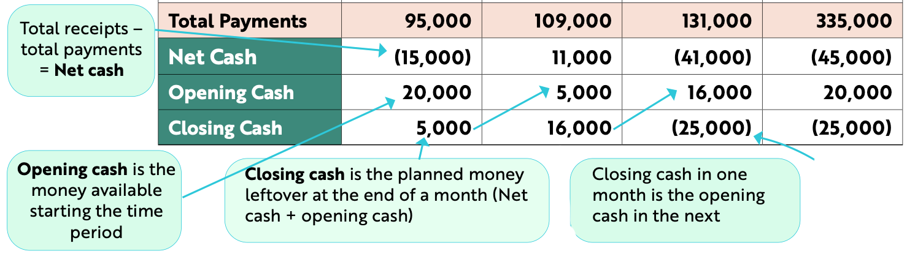
Analysing The Cashflow Forecast
Back in Business
This is an example of a closing cash
deficit - they plan to be -€25,000 in December

Slide 47
Actions A Business Can Take To Address Future Cashflow Problems
Back in Business
Spread payments over time for a one-off purchase. It could pay off the asset over smaller monthly repayments to spread out the expense, or choose to lease it.
Increase cash receipts. The business could run a promotion offering discounts for a set time period to try to quickly bring in extra cash for the business.
Reduce cash payments. The business could cut unnecessary spending, source cheaper suppliers or restructure a loan to spread out the payments over a longer time at smaller amounts.
Avail of a short-term source of finance. The business could arrange a bank overdraft or short-term loan to cover temporary cash shortfalls.

Slide 48
Suggested Activities for LO 10.3
Sample Papers
OL2 Q4 (a)
CFF Analysis questions
Activity Book Qs
HL Q5, Q6
OL Q7

