Slide 1

Strand 1
Chapter 2
Forms of Business, Business Regulation and Governance
Back In Business

Slide 2

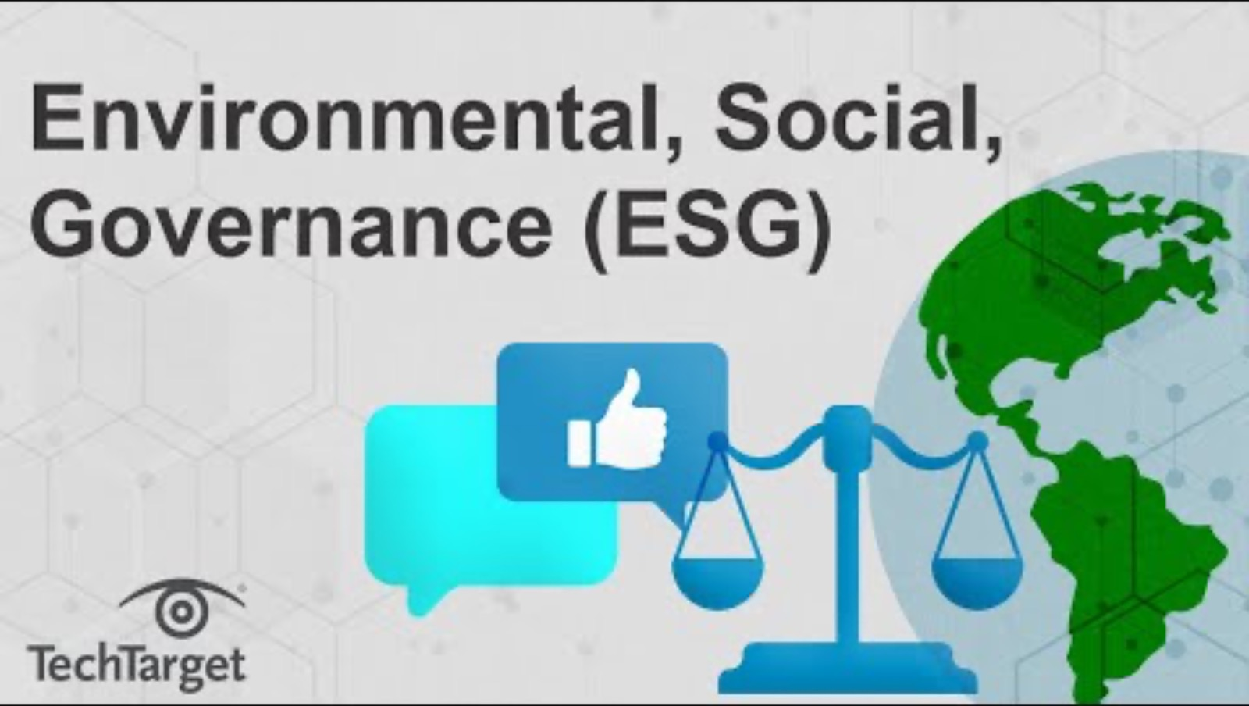
Introduction
Starter Activity
ESG stands for environmental, social and governance factors, and have become a focus for many businesses in recent years.
Watch the video and then answer the activity sheet that accompanies it.
Activity sheet is here
https://www.youtube.com/watch?v=Dg8nTJ0cHVI&t=2s

Slide 3
Introduction
Primer Questions
Do you know anyone who runs their own business?
Do you know what ownership structure they use (sole trader, limited company)?
If you were to invest your money in a business, is there anything else you would consider other than profits? Why?
Do you think the government should provide goods and services or should they leave that to private companies? Why?

Slide 4
Learning Outcome 2.1
2.1 Distinguish between public, private, and not for profit enterprises and analyse the contribution of each of these types of enterprise both locally and nationally.
Back In Business

Slide 5
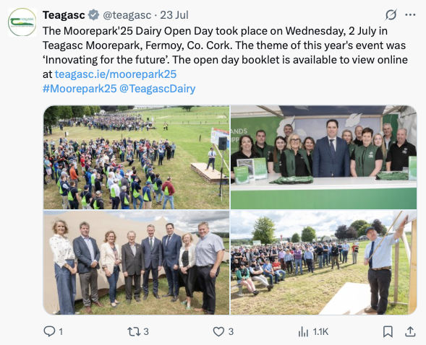
Types of Enterprise in Ireland - Public Enterprise
  These are businesses owned and controlled by the government. Their main aim is not profit, but to provide services that are essential for society.
  Examples:
  Teagasc (non-commercial): Supports agriculture through research and education
  ESB (semi-state): Competes in the energy market but remains state-owned

Slide 6

Types of Enterprise in Ireland - Private Enterprise
  Owned by individuals or shareholders, operating for profit. They range from small local businesses to large multinational companies.
  Examples:
  Ryanair is owned owned by shareholders that can buy shares on the stock exchange
  Supermac’s is owned by Pat McDonagh

Slide 7

Types of Enterprise in Ireland - Not-for-Profit Enterprises
  These organisations aim to meet a social or community need rather than make a profit. Any income they generate is reinvested into their mission.
  Examples:
  The Irish Cancer Society operates to support cancer sufferers
  Focus Ireland is a charity that operates to help the homeless
  Local GAA clubs are run to serve the community

Slide 8
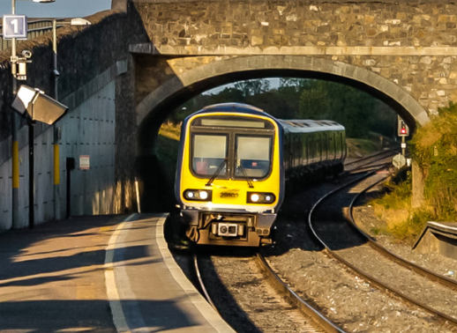

Contribution of Public Enterprises at a local level
Essential Services: Public enterprises maintain services in areas where private firms would not operate.
E.g. Irish Rail runs rural transport routes that wouldn’t be profitable for private operators.
Community Support: They sponsor and support local initiatives.
E.g. Sport Ireland funds Park Runs and local activity programs.

Slide 9
Contribution of Public Enterprises at a national level
Infrastructure Investment: They fund and maintain national systems in transport, energy and communications.
E.g. ESB manages the energy grid; An Post delivers national postal services.
Sustainability Leadership: Public enterprises are often leaders in environmental progress.
E.g. Bord na Móna invests in renewable energy to support climate targets.

Slide 10
Contribution of Private Enterprises at a local level
Job Creation: Private businesses provide employment in towns and cities across Ireland.
E.g. Dunnes Stores employs over 18,000 people nationally across its retail network.
Local Supply Chains: Many businesses rely on Irish suppliers, supporting other local firms.
E.g. In 2024, Lidl spent over €1.6 billion sourcing goods and services from Irish businesses.

Slide 11

Contribution of Private Enterprises at a national level
Exports and Growth: Private companies drive economic expansion and global trade.
E.g. Glanbia, an Irish agri-food business, exports over €5 billion annually.
Tax Contribution: Profitable businesses pay corporation tax, funding public services.
E.g. Irish companies pay 12.5% or 15% tax on their profits, contributing to state income.

Slide 12

Contribution of Not-for-Profit Enterprises at a local level
Contribution of Not-for-Profit Enterprises at a local level
Promoting Social Inclusion: These organisations support vulnerable or isolated groups in communities.
E.g. Over 450 Men’s Sheds across Ireland provide spaces for older men to connect, learn and improve wellbeing.
Jobs and Volunteering: They create paid roles and meaningful volunteer opportunities.
E.g. Local GAA clubs offer chances to coach, referee or help with club activities.

Slide 13

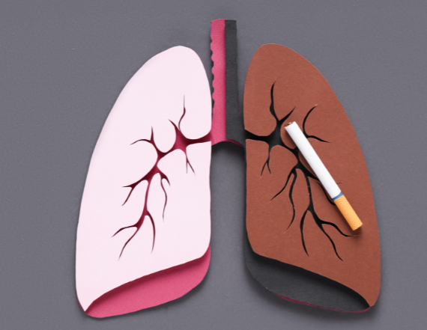
Contribution of Not-for-Profit Enterprises at a national level
Delivering Essential Services: They meet needs not fully addressed by state or private services.
E.g. Focus Ireland supports homeless families with housing and case management.
Influencing Policy and Awareness: They raise awareness and advocate for policy change on national issues.
E.g. The Irish Cancer Society campaigned successfully for plain packaging laws on cigarettes.

Slide 14
Suggested Activities for LO 2.1
Sample Papers
HL1 Q1 (a) Outline one way ProjectOne contributes to the local economy.
HL2 Q1 (e) Analyse two implications to local areas of restaurants and cafés closing down.
OL1 Q5 (g) (i) Indicate if (public, private, or not-for-profit) from (Ryanair, Irish Rail, Barnardos)
(ii) Describe two contributions not-for-profit enterprises make to the Irish economy.
Activity Book Qs
HL Q1, Q2
OL Q1

Slide 15
Learning Outcome 2.2
2.2 Outline how business ownership differs between different types of organisations and how ownership can change over time.
Back In Business

Slide 16
1. Sole Traders
  The business is owned and run by one individual
  Easy to set up and low-cost registration with Revenue and CRO
  Full control and all profits go to the owner
  Unlimited liability – personal assets are at risk if debts arise
  Limited access to finance (sole trader’s savings, harder to get bank loans when not a limited company), making it harder to grow
  Potential Evolution: A sole trader may become a private limited company to reduce personal risk and access greater investment, gaining limited liability and continuity of existence (the business will continue upon death of the owner).

Slide 17
2. Partnerships (2-20 partners)
  A written Partnership Agreement outlines roles, responsibilities and profit sharing
  Partners share decision-making and bring combined skills, finance and expertise, but also share profits of the business.
  Unlimited liability – partners’ personal assets are at risk if the business fails
  No continuity of existence – unless stated, the partnership dissolves if a partner dies
  Potential Evolution: A partnership may convert to a private limited company to become a separate legal entity, benefit from limited liability, and attract more capital by allowing shareholders to invest (up to 149).

Slide 18
3. Private Limited Company (1-149 Owners)
  A separate legal entity owned by up to 149 shareholders
  Must register with the CRO and submit financial reports annually (accounts can be accessed by the public)
  Shareholders have limited liability – only their investment is at risk if the business suffers debt
  Controlled through AGMs using the ‘one share, one vote’ rule
  Easier access to finance – up to 149 investors can buy shares and invest, and companies can apply for loans more easily from banks
  Potential Evolution: A limited company may become a public limited company (PLC) to raise funds by selling shares on the stock market and expanding operations further.

Slide 19
4. Designated Activity Companies (DAC)
  A private company formed for a specific, defined purpose stated in its constitution (called the object clause)
  A DAC must register with the CRO and have at least two directors and can have up to 149 shareholders
  Shareholders have limited liability and elect a board to manage the business
  Follows the ‘one share, one vote’ model at AGMs; profits may be paid as dividends
  The specific activity of the business limits its flexibility to diversify
  Potential Evolution: May convert to a standard private limited company (Ltd) to gain more flexibility in operations or move to a PLC to raise capital with public investment.

Slide 20
5. Public Limited Company
  A business with shares traded on the stock exchange and available to the public
  Must have at least two directors and seven shareholders, but no upper ownership limit
  Shareholders have limited liability and vote at AGMs; a board and CEO manage operations
  Can raise large amounts of capital by selling shares publicly
  Required to publish detailed financial reports and meet strict compliance rules
  Potential Evolution: A group of investors may buy over 50% of a PLC’s shares and convert it into a private limited company to reduce compliance obligations and regain tighter control.

Slide 21

REFLECT & RESEARCH Pg26
Elon Musk took Twitter from a Public Limited Company (PLC) to a Private Company in October 2022.
1. Identify the current company valuation for X. Outline three reasons
for the change in valuation since Musk’s takeover, based on your research.
2. Research how the verification process Musk introduced works on X.
Do you think this is a sustainable revenue model for social media platforms?
Why or why not? Provide evidence to support your opinion.

Slide 22
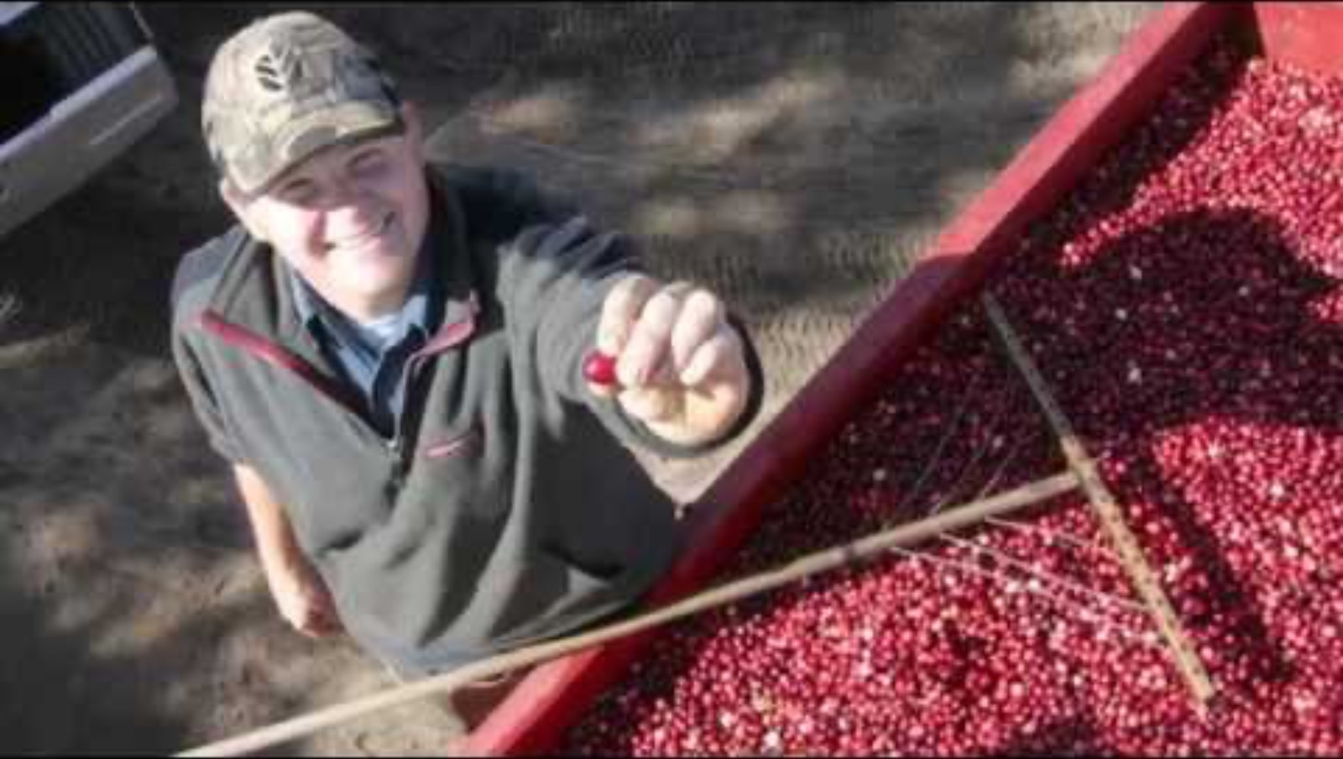
6. Co-Operatives
  This is a democratically controlled business that is jointly owned by its members, who operate the
  business for their mutual benefit (they share a common goal).
  Examples include worker co-ops, financial co-ops, producer co-ops, or consumer co-ops.
https://www.youtube.com/watch?v=n-Bkm9uJMcc&t=3s

Slide 23

Co-Operatives
  In Ireland, Credit Unions are examples of financial co-ops.
https://www.youtube.com/watch?v=NIrN66UP9Kc&t=1s

Slide 24
Co-Operatives
  A democratically controlled business jointly owned by at least seven members
  Operates for the mutual benefit of members, not profit for external investors
  Each member has one vote regardless of financial contribution (‘one member, one vote’)
  Members share in profits/surplus based on their use or savings with the co-op
  However limited access to finance can restrict growth or investment potential
  Potential Evolution: A co-operative may convert to a public limited company (PLC) to raise investment, as Glanbia did in 2000, while allowing members to retain some ownership.

Slide 25
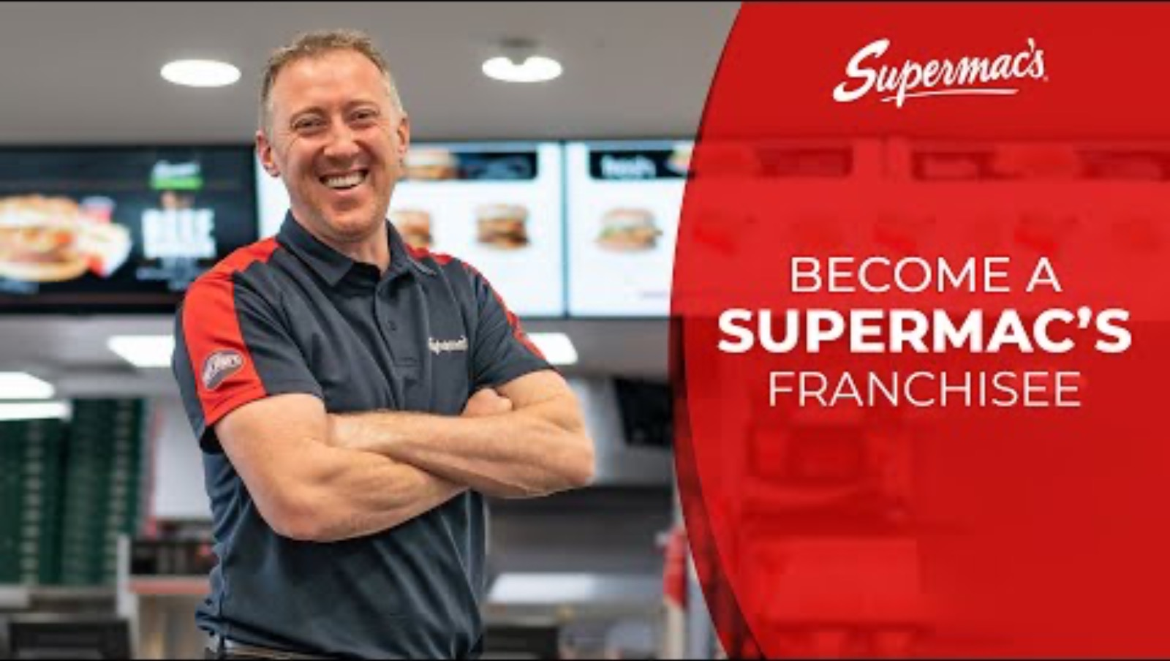
7. Franchises
  A franchise is set up when a licence is granted by a business (the franchisor) to let someone else (the franchisee) sell its products or services using their brand and logo in return for a fee, as well as either a percentage of their turnover or profits.
  Supermac’s is an Irish example.
https://www.youtube.com/watch?v=6hyCZfgUQDk&t=1s

Slide 26
REFLECT & RESEARCH Pg27
1. List the services provided by a credit union of your choice.
2. Compare the interest rates for different financial products (loans, mortgages) between a credit union and a bank.

Slide 27
Franchises - Benefits for the Franchisee
  1. Proven Business Model - Franchisees operate under a well-known brand with an established customer base, reducing risk for a start-up business.
  2. Training and Support - Franchisors provide training, support, and systems that make it easier for franchisees to succeed.
  3. Economies of Scale - Franchisees benefit from lower costs through bulk purchasing and national advertising campaigns, as all franchises can contribute to them.
  4. Built-in Customer Base - Many customers already recognise the brand, so franchisees benefit from strong initial demand.

Slide 28
Franchises - Drawbacks for the Franchisee
  1. High Setup Costs - Franchisees must pay upfront fees and invest in fitting out the premises to strict brand guidelines.
  2. Reduced Flexibility - Franchisees have limited freedom to adapt products or services or implement new ideas.
  3. Brand Risk - If other franchisees damage the brand reputation through poor service or quality, it can impact all outlets.

Slide 29

REFLECT & RESEARCH Pg28
1. How much does the Camile franchise cost? How does this compare to other similar franchise options someone might have?
2. Outline, using examples, how Camile operates in an ethical and sustainable manner.
3. What are Camile’s unique selling points? Do you think they would be a good investment or not?

Slide 30

8. Public Sector Organisations
  Public sector organisations are owned and operated by the state to deliver essential services to the public.
  Examples include Irish Rail, RTÉ, Bord Gáis, An Post, and Dublin Airport Authority.
  These organisations may be part- or fully-funded by the government and operate in sectors like transport, energy, and media.

Slide 31
8. Public Sector Organisations
  Privatisation: This is the selling pf a state-owned business to private investors.
  E.g. Aer Lingus was privatised in stages from 2006 to raise investment to allow it to compete with Ryanair.
  Nationalisation: This is when the Government takes over a private business, usually in a crisis situation or to prevent a key industry failing in the economy.
  E.g. AIB was nationalised in 2010 to prevent a banking collapse during the financial crisis, to try to protect Irish citizens from the bank failing.

Slide 32

Advantages of Privatisation
  1. Increased Government Revenue - The state gains a large lump sum which can be invested in state services or infrastructure.
  2. Greater Efficiency - Private firms often invest more, reduce bureaucracy, and innovate faster than state-run organisations, improving the service or price in the market.
  3. More Competition - Privatising former monopolies (e.g. telecoms) can increase choice and lower prices for consumers in the market and allows other firms to enter and compete in the market.

Slide 33

Disadvantages of Privatisation
  1. Loss of Public Assets - Key national services may fall under private control, reducing accountability and public benefit.
  2. Unemployment Risks - Privatisation may result in cost-cutting and layoffs, particularly if services are rationalised.
  3. Higher Prices / Lower Quality - Profit-driven firms might cut corners or raise prices, especially in less competitive markets.

Slide 34
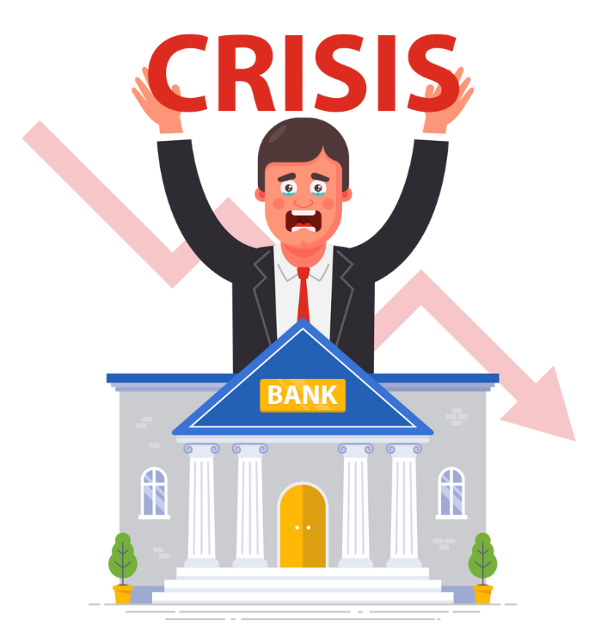
Why Governments Nationalise Businesses
  1. Protecting Critical Services - The state may step in if essential services (e.g. banking, energy) are at risk of collapse.
  2. Stabilising the Economy - During a financial crisis, nationalising firms (like AIB in 2010) helps to protect public savings and prevents wider economic fallout.
  3. Public Interest - Nationalisation ensures important sectors remain accessible, affordable, and accountable to citizens.

Slide 35
Reasons for Changing Business Structure Over Time
  1. To benefit from limited liability - Owners want to protect personal assets from business debts. A sole trader becomes a private limited company to ensure only business assets are at risk.
  2. To ensure continuity of existence - Businesses want to survive the death or departure of owners. A family-run partnership changes to a Ltd so the business can be passed down across generations.
  3. To pay lower taxation rates - Corporate tax can be lower than personal income tax rates. A successful sole trader earning high profits changes to a Ltd to benefit from a 15% corporate tax rate (2025).

Slide 36
Reasons for Changing Business Structure Over Time
  4. To become a separate legal entity - A legally distinct company can be sued or enter contracts in its own name. A sole trader moves to Ltd status so business debts or lawsuits won’t affect their personal standing.
  5. To protect an essential industry - The government may intervene to protect key services.
  AIB was nationalised during the financial crisis to protect the banking system.
  6. To allow for expansion - Businesses may seek major funding to grow. A private company becomes a PLC to raise capital by selling shares publicly and expand operations. A sole trader might become a private limited company to raise capital from up to 149 owners.

Slide 37
Suggested Activities for LO 2.2
Sample Papers
OL1 Q1 (a) (i) Indicate the ownership structure under which EverGlow Organics Ltd operates (Private Limited Company or Sole Trader)
OL1 Q2 (a) (i) Choose the correct words from: Private, Public, Unlimited, Limited - "Amazon operates as a xxx listed company whose owners have xxx liability.
(ii) T/F The owners of a company are known as shareholders; Privatisation is the transfer of a business from the government to the private sector; A cooperative is owned and controlled by the government.
OL2 Q4 (c) Outline two reasons for changing from sole trader to a private limited company
Activity Book Qs
HL Q3,Q4,Q5, BW Q1
OL Q2,Q3

Slide 38
Learning Outcome 2.3
2.3 Outline the purpose of regulation in business and investigate how organisations are regulated both internally and externally.
Back In Business

Slide 39

Purpose of Regulation
  Regulation is the system of rules, laws, and controls that ensure businesses act legally, fairly, and responsibly.
  Main Aims of Regluation:
  Consumer protection (e.g. product safety laws)
  Fair employee treatment (e.g. equal pay)
  Market fairness (e.g. anti-monopoly rules)
  Financial integrity (e.g. audited reports)
  Environmental protection (e.g. waste regulations)

Slide 40
What is Internal Regulation?
  These are systems and checks a business puts in place to ensure it operates legally, ethically, and efficiently. It helps businesses spot problems early and avoid legal or reputational damage.

Slide 41
Internal Regulation – How Organisations Regulate Themselves
  1. Internal Audits
  Regular reviews of financial records, safety processes, or environmental performance to check for errors or risks.
  E.g. A company like ESB may audit how safely its engineers follow safety procedures.
  2. Risk Management
  A formal process of identifying potential risks and putting plans in place to reduce or respond to them.
  E.g. A hotel may plan for risks like fire, data breaches or customer injury.

Slide 42
Internal Regulation – How Organisations Regulate Themselves
  3. Compliance Systems
  Policies and procedures that ensure staff follow legal and company rules.
  E.g. A code of conduct, online training on workplace safety, or reporting procedures for wrongdoing.
  4. Governance Structures
  Leadership teams like Boards of Directors who oversee company decisions, strategy, and ethics.
  E.g. A board ensures decisions are made in line with legal responsibilities and shareholder interests.

Slide 43

What is External Regulation?
  This is when independent bodies like the government, EU, or professional regulators monitor how businesses behave. These regulators enforce laws and take action when businesses break rules.

Slide 44
External Regulation – Oversight from Outside the Business
  1. Government Regulators
  Independent public bodies that oversee, monitor and regulate different areas of business:
  CCPC: Makes sure companies don’t fix prices or mislead customers
  WRC: Ensures fair treatment of employees under employment law
  EPA: Enforces rules about pollution, waste and environmental impact
  Revenue: Collects taxes and monitors financial compliance
  CRU: Regulates providers of energy and water services

Slide 45
External Regulation – Oversight from Outside the Business
  2. National Laws
  Laws passed in Ireland to protect consumers, workers, and the environment:
  E.g. Consumer Rights Act 2022, Unfair Dismissals Acts, Waste Management Acts
  3. External Audits
  Independent accountants or audit firms check that company finances are accurate and lawful. E.g. Public limited companies must publish audited accounts each year.
  4. EU Regulations
  Businesses in Ireland must also follow EU rules E.g. GDPR ensures companies protect your personal data

Slide 46
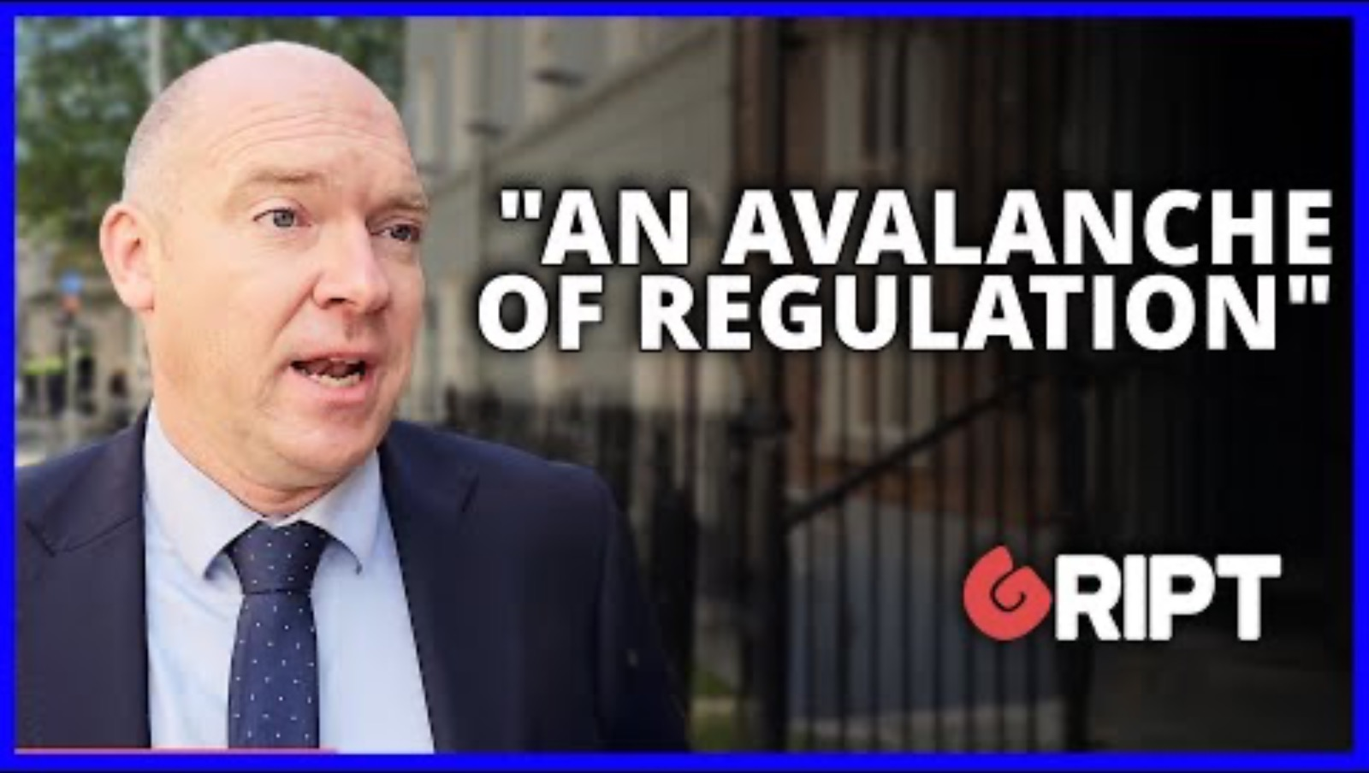
The impact of regulation on businesses who are under an “avalanche of regulation”
https://www.youtube.com/watch?v=qdhVNN-XZcU&t=1s

Slide 47
Suggested Activities for LO 2.3
Sample Papers
None
Activity Book Qs
HL Q6
OL Q4

Slide 48
Learning Outcome 2.4
2.4 Explain what is meant by governance in an organisation.
Back In Business

Slide 49
What Is Governance in Business?
Governance is the system of rules, processes, and practices that direct and control a business.
It clarifies who makes decisions and who is accountable for how the business behaves.
Good governance promotes transparency, accountability, and ethical conduct.
Governance policies should be shared with all stakeholders, including employees, customers, and suppliers.

Slide 50
Key Components of Good Governance
1. Board of Directors - Leads the business, sets strategy, and oversees management. Should include diverse and independent voices.
2. Internal Controls (Risk Management) - Processes to identify and manage risks, including accurate financial reporting.
3. Transparency - Honest disclosure of issues like financial or data breaches maintains stakeholder trust.
4. Ethical Practice - A code of ethics outlines the expected moral behaviour for staff and management.
5. Stakeholder Engagement - Open communication with shareholders, employees, customers and regulators builds trust.

Slide 51
Why Governance Matters
Prevents Fines: Following legal and ethical rules reduces the risk of costly penalties.
Reduces Risk: Governance systems help detect and address problems early.
Builds Trust: Stakeholders are more likely to engage with a business known for fairness and transparency.

Slide 52
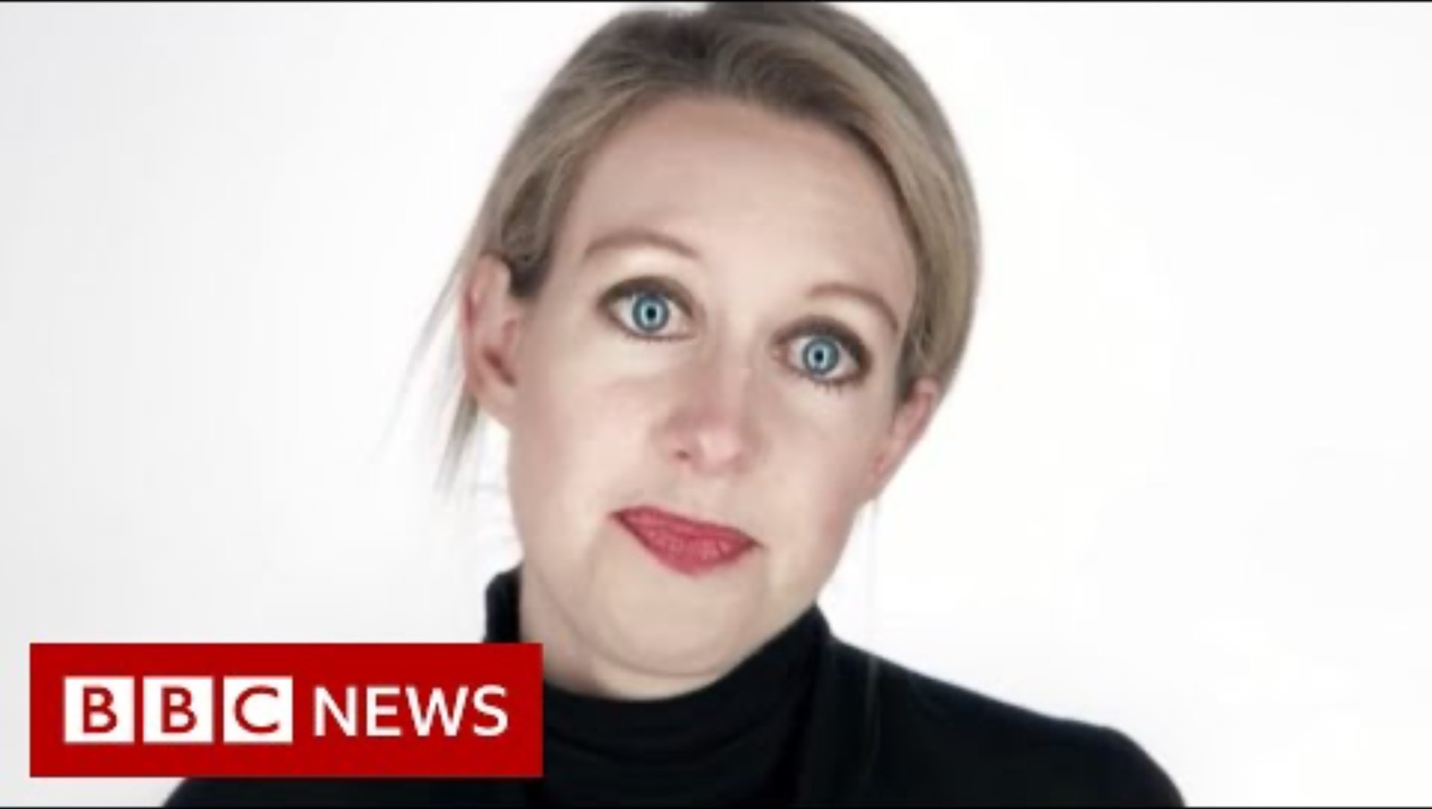
https://www.youtube.com/watch?v=fwHould1ePY

Slide 53
1. How much does the Camile franchise cost? How does this compare to other similar franchise options someone might have?
2. Outline, using examples, how Camile operates in an ethical and sustainable manner.
3. What are Camile’s unique selling points? Do you think they would be a good investment or not?

Slide 54
Suggested Activities for LO 2.4
Sample Papers
None
Activity Book Qs
HL BW Q4
OL Q5

Slide 55
Learning Outcome 2.5
2.5 Outline the three factors considered in an ESG report.
Back In Business

Slide 56
What Is ESG?
  ESG stands for Environmental, Social, and Governance
  These are three key areas used to assess a company’s sustainability and ethical performance
  Many businesses now publish ESG reports to show how they are meeting social, environmental and ethical expectations – and some businesses are legally obliged to
  Investors use ESG data to assess long-term risk and corporate responsibility

Slide 57
The Three Pillars of ESG
  1. Environment
  Focuses on emissions, waste, energy use, and sourcing
  E.g. A company installing solar panels to cut carbon output
  2. Social
  Concerns employees, communities, customer safety, and ethical supply chains
  E.g. Promoting workplace safety and equal opportunities
  3. Governance
  Covers leadership, transparency, board structure, and anti-corruption
  E.g. Publishing accurate financial statements and policies on ethical behaviour

Slide 58

Benefits of ESG Reporting
  1. Environmental Benefits
  Improves carbon footprint and resource efficiency
  E.g. IKEA cuts packaging waste and uses renewable energy
  2. Social Benefits
  Boosts brand reputation and employee satisfaction
  E.g. Starbucks shares how it sources coffee ethically under FairTrade
  3. Governance Benefits
  Increases trust through transparency and compliance
  E.g. Unilever discloses board diversity and executive pay structures

Slide 59
REFLECT & RESEARCH Pg38
1. Identify three different companies that were nominated for
an ESG award in different categories.
2. For each company, research why they were nominated for
the award.
3. What are the benefits for an Irish business of winning an ESG award?

Slide 60
Suggested Activities for LO 2.5
Sample Papers
HL1 Q3 (a) Identify the three elements of an ESG report.
OL1 Q3 (a) (i) What do the letters ESG stand for?
(ii) Indicate the area of the ESG report to which each topic relates (given E,S,G) –
• Employee Wellbeing
• Pollution Prevention
• Community Involvement
• Structure of the Board of Directors
Activity Book Qs
HL Q7, BW Q2, BW Q3
OL Q6

