Slide 1

Strand 1
Chapter 1
Key stakeholders in business
Back In Business

Slide 2




Introduction
Back In Business
Starter Activity
In recent years, major Irish banks like Bank of Ireland and AIB have closed numerous rural branches, citing cost-cutting and a shift toward digital banking.
These closures have sparked concern among local communities, employees, and government representatives.
Watch the RTE News story on it and answer the worksheet based on how a business decision can impact on different stakeholders.
Worksheet here -> https://backinbusinesshub.com/wp-content/uploads/2025/06/Starter-worksheet-Chapter-1.pdf
https://www.youtube.com/watch?v=dR3noHBXR7Q

Slide 3
Introduction
Back In Business
Primer Questions
Think of a local business – which groups of people do you think it depends on most to operate daily?
Why might investors and employees sometimes disagree on what's best for a business?
If a business had to cut costs quickly, who might be impacted first?

Slide 4
Learning Outcome 1.1
1.1 Outline the key internal and external stakeholders in a business and demonstrate their importance in the business environment.
Back In Business

Slide 5
Back In Business
Internal stakeholders are individuals or groups that are directly involved in the running of the business.
External stakeholders are individuals or groups that aren’t directly involved in the running of the business but are affected by its activities.
Internal Stakeholders
1. Business Owner/Entrepreneur
2. Managers
3. Employees
4. Investors
External Stakeholders
1. Consumers
2. Local Community
3. Suppliers
4. Government
5. Interest Groups

Slide 6
Back In Business
1. Business Owner/Entrepreneur (Internal)
  Role in the Business: They identify market opportunities, secure the necessary funding, and accept personal and financial risks, including potentially inheriting or managing family-owned businesses.
  Their Importance: They are crucial as they transform initial business ideas into viable operations, providing essential leadership, strategic vision, and shouldering the early risks necessary for business establishment.

Slide 7

Back In Business
1. Business Owner/Entrepreneur (Internal)
  Their Needs & Wants: Entrepreneurs typically aim for financial success and profitability, seek personal recognition and achievement, and value independence and control over business decisions.
  Example: Shane Curran, aged 19, successfully secured over €3 million in funding to launch his cybersecurity start-up, Evervault.

Slide 8

Back In Business
2. Managers (Internal)
  Role in the Business: They set objectives based on the entrepreneur’s vision and organise resources effectively to achieve these business goals.
  Their Importance: Essential for coordinating daily operations, motivating staff, and ensuring the business remains focused on achieving both immediate and future objectives.

Slide 9

Back In Business
2. Managers (Internal)
  Their Needs & Wants: Managers need sufficient resources (like staffing, finance, and equipment) to fulfil business objectives and typically desire recognition, career growth, and decision-making responsibilities.
  Example: Anne O’Leary became Head of Meta Ireland in May 2023, previously serving as CEO of Vodafone Ireland, showcasing significant managerial progression and achievement.

Slide 10
Back In Business
3. Employees (Internal)
  Role in the Business: They follow the manager’s instructions, share ideas, and use their skills to help the business run day to day.
  Their Importance: Employees provide their time, experience, skills, ideas, and qualifications that help the business complete its daily tasks and stay productive.

Slide 11

Back In Business
3. Employees (Internal)
  Their Needs & Wants: They need fair pay, good working conditions, and to be treated with respect. Many also want better wages, improved conditions, or more responsibility over time.
  Example: A busy shop needs well-trained and motivated staff to work as sales assistants to help things run smoothly for customers.

Slide 12
Back In Business
4. Investors (Internal)
  Role in the Business: Investors provide funding to a business in return for a share of ownership (called equity), hoping to earn profits as the business grows.
  A bank can also provide funding in return for repayments with interest (called debt), but not take any ownership in the business.
  Their Importance: They help the business grow by providing funding, and sometimes also bring useful experience, contacts, or advice that can support business success.

Slide 13

Back In Business
4. Investors (Internal)
  Their Needs & Wants: At the start, they may accept a higher level of risk and lower dividends, but over time they expect a return on their money through dividends and may prefer less risk when the business is established.
  Example: Groups like Act Venture Capital or Enterprise Ireland invest in businesses and get a share of ownership, helping them grow in return for future returns.

Slide 14
Back In Business
1. Consumers (External)
  Role in the Business: They purchase goods or services from the business, give feedback on what they like or don’t like, and can become advocates for the business, especially through social media.
  Their Importance: Consumers drive revenue through their purchases and help shape the business’s brand reputation by sharing opinions or promoting products online. They can also share ideas/feedback to help develop new ideas.

Slide 15
Back In Business
1. Consumers (External)
  Their Needs & Wants: Consumers look for quality and value for money, expect excellent customer service, and often want to support businesses that act in a way they see as ethical or sustainable.
  Example: Patagonia is seen as an environmentally and ethically responsible brand, and its consumers are happy to pay higher prices because they believe in the business’s values.

Slide 16

Back In Business
2. Local Community (External)
  Role in the Business: The area and people that surrounds and interacts with the business, often through shared space, services, or employment.
  Their Importance: A supportive community creates goodwill and can provide a reliable base of customers and employees, helping the business succeed.
  Their Needs & Wants: The community may want local job creation, access to important goods or services, environmental responsibility, and ethical business practices from the businesses operating nearby.

Slide 17
Back In Business
3. Suppliers (External)
  Role in the Business: They provide the raw materials, products, or services that a business needs in order to produce and deliver its own goods or services.
  Their Importance: Reliable suppliers allow for consistent production and service delivery by supplying quality inputs on time, helping the business stay efficient and meet customer demand.

Slide 18

Back In Business
3. Suppliers (External)
  Their Needs & Wants: If selling goods on credit, they want to be paid on time and may prefer longer-term contracts to protect their own financial sustainability.
  Example: McDonald’s sources all the beef for its burgers sold in Ireland from 100% Irish farms, showing how it relies on local suppliers to meet its standards.

Slide 19
Back In Business
4. Government (External)
  Role in the Business: It regulates and oversees business activities, and provides grants and incentives to support businesses starting up or planning to expand.
  Their Importance: During start-up and expansion, the government can offer training, mentoring, and funding through bodies like Local Enterprise Offices or Enterprise Ireland, especially for businesses aiming to export or scale.
  They also try to create a positive business climate for businesses to operate in by lowering taxes, offering training for employees and developing infrastructure.

Slide 20

Back In Business
4. Government (External)
  Their Needs & Wants: The government expects businesses to comply with laws, pay their tax contributions, and act with social responsibility. They also want Irish firms to sell goods/services abroad to help bring more money in to the Irish economy, and to create jobs to lower unemployment.

Slide 21
Back In Business
5. Interest Groups (External)
  Role in the Business: They represent the common viewpoint, objectives and goals of a particular group of stakeholders, and are also known as pressure groups or lobby groups.
  Their Importance: They help promote the interests of their members by negotiating or informing other stakeholders about what those members want from a particular situation.

Slide 22
Back In Business
5. Interest Groups (External)
  Their Needs & Wants: Interest groups aim to influence decision-makers through methods like lobbying, media campaigns, public protests, boycotts, and sometimes legal action.
  Example: In 2024, the Small Firms Association (SFA) lobbied the Government to support small businesses with the rising costs of running their operations.

Slide 23

Business in our world Pg 6
  In June 2024, Aer Lingus pilots began industrial action over pay, citing the rising cost of living.
  Their union, IALPA, organised an 8-hour strike on June 26th, followed by work-to-rule action into July.
  Over 600 flights were cancelled across 3 weeks, affecting thousands of Irish holidaymakers.
https://www.youtube.com/watch?v=aVCkxp8p4Wg
1. Why do you think the employees felt they needed to take industrial action?
2. How might these stakeholders have been affected across the 3 weeks: (i) customers (ii) suppliers of on-flight food (iii) employees

Slide 24
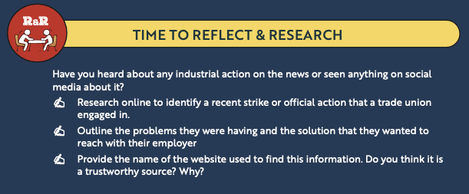
Business in our world Pg 6

Slide 25
Suggested Activities for LO 1.1
Sample Papers
OL2 Q1 (a) List three stakeholders that may be impacted by the recent growth of PJ’s business.
HL1 Q2 (ii) Outline the importance of Grainne's relationship with her suppliers.
Activity Book Qs
HL Q1
OL Q1

Slide 26
Learning Outcome 1.2
1.2 Demonstrate how stakeholders interact and identify potential conflict between stakeholders.
Back In Business

Slide 27

Back In Business
1. Cooperative Relationships between stakeholders
When they both mutually benefit from a relationship, it is seen as a co-operative relationship.
When both stakeholders are working towards a common goal. It is a win-win situation.
Examples include:
Employer & Employee: When employers invest in staff training, employees gain skills for promotion or pay rises, while businesses benefit from more productive workers.

Slide 28
Back In Business
1. Cooperative Relationships between stakeholders
Investor & Business Owner: Investors provide funding to help the business grow, while business owners use that funding to invest in resources and drive results creating profits for both.
Supplier & Manager: Investors provide funding to help the business grow, while managers use that funding to invest in resources and drive results.
Producer & Producer: Local producers may share resources or promotional costs (e.g. local cheese makers promoting a cheese festival together) so both benefit from increased customer traffic.

Slide 29
Back In Business
2. Competitive Relationships between stakeholders
Conflicts can arise when the needs and wants of different stakeholders compete with each other – if one party benefits, the other loses out. This is a win-lose situation. This occurs when both stakeholders are working towards a mutually exclusive goal.
Examples include:
Employer & Employee: Employers may want to cut pay to reduce costs, while employees want a pay rise for higher disposable income — if one side wins, the other loses.

Slide 30
Back In Business
2. Competitive Relationships between stakeholders
Investor & Business Owner: Investors want higher dividends from profits; managers may prefer to reinvest profits into the business — both can't happen fully at the same time.
Supplier & Manager: Suppliers may want faster payment or shorter credit terms, while managers may want to delay payment to manage cash flow — this creates tension.
Producer & Producer: Competing producers may try to increase sales by improving price, quality, or service — if one gains customers, the other may lose them.

Slide 31
Suggested Activities for LO 1.2
Sample Papers
None
Activity Book Qs
HL Q2
OL Q2

Slide 32
Learning Outcome 1.3
1.3 Suggest appropriate ways of avoiding and resolving conflict between stakeholders.
Back In Business

Slide 33
Back In Business
Strategies to help avoid stakeholder conflict:
1. Open Communication: Keep honest, regular contact with stakeholders to understand concerns and avoid conflict e.g. fairly handling customer complaints.
2. Corporate Social Responsibility (CSR): Make ethical decisions that balance profit with societal good e.g. avoid unfair price hikes that exploit loyal customers.
3. Stakeholder Involvement: Include stakeholders in key decisions e.g. builders should consult local communities before starting major projects.

Slide 34

Back In Business
Strategies to help resolve stakeholder conflict:
1. Meet & Talk (Supplier & Manager):
A supplier and a manager might meet to discuss delayed payments and agree on a realistic timeline for future invoices to avoid damaging the relationship.
2. Negotiation or Bargaining (Employee & Business Owner):
An employee may want a four-day work week, while the owner wants to maintain output. They agree on a trial phase with performance targets to meet both needs halfway.

Slide 35
Back In Business
Strategies to help resolve stakeholder conflict:
3. Mediation (Local Community & Developer):
A local community group concerned about a new building project meets with a property developer, supported by a neutral mediator to ensure both sides feel heard.
4. Conciliation (Investor & Manager):
An investor wants higher dividends, while the manager wants to reinvest profits and they can’t find a solution. A third party listens to both, may suggest a phased dividend increase to try to help them reach an agreement themselves to end the dispute.

Slide 36

Back In Business
Strategies to help resolve stakeholder conflict:
5. Arbitration (Employee & Employer):
An employee claims they were unfairly dismissed, while the employer insists proper procedures were followed. An independent arbitrator listens to both sides and reviews the evidence before recommending a resolution — for example, reinstatement, compensation, or upholding the dismissal. Both parties agree beforehand to accept the outcome.

Slide 37
Suggested Activities for LO 1.3
Sample Papers
None
Activity Book Qs
HL Q3
OL Q3

Slide 38
Learning Outcome 1.4
1.4 Conduct stakeholder mapping and explain the importance of prioritising different stakeholder interests.
Back In Business

Slide 39
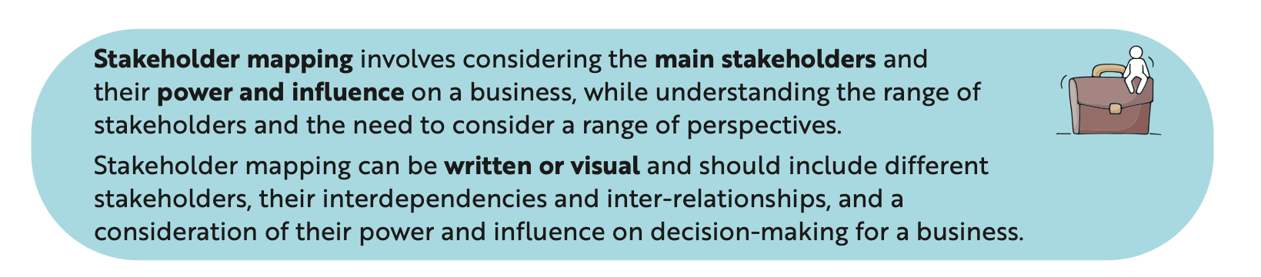
Back In Business
Stakeholder Mapping
Generally a business would measure the interest and influence/power each group of stakeholders has, to help decide who to prioritise when making decisions.

Slide 40
Back In Business
Two Teachers Stakeholder Mapping Video
https://www.youtube.com/watch?v=L5ahqkZAfn8&t=1s

Slide 41

Back In Business
Steps in Stakeholder Mapping
1. Identify Stakeholders:
List all individuals or groups affected by the business, both internally and externally.
2. Analyse Power & Interest:
Assess each stakeholder’s level of influence and their interest in the business.
3. Map to a Grid:
Place stakeholders on a Power–Interest Grid (High/Low Power vs High/Low Interest) to decide who to prioritise.
4. Allocate Resources & Plan Engagement:
Focus on key stakeholders and create tailored communication or engagement strategies based on their position on the grid.
1. Identify
Stakeholders
2. Analyse Power
& Interest
3. Map to a power
interest grid
4. Allocate resources
& plan engagement

Slide 42
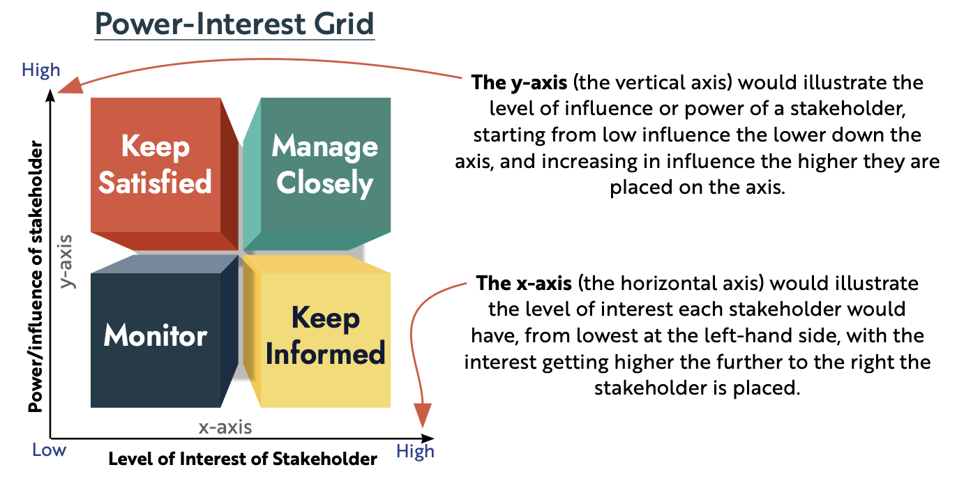
Back In Business

Slide 43
Back In Business
Class Task: Stakeholder Mapping Example – AIB Branch Closures
Context: AIB is planning to close more rural bank branches.
Task: Work through the four steps of stakeholder mapping by focusing on this decision and how each of the following stakeholders need to be prioritised:
AIB identifies the following key stakeholders impacted by rural branch closures:
  Customers (especially older or less tech-savvy customers)
  Local Community (rural towns losing essential services)
  Employees (staff at affected branches)
  Government (local politicians, regulator intervention)
For each stakeholder, decide:
  Do they have high or low interest in this decision?
  Do they have high or low influence (power) over the decision?

Slide 44
Back In Business
Stakeholder Mapping Example – AIB - Suggested Solution
Task: Map out a power-interest grid showing the information provided below.
Stakeholder | Interest | Influence/ Power | Reasoning
Customers | High | Low | Closely affected by branch closures, but limited power to change the decision individually
Local Community | High | Low | Community well-being and accessibility are impacted, but limited power to change the decision
Employees | High | High | Jobs may be at risk, unionised workers may have high power to negotiate
Government | Low | Low | Local politicians may try to influence the decision, concern may exist over removal of services for locals

Slide 45
Back In Business
Importance of Stakeholder Mapping
Improves Decision-Making Quality
Mapping helps a business see all viewpoints before making a decision. It encourages balanced choices that consider the needs, concerns, and influence of different groups.
E.g. A bank may delay a branch closure after mapping shows high-impact on older customers with low digital access.
Supports Strategic Planning
Stakeholder mapping helps businesses plan long-term actions by understanding who to engage and when. This helps reduce surprises and keeps key relationships strong.
E.g. During expansion, a company might map which stakeholders to involve early—such as local councils or investors—to smooth the path.

Slide 46
Suggested Activities for LO 1.4
Sample Papers
HL2 Q1 (b) John and Mark are considering adding new plant-based menu options.
(i) Conduct stakeholder mapping to identify and prioritise four stakeholders affected by this decision.
Activity Book Qs
HL Q4

