Slide 1

Strand 2
Chapter 8
Business planning
Back In Business

Slide 2
Learning Outcomes
8.1 Appreciate the importance of having a business plan and outline the key functions of a business plan.
8.2 Outline the importance of ethics and sustainability when planning in business.
8.3 Explain what is meant by a business model and appreciate its role within the business plan.
8.4 Identify the key elements of the business model canvas and outline the role of business models in successful enterprises.
8.5 Identify and compare the most common business models.
8.6 Outline how digital technology is a driver of change in business.
8.7 Identify and compare a number of technology-driven business models and outline the key characteristics of each model.
Back In Business

Slide 3

Introduction
Back In Business
Priming activity
Discussion/whiteboards/pairwork - pick 2 from the list below to answer:
1. If you had €50,000 to invest in a family member’s business, what are three pieces of information you’d need to know before giving them the money to use?
2. What’s the difference between a business idea and a business plan?
3. Can a business be successful in 2025 without strong ethics or sustainability practices?
4. If you started a business tomorrow, what apps or digital technology would you use, and why?

Slide 4



Introduction
Back In Business
Starter Activity
Consumers can buy a Nespresso machine for a low price
But then Nespresso can make a lot of money from selling coffee pods once consumers own the machine.
What is clever about the way Nespresso operate their business by providing cheap coffee machines for their coffee pods?
Can you think of other examples of businesses that use this model of giving a machine or product that then requires additional purchases after to use it?
This is called a ‘razor and blade’ or ‘bait and hook’ business model showing how a business can create and deliver value to consumers and how they will generate revenue by doing it.
Printable Worksheet here → https://backinbusinesshub.com/wp-content/uploads/2025/06/Starter-worksheet-Chapter-8-2.pdf

Slide 5
Learning Outcome 8.1
8.1 Appreciate the importance of having a business plan and outline the key functions of a business plan.
Back In Business

Slide 6
Back In Business
What is a Business Plan?
A business plan is a written document that outlines what a business wants to achieve and how it will achieve it.
Purpose:
  Helps the entrepreneur think through their idea clearly and clarify exactly how it will work.
  Sets out goals/strategies to achieve and use to benchmark performance against.
  Can be used to attract investment, secure loans, or gain financial support.
  Can help assess the potential market size, as well as resources required.
  Identify potential risks and challenges facing the business

Slide 7
Back In Business
What Sections would be in a typical Business Plan?
1. Executive Summary
A short, persuasive overview explaining what the business does, why it will succeed, and the key financial highlights (profits, funding needed). It should convince investors of the business’s value and potential.
2. Market Analysis
Details trends in the market, consumer behaviour, competitors' strengths and weaknesses, and the business’s competitive advantage. Also defines the target market in detail.
3. Sales and Marketing
Explains how the business will reach its target market and drive sales using the marketing mix (promotions, packaging etc..) and it’s sales strategy (e.g. online, using retailers, social media).

Slide 8
Back In Business
What Sections would be in a typical Business Plan?
4. Financial Plan
Shows projected income, costs (fixed and variable), cash flow forecasts, and expected profits to demonstrate whether the business can grow and be sustainable.
5. Production Plan
Describes how goods or services will be produced (custom-made or batch), the machinery needed, and production timelines and targets.
6. Operational Plan
Outlines daily operations including staffing, stock handling, and working hours. It shows how the business will run smoothly and reliably.

Slide 9

Back In Business
What Sections would be in a typical Business Plan?
7. Business Model Canvas
A tool to summarise the business model - how the business creates and delivers value on one page.
It includes 9 sections e.g. key partners, resources, customer segments, cost structure, and revenue streams.
https://www.youtube.com/watch?v=QoAOzMTLP5s

Slide 10
Back In Business
The Importance of a Business Plan at Different Stages
  What is a ‘Value Proposition?’
  It is a short and clear statement explaining what a product/service is, who it is for and the range of benefits it offers to make it better than the alternatives.
  For All Real Nutrition protein bars it might be: A bar high in protein and made from real, natural ingredients while supporting Irish suppliers and sustainability, with zero plastic packaging.
1. Start-up Stage
  Clarifies the idea, defines the value proposition, and confirms market demand. Essential to help secure early funding from investors or LEOs.
  Key sections: Executive Summary, Market Analysis, Business Model Canvas, and Financial Plan.

Slide 11
Back In Business
The Importance of a Business Plan at Different Stages
2. Growth and Expansion Stage
  Guides expansion and investment decisions. Shows growth potential to funders using updated forecasts and strategies.
  Key sections: Sales and Marketing, Financial Plan (with revised projections).
3. Maturity Stage
  Supports day-to-day efficiency and long-term planning. Helps manage costs, benchmark performance, and maintain focus on profitability.
  Key sections: Operational Plan, Production Plan, and Financial Plan.

Slide 12
Suggested Activities for LO 8.1
Sample Papers
OL2 Q1 (c) Explain how PJ’s business plan contributed to his success so far.
Activity Book Qs
HL Q1
OL Q1, Q2

Slide 13
Learning Outcome 8.2
8.2 Outline the importance of ethics and sustainability when planning in business.
Back In Business

Slide 14
Back In Business
The importance of Ethics and Sustainability in Planning
Builds Trust and Brand Loyalty
  When a business highlights its ethical values and sustainability goals in the Executive Summary and Sales & Marketing sections, it shows customers that the business stands for more than profit. This can lead to stronger loyalty, brand advocacy, and long-term customer relationships.
Helps Attract Investment
  Modern investors often apply ESG (Environmental, Social, Governance) criteria when deciding where to invest. Businesses that clearly demonstrate responsible practices in their Financial Plan and Risk & Sustainability sections are more likely to secure funding and long-term backing.

Slide 15
Back In Business
The importance of Ethics and Sustainability in Planning
  Avoids Legal and Reputational Risks
  Planning for compliance from the outset — particularly in the Operations Plan and Production Plan — reduces the risk of breaking laws or being linked to unethical behaviour. This protects the business from fines, scandals, and reputation damage that could be costly to recover from.
Examples
Kenco's “Coffee vs Gangs” campaign aligned its marketing with social impact.
https://www.youtube.com/watch?v=hD4fCmCRCxQ

Slide 16
Back In Business
The importance of Ethics and Sustainability in Planning
  Supports Long-Term Profitability
  Businesses that build ethics and sustainability into their Financial Plan tend to be more resilient and adaptable. They are better positioned to respond to changing regulations, resource constraints, and customer expectations — helping them stay competitive in the long run.

Slide 17

Back In Business
1. Gather further evidence online as to how Unilever plans to become more sustainable in the following areas:
(i) Use of plastics (ii) Emissions (iii) Livelihood of employees and suppliers
2. Do you think Unilever’s plans are a positive step for the company? Explain the impacts any actions they are p!anning will have on two stakeholders of your choice. Justify the impact based on Unilever’s plans.
3. Research online to identify any articles that assess Unilever’s plans and motives to become more sustainable and ethical – what did you find out? Has it changed your opinion of their actions?
Reflect & Research Pg 129

Slide 18
Suggested Activities for LO 8.2
Sample Papers
OL2 Q3 (d) Outline three benefits to Coldplay of incorporating sustainability initiatives into their business planning.
Activity Book Qs
HL Q2
OL Q3

Slide 19
Learning Outcome 8.3
8.3 Explain what a business model means and its role within the business plan.
Back In Business

Slide 20
Back In Business
What a business model is
A business model is an element within the business plan that outlines how a company will operate, create, deliver, and capture value in economic, social, and cultural contexts.
Examples of business models include:
Retail – Products sold in physical or online stores (e.g. Penneys, Zara).
Marketplace – Connects buyers and sellers without holding inventory (e.g. Airbnb, DoneDeal.ie).
Franchise – A business (franchisor) licenses its model to others (franchisees) to operate (e.g. Supermac’s, McDonald’s).
Subscription – Customers pay a recurring fee for continued access (e.g. Gym membership, Netflix, Spotify, Adobe).

Slide 21
Back In Business
The role of a business model in the business plan
A business model explains how a business will operate and succeed, outlining how it:
1. Creates value - The product or service it offers that solves a problem or meets a need
2. Delivers value - How it reaches and serves customers
3. Earns revenue - How they get paid e.g. one-ff, subscription, ads...
Example: Spotify creates value through music streaming, delivers it via an easy-to-use app, and earns revenue through both subscriptions and ads.

Slide 22

Back In Business
Answer the questions below using the prompts and include examples or facts in each of your sections to support your answer.
1. How does Netflix generate revenue? - How much income comes from pricing? What other revenue streams (e.g. advertising) does
Netflix use?
2. How is value created and delivered to customers? – How do people access Netflix? What role does technology play? What makes Netflix valuable for their customers?
3. How Netflix captures value in return – How is customer data valuable for Netflix? What makes their model sustainable as a business?
Reflect & Research Pg 130

Slide 23
Suggested Activities for LO 8.3
Sample Papers
-
Activity Book Qs
HL Q3
OL Q5

Slide 24
Learning Outcome 8.4
8.4 Identify the key elements of the business model canvas and outline the role of business models in successful enterprises.
Back In Business

Slide 25





Back In Business
Business Model Canvas (BMC)
A business model canvas is a tool used to map out a business model and includes the key partners, activities and resources, the value proposition (why the customer would choose the product/service), customers, customer relations and channels, costs, and revenues.
https://www.youtube.com/watch?v=g4E3fhybhGM

Slide 26

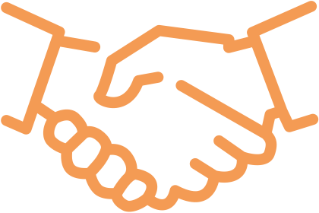




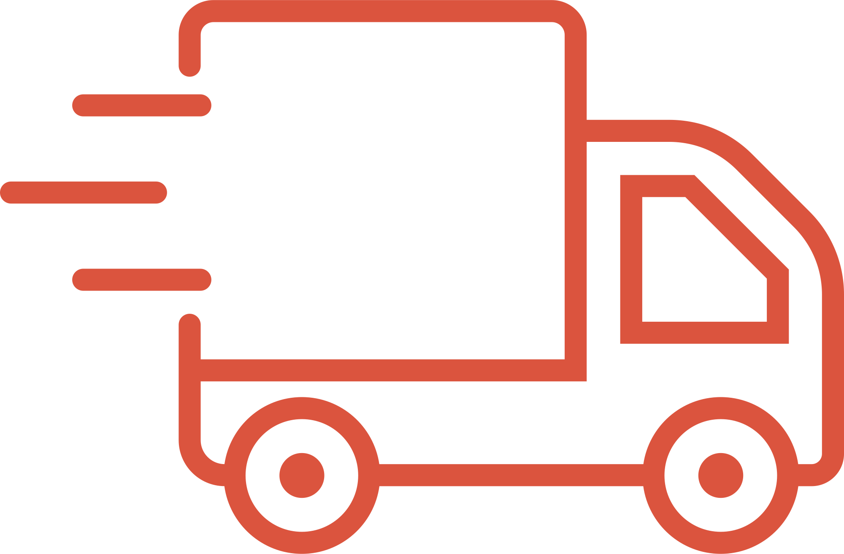



Key Partners
Key Activities
The Value
Proposition
Customer
Relationships
Customer
Segments
Customer
Channels
Key Resources
Costs
Revenue Streams

Slide 27
Key Partners
Key Activities
The Value
Proposition
Customer
Relationships
Customer
Segments
BUSINESS
MODEL
CANVAS
Help the business operate - suppliers, software providers, logistics / couriers, producers
Actions to operate - design, marketing, customer service
The full range of benefits the good/ service offers to customers - the ‘why’ a customer would choose that good / service
Managing interactions - social media, in-store...
Different customer groups - target market and other segments targeted by the business
Customer
Channels
Key Resources
Assets that help create value - IP, patents, key worker, premises / location
How customer is reached - online, store, email, newsletter, social media...
Costs
Revenue Streams
The fixed and variable costs of running the business
How income is earned - direct sales, recurring subscription, ad based...

Slide 28

Back In Business
Read through the Business Model Canvas on page 132 then answer...
1. Do you agree with all of the points given in Monster’s BMC? What is missing in the BMC? Has Monster changed anything since this was created?
2. Create a Business Model Canvas on a business of your choice using the same format.
List at least 3 sources that you used to get the information (write out the website names and dates of the information).
Reflect & Research Pg 133

Slide 29
Suggested Activities for LO 8.4
Sample Papers
-
Activity Book Qs
HL Q4
OL Q4

Slide 30
Learning Outcome 8.5
8.5 Identify and compare the most common business models.
Back In Business

Slide 31
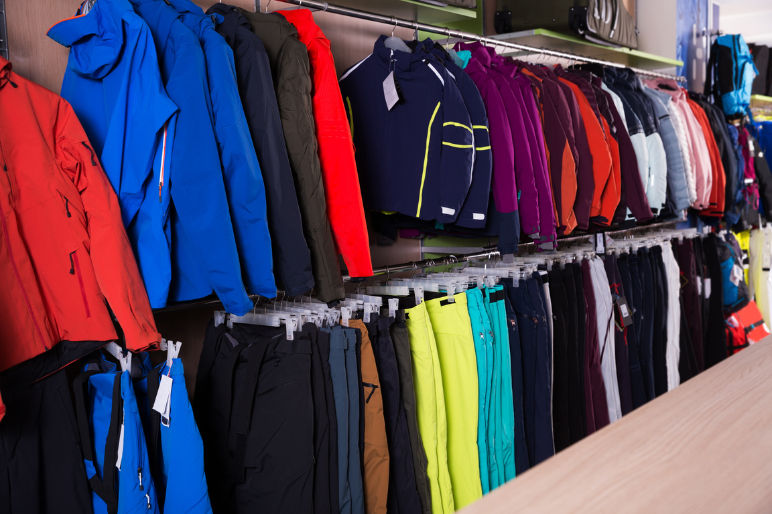
Back In Business
Business Model -> Retailer
How revenue is generated: Retailers buy products at wholesale prices from suppliers/manufacturers and sell them at a higher price to consumers, either online or in-store. E.g. Book Haven, Life Style Sports, Dunnes Stores
How value is created and delivered:
  Convenience: Easy access to a range of products / services / brands in one place.
  Choice: Broad product range in one place.
  Loyalty rewards: Points or discounts for repeat customers. E.g. Tesco Clubcard.

Slide 32
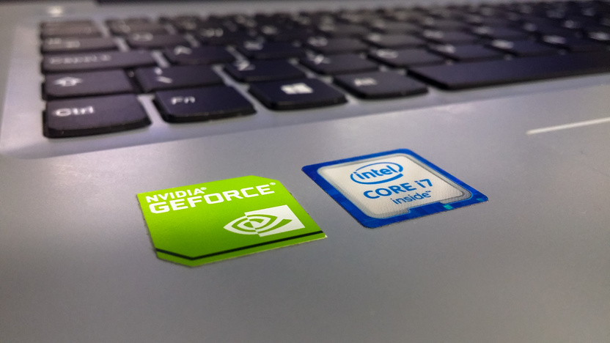
Back In Business
Business Model -> Manufacturer
How revenue is generated: Manufacturers make goods from raw materials and sell them at a profit, either to retailers (B2B Business to business) or directly to customers (B2C Business to consumer).
E.g. Intel (B2B), Nike.com (B2C).
How value is created and delivered:
  Innovation: Continuous product development to meet customer needs.
  Efficiency: Cost-effective production allows competitive pricing.

Slide 33

Back In Business
Business Model -> Subscription
How revenue is generated: Revenue is earned through recurring subscription payments. Monthly fees tend to be higher than annual payments.
E.g. Gym memberships, Sky TV, Virgin boradband.
How value is created and delivered:
  Continuous access to services or content.
  Customisation of user experience.
  Flexibility in payment and account options e.g. cancel if not using it

Slide 34

Back In Business
Business Model -> Franchise
How revenue is generated: A franchisor grants a licence to franchisees to operate branches under the franchisor’s brand, logo, systems, and products in exchange for fees and a percentage of revenue or profits. E.g. McDonald's and Insomnia Coffee.
How value is created and delivered:
  Brand consistency: Familiar product and service experience across locations.
  Increased availability: Access to a product or service in lots of locations

Slide 35
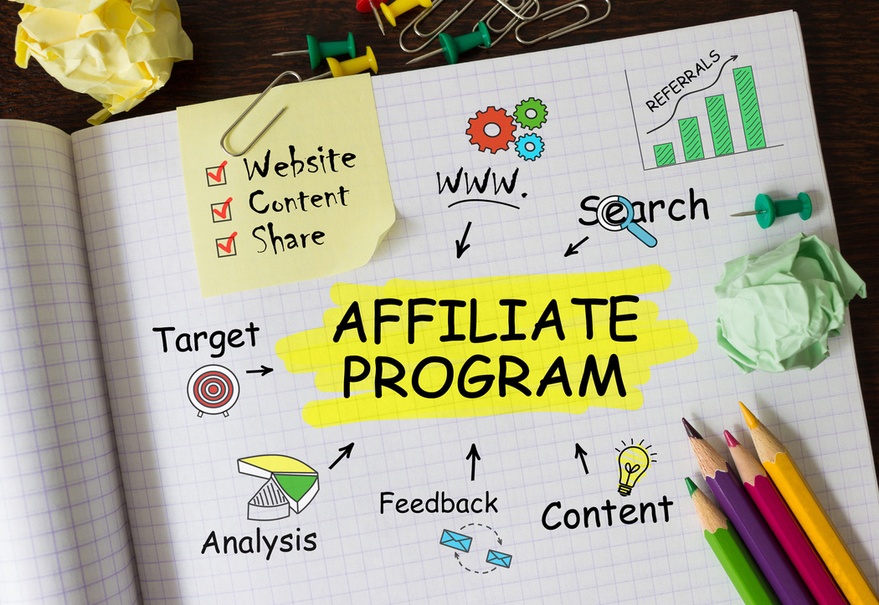
Back In Business
Business Model -> Affiliate
How revenue is generated: Affiliates earn commission when their content leads to a sale. The business pays a percentage of that sale.
E.g. TikTok influencers promoting Gymshark or Amazon links.
How value is created and delivered:
  Influencer trust: Leverages credibility and reach of influencers.
  Targeted marketing: Products shown to niche or interested audiences,
improving engagement.

Slide 36
Suggested Activities for LO 8.5
Sample Papers
-
Activity Book Qs
HL Q5
OL Q5

Slide 37
Learning Outcome 8.6
8.6 Outline how digital technology is a driver of change in business.
Back In Business

Slide 38
Back In Business
How tech helps drives internal change
1. Innovation and Product Development
  Digital tools accelerate innovation by supporting product testing, design, and updates.
  Example: ASOS uses mobile apps and social media to offer personalised shopping and quickly launch new collections.
2. Efficiency and Automation
  Businesses automate processes using AI and robotics to save time, cut costs, and reduce errors.
  Example: Amazon uses robots and automated inventory systems to improve warehouse operations.

Slide 39
Back In Business
How tech helps drives internal change
3. Data-Driven Decisions
  Businesses can instantly collect and analyse huge amounts of user data to help guide strategy and product choices in real-time.
  Example: Netflix uses AI to track viewer habits and decide which shows to produce and which to suggest to each viewer.
4. Employee Collaboration
  Remote work tools support global teamwork and project management so it’s easier to work together and innovate across the globe.
  Example: Tools like Slack and Notion help teams communicate and stay organised.

Slide 40
Back In Business
How tech helps drives external change
5. Changing Consumer Behaviour
  Consumers now expect convenience, personalisation, and speed — shaped by digital platforms, so businesses need to develop technology to stay relevant and compete.
  Example: Gymshark uses TikTok to test and improve products through direct feedback.
6. Competitive Pressure
  New digital-first businesses disrupt markets, pushing others to adapt or risk becoming outdated.
  Example: Uber forced traditional taxi firms to launch their own apps.

Slide 41
Back In Business
How tech helps drives external change
7. Globalisation
  Tech tools make it easier to trade internationally and manage cross-border logistics.
  Example: Shein uses digital payments and translation tools to sell globally.
8. Brand Image and Public Engagement
  Social media shapes brand reputation in real time.
  Example: Ryanair uses humour and online trends to engage with customers and control its public image.

Slide 42
Back In Business
How tech helps drives external change
7. Globalisation
  Tech tools make it easier to trade internationally and manage cross-border logistics.
  Example: Shein uses digital payments and translation tools to sell globally.
8. Brand Image and Public Engagement
  Social media shapes brand reputation in real time.
  Example: Ryanair uses humour and online trends to engage with customers and control its public image.

Slide 43
Suggested Activities for LO 8.6
Sample Papers
-
Activity Book Qs
HL Q7
OL -

Slide 44
Learning Outcome 8.7
8.7 Identify and compare a number of technology-driven business models and outline the key characteristics of each model.
Back In Business

Slide 45
Back In Business
Technology-driven Business Model
Business models have been disrupted through a digital transformation. Cheaper and more accessible software, cloud computing, social media, and data analytics are among the digital tools enabling entirely new ways of doing business.
From streaming platforms to crowdfunding and influencer marketing, technology-driven business models now reach users quicker, adapt faster, and scale with lower costs than traditional models.

Slide 46
Back In Business
Technology-driven Business Model
Tech-driven models we look at include:
Marketplace (Vinted)
Subscription (Netflix)
Crowdfunding (Kickstarer)
Advertising supported (YouTube).
There are others to potentially explore also like Freemium, Data monetisation (Facebook), Software-as-a-Service (called Saas) e.g. Zoom

Slide 47
Back In Business
Technology-driven Business Models → Marketplace
Examples: Vinted, Deliveroo, DoneDeal, Depop, AirBnB
Revenue Generation
Consumer access and cost
The platform earns income by charging fees or commissions (a percentage of sales) on transactions between buyers and sellers.
Usually free or low-cost to access for users.
Sellers or hosts may pay a listing or service fee e.g. a DoneDeal ad

Slide 48
Back In Business
Technology-driven Business Models → Marketplace
Examples: Vinted, Deliveroo, DoneDeal, Depop, AirBnB
Scalability and growth
User retention and engagement
Highly scalable. Platforms can grow quickly as more users join and contribute. Doesn’t require owning/expanding stock or property.
Platforms use reviews, ratings, and personalised suggestions to build trust and keep users coming back.

Slide 49
Back In Business
Technology-driven Business Models → Subscription
Examples: Netflix, Spotify, Strava
Revenue Generation
Consumer access and cost
Through recurring payments, typically monthly or annually.
Some offer premium tiers or ad-supported lower-cost options.
Customers pay for continued access to content or features. Freemium models offer limited access for free, with upgrades available.

Slide 50
Back In Business
Technology-driven Business Models → Subscription
Examples: Netflix, Spotify, Strava
Scalability and growth
User retention and engagement
Highly scalable. Digital delivery means services can grow globally without major infrastructure costs. More users can be added at little extra cost.
Personalised content (e.g. Spotify playlists or Netflix recommendations) and exclusive features or new content help keep users engaged and subscribed.

Slide 51
Back In Business
Technology-driven Business Models → Crowdfunding
Examples: Go Fund Me, Kickstarter, Fundit.ie
Revenue Generation
Consumer access and cost
Businesses raise small amounts of money from many individuals online, usually before the product or service is launched/made.
Typically no cost to browse or support a campaign. Backers may contribute in exchange for rewards, early access, or products.

Slide 52
Back In Business
Technology-driven Business Models → Crowdfunding
Examples: Go Fund Me, Kickstarter, Fundit.ie
Scalability and growth
User retention and engagement
Campaigns can go viral, reaching global audiences without large budgets. Low overhead makes it accessible for start-ups.
Campaign updates, reward tiers, and social storytelling build emotional connection and community support.

Slide 53
Back In Business
Techn-driven Business Models → Advertising-supported
Examples: TikTok, Facebook, YouTube
Revenue Generation
Consumer access and cost
Advertisers pay based on user views, clicks, or impressions. Premium options (e.g. YouTube Premium) offer ad-free access for a fee.
Typically free to use for consumers. Revenue is earned indirectly through advertising rather than user payments.

Slide 54
Back In Business
Techn-driven Business Models → Advertising-supported
Examples: TikTok, Facebook, YouTube
Scalability and growth
User retention and engagement
Extremely scalable. Platforms grow as more users join and content is created, increasing ad reach without significant added cost.
Algorithms personalise content to keep users scrolling or watching, increasing time spent on the platform and ad exposure.

Slide 55
Back In Business
Similarities and Differences Between Technology-Driven and Non-Digital Business Models
Marketplace - similarities
- Both connect buyers and sellers.
- Non-digital versions: auction houses, ads in newspapers, farmers markets.
Subscription - similarities
- Traditional examples: gyms, milk delivery, print magazines.
Subscription - differences
- Easier to cancel or pause for user.
- Personalised digital content pushed at user.
- Users stream instead of owns content.
- Not limited by location to scale
Marketplace - differences
- Operates 24/7, no physical space needed.
- Runs on tech platforms and is easily scalable.

Slide 56
Back In Business
Similarities and Differences Between Technology-Driven and Non-Digital Business Models
Crowdfunding - similarities
- Most businesses need start-up capital through loans/borrowing - bank is traditional.
- Must convince people to fund their idea.
Advertising-supported - similarities
- Traditional in newspapers, radio, and TV.
- Paid ad space with premium/cheap options.
Advertising-supported - differences
- Uses data to personalise ads.
- Free content model.
- Global reach through clicks and views.
Crowdfunding - differences
- Public funds the business directly (not banks).
- Builds a customer base and marketing buzz together.

Slide 57
Back In Business
Similarities and Differences Between Technology-Driven and Non-Digital Business Models
Take-home differences
- Digital platforms upgrade convenience, scale, and personalisation—while still using familiar models.
- Technology has changed who funds, how ads work, and how a business can go global and enter more markets at scale on a much lower budget.

Slide 58

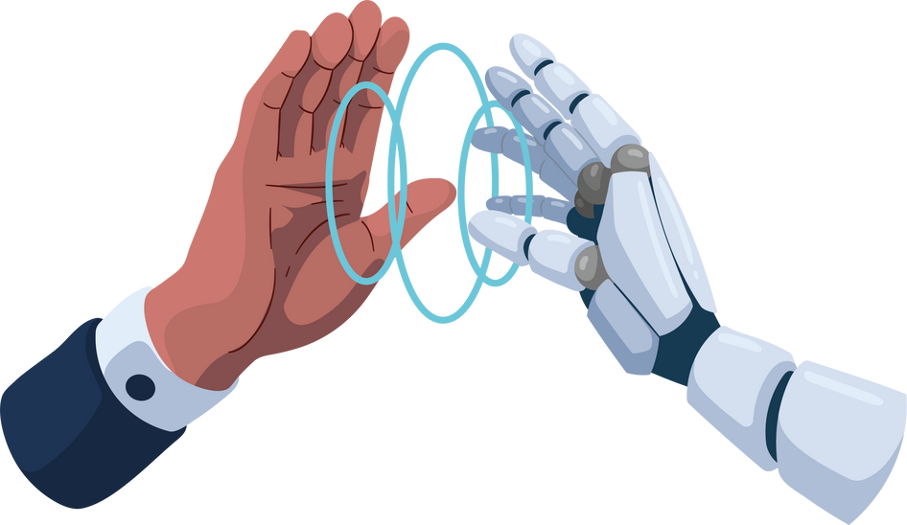
Back In Business
Choose one real-life business for each technology-driven business model given above, and then answer the following questions based on those businesses:
1. Research data on the main revenue streams they rely on to be successful.
2. Give your opinion on three benefits of that business model for each business. Provide evidence to support your opinion.
3. Discuss two challenges for each business based on the business model they use. Provide evidence to support you.
4. Recommend one other potential business model each business could use, giving reasons to support your recommendation.
Reflect & Research Pg 138

Slide 59
Suggested Activities for LO 8.7
Sample Papers
HL1 Q2 (b) (i) Explain the term Crowdfunding. (ii) Explain two key characteristics of each of the following technology-driven business models: Subscription, Advertising
HL2 Q3 (d) Using any two of the headings below, compare a subscription service such as the one discussed above with another technology-driven business model you have studied → Revenue generation; Consumer access and cost; Scalability and growth; User engagement and retention
OL1 Q2 (d) (i) Match business to business model: Marketplace, Subscription, Crowdfunding from choice of Ebay, gofundme, Netflix
(ii) Describe any one of the following business models: Marketplace, Subscription, Crowdfunding
Activity Book Qs
HL Q6
OL Q6

