Slide 1


Strand 2
Chapter 7
Idea development
Back In Business

Slide 2

Chapter resources
Starter worksheet
Activity book solutions
Sample papers workpack
Flashcards
Class exam

Slide 3
Priming activity
Discussion/whiteboards/pair-work - pick 2 from the list below to answer:
1. Why might two businesses in the same industry come up with very different ideas?
2. What’s the last product or app you used that felt like it was really designed for you? Why?
3. What’s the difference between coming up with an idea yourself vs solving someone else’s problem? Which do you think would be more successful?
4. Why might a great idea still fail in the real world?

Slide 4

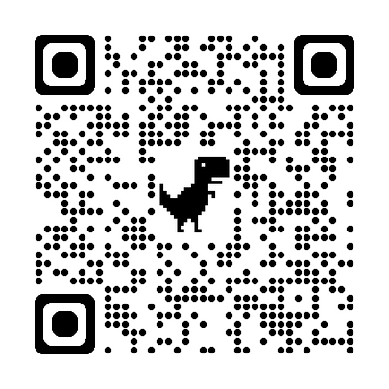

Introduction - starter activity
How does Uber Eats use design thinking to improve their app and services?
Design Thinking is a method used by businesses to develop new business ideas that we cover in this chapter - the stages are
Clarify --> Ideate --> Develop --> Implement
Watch the YouTube explainer video then read the Uber Eats article to see Design Thinking in action and answer the worksheet.
Printable Worksheet here → https://backinbusinesshub.com/wp-content/uploads/2025/06/Starter-worksheet-Chapter-7-2.pdf
Video link: https://www.youtube.com/watch?v=IZvAm3xLIWU
Uber Eats
article

Slide 5

Learning Outcomes
7.1 Determine the factors that impact on the development of business ideas.
7.2 Outline design thinking as an innovative approach to idea development and appreciate how the process is iterative and both solution- and person-centred.
7.3 Appreciate the importance of conducting a feasibility study to evaluate a business idea.
Back In Business

Slide 6
Learning Outcome 7.1
7.1 Determine the factors that impact on the development of business ideas.
Back In Business

Slide 7
Internal Sources of Business Ideas
  Hobbies & Interests – Ideas based on personal passion or problems people have experienced. Dyson’s founder created a bagless vacuum from frustration with his own cleaner.
  Skills & Experience – Using what you know from work, training, or life to develop an idea.
  Invention & R&D – New technologies or product improvements from testing or research.

Slide 8
Internal Sources of Business Ideas
  Brainstorming – Team-based idea generation where no idea is off limits.
  Intrapreneurship – Employees developing new ideas within an existing business.
In the early 1990s, Sony engineer Ken Kutaragi was secretly working on a project to improve video game sound for his daughter's Nintendo console. Instead of being fired for using company time, Sony leadership supported him and the idea grew into the PlayStation.

Slide 9
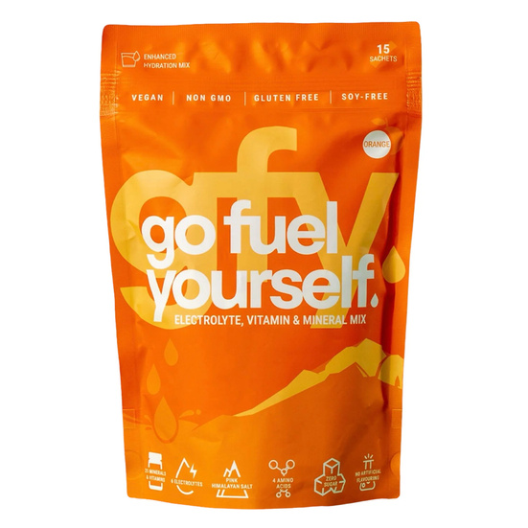
External Sources of Business Ideas
  Customers – Asking what people want, reading reviews, or solving complaints.
  Competitors – Improving or localising something that’s working elsewhere.
  Market Research – Using surveys, interviews, or social listening to spot gaps.
  Import Substitution – Creating a homegrown alternative to a product from abroad.
In our case studies in the book, the idea for Go Fuel Yourself was developed from looking at the current market and competitors and coming up with an alternative to them.

Slide 10


Back In Business
Reflect & Research Pg 116
1. Task: List 5 products/services you use daily and investigate how the original idea was developed.
2. Were they created from a problem, a passion, or a gap in the market?
3. Share the most interesting one with the class.

Slide 11

Back In Business
Factors Influencing Idea Development
  Organisational Culture
  The leadership style in a business shapes how willing staff are to offer new ideas. Visionary leaders like Steve Jobs at Apple inspire creativity and encourage ideas and risk taking in their staff.
  Availability of Resources
  Without time, funding, or skilled people, it’s hard to develop ideas. Google encourages innovation by giving employees 20% of their time to work on new concepts.

Slide 12

Back In Business
Factors Influencing Idea Development
  Market Trends & Consumer Behaviour
  When consumer habits shift, so do opportunities. For example, the move away from plastic opened the market for eco-friendly products like paper straws.
  Technological Advancements
  New tech unlocks new industries. Smartphones made app-based
  services like Deliveroo and Just Eat possible — ideas that didn’t
  work before became profitable.

Slide 13
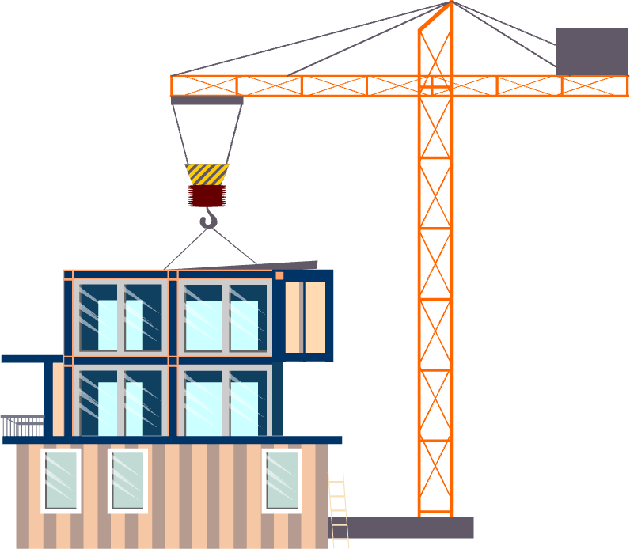
Back In Business
Factors Influencing Idea Development
  Legal Requirements
  Sometimes a great idea can’t progress due to outdated laws. For example, in 2025 an idea for modular homes to address Ireland’s housing crisis require legal changes before they can be rolled out.

Slide 14
Suggested Activities for LO 7.1
Sample Papers
None
Activity Book Qs
HL Q1
OL Q1, Q2

Slide 15
Learning Outcome 7.2
7.2 Outline design thinking as an innovative approach to idea development and appreciate how the process is iterative and both solution- and person-centred.
Back In Business

Slide 16

Back In Business
What is Design Thinking?
Design thinking is an innovative, non‑linear approach to the development of products and services which focuses on solutions for the end user.

Slide 17
Back In Business
Design Thinking is:
“Person‑Centred,” “Solution‑Centred,” and “Iterative” in it’s approach
Person‑Centred
Focuses on understanding the user’s real problems and empathising with them first before coming up with solutions to shape the idea.
Solution‑Centred
The process outlines the problem their product/service will solve clearly from the start and explore creative ways to solve it, beginning with the desired outcome.
Iterative
Uses repeated cycles of prototyping, testing, refining, and retesting until a practical, user‑approved solution emerges. Re-visiting previous steps again and again until they are happy.

Slide 18
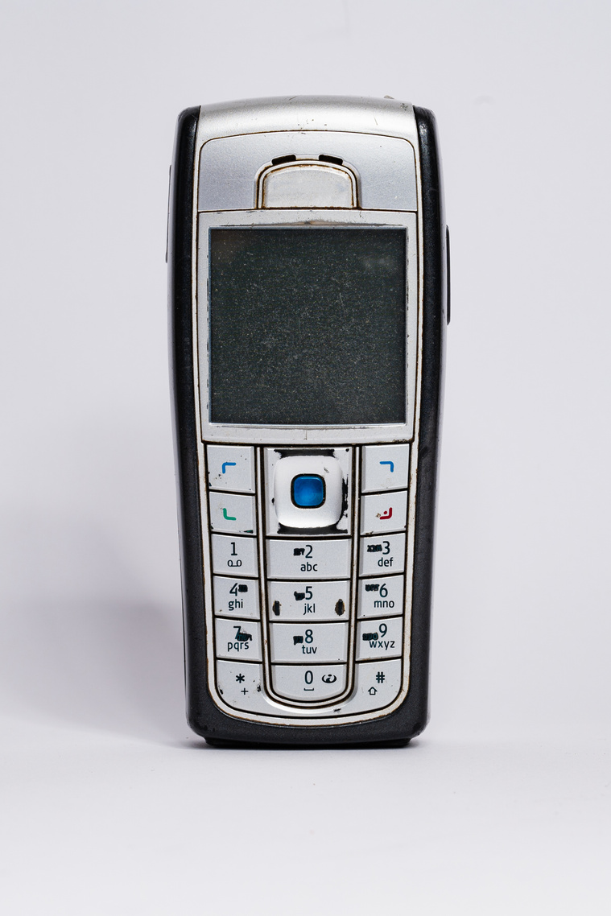
Back In Business
Apple's approach in designing the first iPhone aligned closely with the core elements of design thinking: being user-centred, solution-focused, and iterative.
1. Read the Business In Our World now on page 116 and summarise how Apple were: (i) Person-centred (ii) Solution-centred (iii) Iterative in their approach
2. Research another examples of a brand that using design thinking to create a new product. Refer to how these brands used person-centred, solution-centred, and iterative thinking in their product development.
Reflect & Research Pg 116

Slide 19


Back In Business
The Four Phases of Design Thinking
1. Clarify
Gain a deep understanding of the current problem from the user’s perspective through surveys, observation, or other research.
2. Ideate
Hold creative brainstorming sessions to explore multiple potential solutions to the current problems users have with a product/service/process

Slide 20


Back In Business
The Four Phases of Design Thinking
3. Develop
Turn top ideas into early prototypes—these can be sketches or first working models, to see what it works like, looks like and to test it’s functionality.
4. Implement
Test prototypes with real users, gather feedback, and refine repeatedly until the solution meets their needs.

Slide 21

Back In Business
Business in Our World – Airbnb
Pg 119
Video link: https://www.youtube.com/watch?v=ZrM55P8H0X8

Slide 22
Suggested Activities for LO 7.2
Sample Papers
HL1 Q1 (d) Outline how ProjectOne can use each of the four phases of design thinking to successfully meet GlowInc's expectations.
Activity Book Qs
HL Q2, Q3
OL Q3, Q4

Slide 23
Learning Outcome 7.3
7.3 Appreciate the importance of conducting a feasibility study to evaluate a business idea.
Back In Business

Slide 24

Back In Business
Checking if an idea will actually be able to work - feasibility study
  Not every good idea can or should become a business.
  A feasibility study helps test if an idea is workable, profitable and sustainable before investing time and money.
  Doing this early saves resources and helps avoid launching something that won’t succeed.

Slide 25
Back In Business
Areas to check Feasibility of to evaluate an idea
Market Feasibility
  Investigates whether customers actually want or need the product.
  Uses surveys, interviews, or observations to assess the size of the market and competitors.
  Key Question: Is there demand for this product/service if we make it?
Production Feasibility
  Assesses whether the product or service can actually be built or delivered with available resources.
  Includes skills, equipment, and technology.
  Key Question: Are we able to make it with the resources we have (or can get)?

Slide 26
Back In Business
Areas to check Feasibility of to evaluate an idea
Financial Feasibility
  Looks at the cost to start and run the business, compared to expected income.
  Estimates break-even points, startup costs, and cash needed.
  Key Question: Can it make a profit?
Environmental Feasibility
  Assesses the potential impact on the environment and how the idea aligns with sustainability goals.
  Includes use of materials, emissions, energy use, and waste.
  Key Question: Will this idea meet environmental standards and expectations?

Slide 27

Back In Business
Areas to check Feasibility of to evaluate an idea
Legal Feasibility
  Checks if the idea meets current laws or regulations or if there are any legal issues that would prevent it from being possible/add costs.
  Some ideas may face delays or barriers due to planning, safety, or industry rules.
  Key Question: Are there any legal or regulatory obstacles?

Slide 28
Suggested Activities for LO 7.3
Sample Papers
OL1 Q5 (b) Explain one function of a feasibility study when developing a new business idea.
Activity Book Qs
HL Q4
OL Q5

